Slide 1


UE LABS
Testing, certification & product validation network
Nuria Bas
UE CS&Q Director & Labs Director
© 2020 Schneider Electric, All Rights Reserved | Confidential Property of Schneider Electric
Page 1
Notes:
Source cover facts preserved: UE LABS; presenter Nuria Bas; role UE CS&Q Director & Labs Director.

Slide 2
NETWORK SNAPSHOT
UE Labs at a glance
Three local manufacturing-plant laboratories supporting validation, certification and quality.
3
7
Labs
Lab Employees
Sarre-Union, Molins de Rei and Capellades
5 lab technicians, 1 Test & Expert Leader and Lab Manager
3012
1
Tests done in 2021
Lab accredited by UL since 1999
One lab in each manufacturing plant: Sarre-Union, Molins de Rei & Capellades.
Capellades Lab is CTDP by UL since 1999, File number DA307
© 2020 Schneider Electric, All Rights Reserved | Confidential Property of Schneider Electric
Page 2
Notes:
Source facts preserved: 3 Labs; 7 Lab Employees; 3012 tests done in 2021; 1 Lab accredited by UL since 1999; one lab in each manufacturing plant; 5 lab technicians, 1 Test & Expert Leader and Lab Manager; Capellades Lab is CTDP by UL since 1999, File number DA307.

Slide 3
SCHNEIDER ELECTRIC ORGANIZATION
Where UE Labs fits in Schneider Electric
Universal Enclosures LoB is inside the Energy Management business structure.
Energy Management
Business
Power Systems & Services
Division
ETO
Engineering To Order LoB
Universal Enclosures
LoB
UE Labs
Validation network
Energy Management → Power Systems & Services → ETO → Universal Enclosures → UE Labs
© 2020 Schneider Electric, All Rights Reserved | Confidential Property of Schneider Electric
Page 3
Notes:
Source facts preserved: UNIVERSAL ENCLOSURES LoB is inside Energy Management Business, Power Systems & services Division, and ETO (Engineering To Order) LoB. UE Labs is shown as the highlighted final destination in the rebuilt pathway.

Slide 4
OPERATING MODEL
UE Labs governance model
Universal Enclosures Lab sits inside Customer Satisfaction & Quality Department.
CS&Q Director
Leads UE labs directly and also leads the Quality Director function for the labs.
Customer Satisfaction & Quality Department
Quality Director function for labs
Test & Expert Leader
Internal name for the labs Technical Director
SU
Sarre-Union Lab
ML
Molins de Rei Lab
KP
Capellades Lab
France
Spain
Spain
© 2020 Schneider Electric, All Rights Reserved | Confidential Property of Schneider Electric
Page 4
Notes:
Source facts preserved: Universal Enclosures Lab is inside Customer Satisfaction & Quality Department. Lab is led directly by the CS&Q Director. CS&Q Director is leading directly UE labs and as well as the function of Quality Director for the labs. The Technical Director for labs is what we call internally “Test & Expert Leader”.

Slide 5
MISSION
Mission
Seven operating responsibilities rebuilt as a validation value chain.
01
Assure the quality of the standard of production
02
Ensure qualification of product evolutions or new products launch
03
Ensure certifications tests, including 1 UL accredited Lab
04
Validate P&S specific solutions
05
Analyse returns, RTA and TEX
06
Give support to the Customer Technical Support team
07
Manage the calibration of labs & plants equipment
UE Labs connects production quality, certification readiness and product validation.
© 2020 Schneider Electric, All Rights Reserved | Confidential Property of Schneider Electric
Page 5
Notes:
Original mission bullets preserved: Assure the quality of the standard of production; Ensure qualification of product evolutions or new products launch; Ensure certifications tests (1 UL accredited Lab); Validate P&S specific solutions; Analyse returns (RTA and TEX); Give support to the Customer Technical Support team; Manage the calibration of labs & plants equipment.

Slide 6
LAB NETWORK
Three-lab network
UE Labs network: SU, ML and KP across France and Spain.
Local labs, shared validation network
SU
Sarre-Union Lab
France
ML
Molins de Rei Lab
Spain
KP
Capellades Lab
Spain
UE Labs network: SU / ML / KP
© 2020 Schneider Electric, All Rights Reserved | Confidential Property of Schneider Electric
Page 6
Notes:
Source facts preserved: SU: Sarre-Union Lab (France); ML: Molins de Rei Lab (Spain); KP: Capellades Lab (Spain).

Slide 7
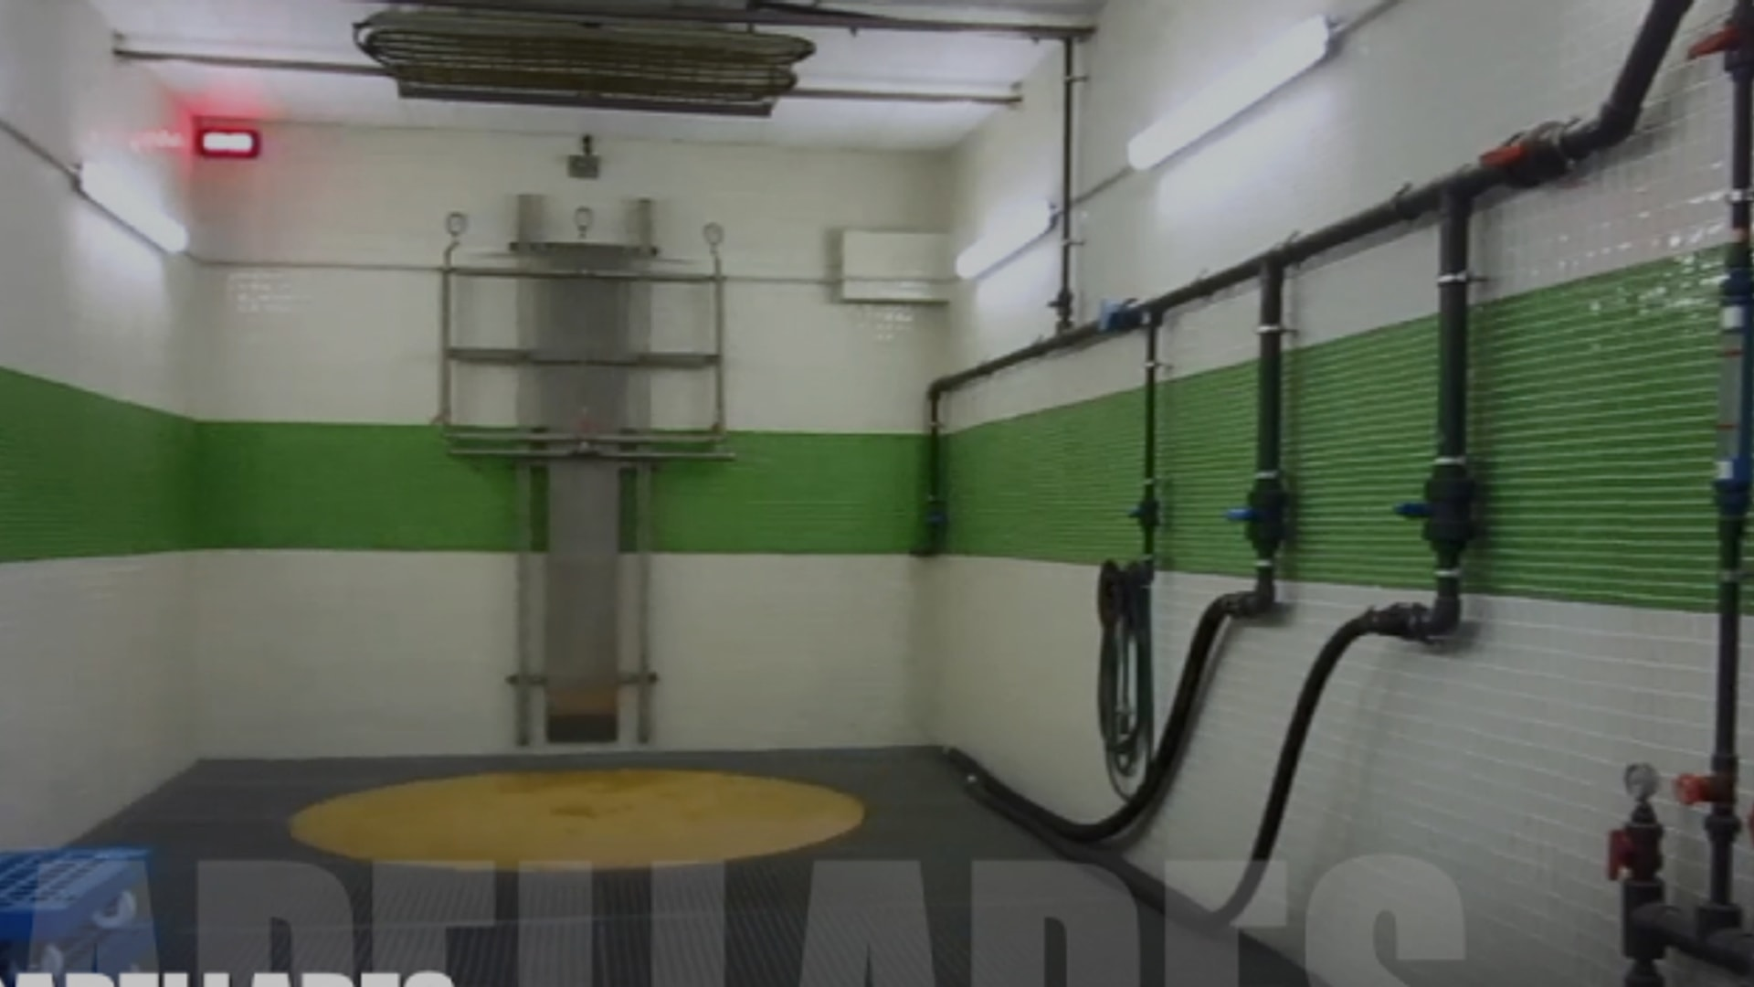
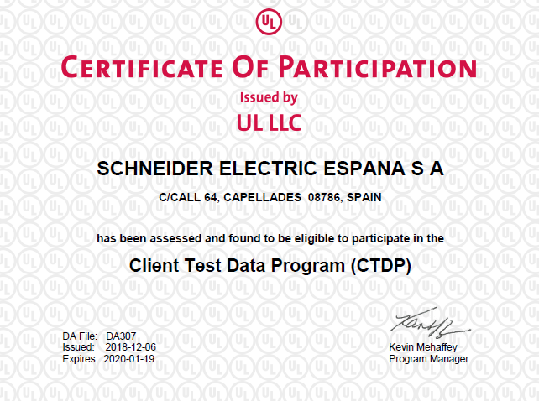
KP | SPAIN
Capellades
Lab
UL CTDP since 1999
File number DA307
Tests according to UL Standard can be performed with total autonomy and direct recognition of Underwriters Laboratories Inc.
© 2020 Schneider Electric, All Rights Reserved | Confidential Property of Schneider Electric
Page 7
Notes:
Source facts preserved: Capellades Lab; Spain; UL CTDP since 1999; File number DA307; tests according to UL Standard can be performed with total autonomy and direct recognition of Underwriters Laboratories Inc.

Slide 8
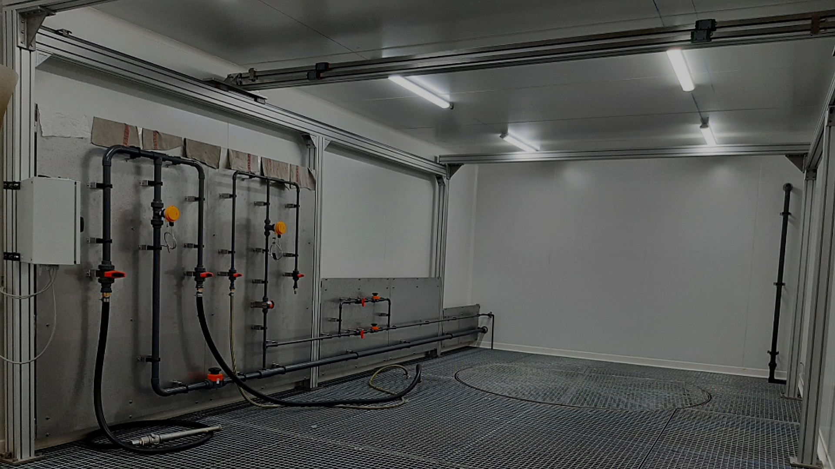
SU | FRANCE
Sarre-Union
Lab
Part of UE Labs network
SU
Sarre-Union Lab
France
© 2020 Schneider Electric, All Rights Reserved | Confidential Property of Schneider Electric
Page 8
Notes:
Source facts preserved: Sarre-Union Lab; France; part of UE Labs network.

Slide 9
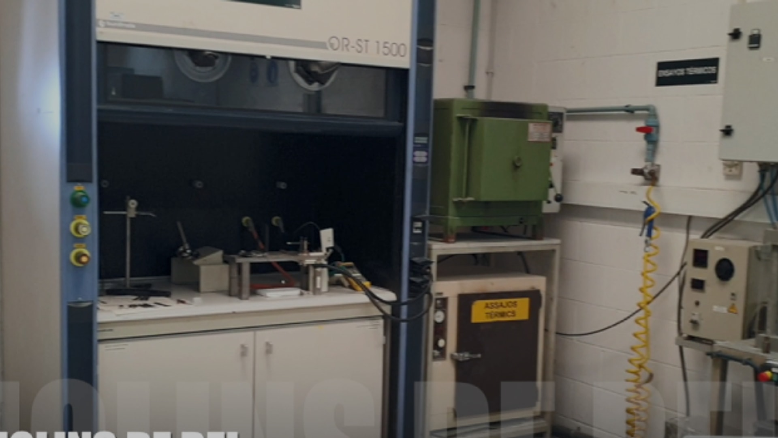
ML | SPAIN
Molins de Rei
Lab
Part of UE Labs network
ML
Molins de Rei Lab
Spain
© 2020 Schneider Electric, All Rights Reserved | Confidential Property of Schneider Electric
Page 9
Notes:
Source facts preserved: Molins de Rei Lab; Spain; part of UE Labs network.

Slide 10
CERTIFICATION SCOPE
Standards & certification scope
Original standards rebuilt as a capability matrix by lab.
SU
Sarre-Union
ML
Molins de Rei
KP
Capellades
IEC
IEC 62208
IEC 62208
IEC 62208
Capellades Lab is CTDP by UL since 1999, File number DA307.
IEC 60079-0
IEC 61439-1
IEC 61439-5
Tests according to UL Standard can be performed with total autonomy and direct recognition of Underwriters Laboratories Inc.
ISO
ISO 12944-6
ISO 12944-6
ISO 4624
EN
EN 61386-1
UL / CSA recognition remains attached to KP in the matrix.
UL / CSA
UL 50 / CSA C22.2 Nº 94.1
UL 50E / CSA C22.2 Nº 94.2
UL 746 C
© 2020 Schneider Electric, All Rights Reserved | Confidential Property of Schneider Electric
Page 10
Notes:
Original standard descriptions preserved: IEC 62208: Empty enclosures for low-voltage switchgear and controlgear assemblies - General requirements ISO 12944-6: Paints and varnishes — Corrosion protection of steel structures by protective paint systems — Part 6: Laboratory performance test methods ISO 4624: Paints and varnishes — Pull-off test for adhesion IEC 60079-0: Explosive atmospheres -- Part 0: Equipment - General requirements EN 61386-1: Conduit systems for cable management -- Part 1: General requirements IEC 61439-1: Low-voltage switchgear and controlgear assemblies - Part 1: General rules IEC 61439-5: Low-voltage switchgear and controlgear assemblies - Part 5: Assemblies for power distribution in public networks UL 50 / CSA C22.2 Nº 94.1: Enclosures for Electrical Equipment, Non-Environmental Considerations UL 50E / CSA C22.2 Nº 94.2: Enclosures for Electrical Equipment, Environmental Considerations UL 746 C: Standard for Polymeric Materials - Use in Electrical Equipment Evaluations Lab grouping follows the three source standards blocks from the original slide: SU top block, ML right block, KP left block with UL CTDP note.

Slide 11
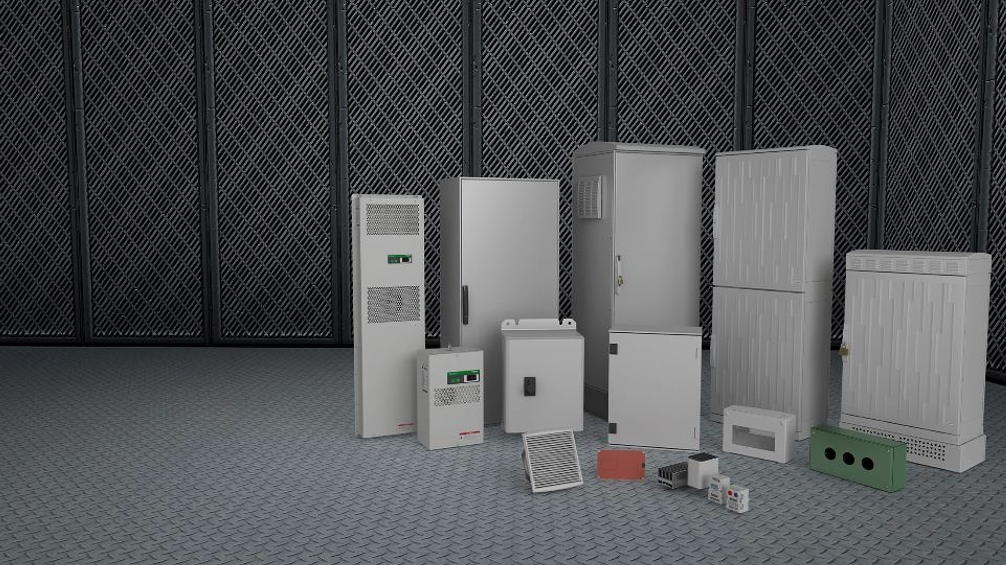
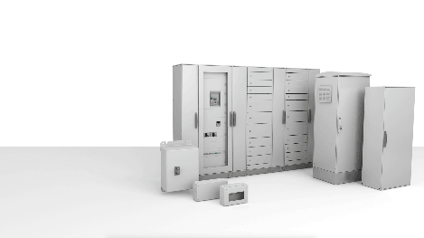
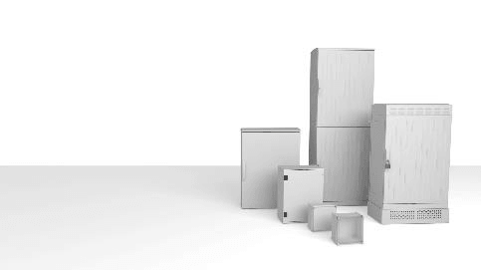
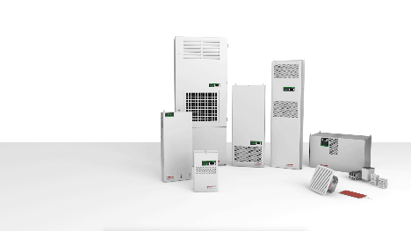
PRODUCTS TESTED
Products tested
Types of Products Tested: Spacial, Thalassa and ClimaSys portfolios.
Spacial
Thalassa
ClimaSys
Steel and stainless steel
Plastic and glass-reinforced polyester
Thermal management systems
© 2020 Schneider Electric, All Rights Reserved | Confidential Property of Schneider Electric
Page 11
Notes:
Source facts preserved: Spacial - Steel and stainless steel; Thalassa - Plastic and glass-reinforced polyester; ClimaSys - Thermal management systems; Types of Products Tested.

Slide 12
ENVIRONMENTS
Product families / environments
Spacial, Thalassa and ClimaSys enclosures and thermal management solutions are the world’s best choice for equipment protection in any type of environment.
Industrial protection
Material resistance
Protection for equipment in demanding industrial settings
Steel, stainless steel, plastic and glass-reinforced polyester
Thermal management
Enclosure reliability
ClimaSys systems for heat and enclosure performance
Validation focus across environments and use cases
© 2020 Schneider Electric, All Rights Reserved | Confidential Property of Schneider Electric
Page 12
Notes:
Source fact preserved: Spacial, Thalassa and ClimaSys enclosures and thermal management solutions are the world’s best choice for equipment protection in any type of environment.

Slide 13
UE LABS
Testing confidence. Certification readiness. Product quality.
© 2020 Schneider Electric, All Rights Reserved | Confidential Property of Schneider Electric
Page 13
Notes:
Closing slide rebuilt from blank source slide using required UE LABS closing line.

