Slide 1
Benford’s law
François GAGNARD – Marc-Henri KASSES

Slide 2
Let’s begin with a Survey…

Slide 3
Simon Newcomb’s discovery
Lower logarithm pages are more used
  Lower numbers, with low leading digit would be used
1881 : publication in the American Journal of Mathematics

Slide 4
Frank Benford (1883-1948)
1938 : Benford noted the same phenomenon
(About 20.000 data about different topics were collected)
  Probability for « 1 » to be the first leading digit ≈ 30%

Slide 5
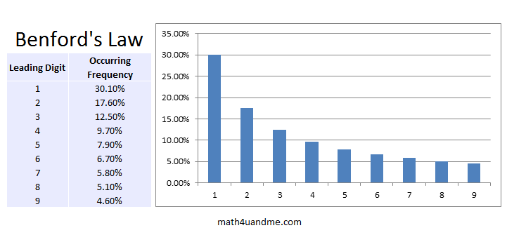

Slide 6
Benford’s Law - Examples
Numbers in newspapers
Addresses
Economical values (Dow Jones)
Population
(2^{n})_{nϵℕ} (even if seems periodical)

Slide 7
Benford’s Law - Explanation
Raffle
  If you have 9 tickets : probability =
    Add the 10th ticket : p =
    Increase until 19 tickets and decrease until 99
      The same pricinple at betwee each power of 10
  Average

Slide 8
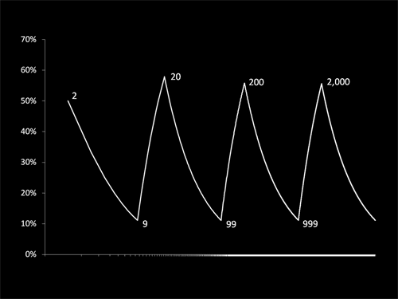

Slide 9
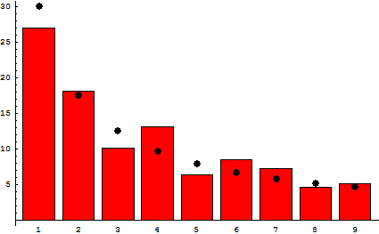
world's countries population
(First digit)

Slide 10
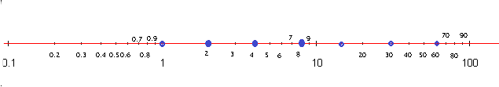
Geometric sequence
Process of growing

Slide 11
Benford’s Law - Explanation
Population
  evolves in percent
    India (pop. 1.251.695.584) would need a lot
    Lebanon (pop. 4,467 millons (2013) + 1,1 million refugees) (+25%)

Slide 12
Benford’s Law - Generalization
Changing Base
Changing measurement unit, currency
Probability of the n leading digits
  Numbers still follow the law

Slide 13
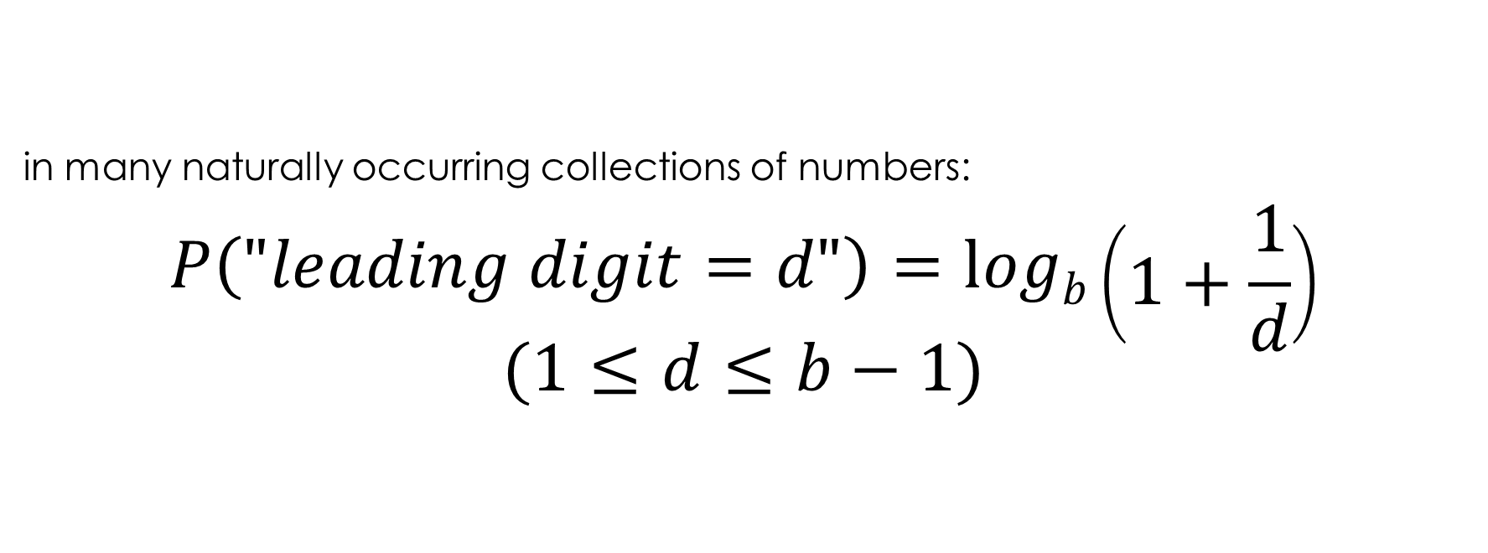
Benford’s Law
in many naturally occurring collections of numbers:

Slide 14
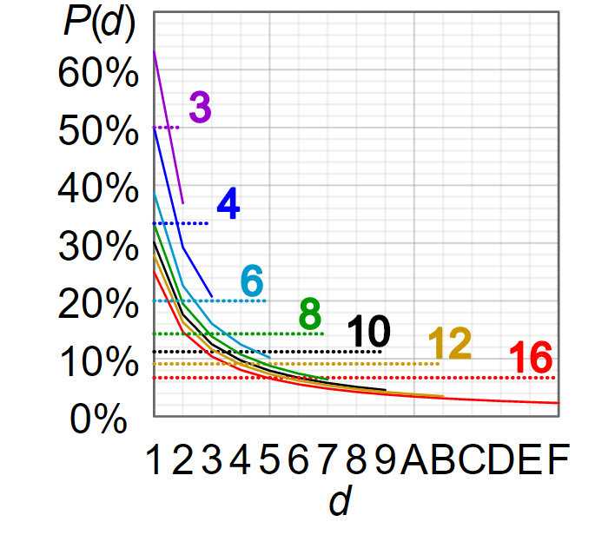

Slide 15
Funny facts
and counter examples
Fibonacci
Rivers’ length
Physical constants
People’s height
Phone numbers
Lottery, dice

Slide 16
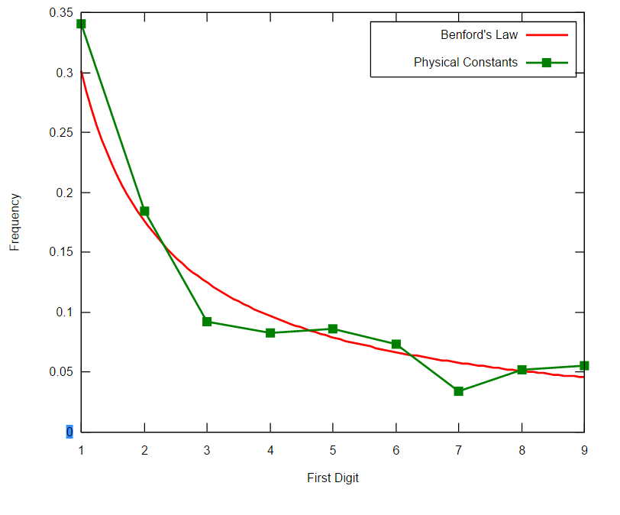
Physical constants

Slide 17
Using the law in life
Mark NIGRINI (USA) : analysing numbers to detect frauds
  « Honest » datas often follow the law
  1993 : employee arrested (diversion of revenue)
Dr Saville (South Africa,) : statistical test
  No manipulated account follow the law
/!\ Not a proof of guilt !
*χ² test to know if we can suspect or not.

Slide 18
Using the Law in life
A. DICKMANN (Zurich) : randomly chosen numbers rarely follow Benford’s Law
Those tests are good ways to suspect people to make frauds

Slide 19
Sources
http://www.apmep.fr/IMG/pdf/Conf_CD1_Loi_de_Benford.pdf
https://en.wikipedia.org/wiki/Benford%27s_law
https://www.youtube.com/watch?v=XXjlR2OK1kM (Numberphile)
http://www.webridge.fr/98/Qui_sommes_nous/CV__RL/centres_interet/loi_de_benford.htm

