Slide 1

OpenStreetMap.org

Slide 2
OpenStreetMap.org
free, open, community driven geo data base
incl various possibilities for routing & navigation
recent advances:
  rapidly increasing number of POIs
  high detailedness (eg house numbers)
  higher reliability of routing
does not include satellite images, but so many details that you won‘t miss them

Slide 3
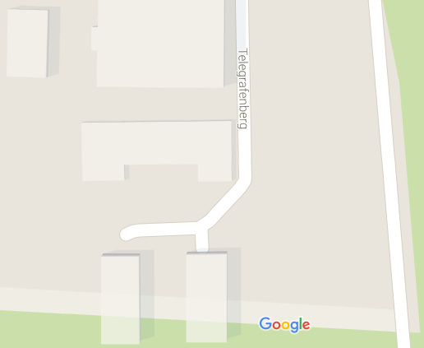
Details I

Slide 4
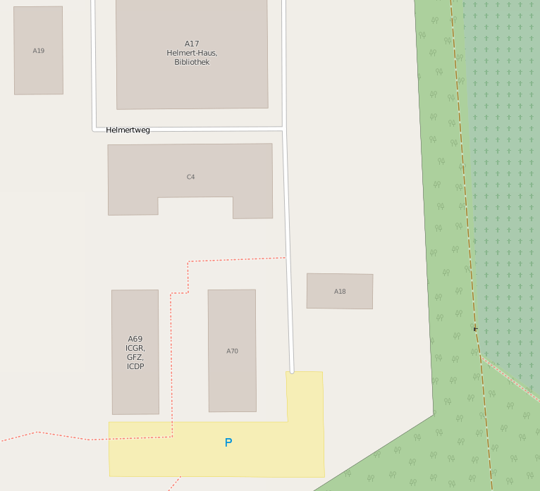
Details I

Slide 5
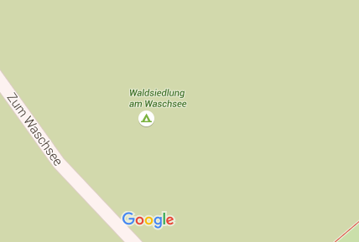
Details II

Slide 6
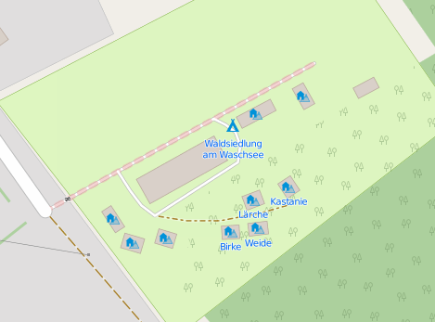
Details II

Slide 7
Use it … www.openstreetmap.org
freizeitkarte-osm.de
  Maps for PC, Garmin GPS & Android Smartphones
  Offline Navigation possible
OsmAnd.net/ OsmAnd.de
  Android App for On & Offline Navigation incl. voice guidance
… and contribute
by GPS-mapping, attributing …
… or at least with error reporting

