Slide 1
DIGIT RECOGNIZER
BY NEHA GUPTA

Slide 2
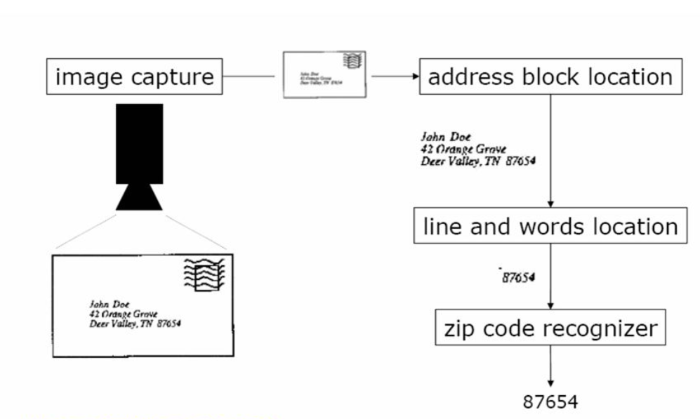
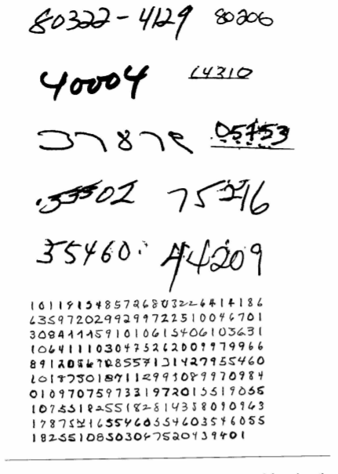
Introduction
Machines read handwritten digits
In 1989, Yann LeCun built a system which was eventually used to read handwritten checks and zip codes by companies.
The system he built was also successfully applied to the recognition of handwritten zip code digits provided by the U.S. Postal Service

Slide 3
Dataset
Source: https://www.kaggle.com/c/digit-recognizer
Training Data:
Rows: 31500
Columns : 785
Validation Data:
Rows: 10500
Columns : 785
Testing Data:
Rows: 28000
Columns : 784

Slide 4
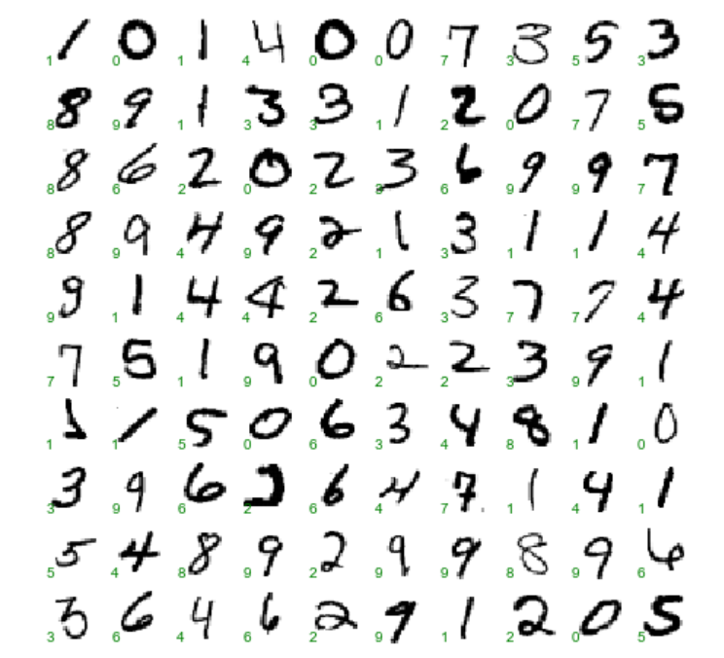
Label & Features
Label(y) : The digit. The first column in dataset
Features(X) : The flattened pixels. All the columns except the first.

Slide 5
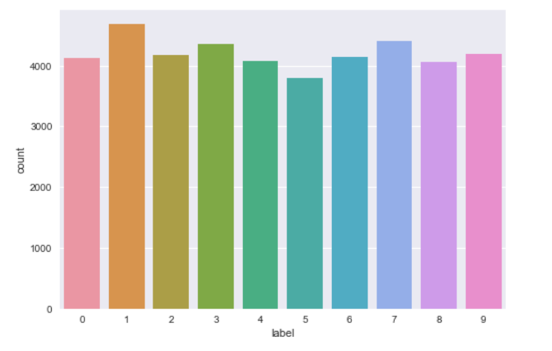
Data Distribution
Digits data distribution in training data set

Slide 6
Machine Learning Model Evaluation
Decision Tree
Logistic Regression
Random Forest
K-Nearest Neighbors (KNN)
Support Vector Machines (SVM)

Slide 7
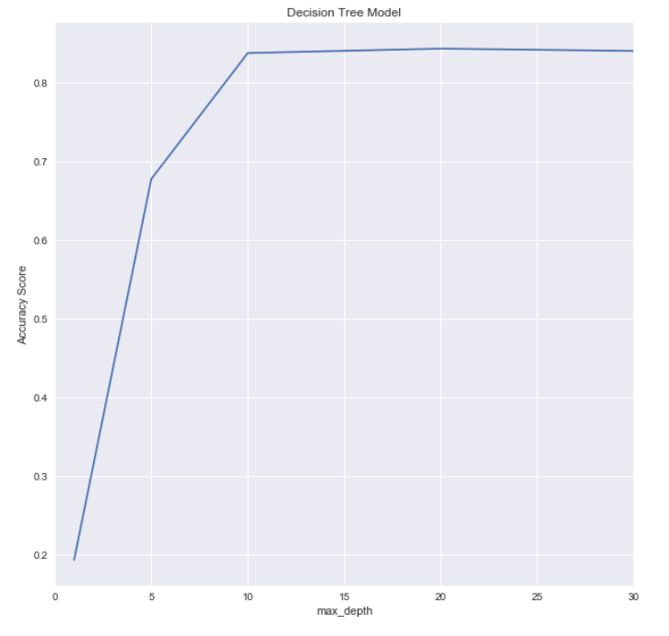
Decision Trees – Cross Validation
Tuned the max_depth with 5-fold cross-validation
Checked for max_depth in (1,5,10,20,30,40,50,60,70,80,90,100)
Achieved optimal accuracy of 85.61% at max_depth = 10

Slide 8
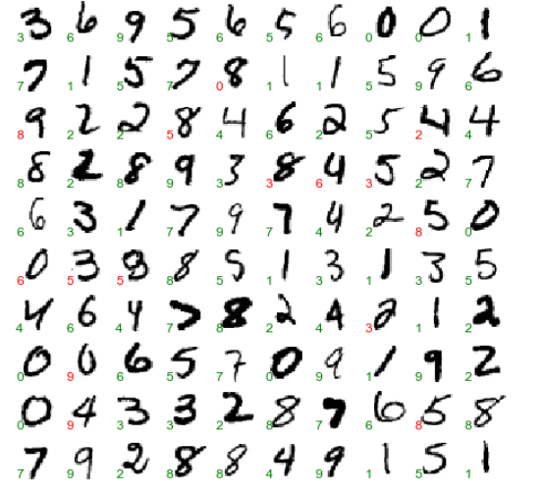
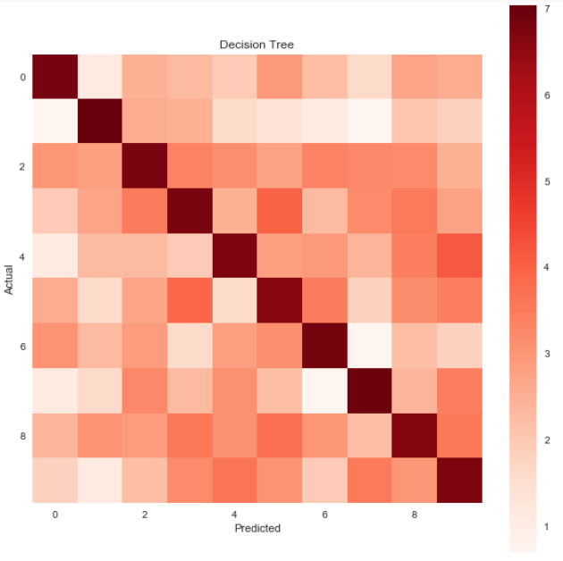
Decision Trees – Results

Slide 9
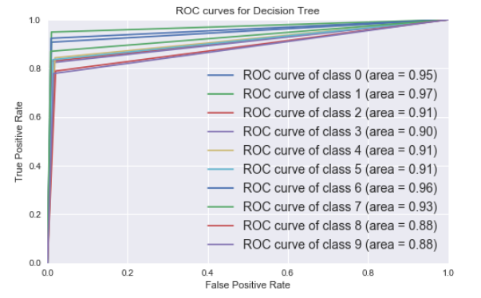
Decision Trees – ROC Curve

Slide 10
Decision Trees - Summary
Method | Accuracy
Default Parameters | 84.54%
Max Depth = 10 | 85.61%
OneVsRestClassifier | 78.74%

Slide 11
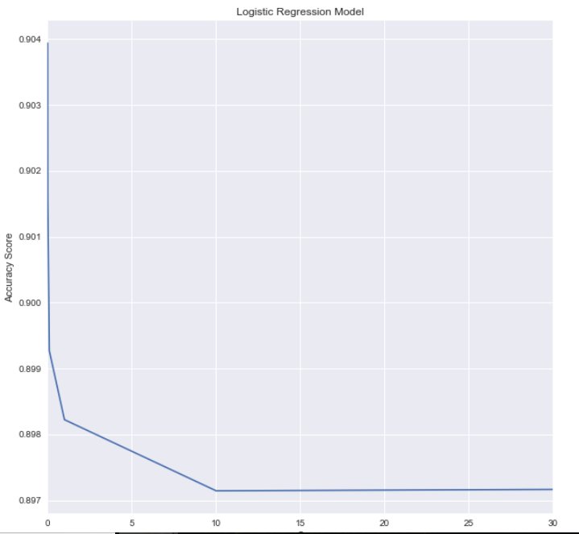
Logistic Regression – Cross Validation
Tuned the ‘C’ with 5-fold cross-validation
Checked for ‘C ’ in (0.001,0.01,0.1,1,10,100)
Achieved optimal accuracy of 90.86% at C = 0.001

Slide 12
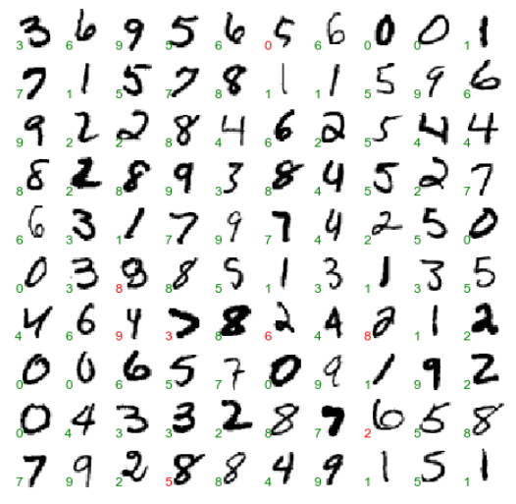
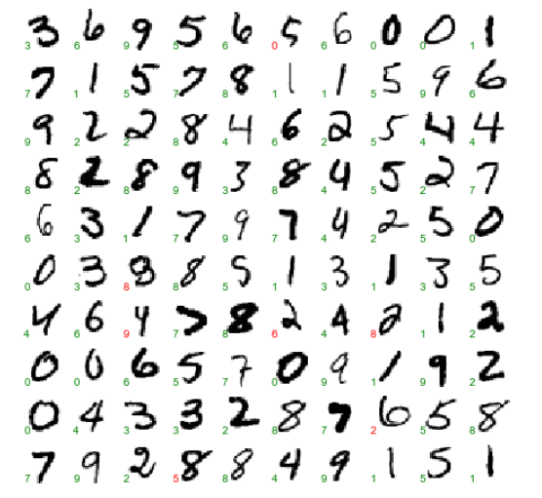
Logistic Regression – Results
C=1
C=0.001

Slide 13
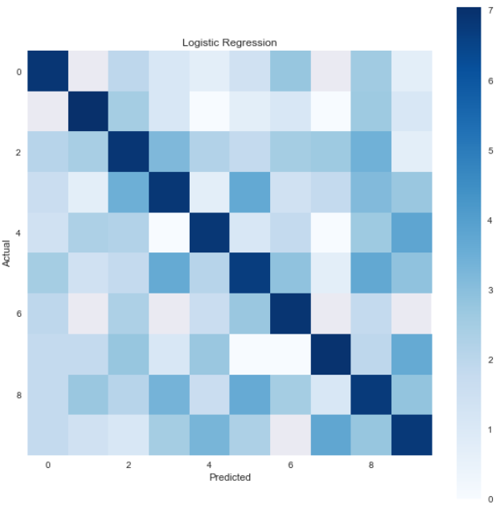
Logistic Regression – Results

Slide 14
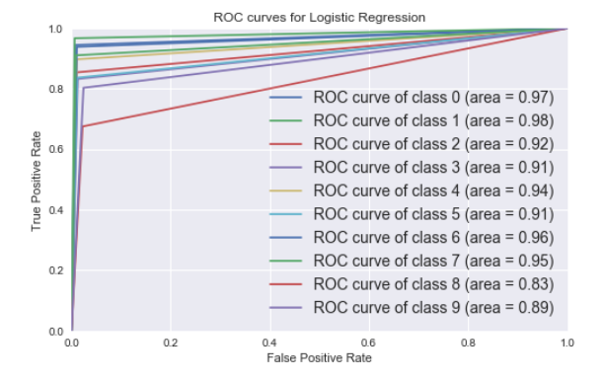
Logistic Regression – ROC Curve

Slide 15
Logistic Regression - Summary
Method | Accuracy
Default Parameters | 90.14%
C = 0.001 | 90.86%
OneVsRestClassifier | 80.48%

Slide 16
Random Forests – Cross Validation
Tuned the ‘n’ with 5-fold cross-validation
Checked for ‘n_estimators ’ in(1,5,10,20,30,40,50,60,70,80,90,100)
Checked for ‘max_depth’ in (1,5,10,20,30,40,50,60,70,80,90,100)
Optimal Combination: n_estimators: 90 max_depth: 30 Accuracy: 96.32%

Slide 17
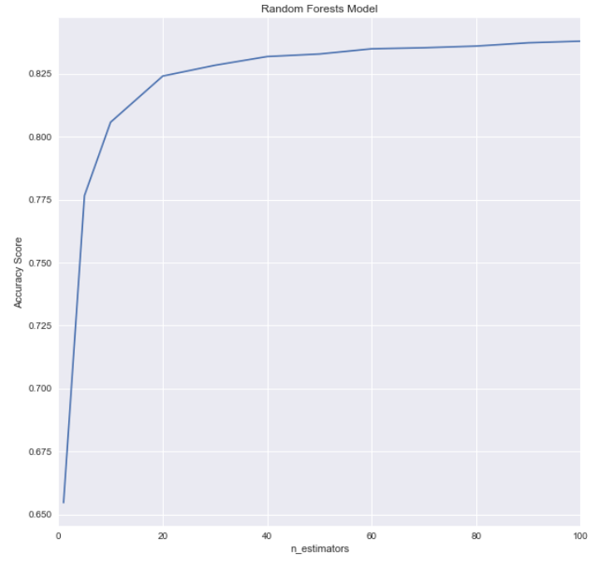
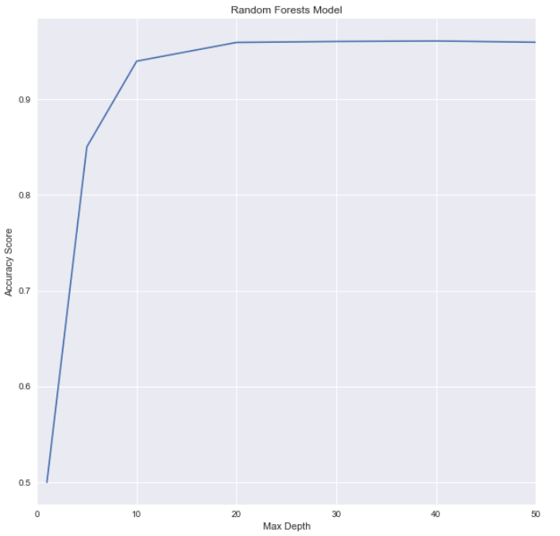
Random Forests – Cross Validation
The optimal value for n_esitmators is 40 and Max Depth is 20
Accuracy : 96.0%

Slide 18
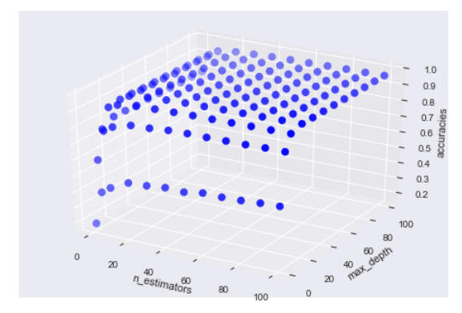
Random Forests – Cross Validation
The optimal value for n_esitmators is 90 and Max Depth is 30
Accuracy : 96.32%

Slide 19
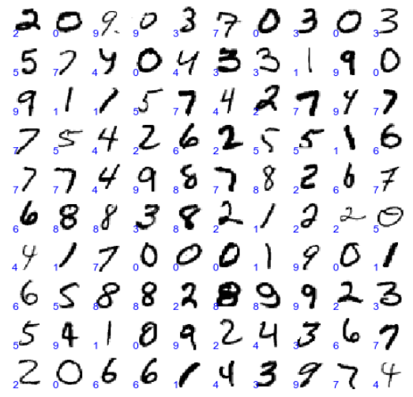
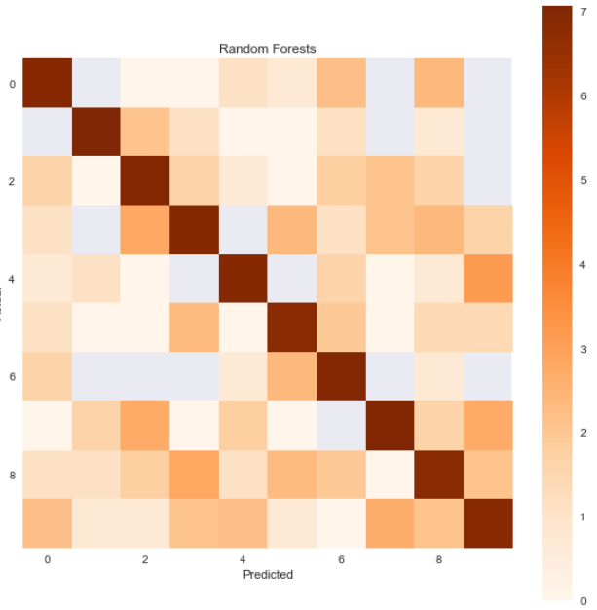
Random Forests – Results

Slide 20
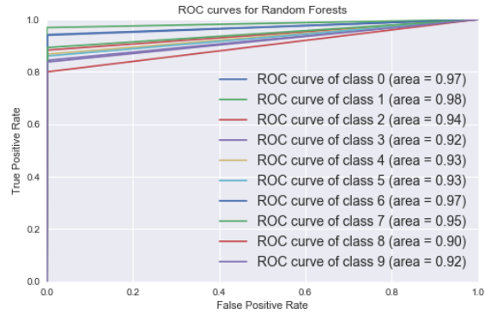
Random Forests – ROC Curve

Slide 21
Random Forests - Summary
Method | Accuracy
Default Parameters | 93.61%
Max_depth = 20 n_esitmators = 40 | 96.00%
Max_depth = 30 n_esitmators = 90 | 96.32%
OneVsRestClassifier | 88.40%

Slide 22
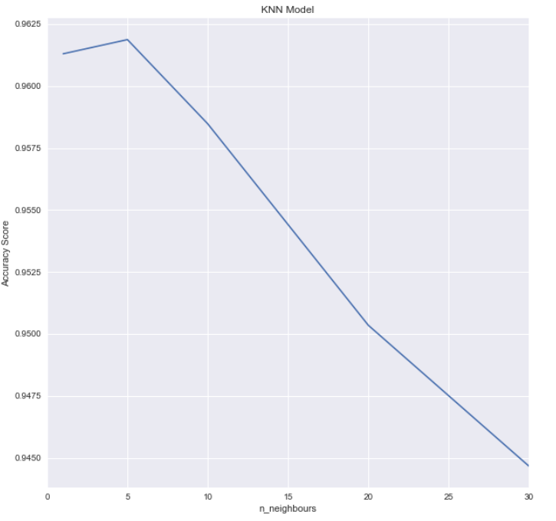
KNN – Cross Validation
Tuned the ‘n_ neighbours’ with 5-fold cross-validation
Checked for ‘n_ neighbours’ in (1, 5, 10, 20, 30)
Achieved optimal accuracy of 96.67% at n_neighbours of 5

Slide 23
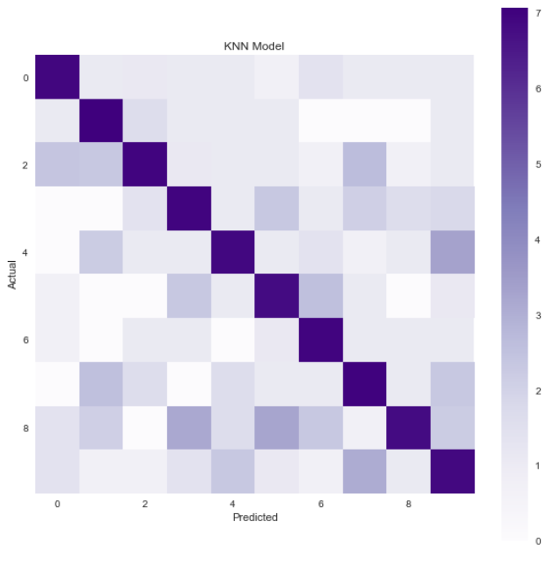
KNN – Results

Slide 24
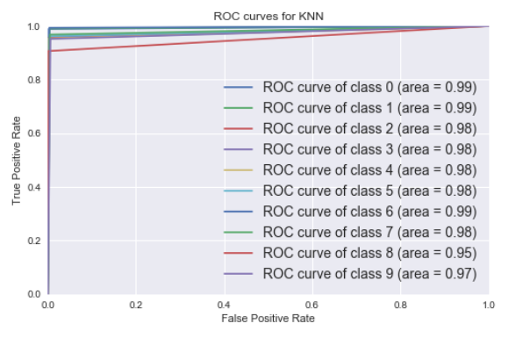
KNN – ROC Curve

Slide 25
KNN- Summary
Method | Accuracy
Default Parameters | 96.67%
n = 5 (Optimal same as default) | 96.67%
OneVsRestClassifier | 96.39%

Slide 26
SVM – Cross Validation
Tuned the ‘C’ and gamma with 5-fold cross-validation
Checked for ‘C ’ in (1, 5, 10)
Checked for ‘gamma’ in (0.01,0.1,0.01)
Optimal Values were Default values in case of linear kernel

Slide 27
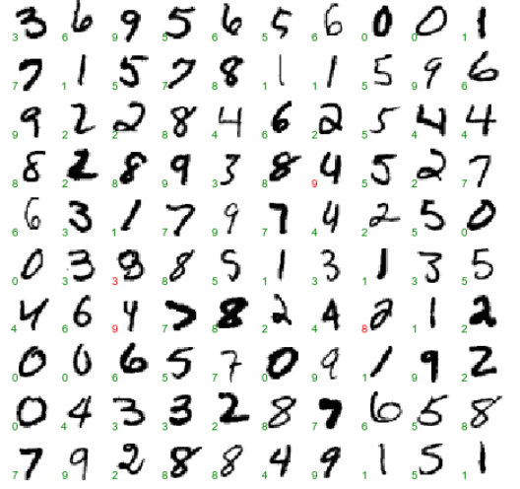
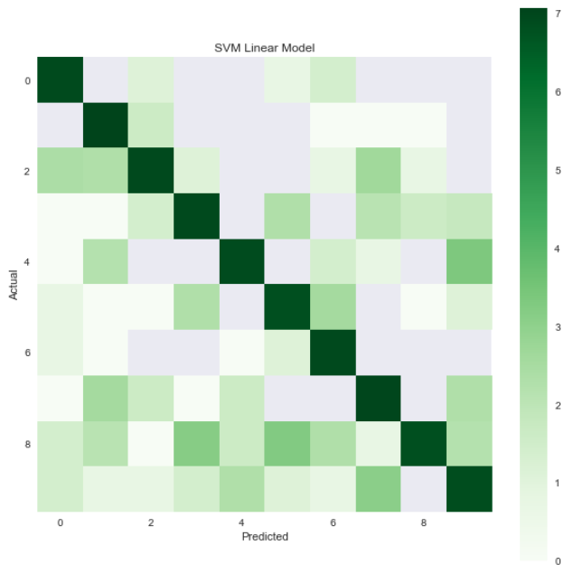
SVM – Results

Slide 28
SVM - Summary
Method | Accuracy
Default Parameters with Linear Kernel | 96.67%

Slide 29
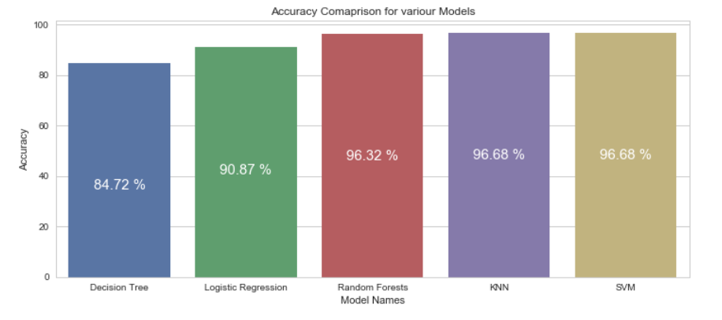
Comparison Summary

Slide 30
Neural Nets
Standard Neural Nets (SNN)
Convolutional Neural Nets (CNN)

Slide 31
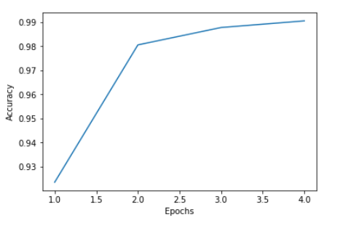
Standard Neural Net Results
4 Epochs, Batch Size 128, Validation Set – 20%
Model loss: 5%
Model accuracy: 98%
Epoch Accuracy:
Epoch 1: 0.9235863095238095
Epoch 2: 0.9806175595238096
Epoch 3: 0.9878348214285714
Epoch 4: 0.9905877976190476

Slide 32
Convolutional Neural Nets (CNN)
Data Source:
http://yann.lecun.com/exdb/mnist/
Converted to png images
https://github.com/myleott/mnist_png
Training Data: 54004
Validation Data: 5996
10% randomly selected images for validation
Testing Data: 10000

Slide 33
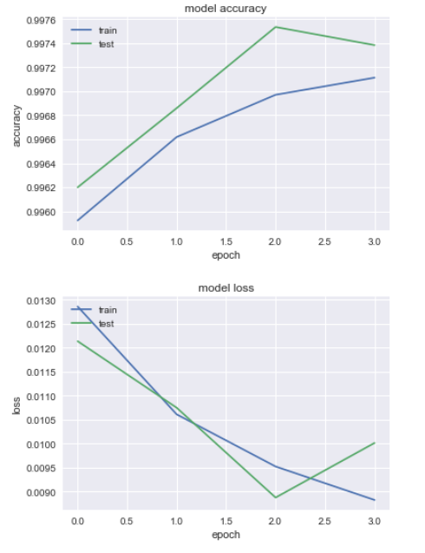
CNN Results
4 Epochs
Model loss: 0.9%
Model accuracy: 99.7%
Epoch Accuracy:
Epoch 1: 0.9961997726198805
Epoch 2: 0.9968593064521052
Epoch 3: 0.9975354490786731
Epoch 4: 0.9973843235976326

Slide 34
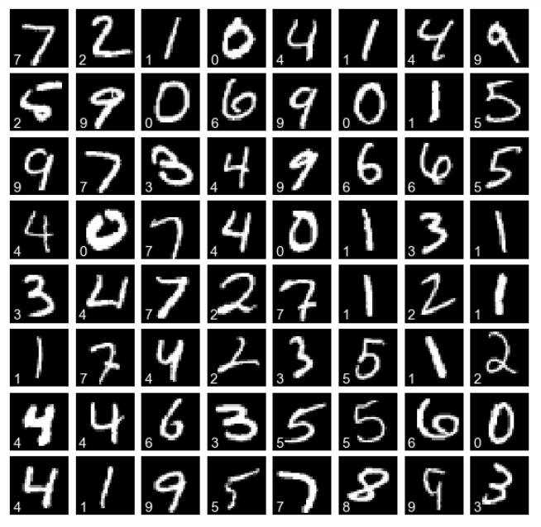

Slide 35
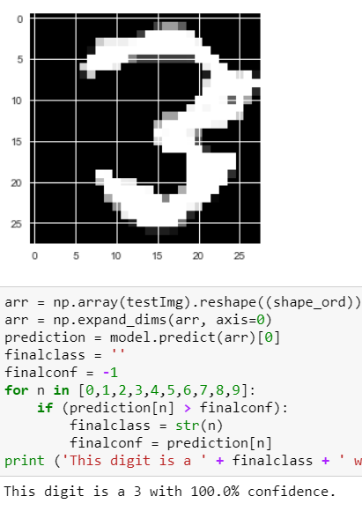
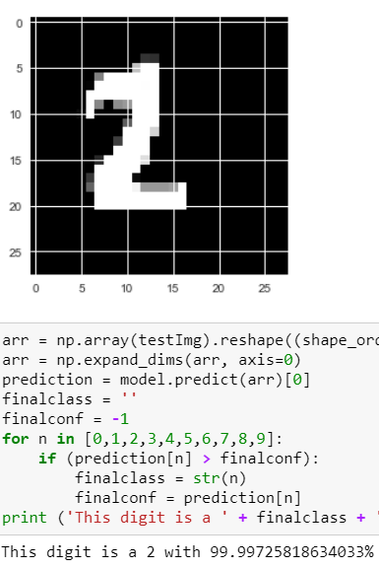
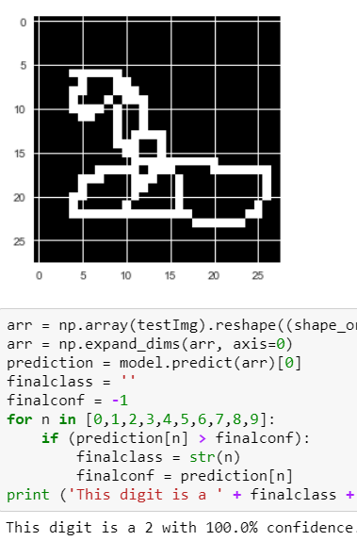
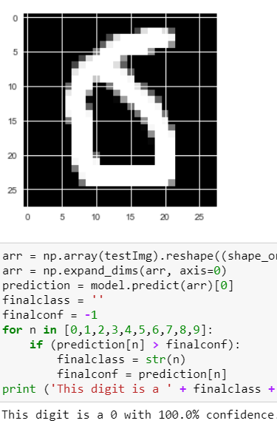
Demo

Slide 36
THANK YOU

