Slide 1


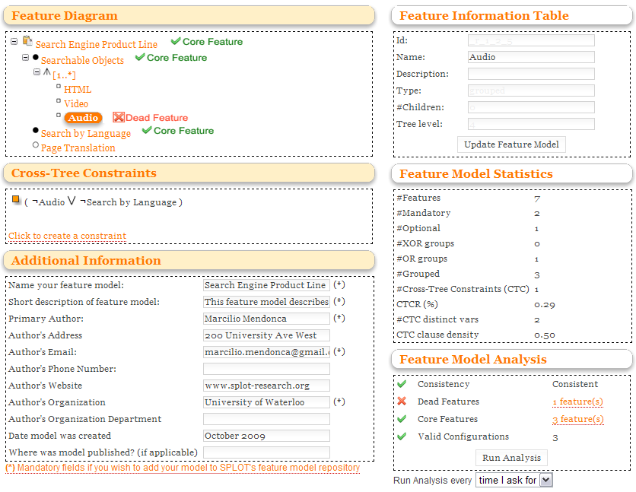
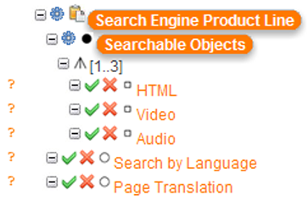
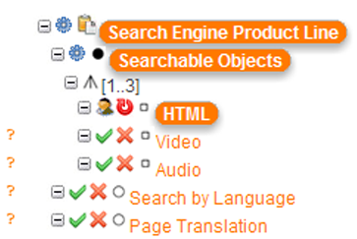
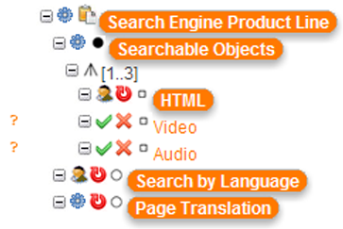





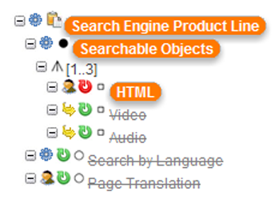
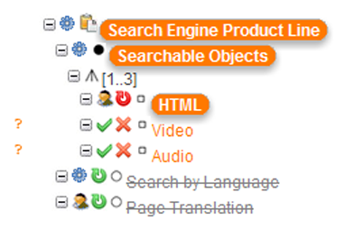
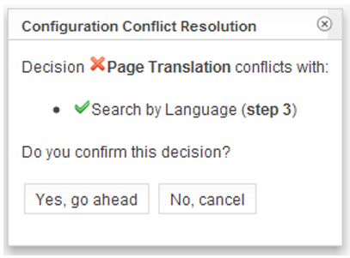

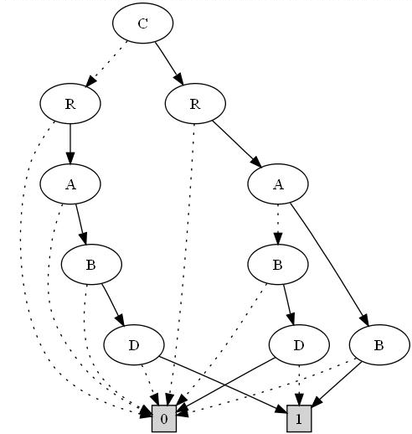
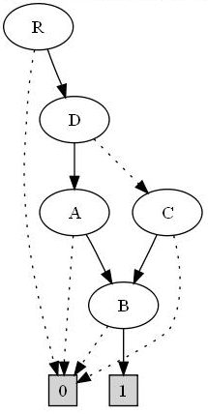
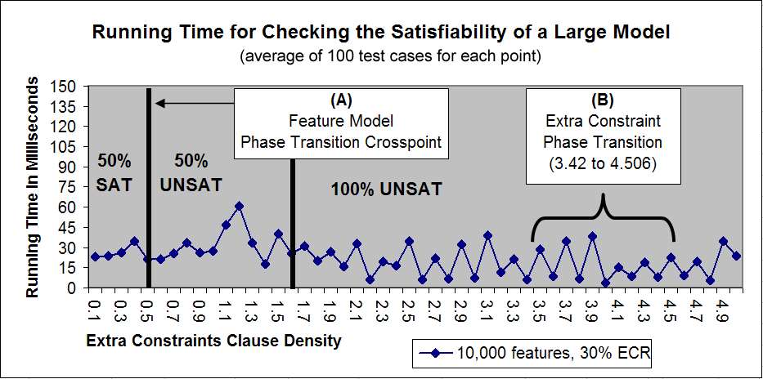
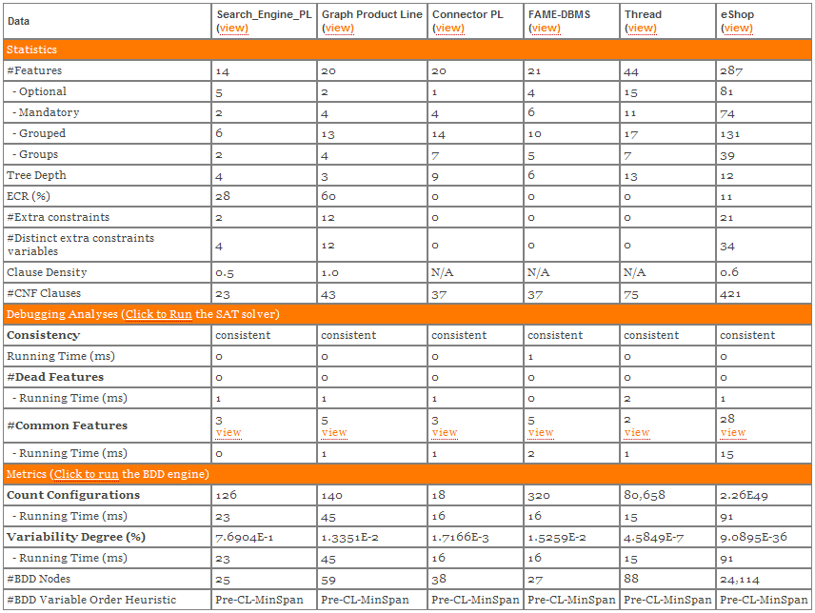
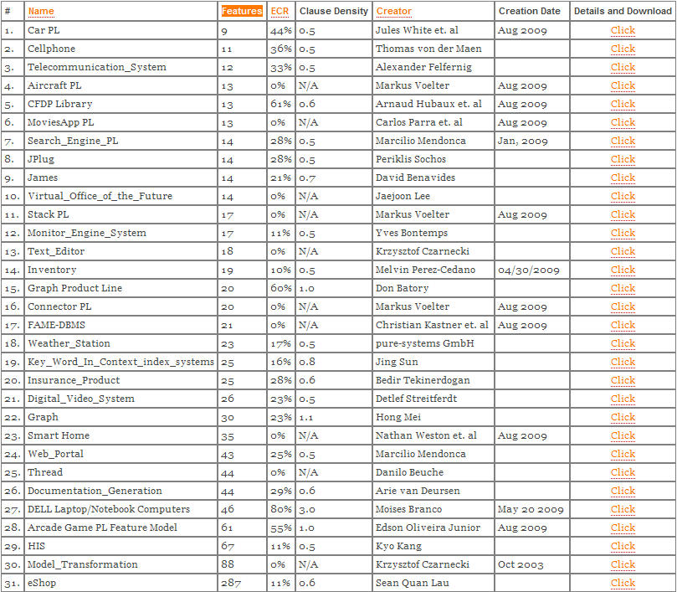
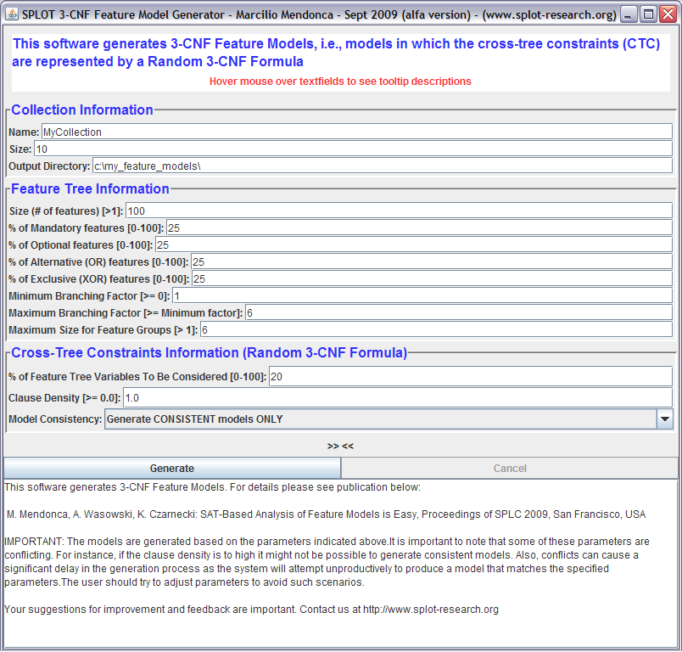
S.P.L.O.T. - Software Product Lines Online Tools (www.splot-research.org)
Marcilio Mendonca, Moises Branco, Donald Cowan, University of Waterloo, Canada - {marcilio,dcowan}@csg.uwaterloo.ca, moises@bnb.gov.br
OOPSLA 2009
An integrated Web-based feature model edition, reasoning and configuration tool for Software Product Lines
Online Feature Model Editor
S.P.L.O.T. is State-of-the-Art Research
Feature-Based Interactive Configuration (BDD & SAT-based)
Key Features:
Provides a Web-based environment for constructing and debugging feature models
Integrates edition, analysis (debugging) and configuration into a single interface
Feature Model
R
1- Initial configuration state (core
features automatically selected)
2- Manual selection of
feature “HTML”
3- Manual selection of feature “Search by Language”
Automatic propagation of feature “Page Translation”
A
B
Feature Diagram
Configure your (final/partial) feature model at any time
Export your model to the SXFM formal
Share your feature model with the research community
C
[1..*]
D
D → A
Cross-tree Constraints (CTC)
Translation to Logics
(R) and (A or R) and (B or R) and (R or B) and … and (D or A)
Boolean Formula
Realtime statistics are computed for your feature model
6- Configuration is completed
automatically by the
“Auto-completion” function
5- Manual toggling of feature
“Page Translation” affecting
feature “Search by Language”
4- Conflict detection for the
case when feature
“Page Translation” is toggled
Check for consistency and detect “dead” features
Run analysis manually or after a number of edition
steps have been performed
Binary Decision Diagrams
SAT Solvers
Importance: Mature technique to reason on Boolean formulas
Research Challenge: Space-Intractability of BDDs
Question: How to reduce the size of BDDs for feature models?
Importance: Mature technique to reason on constraint problems
Research Challenge: Time-Intractability of SAT solvers
Question: Is the observed efficiency of SAT solvers accidental?
Feature Model Automated Analysis
Equivalent BDDs but different sizes for different top-down variable orders
Feature Model Repository
12 nodes vs. 7 nodes
Statistics
Total number of features
Number of features by type
Depth of feature diagram
CTCR (cross-tree constraints representativeness)
Number of cross-tree constraints
Number of distinct variables in the CTC
CTC Clause density
Number of CNF clauses generated for the model
Key Features:
30+ real feature models extracted from relevant sources
Several collections of automatically-generated feature models
Feature Model Generator for customized model generation
SAT solver is efficient during
feature model phase transition!
SAT-Based Analysis
Check feature model consistency
Compute dead features
Computer core (or common) features
SAT solver is efficient during cross-tree
constraints phase transition!
Variable Order: C,R,A,B,D
Variable Order: R,D,A,C,B
Research Contributions:
Identification of current limits and best overall heuristic (DFS)
Proposal of novel variable ordering heuristics for feature models
FMs twice as large can now be handled (1,000 vs. 2,500 features)
Reference:
M. Mendonca, A. Wasowski, K. Czarnecki, D. Cowan: Efficient Compilation Techniques for Large Scale Feature Models. In Proceedings of the 7th ACM International Conference on Generative Programming and Component Engineering (GPCE'08). Oct 2008, NashVille, USA.
Research Contributions:
Empirical evidence of the tractability of SAT problems induced by realistic feature models
Proposal of benchmarks to test SAT-based tools
Reference:
M. Mendonca, A. Wasowski, K. Czarnecki: SAT-based Analysis of Feature Models is Easy. In Proceedings of the 13th International Software Product Line Conference (SPLC’09). Aug 2009, San Francisco, USA.
BDD-Based Analysis
Count total number of valid configurations
Compute the variability degree of feature models
Complete Reference: Efficient Reasoning Techniques for Large-Scale Feature Models, Marcilio Mendonca,
PhD Thesis, University of Waterloo, Canada, January, 2009 (http://uwspace.uwaterloo.ca/handle/10012/4201).

