Slide 1
Motion Planning Using Continuous Optimization
-Based on Trajectory Planning for BERTHA
Arash Kiani, Marc Schmid
13.11.2017

Slide 2
Table of Contents
Objective Function
Building Constraints
Distance Function
Timetable
Review

Slide 3
Objective Function
The optimal trajectory is achieved as minimizing:
With:
//TODO: add other formulas
Arask Kiani, Marc Schmid
‹Nr.›

Slide 4
Building Constraints
Internal Constraints
  Vehicle kinematics and dynamics
External Constraints
  Driving corridor and obstacles
  Building constraint polygons
  Ego vehicle shape and collision checking
Constraint Optimization
  #Add methods
  #Add Pictures
Arask Kiani, Marc Schmid
‹Nr.›

Slide 5
Distance Function
Pseudo distance Function
G(p1p2, t1,t2) …
Arask Kiani, Marc Schmid
‹Nr.›

Slide 6
Time table
Gantt Chart
Arask Kiani, Marc Schmid
‹Nr.›

Slide 7
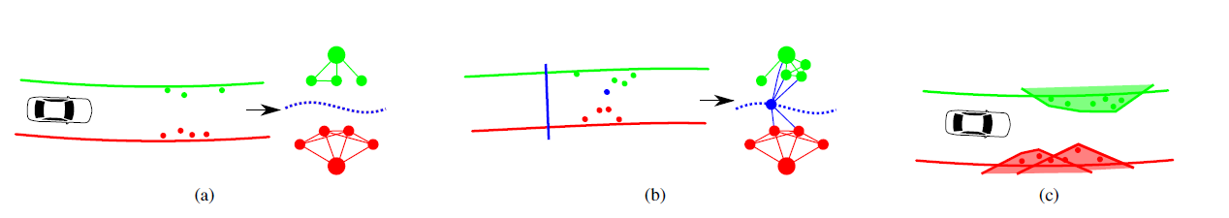
Review
Arask Kiani, Marc Schmid
‹Nr.›

