Slide 1
Car Price Predictor’s Milestone
Marcin Banak, Bartosz Kruszewski, Yaryna Rachkevych, Maciej Szałasz

Slide 2
What has been completed in the project?

Slide 3
Marcin
GitHub repo
Hyperparameter tuning research and functions
Regression training proces
Models comprasions
Maciek
Data cleaning
Merging and adding extra columns
Deleting outliers
Running training on GPU
Bartek
Project framework
Models classess
Training proces for classification
Utility functions
Yaryna
Evaluation metrics research and functions
Model comprasion technics
Evaluation dataclasses
Price intervals number comprasion

Slide 4
Data Proccessing
Fill nulls
Calculate currencies
One-hot encoding
Combine advanced model informations columns into one
Add brand weight and feature score columns
Removing global and specific brand outliers

Slide 5
Evaluation Metrics
Classification
Accuracy
Precision
Recall
F1
AUC ROC
Regression
MAE
MSE
RMSE
R2
MAPE
Custom
Mean classters error
Ideal distance
Comprasion
Consistency percentage
Average distance

Slide 6
Hyperparameters Tuning
Bayesian Optimisation
Main project tuning method
Much faster
Runned for 6 hours for every advanced model
After 2 hours results not chaning much
Grid Search
Too slow
Aborted in this project
Using only for tuning single parameters

Slide 7
What are the results of our work?

Slide 8
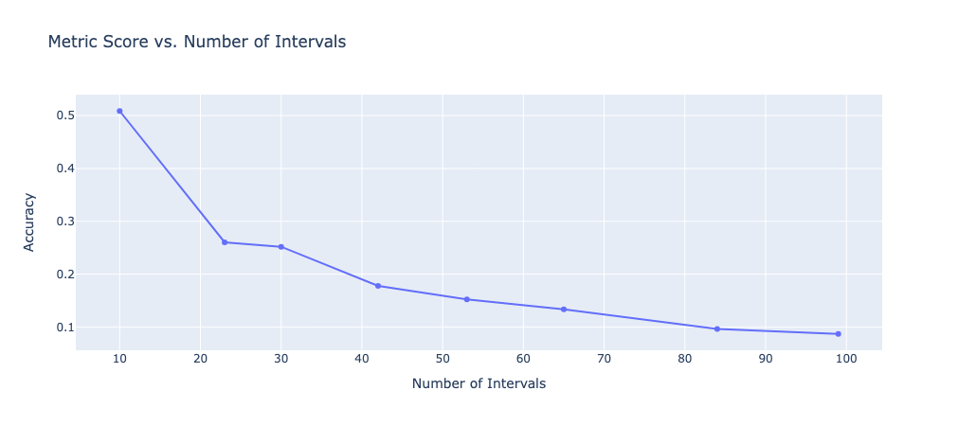
Basic Classification

Slide 9
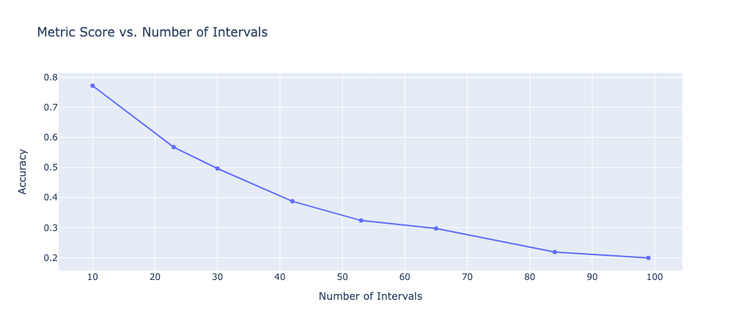
Advanced Classification

Slide 10

Basic Regression

Slide 11
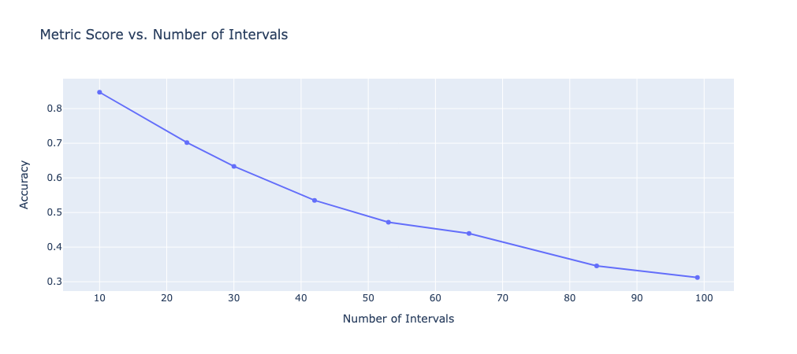
Advanced Regression

Slide 12
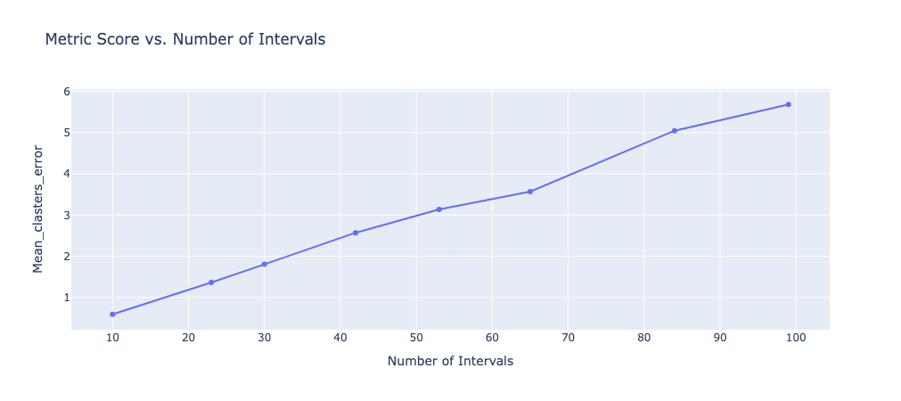
Basic Classification

Slide 13
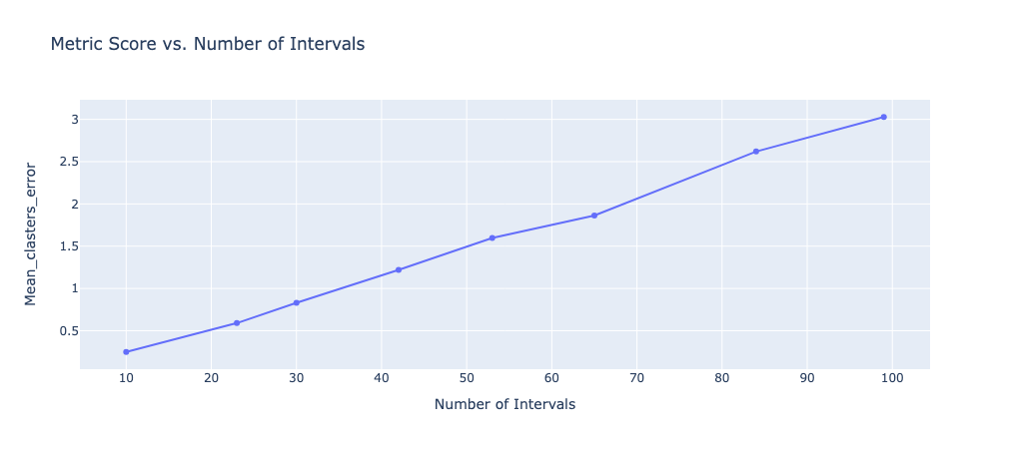
Advanced Classification

Slide 14
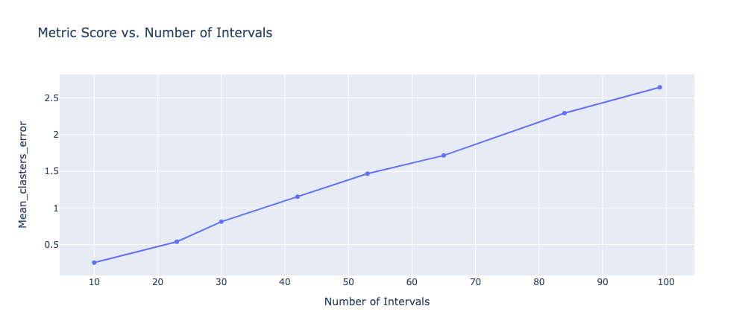
Basic Regression

Slide 15

Advanced Regression

Slide 16
What conclusions can be drawn?

Slide 17
Problem Type Comprasion
Classification
Regression
Lower accuracy
Higher training time (about 2min)
The result is not direct but takes a range into account
Higher accuracy
Lower training time (about 30s)
The results are not stable, as indicated by the high RMSE, however, when clustering is transformed into a classification task, they still perform better

Slide 18
Regression is DEFINITELY better for this task.

Slide 19
Project Status
Completed
Data processing for current price prediction
Framework for training and evaluation
Basic and advanced models for current price prediction
Training proccess for current price prediction
To do
Data processing for future price prediction
Car features aging simulation (using model or non ML algorithm?)
Basic and advanced model for future price prediction
Training proccess for current price prediction
Service allowing the utilization of models for current and fututre price prediction

