Slide 1
Introduction to Python
Chris Marciniak. Summer 2015

Slide 2
Outline
Motivation
Overview of Packages
Getting Started
Demos

Slide 3
Typology of Programming Languages
Compiled languages. C, C++, Java, Fortran
Interpreted or Scripting languages. Python, Ruby, Javascript, PHP
Statistical programming. Python, Stata, MATLAB, R, Julia

Slide 4
Python
Scripting language
Created by Guido van Rossum in 1989
Currently at version 3.4
Version 2.7 is supported because of legacy software built upon it.
Wrapped around fast C code

Slide 5
Advantages of Python
Free and Open Source
Simple syntax and easy to use.
Wide Array of available packages
Trading a slight decrease in runtime for a large decrease in development time.

Slide 6
Use within IFPRI
Python with ArcGIS to process 10 years of daily weather station data.
Extract a time series of road construction data from 500 differently formatted spreadsheets.
Download a large number of photos from an ODK server and organize them in a file system.

Slide 7
Beautiful is better than ugly.
Explicit is better than implicit.
Simple is better than complex.
Complex is better than complicated.
Flat is better than nested.
Sparse is better than dense.
Readability counts.
Special cases aren't special enough to break the rules.
Although practicality beats purity.
Errors should never pass silently.
Unless explicitly silenced.
In the face of ambiguity, refuse the temptation to guess.
There should be one-- and preferably only one --obvious way to do it.
Although that way may not be obvious at first unless you're Dutch.
Now is better than never.
Although never is often better than right now.
If the implementation is hard to explain, it's a bad idea.
If the implementation is easy to explain, it may be a good idea.
Namespaces are one honking great idea -- let's do more of those!
—The Zen of Python by Tim Peters

Slide 8
Simple is better than complex
Readability counts
There should be one-- and preferably only one --obvious way to do it

Slide 9
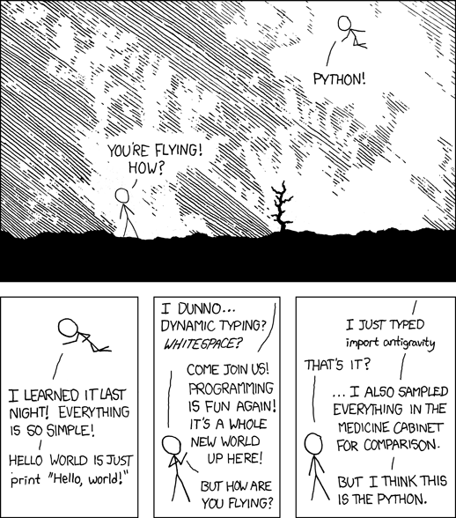
Packages

Slide 10
PyData
NumPy. Numerical Python. Matrices and linear algebra.
SciPy. Scientific computation.
Pandas. Python Data Analysis Library. Provides R-like data frames. I/O for Excel and Stata formats.
Statsmodels. Econometrics: OLS, GLM, GMM, VAR, ARMA
Sci-kit Learn. Machine Learning. Clustering and Classification
MatPlotLib. Plotting and Visualization.

Slide 11


Web Apps
Django. Framework designed to handle common web tasks e.g. connecting to a database, templates.
Flask. A microframework.

Slide 12
Big Data
Apache Spark. High-level API for Hadoop Clusters.
Blaze. Use numpy and scipy on databases.
Theano. Define, optimize, and evaluate mathematical expressions involving multi-dimensional arrays efficiently and using the GPU.

Slide 13
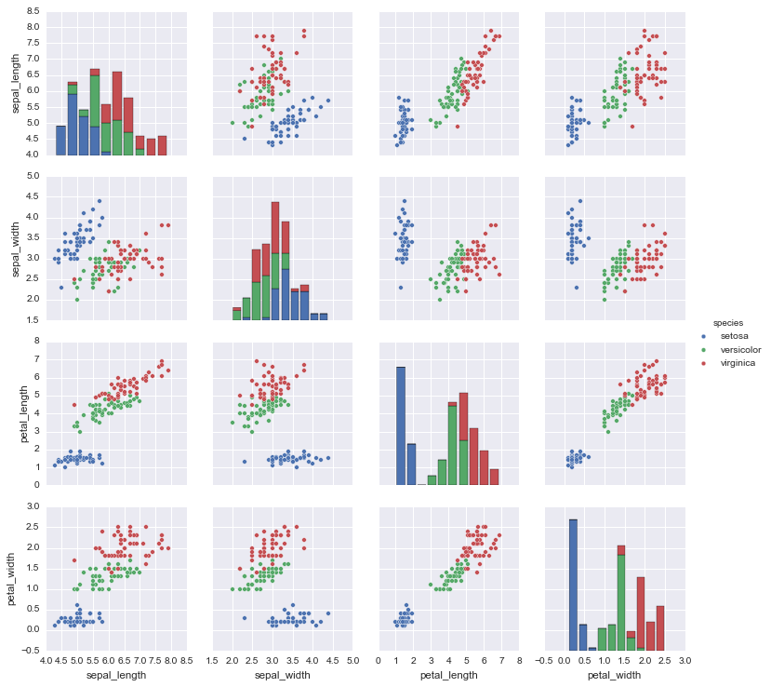
Visualization
Matplotlib
Seaborn
Bokeh. Interactive web graphics.

Slide 14
Text Mining
Packages include nltk, genism
Word2Vec algorithm constructs a matrix of word co-occurences weighted by distance
vec(“Obama”)+vec(“Russia”)-vec(“USA”)=vec(“Putin”)
Predicting financial time-series using news
Sentiment analysis on free response survey data

Slide 15
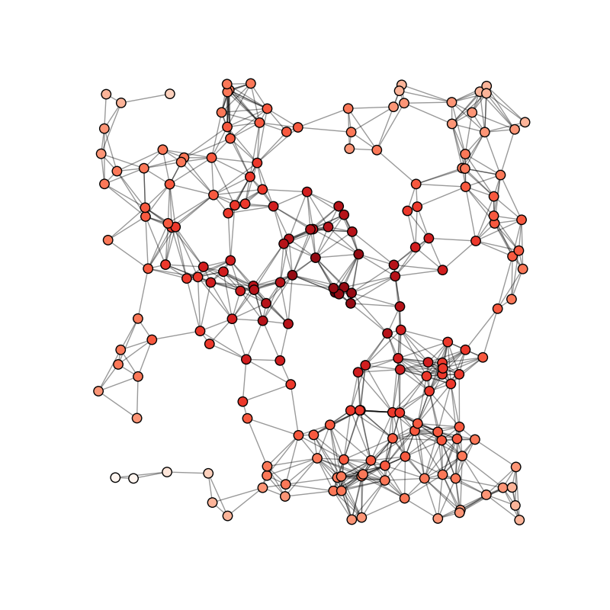
Social Network Analysis
NetworkX
Compute graph measures centrality, clusters, cliques
Algorithms for generating ErdosRenyi graphs, computing shortest paths.

Slide 16
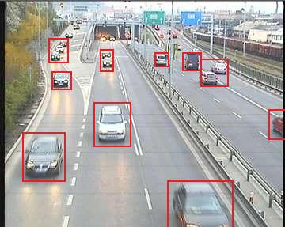
Computer Vision
OpenCV is a C++ library with Python bindings.
Casaburi and Glennester (2013) used a computer vision approach to measure road traffic in Sierra Leone.

Slide 17
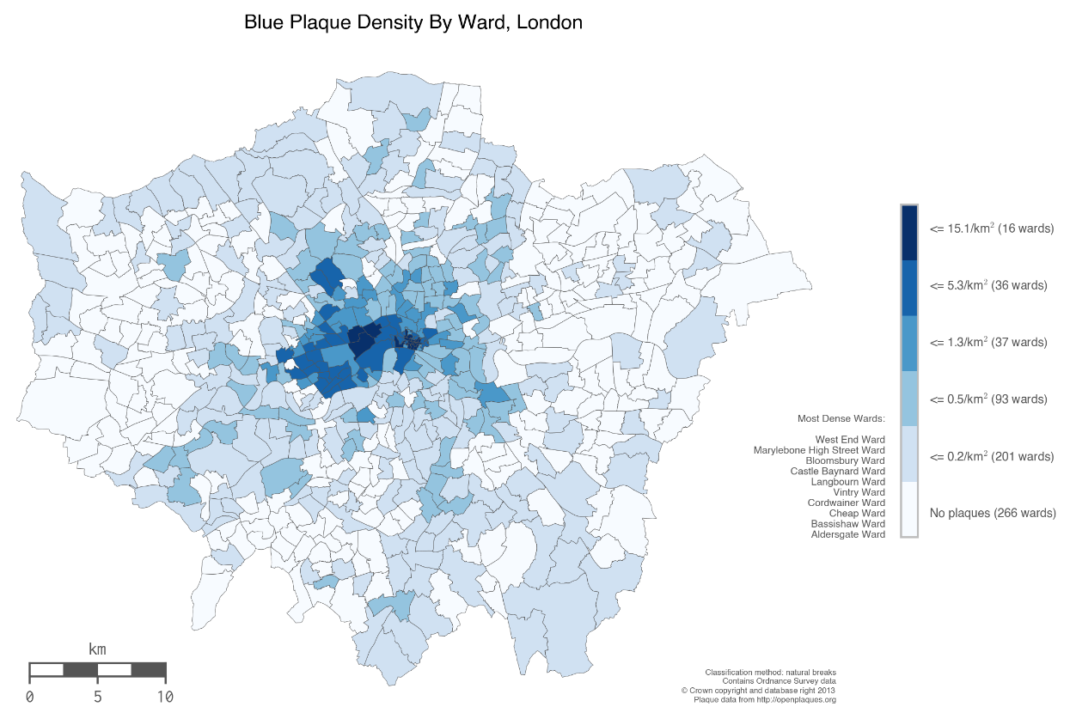
Geographic Information Systems
ArcGIS arcpy
Open-source: GDAL, Shapely, Fiona, PYSAL, Basemap
http://sensitivecities.com/so-youd-like-to-make-a-map-using-python-EN.html#.VYsXkC7zNZE

Slide 18
Other Interesting Packages
Linear Programming. PuLP.
PyMC3. Bayesian statistics and Markov Chain Monte Carlo Analysis.
Web Scraping. Requests and BeautifulSoup. Automate data collection.
GIS. Arcpy, GDAL, Shapely, Fiona.

Slide 19
3rd-Party Software
ArcGIS. arcpy. All ArcGIS functions are written in Python.
OpenSesame. Software written for psychology experiments.

Slide 20
Syntax
Whitespace instead of Brackets
numbers = [0,1,2,3,4]
for num in numbers:
if num%2==0:
print (numbers)
# 0 , 2 , 4

Slide 21
Data Types
Dynamic typing. Python recognizes type automatically
Strings ‘string’ or “string”
Integer 4
Float 4.0
Boolean. True or False
5/6 = 1
5/6.0 = .83333

Slide 22
Functions
def square(x):
return x**2
Functions may be passed as arguments to other functions
print( square(4) )

Slide 23
Branching
if x == True and y == False:
print(False)
elif x == True or y == False:
print(True)
else:
print(“No real solution”)

Slide 24
Lists
Also called arrays.
Indexed numerically starting at 0
list = [3, “sprouts”, 45.2, “Shakespeare”]
print(list[1]) # sprouts

Slide 25
Slicing
list = [3, “sprouts”, 45.2, “Shakespeare”]
print(list[1:2]) # [“sprouts”,45.2]
print(list[0:3:2] # [3,45.2]
Strings can also be sliced
poet = “Shakespeare”
poet[0:5] # “Shakes”
Reverse a string
poet[::-1] # “eraepsekahS”

Slide 26
Dictionaries
Also called look-up tables, hashtables, hashmaps
Indexed by string ‘keys’ that you provide
gdp = {“Burkina Faso”: 63 , “Mali”: 80 , “Zimbabwe”: 107.4 }
Any value can be retrieved in constant time regardless of the size of the dictionary.
gdp[“Mali”] # 80

Slide 27
Loops
for i in range(0,128):
print(i)
while num < 128:
print(i)
i=i+1
gdp = {“Burkina Faso”: 63 , “Mali”: 80 , “Zimbabwe”: 107.4 }
for country, figure in gdp.iteritems():
print(country+“’s GDP is ” +figure)

Slide 28
Example: Query an API
http://data.worldbank.org/querybuilder
return JSON
Output to CSV using Pandas

Slide 29
Example: Scrape a Website
Download PDF files at http://web.maga.gob.gt/precios-agricolas/

