Slide 1


Project 2
Weather App

Slide 2




Team

Slide 3
Project Purpose
The purpose of the project is to focus more on learnings rather than develop a product

Slide 4
Scope of the Project
Weather app is designed to:
collect weather data from sources
store this information in the database
provide visual presentation of the stored data

Slide 5
Technologies Used
JavaScript, HTML, CSS, HBS
Node.js
MongoDB
C++
Flickr
Openweathermap API
Mapbox API

Slide 6
Demo

Slide 7
Lessons Learnt
Node server (express)
Front-end templating (handlebars)
Building physical sensor
MongoDB w/Mongoose
Project Management
Code review/git/github

Slide 8
Potential Learning Opportunities
Develop project in React or other
Use machine learning to develop forecasts
Create user accounts with saved preferences
Deployment
Fully integrate a physical sensor

Slide 9
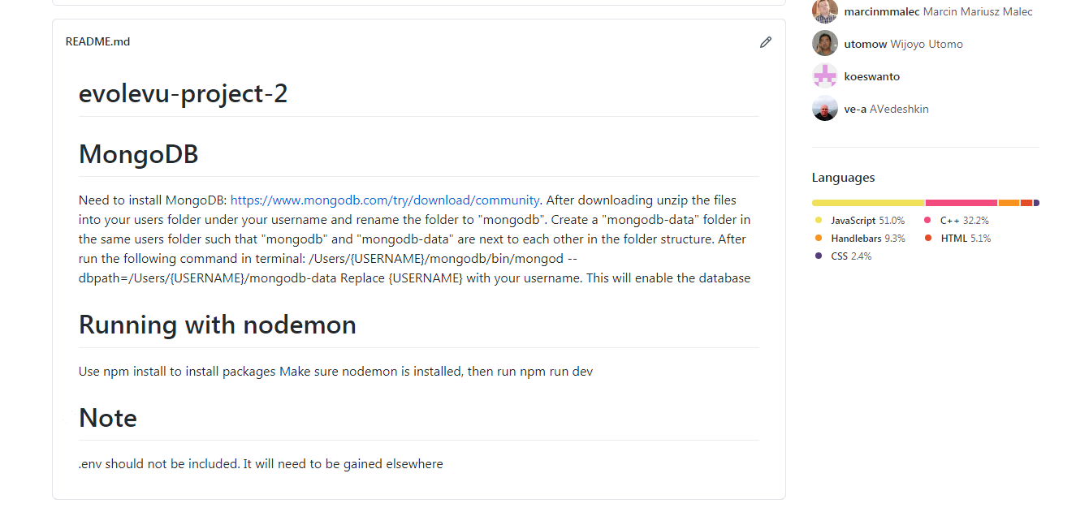
Repository
Currently available at https://github.com/marcinmmalec/evolevu-project-2

Slide 10
Thank You!

