Slide 1

Requirements wg RUP
Wojskowa Akademia Techniczna
Wydział Cybernetyki
Materiały na seminarium
„Metodyki tworzenia SI”
Wykonał Marcin Wiącek
Styczeń 2006
Wersja online www.mwiacek.com

Slide 2

Artifacts
Either final or intermediate work products produced and used during a project. Artifacts capture and convey project information, and may take various shapes or forms.
Disciplines
Each discipline describes a set of associated activities and artifacts based around a common skillset. RUP describes disciplines at an overview level-a summary of all roles, activities, and artifacts that require a given set of skills to perform the discipline.

Slide 3
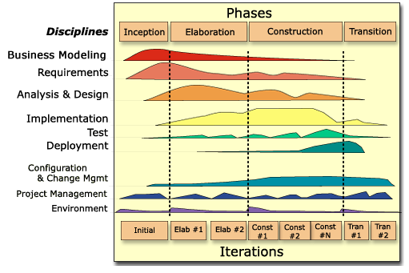

Slide 4
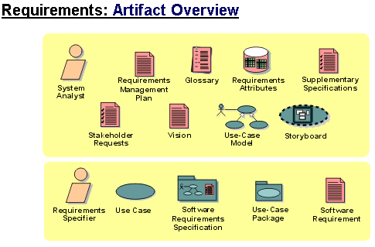
The roles and the artifacts developed in the Requirements discipline.
RUP (Analyst | Requirements/Artifact Overview)

Slide 5

Requirements/Glossary
Co to jest ?
The Glossary defines important terms
used by the project.
Kto wykonuje ?
The System Analyst role leads and coordinates requirements elicitation and use-case modeling by outlining the system's functionality and delimiting the system; for example, identifying what actors exist and what use cases they will require when interacting with the system.
Kiedy wykonuje ?
The Glossary is primarily developed during the inception and elaboration phases, because it's important to agree on a common terminology early in the project.

Slide 6
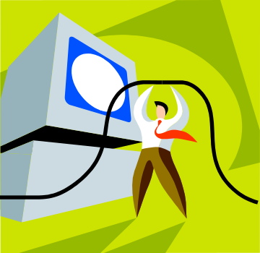
Requirements/Glossary
Po co ?
There is one Glossary for the system that provides a consistent set of definitions to help avoid misunderstandings. Project members initially use the Glossary to understand the terms that are specific to the project. This document is also important to people performing these roles:
Developers, who make use of the terms in the Glossary when designing and implementing classes, database tables, user-interfaces, and so forth
Analysts, who use the Glossary to capture project-specific terms so they can clearly define business rules, and to ensure that requirement specifications make correct and consistent use of those terms
Course developers and technical writers, who use the Glossary to construct training material and documentation using recognized terminology

Slide 7
Requirements/Glossary
  Punkty do sprawdzenia
  Does each term have a clear and concise definition?
  Is each glossary term included somewhere in the use-case descriptions? If not, it may imply that a use case is missing or that the existing use cases are not complete. It is more likely, though, that the term is not included because it is not needed. In that case, you should remove it.
  Are terms used consistently in the brief descriptions of actors and use cases?
  Does a term represent the same thing in all use-case descriptions?

Slide 8
Requirements/Glossary
Course Registration System
Glossary
Version 2.0
Revision History
Date Version Description Author
26/Dec/1998 1.0 Draft version Bill Collings
19/Feb/1999 2.0 Moved some of the terms to the Wylie College glossary. Bill Collings
Glossary
1.Introduction
The glossary contains the working definitions for terms and classes in the Course Registration System. This glossary will be expanded throughout the life of the project. Any definitions not included in this document may be included in the Rational Rose Model. Generic terms used outside this project should be captured in the organizational Glossary.
2. Definitions
Alternative course selection
  A student might choose to register for one or more alternative courses, in case one or more of the primary selections are not available.
Billing System
  Part of the university's Finance System used for processing billing information.

Slide 9
The roles and the artifacts developed in the Requirements discipline.
RUP (Analyst | Requirements/Artifact Overview)

Slide 10
Requirements/Stakeholder Requests
Co to jest ?
This artifact contains any type of requests a stakeholder (customer, end user, marketing person, and so on) might have on the system to be developed. It may also contain references to any type of external sources to which the system must comply.
Kto wykonuje ?
Although the system analyst is responsible for this artifact, many people will contribute to it: marketing people, end users, customers-anyone who is considered to be a stakeholder to the result of the project.

Slide 11
Requirements/Stakeholder Requests
Kiedy wykonuje ?
Stakeholder Requests are mainly collected during the inception and elaboration phases, however you should continue to collect them throughout the project's lifecycle for planning enhancements and updates to the product. A change request tracking tool is useful for collecting and prioritizing these requests.

Slide 12
The roles and the artifacts developed in the Requirements discipline.
RUP (Analyst | Requirements/Artifact Overview)

Slide 13
Requirements/Storyboard
Co to jest ?
A Storyboard is a logical and conceptual description of system functionality for a specific scenario, including the interaction required between the system users and the system. A Storyboard "tells a specific story".
Kto wykonuje ?
System Analyst
Kiedy wykonuje ?
Optional. Produced in early Elaboration, during requirements elicitation.

Slide 14
Requirements/Storyboard
Po co ?
The following people use the Storyboards:
system analysts, to explore, clarify, and capture the behavioral interaction envisioned by the user as part of requirements elicitation.
user-interface designers, to design the user interface and to build a prototype of the user interface;
designers of the classes that provide the user interface functionality; They use this information to understand the system's interfactions with the user, so they can properly design the classes that will implement the user interface;
those who design the next version of the system to understand how the system carries out the flow of events;
those who test to test the system's features;
the manager to plan and follow up the analysis & design work.

Slide 15
The roles and the artifacts developed in the Requirements discipline.
RUP (Analyst | Requirements/Artifact Overview)

Slide 16
Requirements/Software Requirements Specification
Co to jest ?
The Software Requirements Specification (SRS) captures the software requirements for the complete system, or a portion of that system.
Kto wykonuje ?
The Requirements Specifier role specifies and maintains the detailed system requirements.
Kiedy wykonuje ?
Considered first in the Inception phase, refined in the Elaboration and Construction phases.

Slide 17
Requirements/Software Requirements Specification
Po co ?
The following people use the Software Requirements Specification:
The system analyst creates and maintains the Vision and Supplementary Specifications, which serves as input to the SRS and are the communication medium between the system analyst, the customer, and other developers.
The requirements specifier creates and maintains the individual use case and other components of the SRS package,
Designers use the SRS Package as a reference when defining responsibilities, operations, and attributes on classes, and when adjusting classes to the implementation environment.
Implementers refer to the SRS Package for input when implementing classes.
The Project Manager refers to the SRS Package for input when planning iterations.
Testers use the SRS Package as an input to considering what tests will be required.

Slide 18

Dziękuję za stosunkowo niski poziom szumów tła

