Slide 1
Reconstruction of particle tracks using Deep Neural Networks
Tymoteusz Ciesielski Supervisor: Dr. Marcin Wolter
Eyüp Bedirhan Ünlü

Slide 2
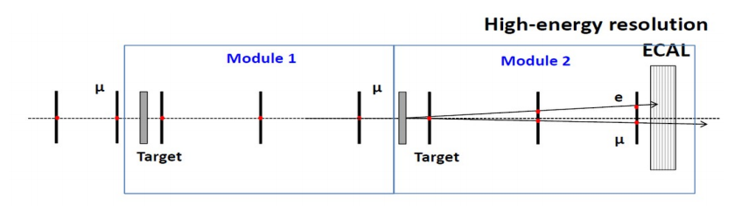
MuonE experiment
MuonE
Future CERN experiment - planned to be built in 2021-2022
Dedicated to measure hadronic correction to the anomalous muon magnetic moment.
We are working on the simulated test beam data
No magnetic field applied, tracks of particles are straight lines
Layers of detectors, determining position of a flying particle - X, Y layers and stereo layers rotated by 45 degrees

Slide 3
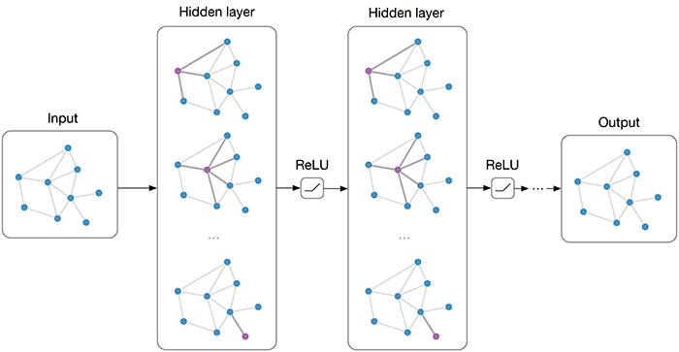
GNN - Graph Neural Network
We used the code of HEPTrkX group, which applied GNN to track reconstruction. We have modified their code: https://github.com/HEPTrkX/heptrkx-gnn-tracking
Motivation to use - building track reconstruction method alternative to the standard pattern recognition methods
Input data - graph, instead of vectors or matrices. In our case, hit positions - nodes.
Output data - graph with edges, connecting the hit points. Each edge has a weight, denoting the probability that it belongs to the particle track

Slide 4
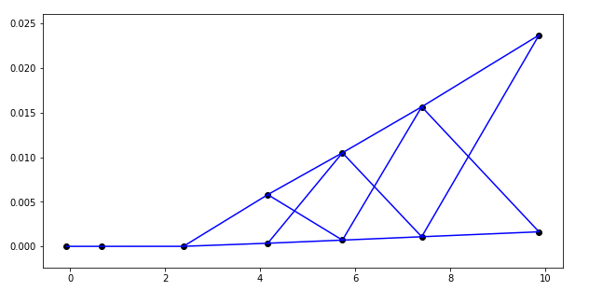
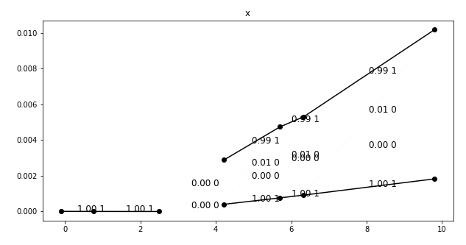
GNN applied to MuonE track recognition
At the moment, we can reconstruct 2D tracks ( XZ and YZ)
First we find all potential edges connecting the hits
Then the edges are validated by GNN; they get probabilities that they form a track
Edges with high probabilities - marked as black
All possible edges
Track candidates
found by GNN
Electron track
Primary muon track
Secondary muon track
target
Z direction
target

Slide 5
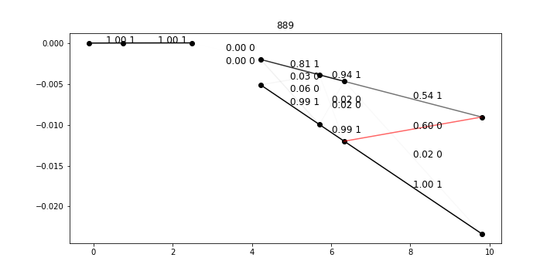
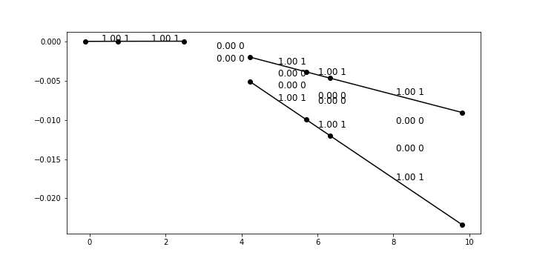
Tuning GNN parameters
Potential problems - simulating tracks that are not real
Changing parameters:
Numbers of layers of Edge Neural Network and Node Neural Network
Number of iterations of weights updates per epoch
This last parameter turned out to be the most significant
Maximum edge classification accuracy that was obtained is 99.9%

Slide 6
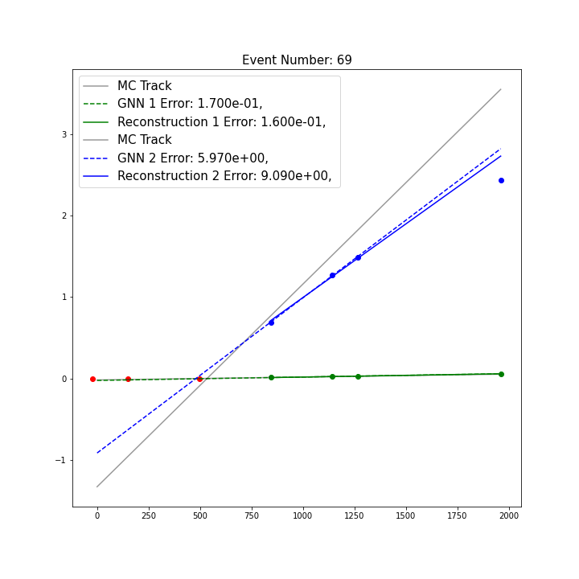
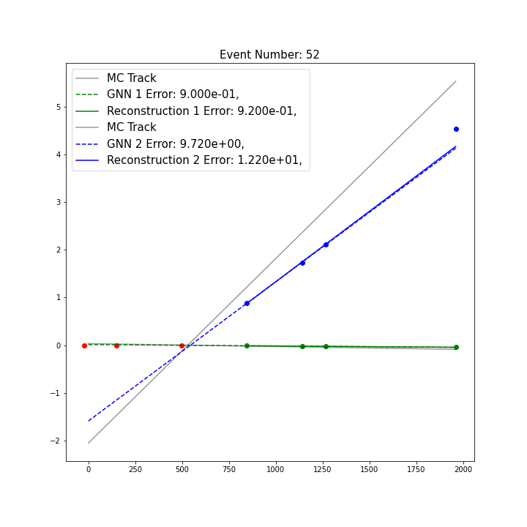
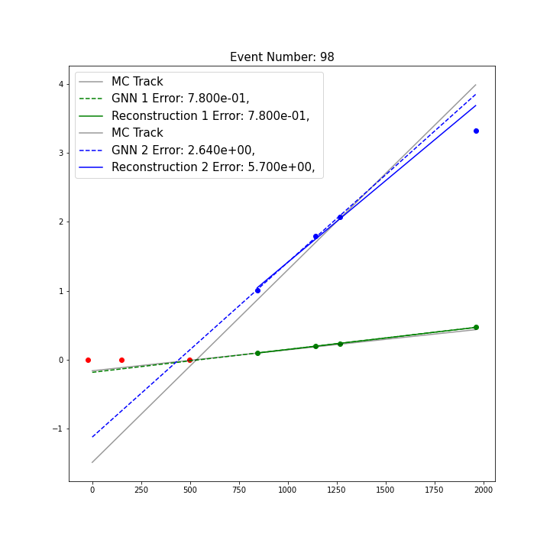
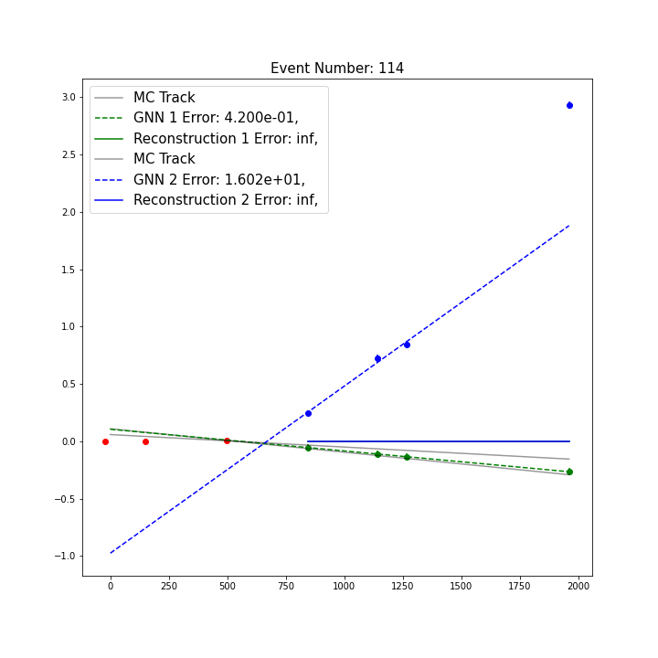
Fitting the particle tracks
GNN reconstructed electron
Particle track is determined by linear fit to the hits found by GNN
Robust fit algorithm - extension of standard linear regression. Allows to drop one outlying point
Comparison between real tracks (Monte Carlo tracks) and those reconstructed by us
Tracks are also compared to those obtained using standard MuonE reconstruction
True electron
Standard reconstructed electron
Muon

Slide 7
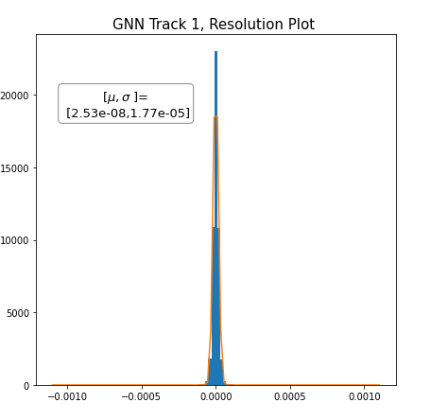
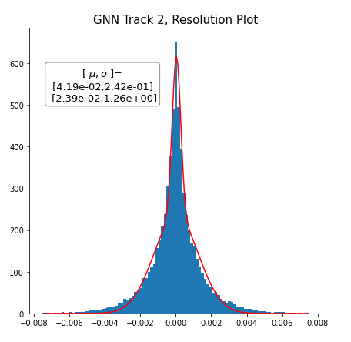
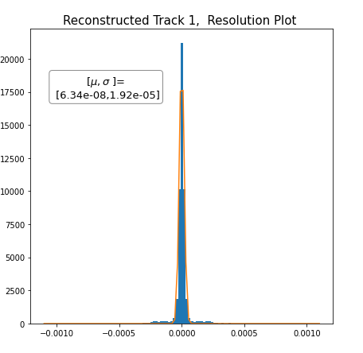
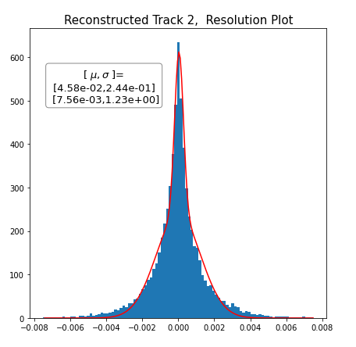
Results: Slope resolution (reconstructed - true)
GNN
Muon track
GNN
Electron track
Number / Percentage of successful reconstructions:
24970 / %99.951965
Number / Percentage of successful reconstructions:
24777 / %99.179409
Classical Methods
Muon track
Classical Methods
Electron track
Number / Percentage of successful reconstructions:
24077 / %96.377392
Number / Percentage of successful reconstructions:
24978 / %99.983988

Slide 8
Conclusions
Our code: https://github.com/marcinwolter/Tracking_student2020
We managed to implement GNN to reconstruct particle tracks based on hit positions
We obtained the reconstruction efficiency and resolution comparable to the classical methods (and for the scattered electron track even slightly better)
We therefore introduced alternative working method for track reconstruction in the MuonE experiment
Future development of the project - reconstruction of the tracks in 3D

Slide 9
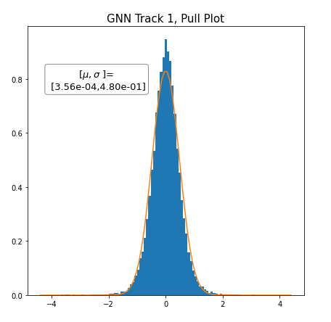
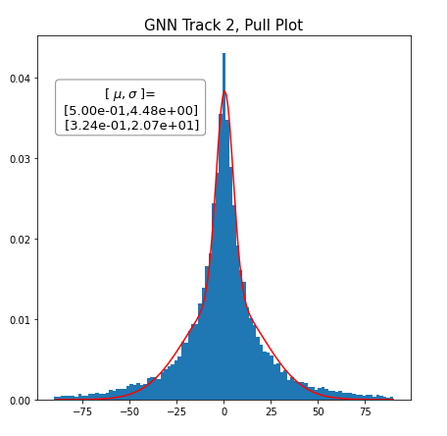
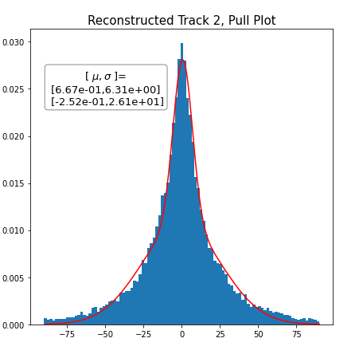
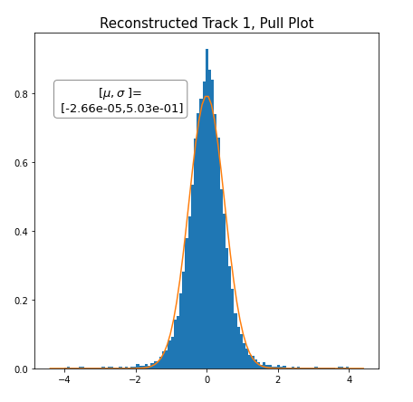
Supplementary

