Slide 1
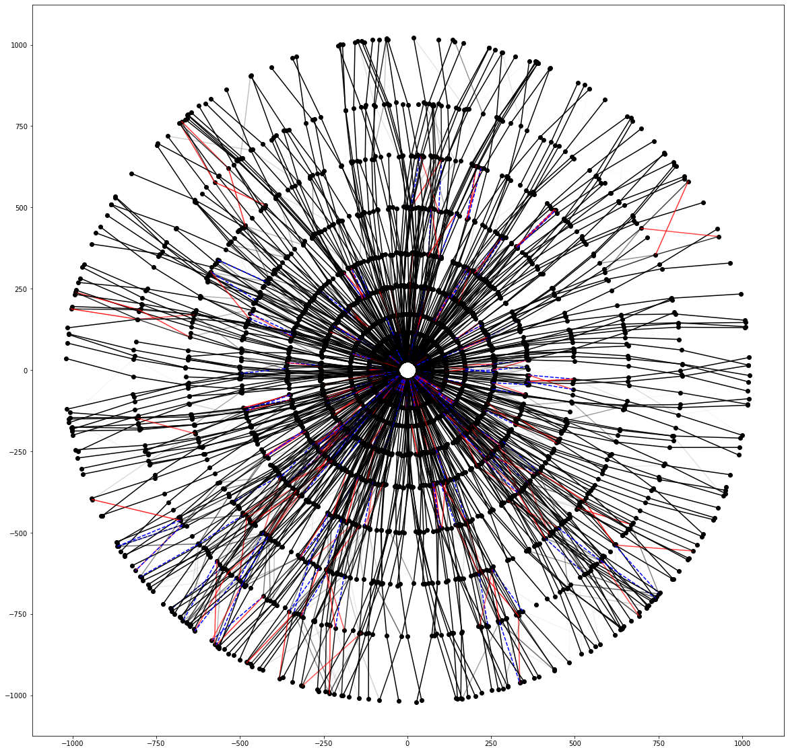
Reconstruction of particle tracks using Deep Neural Networks
Marcin Wolter
IFJ PAN
11 July 2022
Notes:
Uporzadkowac
Dodac przykłady

Slide 2
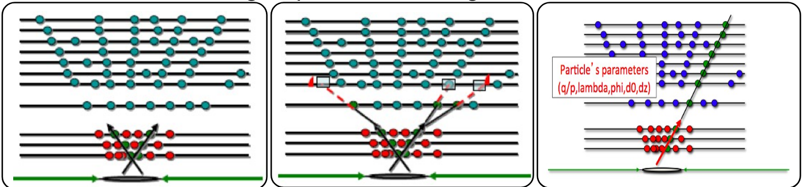
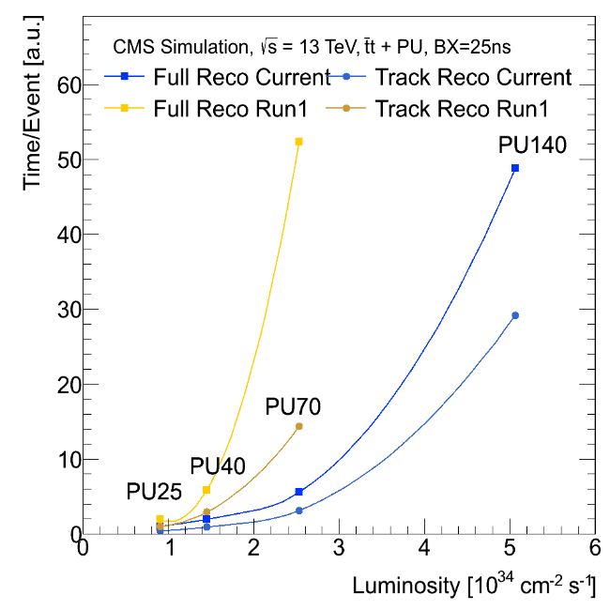
Track reconstruction
Seeding Track Building Track Fitting
Usually this method works fine, is robust and efficient!
Problem:
  The time needed to process one event grows quickly (worse than quadratic) with luminosity (number of collisions).
  Huge part of CPU consumption by the track finding.
Solution: use Neural Network!

Slide 3
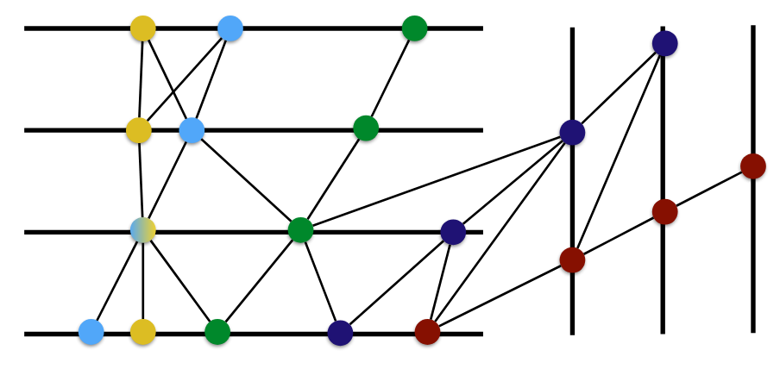
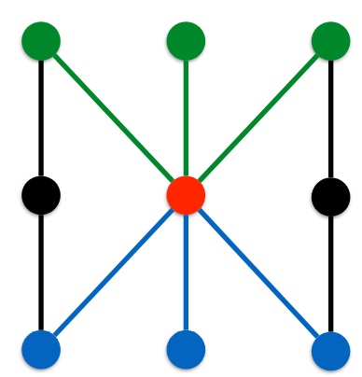
Graph Neural Network
Structure our data as a graph of connected hits
What kinds of models can we apply to this representation?
Traditional architectures clearly don’t work
but there’s a growing sub-field of ML called Geometric (Graph) Deep Learning
Two main components operate on the graph locally:
Edge network uses the node features to compute edge weights
Node network aggregates forward and backward node features with the edge weights and updates node features

Slide 4
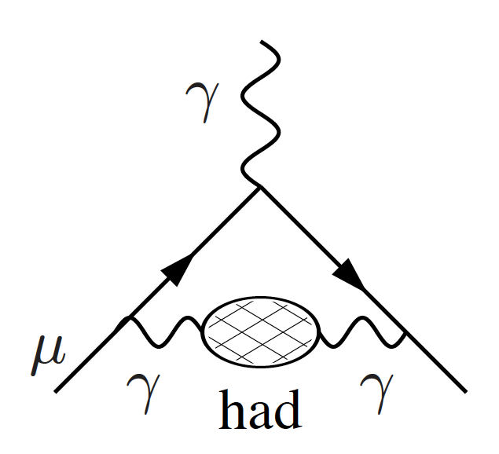
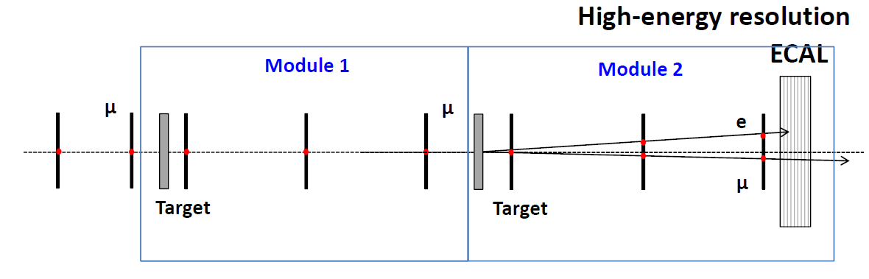
Task – GNN for MuonE experiment
MuonE – future CERN experiment dedicated to measure a hadronic correction to the anomalous muon magnetic moment.
TASK: apply GNN to the simulated test beam data:
  No magnetic field – straight tracks
  Few detector layers
  Layers detecting X and Y position with so called stereo layers rotated by 45 degrees
hadronic vacuum polarization

Slide 5
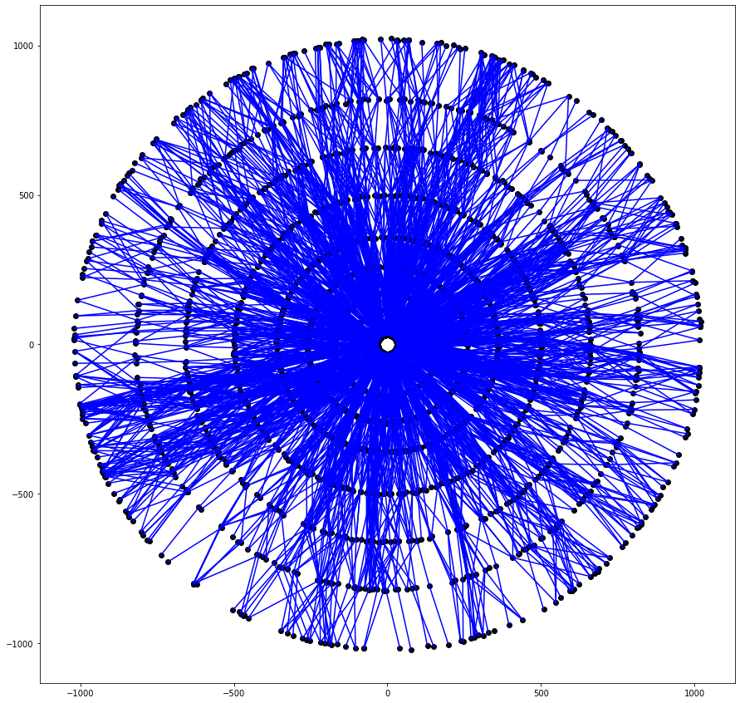
Information about Graph Neural Networks
Great page:
http://geometricdeeplearning.com/
Nice lecture:
https://ucbrise.github.io/cs294-ai-sys-sp19/assets/lectures/lec03/gnn.pdf
Presentation about GNN tracking:
https://indico.cern.ch/event/658267/contributions/2881175/

Slide 6
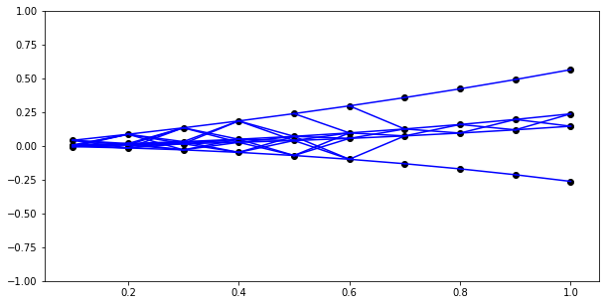
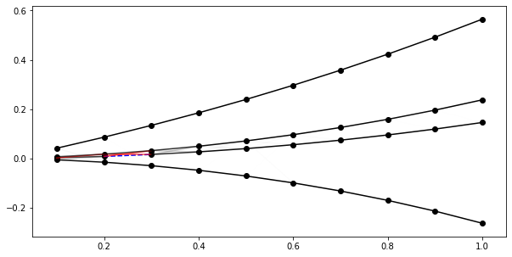
See the code of a toy example on github
It is pretty compact:
https://github.com/marcinwolter/Tracking_student2022/blob/master/GNN_Tutorial_Colab.ipynb
Plus input data: https://drive.google.com/open?id=1NNZadxZcrxkm0NJv3CgeNGwBnsnByioV
And you can run it on Google Colab: https://colab.research.google.com

Slide 7
Repository
There is a starting repository for you:
https://github.com/marcinwolter/Tracking_student2022
It contains:
  GNN_Tutorial_Colab.ipynb - tutorial code for GNN tracking
  Data for GNN_Tutorial_Colab: https://drive.google.com/drive/folders/1NNZadxZcrxkm0NJv3CgeNGwBnsnByioV?usp=sharing
  GNN_MuonE_v1.ipynb - starting code I have prepared for students in 2020
  Data: https://drive.google.com/drive/folders/1PpdNJHw9KYpY6kczmeGsFLRfaeCq65gK?usp=sharing
  GNN_MuonE_v1_Robust_mc-recon_comparison.ipynb - program for tracking in 2D created by students in 2020

Slide 8
Your task
Read the tutorials (we can do it together)
Read the presentation of summer students from 2022:
  https://github.com/marcinwolter/Tracking_student2020/blob/master/PPSS_Presentation.pdf
  Try to understand the code GNN_MuonE_v1.ipynb
  Think how to make pattern recognition
Students in 2020 created the code working in 2D doing:
  Pattern recognition using GNN
  Robust fit to the hits to find the track parameters

Slide 9
Your task
There are so called stereo layers tilted by 45 deg – they allow reconstruction in 3D
Think, whether we can do reconstruction using three types of layers at once:
  X layers
  Y layers
  Stereo layers

