Slide 1
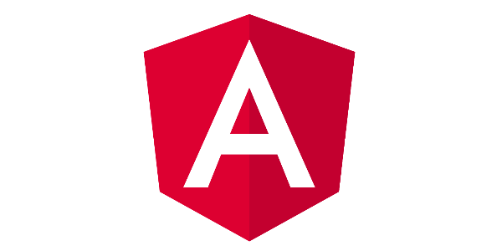
Angular Fundamentals
Marcin Wróbel
marcin.wrobel@credit-suisse.com

Slide 2

Agenda
What is Angular?
Directives
Pipes
Services & Dependency Injection
Intro To RxJs
Angular HTTP Service
Angular Router
Demo
Questions & answers

Slide 3
Angular Fundamentals
What is Angular?
Directives
Pipes
Services & Dependency Injection
Intro To RxJs
Angular HTTP Service
Angular Router
Demo
Questions & answers

Slide 4
What is Angular?
SPA (Single Page Application)
Developed by Google Team
Typescript based open source front-end framework
Moduled application
Uses RxJS library

Slide 5
What is Angular?
Required software
a) Node.js
b) NPM or yarn or any other package manager
Install AngularCLI (npm install -g @angular/cli)
Create application project (ng new <name>)
Install all additional packages (npm install <name>)
a) --save
b) --save-dev
package.json file
angular-cli.json file

Slide 6
Angular Fundamentals
What is Angular?
Directives
Pipes
Services & Dependency Injection
Intro To RxJs
Angular HTTP Service
Angular Router
Demo
Questions & answers

Slide 7
Directives
Components
Structural directives
Attribute Directives

Slide 8
Directives - Components
Components are the fundamental building blocks of Angular applications. They display data on the screen, listen for user input, and take action based on that input.
Components Tree
Components lifecycle
ng generate component <name>

Slide 9
Directives – Components – Components Tree
App Root
Component A
Component C
Component B
Component D

Slide 10
Directives – Components – Components Lifecycle
ngOnChanges
ngOnInit
ngDoCheck
ngAfterContentInit
ngAfterContentChecked
ngAfterViewInit
ngAfterViewChecked
ngOnDestroy

Slide 11
Directives – Structural Directives
Structural directives are responsible for HTML layout. They shape or reshape the DOM's structure, typically by adding, removing, or manipulating elements.
*ngFor, *ngIf

Slide 12
Directives – Attribute Directives
Used as attributes of elements
[ngClass], [ngStyle]
ng generate directive <name>

Slide 13
Angular Fundamentals
What is Angular?
Directives
Pipes
Services & Dependency Injection
Intro To RxJs
Angular HTTP Service
Angular Router
Demo
Questions & answers

Slide 14
Pipes
A pipe takes in data as input and transforms it to a desired output
ng generate pipe <name>

Slide 15
Angular Fundamentals
What is Angular?
Directives
Pipes
Services & Dependency Injection
Intro To RxJs
Angular HTTP Service
Angular Router
Demo
Questions & answers

Slide 16
Service & Dependency Injection
Service is typically a class with a narrow, well-defined purpose. It should do something specific and do it well.
Dependency Injection (DI)
Singleton until will not be overwriten
ng generate service <name>

Slide 17
Angular Fundamentals
What is Angular?
Directives
Pipes
Services & Dependency Injection
Intro To RxJs
Angular HTTP Service
Angular Router
Demo
Questions & answers

Slide 18
Intro to RxJS
RxJS is a library for reactive programming using Observables, to make it easier to compose asynchronous or callback-based code
Observable
BehaviorSubject
Subject
Subscription
operators

Slide 19
Angular Fundamentals
What is Angular?
Directives
Pipes
Services & Dependency Injection
Intro To RxJs
Angular HTTP Service
Angular Router
Demo
Questions & answers

Slide 20
Angular HttpService
Built-in service responsible for calling Web API to get data
Implements REST interface

Slide 21
Angular Fundamentals
What is Angular?
Directives
Pipes
Services & Dependency Injection
Intro To RxJs
Angular HTTP Service
Angular Router
Demo
Questions & answers

Slide 22
Angular Router
Built-in mechanism to navigate between parts of application
Different routes in different modules
Easy separation of reponsibility
<router-outlet></router-outlet>
Lazy loading
Preloading

Slide 23
Angular Fundamentals
What is Angular?
Directives
Pipes
Services & Dependency Injection
Intro To RxJs
Angular HTTP Service
Angular Router
Demo
Questions & answers

Slide 24
Angular Fundamentals
Website
https://angular.io/
http://reactivex.io/rxjs/
Literature
https://github.com/RHieger/ng-book-angular-8
Reactive Programming with RxJS: Untangle
Your Asynchronous JavaScript Code

Slide 25
Angular Fundamentals
What is Angular?
Directives
Pipes
Services & Dependency Injection
Intro To RxJs
Angular HTTP Service
Angular Router
Demo
Questions & answers

