Slide 1
Supervised Machine Learning Random Forests Support Vector Machines (SVMs)
Data Science Skills Series
Márcio Mourão
http://scikit-learn.org/

Slide 2
References
http://scikit-learn.org/
http://scikit-learn.org/stable/modules/svm.html/
www.cs.kent.edu/~jin/DM07/ClassificationDecisionTree.ppt
http://www.svm-tutorial.com/2014/11/svm-understanding-math-part-1/
http://cs.haifa.ac.il/hagit/courses/seminars/visionTopics/Presentations/SVM_Lecture.ppt/

Slide 3
Summary
Introduction to Random Forests
Use Random Forests to model available census data and predict whether someone makes more than 50K a year
Introduction to Support Vector Machines (SVMs)
Use SVMs to predict handwritten digits

Slide 4
Random Forests

Slide 5
Create a decision tree from training data
categorical
categorical
continuous
class
Splitting Attributes
Refund
Yes
No
NO
MarSt
Single, Divorced
Married
TaxInc
NO
< 80K
> 80K
NO
YES
Training Data
Model: Decision Tree

Slide 6
Apply model to test data
Refund
Test Data
Yes
No
NO
MarSt
Single, Divorced
Married
TaxInc
NO
< 80K
> 80K
NO
YES

Slide 7
Decisions and algorithms
Determine how to split
Specify attribute test condition
Attribute type: nominal, ordinal, continuous
Splitting: 2-way split, multi-way split
Determine best split
Need a measurement of impurity: Gini Index, Entropy, Misclassification Error
There are many algorithms available
Hunt’s, CART, ID3, C4.5, SLIQ, SPRINT

Slide 8
Advantages
Inexpensive to construct
Extremely fast at classifying unknown records
Easy to interpret for small-sized trees
Easily handles mixed data
Scalable
Accuracy is comparable to other classification techniques for many simple data sets

Slide 9
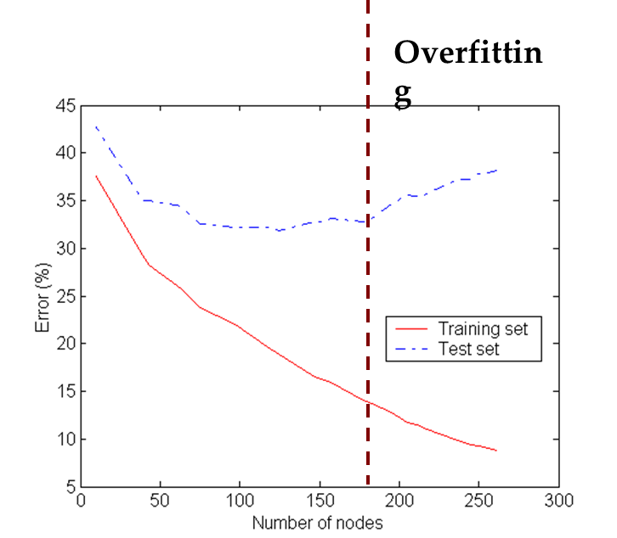
Disadvantages
Prone to produce decision trees that are more complex than necessary (overfitting)
In overfitting, trees are highly sensitive to noise in the training set
Training error no longer provides a good estimate of how well the tree will perform on previously unseen records
Overfitting

Slide 10
Random Forests
Random Forests correct decision’s tree habit of overfitting
Random Forests fall under a class of learners called “Ensemble Methods”
For what problems can you apply this method?
Regression/Prediction for Continuous Outcome Variables
Classification for Categorical Outcome Variables (2 or more levels)

Slide 11
Methodology
Step 1: Establish the Forest (bagging)
Generate ntree bootstrap samples from the original data set, with replacement, and having the same size as the input data set.
Reduces correlation between trees by using different data sets
Decreases the variance of the model
Step 2: Grow Trees
For each bootstrap sample from Step 1, grow a classification or regression tree to full size (with no pruning)
At each node, randomly select predictor variables to use for splitting
Splits will be based on the BEST variable from those randomly selected for a given node

Slide 12
Methodology
Step 3: Prediction
After all trees in the forest have been grown, form a prediction for new data from each tree in the forest
Final predictions in classification problems are based on the majority
Final predictions in regression problems are means

Slide 13
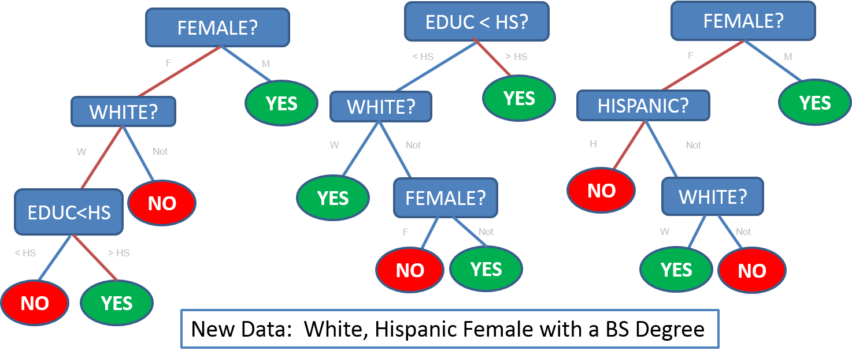
Illustration

Slide 14
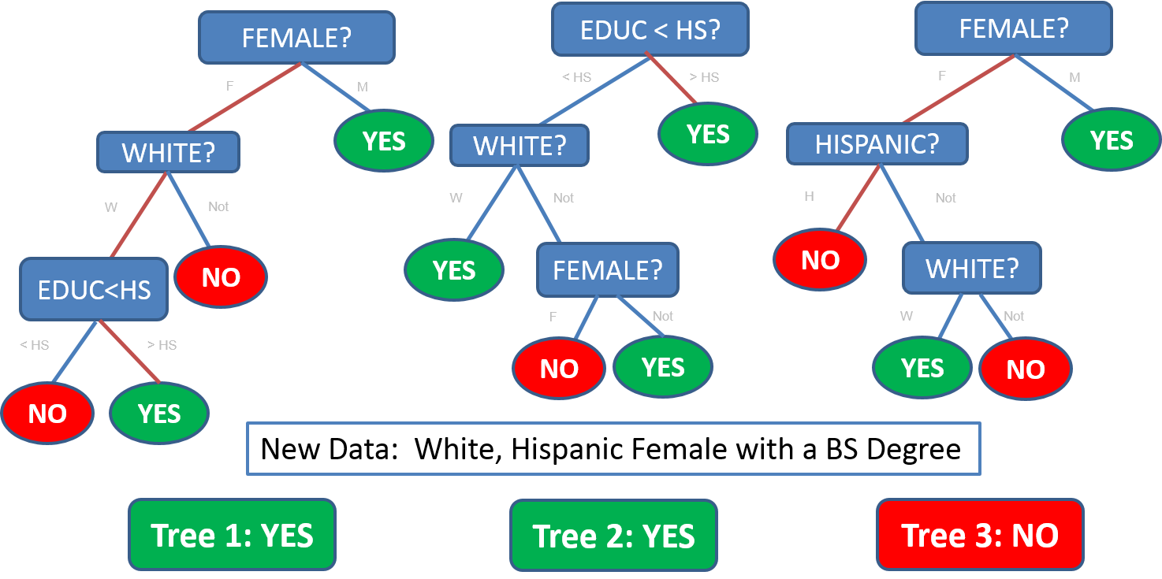
Illustration

Slide 15
Pros and Cons of Random Forests
Pros
Can handle predictors that are continuous, categorical, skewed and sparse data as well as missing data
Aptly suited for the “large p, small n” scenario
Very effective for estimating outcomes that are a complex functions of predictors with many interactions or possibly non-linear functions of the parameters
Cons
Random Forests can be extremely computationally intensive
Unlike Trees, Random Forests are not easily visualized

Slide 16
Random Forests using Scikit-Learn in Python
#Import Library
from sklearn.ensemble import RandomForestClassifier
# Create SVM classification object
model = RandomForestClassifier(n_estimators=10, criterion='gini’)
# Train the model using the training sets
model.fit(X, y)
#Predict Output
predicted= model.predict(x_test)

Slide 17
Case study: 1994 census dataset
This data was extracted from the 1994 Census bureau database by Ronny Kohavi and Barry Becker (Data Mining and Visualization, Silicon Graphics)
A set of reasonably clean records was extracted using the following conditions: ((AAGE>16) && (AGI>100) && (AFNLWGT>1) && (HRSWK>0))
The prediction task is to determine whether a person makes over $50K a year

Slide 18
Support Vector Machines (SVMs)

Slide 19
The goal of SVM is to find an hyperplane that separates two classes
A separating hyperplane

Slide 20
There are many hyperplanes separating the two classes
A separating hyperplane

Slide 21
SVM’s goal is to maximize the Margin
The Margin is twice the distance “d” between the separating hyperplane and the closest sample
This is robust to outliers and hence, strong generalization ability
Support vectors
Support vectors are the samples closest to the separating hyperplane
Margin
d
d
d

Slide 22
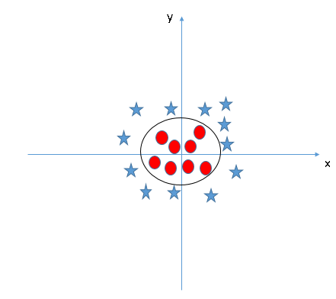
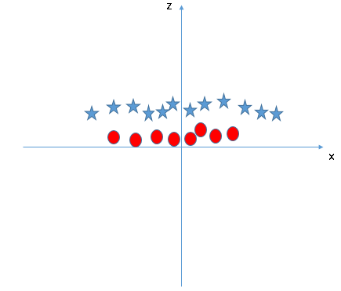
What if the points are not linearly separable?
Key idea: map the points to a space of sufficiently high dimension so that they will be separable by a hyperplane: SVM has Kernel functions which take low dimensional input space and transforms it to a higher dimensional space

Slide 23
Higher dimensional spaces introduce additional problems
A strong kernel ,which lifts the data to a great number of dimensions, sometimes may lead us to the severe problem of overfitting:
Low margin → poor classification performance
Large number of support vectors→ Slows down the computation

Slide 24
Overfitting can be partially solved by introducing soft margins
Soft margins allows for some error in classification
Introduction of parameter C for controlling the error term: this controls the trade off between a soft boundary and classifying the training points correctly

Slide 25
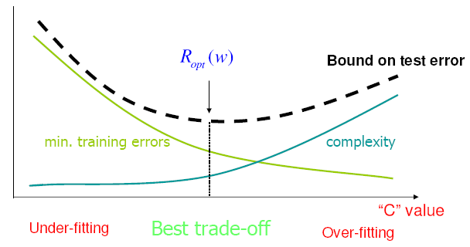
You need to consider the tradeoff between underfitting and overfitting
Under-Fitting
Over-Fitting
Too much simple!
Too much complicated!
Opt
Trade-Off

Slide 26
Pros and Cons with SVM
Pros
It works really well with clear margin of separation
It is effective in high dimensional spaces
It is effective in cases where number of dimensions is greater than the number of samples
It uses a subset of training points in the decision function (called support vectors), so it is also memory efficient
Cons
It doesn’t perform well when we have large data set because the required training time is higher
It also doesn’t perform very well when the data set has more noise i.e. target classes are overlapping

Slide 27
SVM using Scikit-Learn in Python
#Import Library
from sklearn import svm
# Create SVM classification object
model = svm.SVC(kernel='linear', c=1)
# Train the model using the training sets
model.fit(X, y)
#Predict Output
predicted= model.predict(x_test)

Slide 28
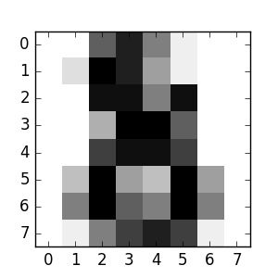
Case study: the digits dataset
This dataset is made up of 1797 8x8 images
Each image, like the one shown below, is of a hand-written digit
The goal is to recognize handwritten digits

