Slide 1
Supervised Machine Learning Random Forests
Data Science Skills Series
Márcio Mourão
http://scikit-learn.org/

Slide 2
References
http://scikit-learn.org/
http://scikit-learn.org/stable/modules/generated/sklearn.ensemble.RandomForestClassifier.html
www.cs.kent.edu/~jin/DM07/ClassificationDecisionTree.ppt

Slide 3
Decision trees

Slide 4
Create a decision tree from training data
categorical
categorical
continuous
class
Splitting Attributes
Refund
Yes
No
NO
MarSt
Single, Divorced
Married
TaxInc
NO
< 80K
> 80K
NO
YES
Training Data
Model: Decision Tree

Slide 5
Apply model to test data
Test Data
Refund
Yes
No
NO
MarSt
Single, Divorced
Married
TaxInc
NO
< 80K
> 80K
NO
YES

Slide 6
Decisions and algorithms
Determine how to split
Specify attribute test condition
Attribute type: nominal, ordinal, continuous
Splitting: 2-way split, multi-way split
Determine best split
Need a measurement of impurity: Gini Index, Entropy, Misclassification Error
There are many algorithms available
Hunt’s, CART, ID3, C4.5, SLIQ, SPRINT

Slide 7
Advantages
Inexpensive to construct
Extremely fast at classifying unknown records
Easy to interpret for small-sized trees
Easily handles mixed data
Scalable
Accuracy is comparable to other classification techniques for many simple data sets

Slide 8
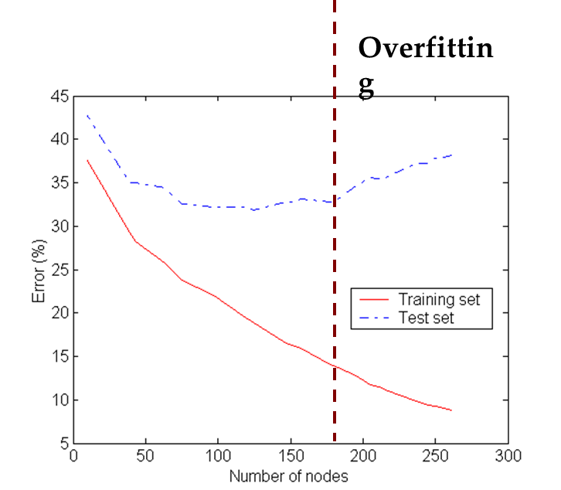
Disadvantages
Prone to produce decision trees that are more complex than necessary (overfitting)
In overfitting, trees are highly sensitive to noise in the training set
Training error no longer provides a good estimate of how well the tree will perform on previously unseen records
Overfitting

Slide 9
Random Forests

Slide 10
Random Forests
Random Forests correct decision’s tree habit of overfitting
Random Forests fall under a class of learners called “Ensemble Methods”
For what problems can you apply this method?
Regression for Continuous Outcome Variables
Classification for Categorical Outcome Variables (2 or more levels)

Slide 11
Methodology
Step 1: Establish the Forest (bagging)
Generate ntree bootstrap samples from the original data set, with replacement, and having the same size as the input data set.
Step 2: Grow Trees
For each bootstrap sample from Step 1, grow a classification or regression tree to full size (with no pruning)
At each node, randomly select predictor variables to use for splitting
Splits will be based on the BEST variable from those randomly selected for a given node

Slide 12
Methodology
Step 3: Prediction
After all trees in the forest have been grown, form a prediction for new data from each tree in the forest
Final predictions in classification problems are based on the majority
Final predictions in regression problems are means

Slide 13
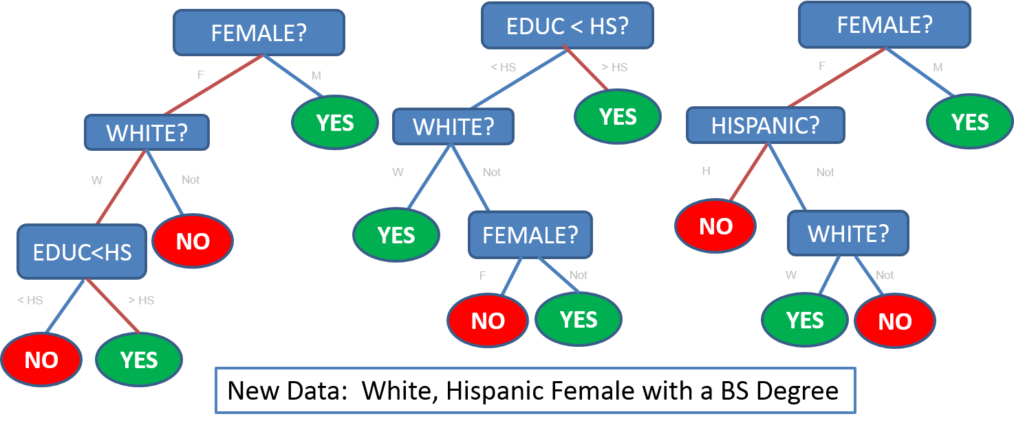
Illustration

Slide 14
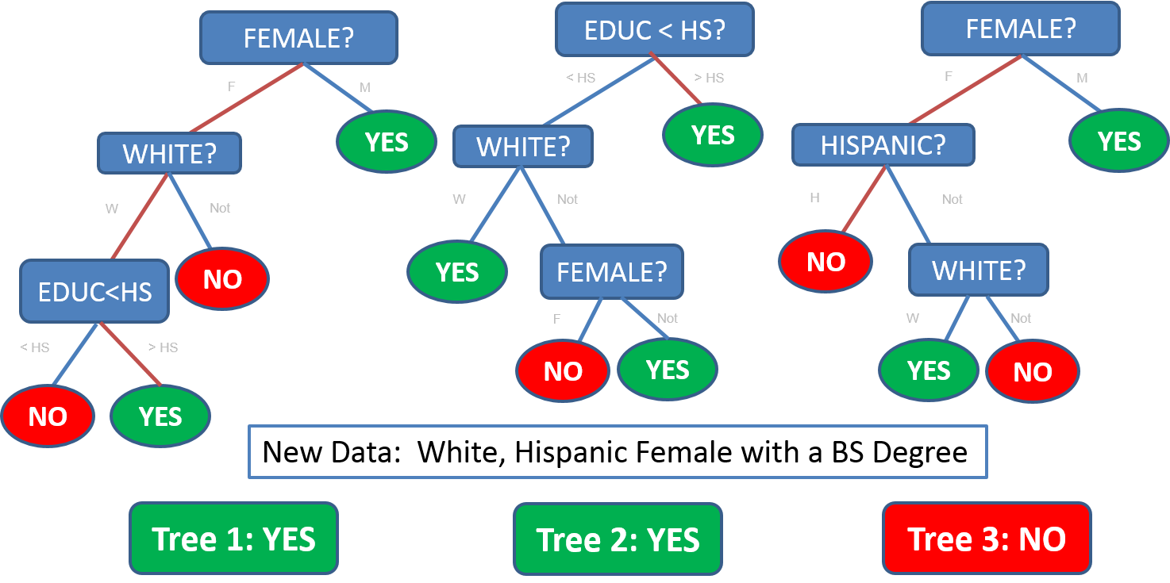
Illustration

Slide 15
Performance: Error Rates
How are error rates assessed for Random Forests?
Unlike other machine learning methods that require some type of external test sample to assess performance, Random Forests automatically generate an internally valid, and in many cases unbiased, assessment of error
Out of Bag Error Rate (OOB Error Rate)

Slide 16
Performance: Error Rates
How is the OOB Error Rate Computed?
Step 1: Each tree in the forest uses approximately 2/3 of the original data. For the remaining 1/3 of cases (called Out of Bag, OOB), use the given tree to make predictions. Call these “Out of Bag Predictions.”
Step 2: For a given case, aggregate all “Out of Bag Predictions” across the roughly ntree/3 trees for which the case was OOB.
Means for regression applications
Majority vote for classification applications

Slide 17
Performance: Error Rates
Step 3: Compare the aggregated estimate from Step 2 to the actual value of the outcome for each case in the data set
Correct/Incorrect for Classification
Residual for Regression (y_{i} – Step 2 Estimate).
The OOB Error is the:
Proportion of “incorrect” values from Step 3 (classification)
Average squared residual from Step 3 (regression)

Slide 18
Pros and Cons of Random Forests
Pros
Can handle predictors that are continuous, categorical, skewed and sparse data
Aptly suited for the “large p, small n” scenario
Very effective for estimating outcomes that are a complex functions of predictors with many interactions or possibly non-linear functions of the parameters
Cons
Random Forests can be extremely computationally intensive
Unlike Trees, Random Forests are not easily visualized

Slide 19
Random Forests using Scikit-Learn in Python
#Import Library
from sklearn.ensemble import RandomForestClassifier
#Create a RandomForest classification object
model = RandomForestClassifier(n_estimators=10, criterion='gini’)
#Train the model using the training sets
model.fit(X, y)
#Predict Output
predicted= model.predict(x_test)

