Slide 1


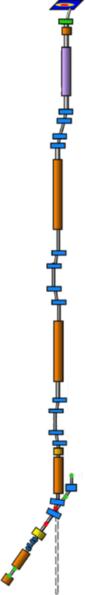
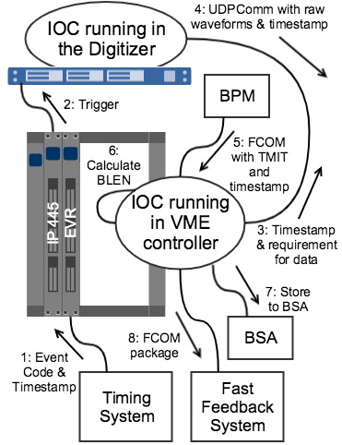
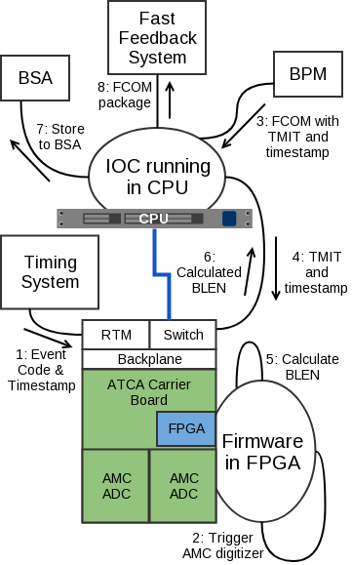
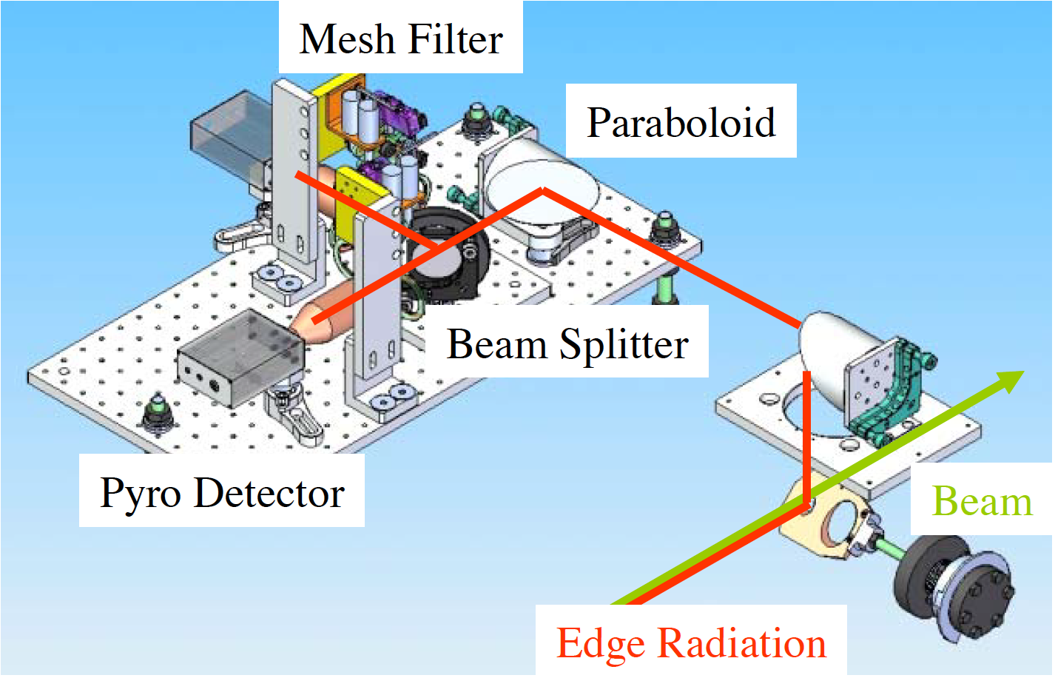
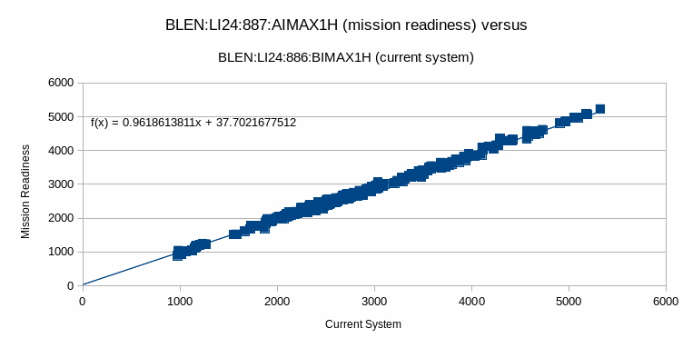
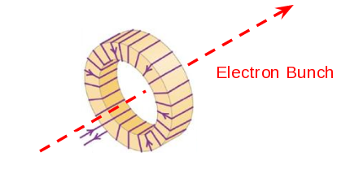
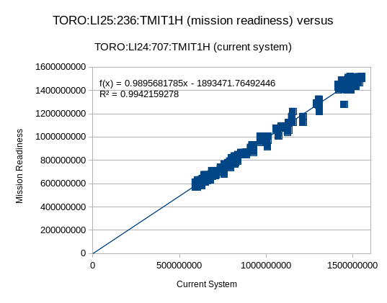
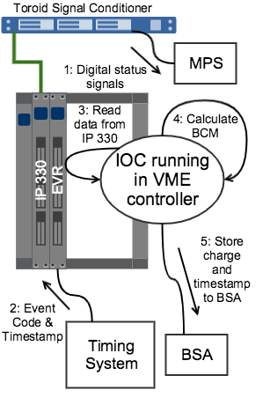
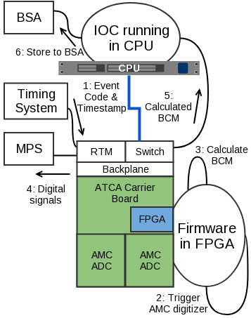
Upgrade of the Bunch
Length and Bunch Charge Control for the SLAC LCLS
M. P. Donadio, A. S. Fisher, L. Sapozhnikov, SLAC, Menlo Park, USA
XTCAV
The challenge: from 120 Hz to 1 MHz
The new SLAC Superconducting Linac will operate with 1 million electron bunches per second, compared to the 120 bunches per second of the 2009 Copper Linac. Software running in VME was able to deal with 120 Hz, but a new architecture was needed to operate at 1 MHz: ATCA-based with FPGA in the carrier boards. Two components were used to test the new architecture in the Copper Linac, still at 120 Hz: the Bunch Length (BLEN) monitors based on pyroelectric detectors and the Bunch Charge Monitors (BCM) based on toroids. This upgrade is part of the Mission Readiness Program.
Undulators
Previous VME-based system
New ATCA-based system
The pyroelectric detector signal is input in a Pizza Box digitizer
Upgrade from the VME-based architecture to an ATCA-based one
The pyroelectric detector signal is input in an AMC card in the ATCA
2 BCM
BLEN
Bunch
Compressor
2
2 BCM
Edge radiation from the last dipole of the BC is measured by pyroelectric detectors
Successful results: correlation 1 between the VME-based calculation and the ATCA-based calculation for BLEN and BCM
BLEN
The electron beam inducts a current in the toroid
Bunch
Compressor
1
2 BCM
The toroid current is input in a Signal Conditioner connected to an IP330
The toroid current is input in a Signal Conditioner connected to an ATCA AMC card
Injector
Upgrade from the VME-based architecture to an ATCA-based one
2 BCM
Previous VME-based system
New ATCA-based system

