Slide 1
V
VERDIS · v0.9
Agri-AI · Final-year project
FINAL-YEAR COMPUTER VISION PROJECT · 2026
Smartphone-Based Crop Disease Detection and Decision Support
A computer vision case study in real-world domain adaptation
REAL-WORLD ACCURACY
DISEASE CLASSES
TRAINING IMAGES
ARCHITECTURE
75.40%
27
41,039
ResNet50
PlantDoc test · with TTA
14 plant species
PlantVillage + PlantDoc
vs EfficientNet-B0
VERDIS · Crop Disease Detection
01 / 13

Slide 2
01 · THE PROBLEM
Crop disease costs the world a fifth of every harvest.
20–40% of annual crop yields are lost to pests and disease (FAO). Plant pathologists who can diagnose disease from a leaf are concentrated in research labs, not on small farms. Smartphones, however, are everywhere. This is a computer-vision problem: the diagnostic signal is visual (lesions, discoloration, spots, mosaics, wilting).
GLOBAL IMPACT
20–40%
crop yield lost to disease each year
AGRICULTURAL REALITY
< 1 expert
per 10,000 farmers in many regions
TECHNOLOGY REACH
6.8 billion
smartphone users worldwide
VERDIS · Crop Disease Detection
02 / 13

Slide 3
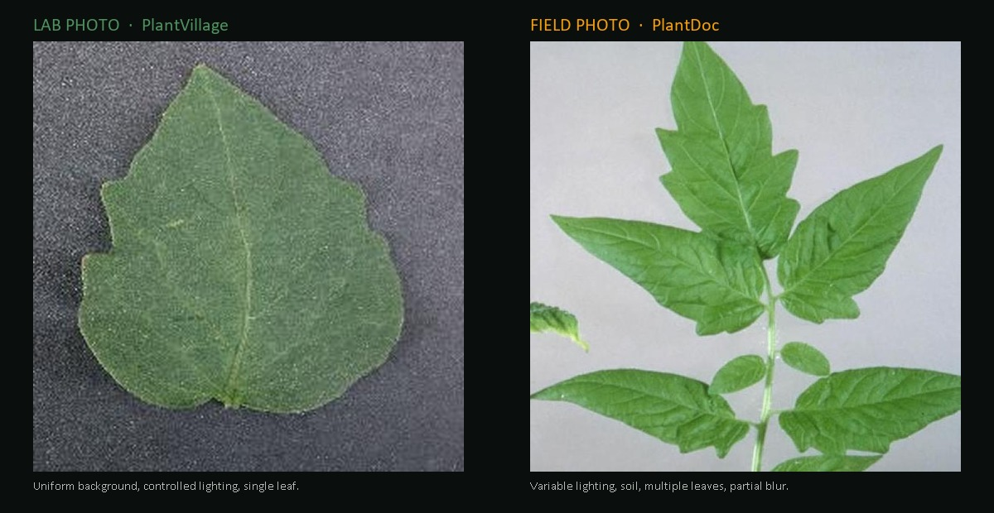
02 · THE CV CHALLENGE
A model that wins the benchmark can still fail in the field.
DOMAIN SHIFT
~100% on PlantVillage validation → ~30% on real PlantDoc field photographs. Bridging this gap is the entire project.
VERDIS · Crop Disease Detection
03 / 13

Slide 4
03 · DATASETS
Two datasets — one easy benchmark, one honest test.
BENCHMARK
REAL-WORLD
PlantVillage
PlantDoc
Mohanty et al., Penn State (2016)
Singh et al., IIT-Hyderabad (2020)
◆ 54,000+ leaf images, lab conditions
◆ Uniform background, perfect lighting
◆ Trivial benchmark — used for pretraining
◆ 2,500+ photos taken in actual fields
◆ Variable lighting, dirt, blur, occlusion
◆ Our honest evaluation set
After alignment to 27 shared classes: 30,747 PV train 7,372 PV val 2,668 PD train 252 PD test · 41,039 images total
VERDIS · Crop Disease Detection
04 / 13

Slide 5
04 · ARCHITECTURE & CONTROLLED EXPERIMENT
ResNet50 vs EfficientNet-B0, on identical conditions.
Same dataset (PV+PD, no augmented). Same loss, augmentation, schedule. Only the architecture differs.
WINNER
BASELINE
ResNet50
EfficientNet-B0
25.6M parameters · skip connections
5.3M parameters · compound scaling
58.33%
57.14%
PlantDoc real-world test accuracy
PlantDoc real-world test accuracy (with TTA)
1.19-point gap = ~3 images out of 252. Within noise. Architecture matters less than expected — the limiting factor is data, not network design.
VERDIS · Crop Disease Detection
05 / 13

Slide 6
05 · DATA AUGMENTATION
Teach the disease — not the photo.
Eight randomized transforms applied to every training image, every epoch — forcing invariance to nuisance variation.
TRANSFORM
PARAMETERS
WHAT IT BUYS US
RandomResizedCrop
scale 0.6–1.0
Scale / zoom invariance
RandomHorizontalFlip
p=0.5
Mirror symmetry
RandomRotation
±30°
Camera-tilt invariance
RandomPerspective
distortion 0.3 · p=0.4
3D viewing-angle invariance
ColorJitter
b/c/s 0.3 · hue 0.08
Lighting / white-balance invariance
RandomGrayscale
p=0.05
Avoid over-reliance on color
GaussianBlur
kernel 3 · σ 0.1–2.0
Motion / focus blur invariance
VERDIS · Crop Disease Detection
06 / 13

Slide 7
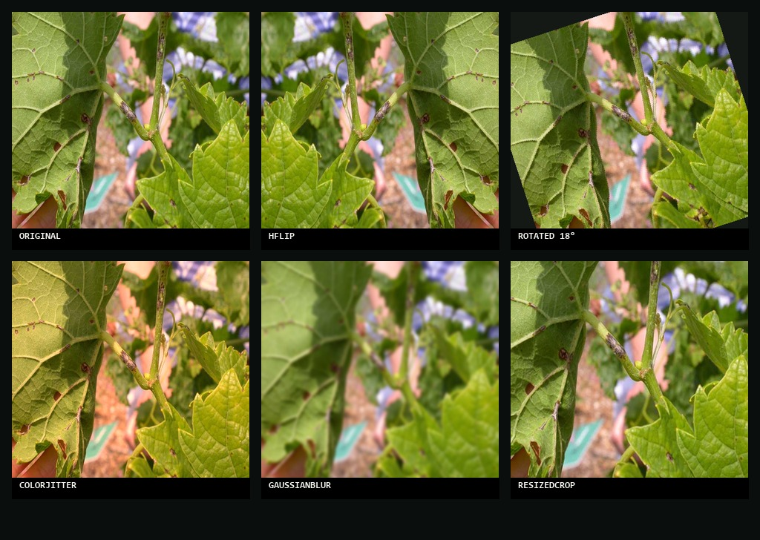
05B · AUGMENTATION, VISUALIZED
One leaf becomes six. Six become hundreds.
WHAT THIS BUYS US
Each training step sees a new variant. The model never memorizes a specific photograph — it learns the disease. Effective dataset size grows from 41k to effectively unlimited. Cost: zero new images. Benefit: real robustness.
VERDIS · Crop Disease Detection
07 / 13

Slide 8
06 · FOUR TECHNIQUES THAT STACKED
Loss, regularization, schedule, inference.
FOCAL LOSS
FL(p) = −(1−p)ᵞ · log(p). Down-weights examples the model already gets right; redirects gradient mass to hard, rare classes (Corn Gray Leaf Spot, Potato blights).
γ = 2.0
CUTMIX
Cut a patch from image A, paste onto image B; mix labels by patch area. Forces the model to use the whole leaf, not just the most salient lesion. Strong regularizer.
α = 0.3
TWO-PHASE FINE-TUNING
Phase 1: train head only (frozen backbone) so random initial gradients don't destroy ImageNet features. Phase 2: unfreeze + LR×0.1. Final lr = 1e-6 with cosine annealing.
freeze 10 epochs → unfreeze 20
TEST-TIME AUGMENTATION
At inference: predict on 8 augmented copies of the image, average the softmax outputs. Free 1-3% gain at 8× inference cost. Our gain: +2 points (73.41% → 75.40%).
8 views averaged
VERDIS · Crop Disease Detection
08 / 13

Slide 9
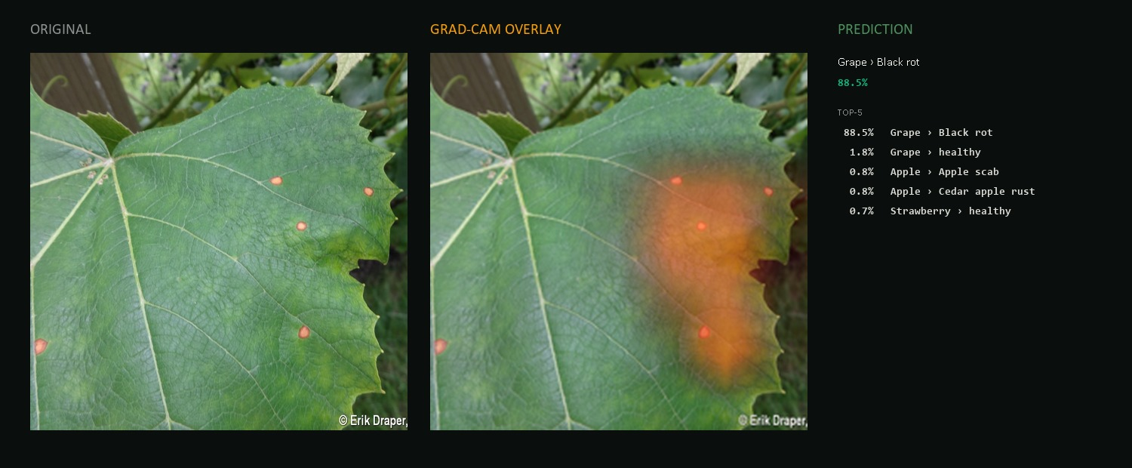
07 · EXPLAINABILITY · GRAD-CAM
A CNN that can't explain itself shouldn't make decisions.
TRUST CHECK · THE HEATMAP FOCUSES ON THE LESION
Grad-CAM weights the activations of the final convolutional block by their gradients with respect to the predicted class. Bright = pixels that drove the prediction. Heatmap on lesions = trustworthy. Heatmap on background = warning.
VERDIS · Crop Disease Detection
09 / 13

Slide 10
08 · FINAL RESULTS
ResNet50 · joint_all · with TTA · PlantDoc test (252 images).
ACCURACY
F1 (MACRO)
PRECISION
RECALL
75.40%
0.746
77.91%
75.58%
+ Test-time augmentation
Across all 27 classes
Macro-averaged
Macro-averaged
+45 POINTS FROM PV-ONLY BASELINE TO FINAL
Stage-by-stage progression on the PlantDoc test set
PV-only baseline
PlantVillage only
~30%
joint
PV + PD
58.33%
joint_all
PV + PD + augmented PD
73.41%
joint_all + TTA
8-view test-time aug
75.40%
VERDIS · Crop Disease Detection
10 / 13

Slide 11
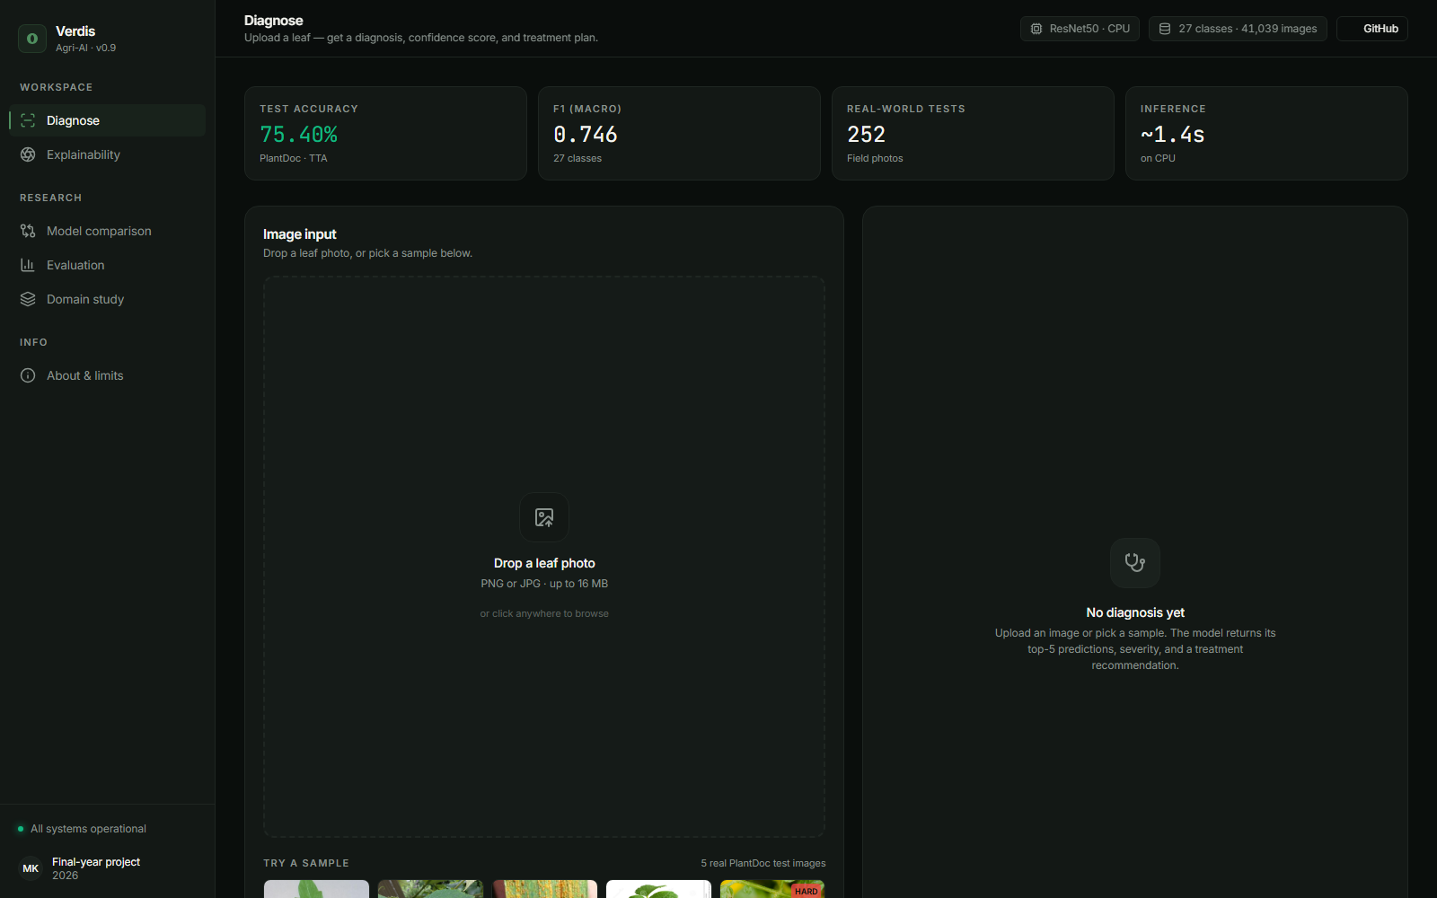
09 · THE WORKING SYSTEM
A classifier is not a product. This is.
WHAT VERDIS DOES
Diagnose Drop a leaf · top-5 + confidence. Treat Severity + treatment plan. Explain Live Grad-CAM overlay. Compare ResNet50 vs EfficientNet. Evaluate Confusion matrix + per-class F1.
VERDIS · Crop Disease Detection
11 / 13

Slide 12
10 · THE NON-OBVIOUS LESSONS
Four things we did not expect to be true.
01
Architecture barely matters.
ResNet50 vs EfficientNet-B0 on identical conditions: 58.33% vs 57.14%. Three images on 252.
02
Data beats every algorithmic trick.
Augmented PlantDoc alone moved test accuracy from 58% to 73%. Larger than every loss-function tweak combined.
03
TTA is free, almost no one uses it.
+2 percentage points with zero retraining. Eight-times inference cost is still 1.4 sec on CPU.
04
A 75% classifier is not a product.
Calibrated confidence + top-5 + Grad-CAM turn raw predictions into something a non-expert can trust.
VERDIS · Crop Disease Detection
12 / 13

Slide 13
11 · CONCLUSIONS & FUTURE WORK
What we learned, what we shipped, what comes next.
01
02
03
Domain shift is the problem.
Data > clever tricks.
A classifier isn't a product.
Beating PlantVillage is easy. Beating PlantDoc forced every architectural and training decision in this project. Lab → field is the real research direction.
Augmented PlantDoc alone gave +15 points. Focal Loss, CutMix and the freeze schedule added smaller but real gains on top.
Calibrated confidence + top-5 + Grad-CAM turn raw predictions into decision support a non-expert can actually trust.
FUTURE WORK
More field data across regions · EfficientNet-B4 / ViT-B/16 to break the 75% ceiling · Open-set rejection so the model can say "I don't know" · Mobile deployment via ONNX → Android.
VERDIS · Crop Disease Detection
13 / 13

