Slide 1
V
VERDIS · v0.9
Agri-AI · Final-year project
FINAL-YEAR COMPUTER VISION PROJECT · 2026
Smartphone-Based Crop Disease Detection and Decision Support
A computer vision case study in real-world domain adaptation
REAL-WORLD ACCURACY
DISEASE CLASSES
TRAINING IMAGES
ARCHITECTURE
75.40%
27
41,039
ResNet50
PlantDoc test · with TTA
14 plant species
PlantVillage + PlantDoc
vs EfficientNet-B0
VERDIS · Crop Disease Detection
01 / 23

Slide 2
01 · THE PROBLEM
Crop disease costs the world a fifth of every harvest.
20–40% of annual crop yields are lost to pests and disease (FAO). Early detection is everything — but the people who can diagnose disease from a leaf (plant pathologists) are concentrated in research labs, not on small farms. Smartphones, however, are everywhere. A farmer in any country can take a photo. The question is whether a model can do what an expert does — identify the disease from a single image. This is fundamentally a computer-vision problem: the diagnostic signal is visual (lesions, discoloration, spots, mosaics, wilting).
GLOBAL IMPACT
20–40%
crop yield lost to disease each year
AGRICULTURAL REALITY
< 1 expert
per 10,000 farmers in many regions
TECHNOLOGY REACH
6.8 billion
smartphone users worldwide
VERDIS · Crop Disease Detection
02 / 23

Slide 3
02 · THE CV CHALLENGE
A model that wins the benchmark can still fail in the field.
ON THE LAB BENCHMARK
ON REAL FIELD PHOTOS
~100%
~30%
Accuracy on PlantVillage validation
Same model on PlantDoc test images
Clean lab photos with controlled background and lighting.
Variable lighting, dirt, occlusion, multiple leaves per frame.
THE GAP
Domain shift. The training distribution is not the deployment distribution. Bridging this gap — making the model robust to messy real-world inputs — is the entire project.
VERDIS · Crop Disease Detection
03 / 23

Slide 4
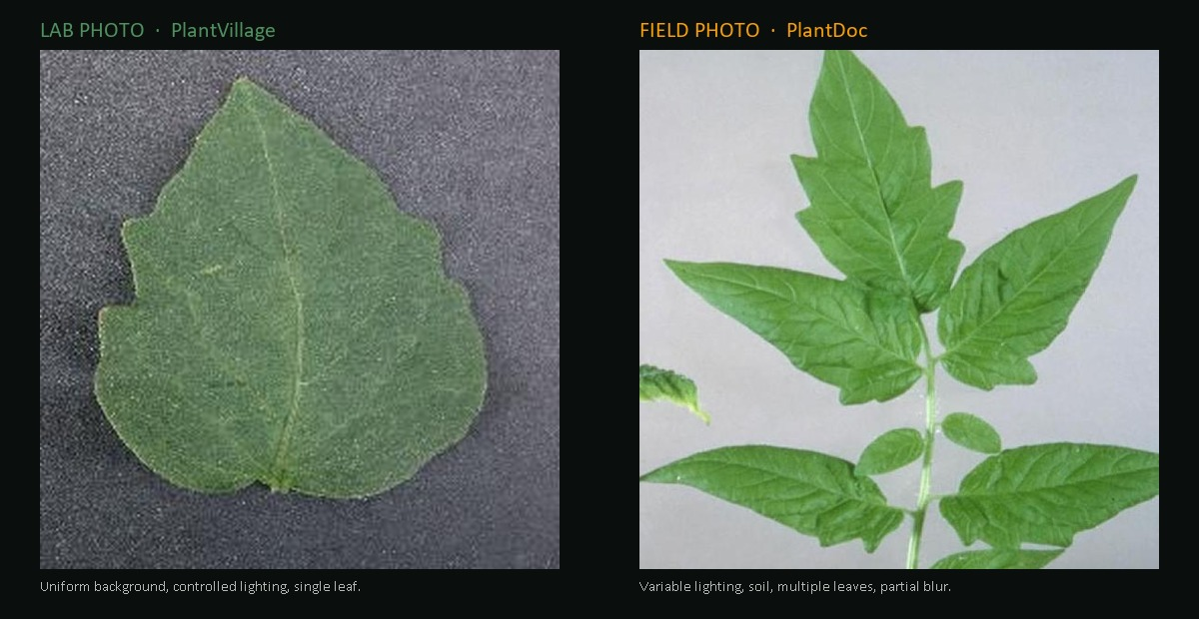
02B · DOMAIN SHIFT, VISUALIZED
Same disease label. Two completely different worlds.
THE TECHNICAL PROBLEM
Domain shift — a CNN that masters the left distribution can score near-zero on the right one. Everything in the next 15 slides is about bridging this gap.
VERDIS · Crop Disease Detection
04 / 23

Slide 5
03 · DATASETS
Two datasets — one easy benchmark, one honest test.
BENCHMARK
REAL-WORLD
PlantVillage
PlantDoc
Mohanty et al., Penn State (2016)
Singh et al., IIT-Hyderabad (2020)
◆ 54,000+ leaf images, lab conditions
◆ Single leaf, uniform background, perfect lighting
◆ Used in countless papers as a benchmark — but trivially easy
◆ Excellent source of pretraining signal
◆ 2,500+ photos taken in actual fields
◆ Variable lighting, dirt, multiple leaves, blur, occlusion
◆ Small per-class sample counts (4–250 images each)
◆ The honest evaluation set for real-world deployment
After alignment to 27 shared classes: 30,747 PV train 7,372 PV val 2,668 PD train 252 PD test · 41,039 images total
VERDIS · Crop Disease Detection
05 / 23

Slide 6
04 · TRANSFER LEARNING
Why we don't train from scratch.
01
02
03
ImageNet pretraining
Replace the head
Fine-tune
ResNet50 has already been trained on 1.2M everyday images across 1,000 classes. Its early layers know what edges, textures, and shapes look like — knowledge that transfers to leaves.
The final 1,000-class layer is removed and replaced with a fresh 27-class layer initialized randomly. Now the model can map its general visual features onto our specific disease taxonomy.
Train on PlantVillage + PlantDoc with a small learning rate. The backbone refines its features for plant disease, the head learns the new mapping. Far less data needed than training from zero.
THE ALTERNATIVE
Training a CNN from scratch on 41k images alone would either overfit badly or fail to converge. Transfer learning is the only practical option at this scale.
VERDIS · Crop Disease Detection
06 / 23

Slide 7
05 · ARCHITECTURE CHOICE
Two very different CNNs — which fits this problem better?
A
B
ResNet50
EfficientNet-B0
He et al. — Microsoft (2015)
Tan & Le — Google (2019)
KEY IDEA
KEY IDEA
Residual / skip connections that solve the vanishing-gradient problem in deep nets — every block learns a residual on top of an identity mapping.
Compound scaling: balance depth, width and resolution together using a single scaling coefficient. Built on MBConv blocks with squeeze-and-excitation attention.
SPECS
SPECS
◆ 25.6 million parameters · 50 layers
◆ Deep, hierarchical feature extractor
◆ Widely used as a strong baseline
◆ 5.3 million parameters — 5× smaller
◆ Designed for accuracy / FLOPS efficiency
◆ Strong on ImageNet at much lower cost
VERDIS · Crop Disease Detection
07 / 23

Slide 8
06 · CONTROLLED EXPERIMENT
Train both on identical conditions. Let the data decide.
Held constant across both runs:
◆ Dataset: PV + PD (no augmented) · Loss: Focal γ=2 + class weights · Augmentation: strong train · CutMix α=0.3 · Schedule: 30 ep · cosine LR · patience 5
WINNER
BASELINE
ResNet50
EfficientNet-B0
58.33%
57.14%
PlantDoc real-world test accuracy
PlantDoc real-world test accuracy (with TTA)
HONEST TAKEAWAY
ResNet50 wins by ~1.2 points. On 252 test samples, that is roughly 3 images — within noise. Architecture matters less than expected at this scale; the limiting factor is the amount and diversity of real-world training data, not the network design.
VERDIS · Crop Disease Detection
08 / 23

Slide 9
07 · THE PIVOT
Focus on ResNet50. Push it as far as it goes.
Five additions, applied one at a time, each justified by a specific CV concept.
01
Augmented PlantDoc
Bring in the additional 21k variants → joint_all.
02
Stronger augmentation
Train with realistic transforms (crop, blur, perspective, jitter).
03
Focal Loss
Down-weight easy examples so training focuses on hard classes.
04
CutMix
Patch-level regularization to prevent overfitting on small data.
05
Two-phase fine-tuning + TTA
Freeze→unfreeze schedule; 8-view averaging at inference.
VERDIS · Crop Disease Detection
09 / 23

Slide 10
08 · DATA AUGMENTATION
Teach the disease — not the photo.
Augmentation creates synthetic training examples by transforming originals — forcing invariance to nuisance factors that have nothing to do with the actual disease.
TRANSFORM
PARAMETERS
WHAT IT BUYS US
RandomResizedCrop
scale 0.6–1.0
Scale and zoom invariance — leaf can fill any part of frame
RandomHorizontalFlip
p=0.5
Mirror symmetry — left/right doesn't encode disease
RandomVerticalFlip
p=0.2
Some upside-down field photos exist; rare but real
RandomRotation
±30°
Camera-tilt invariance — phones are held at any angle
RandomPerspective
distortion 0.3 · p=0.4
3D viewing-angle invariance — leaf at oblique angle
ColorJitter
b/c/s 0.3 · hue 0.08
Lighting and white-balance invariance
RandomGrayscale
p=0.05
Avoid over-reliance on color — texture also carries signal
GaussianBlur
kernel 3 · σ 0.1–2.0
Motion-blur and out-of-focus invariance
VERDIS · Crop Disease Detection
10 / 23

Slide 11
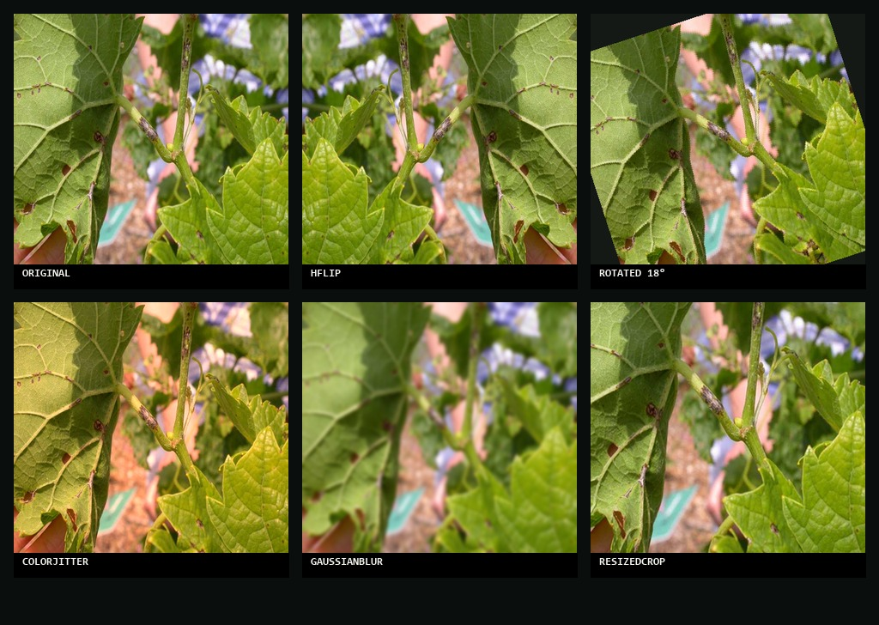
08B · AUGMENTATION, VISUALIZED
One leaf becomes six. Six become hundreds.
WHAT THIS BUYS US
Each training step sees a new variant. The model never memorizes a specific photograph — it learns the disease. Effective dataset size grows from 41k to effectively unlimited. Cost: zero new images. Benefit: real robustness.
VERDIS · Crop Disease Detection
11 / 23

Slide 12
09 · AUGMENTED PLANTDOC
The single biggest accuracy jump came from more data, not better code.
EFFECT OF ADDING AUGMENTED PD
THE CV LESSON
joint → joint_all
Data quality dominates.
The augmented PlantDoc set is roughly 21,000 synthetically-varied copies of the real PD images — each original passed through random crops, rotations, color shifts and blurs. It exposes the model to thousands of plausible "what the phone camera might see" variations of every leaf, especially the rare classes. No clever loss function or learning-rate trick produced gains of this size. The signal was already in the data we hadn't fully used.
58.33%
→
73.41%
PD test accuracy on real-world images
+15 percentage points
From a single change: adding more diverse training data.
VERDIS · Crop Disease Detection
12 / 23

Slide 13
10 · CLASS IMBALANCE & FOCAL LOSS
Make the loss focus on what the model gets wrong.
THE PROBLEM
FOCAL LOSS FORMULA
Heavy class imbalance
Lin et al. — RetinaNet (2017)
Some classes (Tomato Yellow Curl, Tomato Healthy) have over 250 training images. Others (Corn Gray Leaf Spot) have fewer than 30. Cross-entropy treats every error equally → a model can reach high overall accuracy by being correct on the easy, well-represented classes and silently failing on rare ones. Two interventions: 1. Class weights — inverse frequency, applied inside the loss. 2. Focal Loss — see right.
FL(p) = −(1−p)ᵞ · log(p)
When the model is already confident (p close to 1), (1−p)ᵞ → 0 and the loss vanishes — the model stops wasting capacity on easy examples. When the model is uncertain (p close to 0.2–0.5), (1−p)ᵞ stays large and the example dominates the gradient. We used γ = 2.0. Higher γ → more aggressive focus on hard cases.
VERDIS · Crop Disease Detection
13 / 23

Slide 14
11 · CUTMIX REGULARIZATION
Cut a patch from one leaf, paste it onto another.
Mix the labels accordingly. Force the model to look at the whole leaf.
Yun et al. — Naver / Korea Univ. (2019) How it works: • Pick two training images A and B. • Cut a random rectangular patch from B and paste it over A. • Mix the target labels in proportion to the patch area: target = λ · yₐ + (1 − λ) · yᵦ Why this helps: • Prevents over-reliance on any single salient region — the model has to integrate evidence from the whole leaf. • Acts as a strong regularizer against overfitting — particularly useful with our small PlantDoc training set. • Encourages localizable, calibrated predictions. Hyperparameter: α = 0.3 (probability of CutMix per batch).
RELATED TECHNIQUE
CutMix vs MixUp
MixUp (Zhang et al., 2018) blends the two images pixel-by-pixel: λ · A + (1−λ) · B CutMix preserves local pixel structure — patches stay sharp. On natural images, CutMix usually beats MixUp because lesions retain their texture instead of being faded out by blending.
VERDIS · Crop Disease Detection
14 / 23

Slide 15
12 · TWO-PHASE FINE-TUNING
Don't destroy what ImageNet already learned.
PHASE 1
PHASE 2
Train the head only
Unfreeze and refine
Epochs 1 – 10 · backbone frozen
Epochs 11 – 30 · full network · LR × 0.1
The new classification head starts with random weights. If we let those large initial gradients propagate back through the full network, they would destroy the carefully-learned ImageNet features in seconds. So we freeze every parameter except the head. Only the 27-class output layer is trained, until it learns to read the (still frozen) backbone's features.
Now the head is calibrated. We unfreeze everything and drop the learning rate by 10× (final lr=1e-6, cosine schedule). Tiny, careful updates to the entire network — the backbone slowly drifts from "ImageNet objects" toward "plant disease features", without forgetting what it knew.
VERDIS · Crop Disease Detection
15 / 23

Slide 16
13 · TEST-TIME AUGMENTATION (TTA)
Predict on eight views of the same image. Average the answers.
TTA is augmentation applied at inference time instead of training time. For one test image we produce 8 transformed versions — horizontal flip, vertical flip, slight rotation, scale crops — then run the model on each. The 8 softmax outputs are averaged. Why it works: A single forward pass is one noisy measurement of the model's belief. Eight independent measurements over plausible variations of the same image average out the noise. It is a free 1–3% gain — no retraining, no extra data, just more inference compute. In our case: 73.41% → 75.40% (+2 points).
THE PROCESS
1. Input image
2. Apply 8 augmentations
3. Run model on each view
4. Average the softmax outputs
5. Return top-5 predictions
COST
8× inference time
Still under 2 seconds per image on a CPU. Acceptable for non-real-time use.
VERDIS · Crop Disease Detection
16 / 23

Slide 17
14 · EXPLAINABILITY · GRAD-CAM
A CNN that can't explain its prediction shouldn't make decisions.
Selvaraju et al. — Georgia Tech / FAIR (2017) How Grad-CAM works: 1. Forward-pass the image and pick the predicted class y. 2. Compute the gradient of y with respect to the feature maps Aᵏ of the final convolutional layer. 3. Average the gradients spatially to get a channel weight αᵏ for each feature map. 4. Sum αᵏ · Aᵏ across channels and apply ReLU → a coarse heatmap in feature-map resolution. 5. Upsample to image resolution and overlay. The bright regions are the pixels whose presence most increased the score of the predicted class. Why it matters: a model that calls "apple scab" should be looking at the dark scab lesions — not the soil in the background. The heatmap is our trust check.
HEATMAP READING GUIDE
cold
hot
irrelevant region → most influential region
Good sign: Heatmap focuses on lesions, spots, or curled regions — the disease symptoms themselves. Warning sign: Heatmap focuses on background, soil, or healthy leaf edges — the model may be learning a spurious shortcut.
VERDIS · Crop Disease Detection
17 / 23

Slide 18
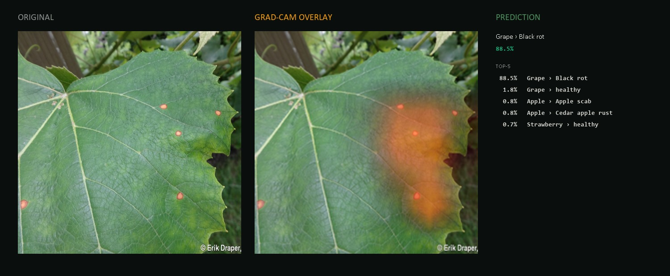
14B · GRAD-CAM, ON A REAL PREDICTION
The model focuses where the disease is.
TRUST CHECK
Test image: real grape leaf with Black Rot lesions. Model prediction: Grape Black Rot 88.5% (correct). Heatmap concentrates exactly on the visible lesions — not the soil, not the leaf edge, not the wood frame in the background. The model is looking at the right thing.
VERDIS · Crop Disease Detection
18 / 23

Slide 19
15 · FINAL RESULTS
ResNet50 · joint_all · with TTA · PlantDoc test set (252 real images).
ACCURACY
F1 (MACRO)
PRECISION
RECALL
75.40%
0.746
77.91%
75.58%
+ Test-time augmentation
Across all 27 classes
Macro-averaged
Macro-averaged
STRONG CLASSES (F1 ≥ 0.85)
WEAK CLASSES (F1 < 0.50)
11 of 27 classes
4 of 27 classes
◆ Five classes at perfect 1.00 F1
◆ (Grape healthy/black-rot, Blueberry, Pepper bell, Strawberry)
◆ Both Tomato Yellow Curl and Pepper Bacterial Spot ≥ 0.88
◆ Healthy classes near-perfect — strong "no disease" signal
◆ Corn Gray Leaf Spot · 0.14 (only 4 test samples)
◆ Potato Early Blight · 0.20
◆ Potato Late Blight · 0.35
◆ Visually similar diseases confound the classifier
VERDIS · Crop Disease Detection
19 / 23

Slide 20
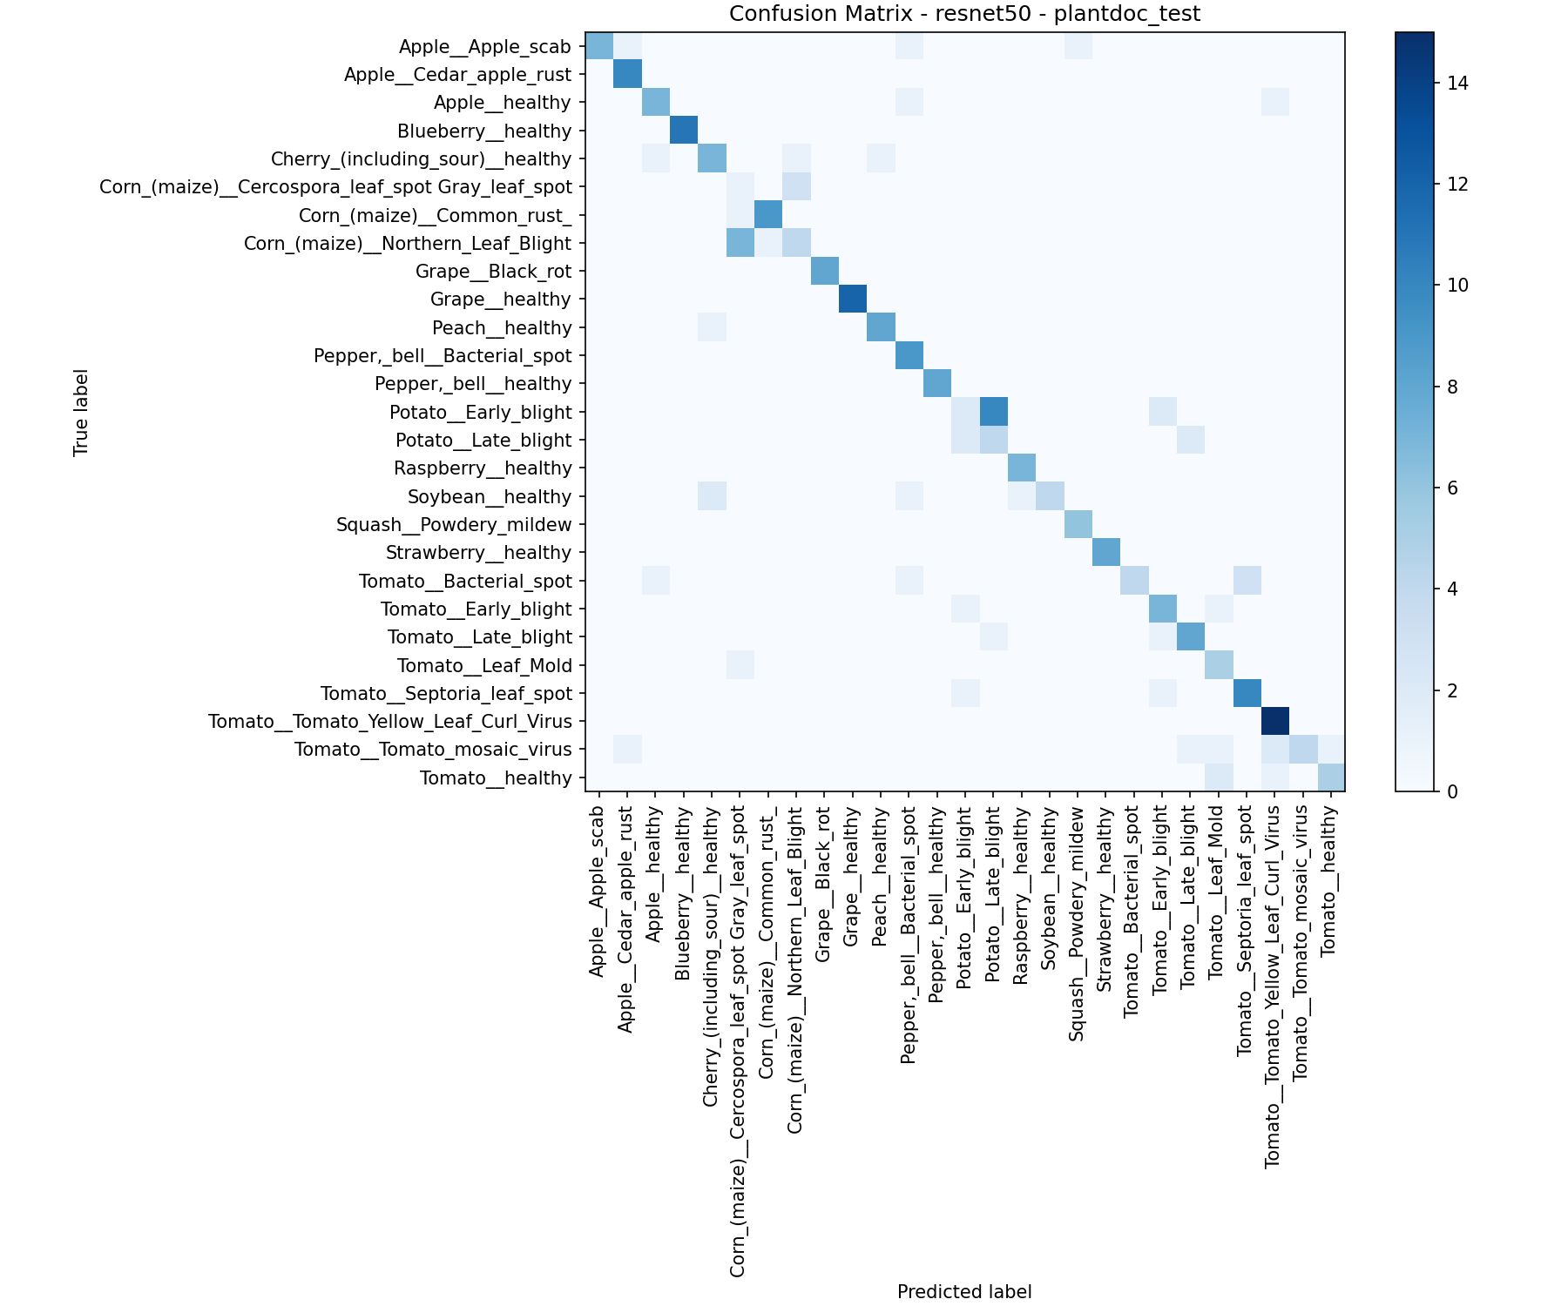
16 · EVALUATION
Where the errors fall reveals what the model actually understands.
Confusion matrix Rows = true class · columns = predicted class. Bright diagonal = correct. What we see: • A strong diagonal — most predictions land on the correct class. • Off-diagonal mass is clustered, not random — the model confuses related diseases (Potato Early ↔ Late Blight, Corn Gray ↔ Common Rust). • Healthy classes rarely mis-predict as diseased — high "true negative" reliability. Why this is encouraging: A human pathologist would likely make the same mistakes on a 2-second glance at a phone photo. The failures are systematic, not random — which means the model has learned something real about disease appearance, and the residual errors map onto genuinely ambiguous visual signatures.
VERDIS · Crop Disease Detection
20 / 23

Slide 21
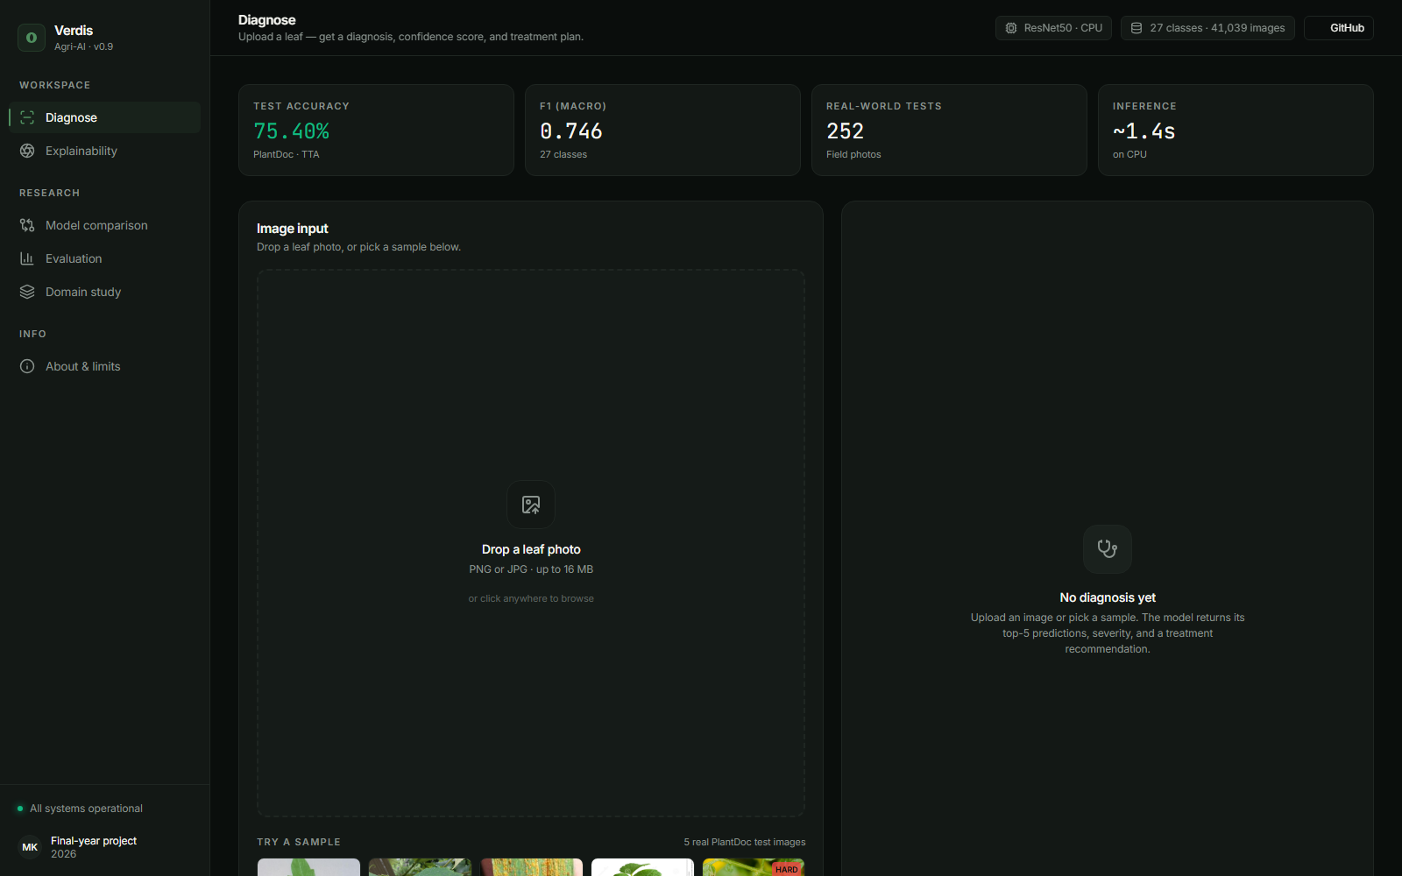
16B · THE WORKING SYSTEM
A classifier is not a product. This is.
WHAT VERDIS DOES
Diagnose Drop a leaf · top-5 + confidence. Treat Severity + treatment plan. Explain Live Grad-CAM overlay. Compare ResNet50 vs EfficientNet. Evaluate Confusion matrix + per-class F1.
VERDIS · Crop Disease Detection
21 / 23

Slide 22
17 · THE NON-OBVIOUS LESSONS
Five things we did not expect to be true.
01
Architecture barely matters.
ResNet50 vs EfficientNet-B0 on identical conditions: 58.33% vs 57.14%. The two models are within three test images of each other. The hours we spent comparing them produced almost no actionable signal.
02
Data beats every algorithmic trick.
Adding the augmented PlantDoc dataset moved test accuracy from 58% to 73% — a single change that outweighed every loss-function tweak, regularizer, and schedule decision combined.
03
TTA is free, and almost no one uses it.
Eight augmented views averaged at inference time produced +2 percentage points on top of the best trained model. Zero retraining. Eight times slower inference is still 1.4 seconds on a CPU.
04
The errors are systematic — and that is a good sign.
The model confuses Potato Early Blight with Potato Late Blight, and Corn Gray Leaf Spot with Common Rust. So would a human pathologist with a 2-second glance. Random errors would worry us; these don't.
05
A 75% accuracy is not the product.
Calibrated confidence + top-5 + Grad-CAM heatmap together turn raw classification into something an untrained farmer can act on. The number on the box is not the deliverable.
VERDIS · Crop Disease Detection
22 / 23

Slide 23
18 · CONCLUSIONS & FUTURE WORK
What we learned, what we shipped, what comes next.
01
02
03
Domain shift is the problem.
Data > clever tricks.
A classifier isn't a product.
Beating PlantVillage is easy. Beating PlantDoc forced every architectural and training decision in this project. Bridging lab → field is the real research direction.
The single biggest jump (58 → 73%) came from adding more diverse training data. Focal Loss, CutMix and freezing strategies each added smaller but meaningful gains on top of that.
Calibrated top-5 + Grad-CAM + confidence-based fallbacks turn raw predictions into a decision-support tool a non-expert can actually trust.
FUTURE WORK
More field data across regions and crop varieties · EfficientNet-B4 / ViT-B/16 to test if larger backbones break our 75% ceiling · Open-set rejection so the model can say "I don't know" · Mobile deployment via ONNX → Android, fully offline.
VERDIS · Crop Disease Detection
23 / 23

