Slide 1
Team Beard
Mockups

Slide 2
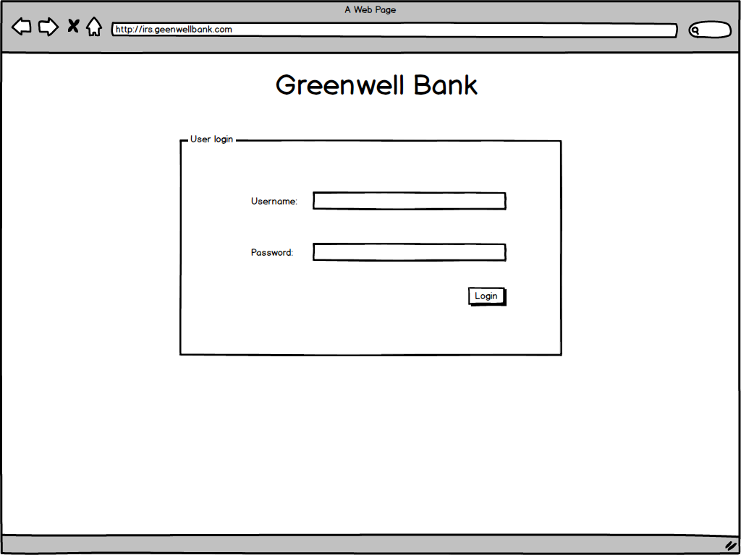
Main Login Screen

Slide 3
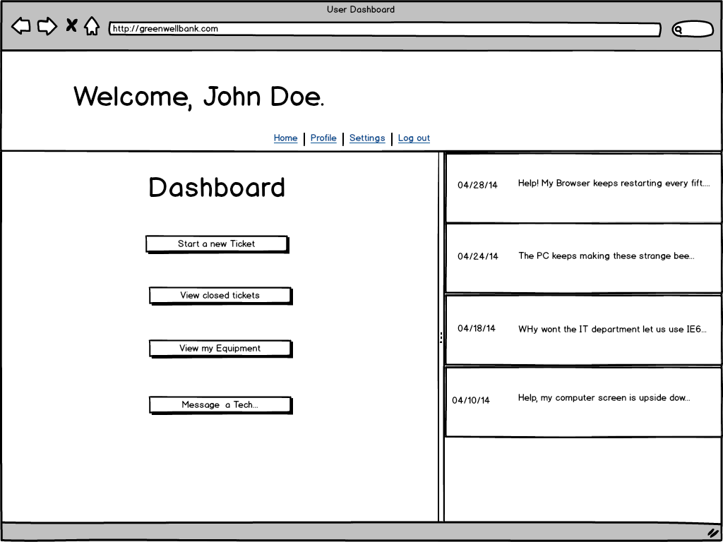
General User View

Slide 4
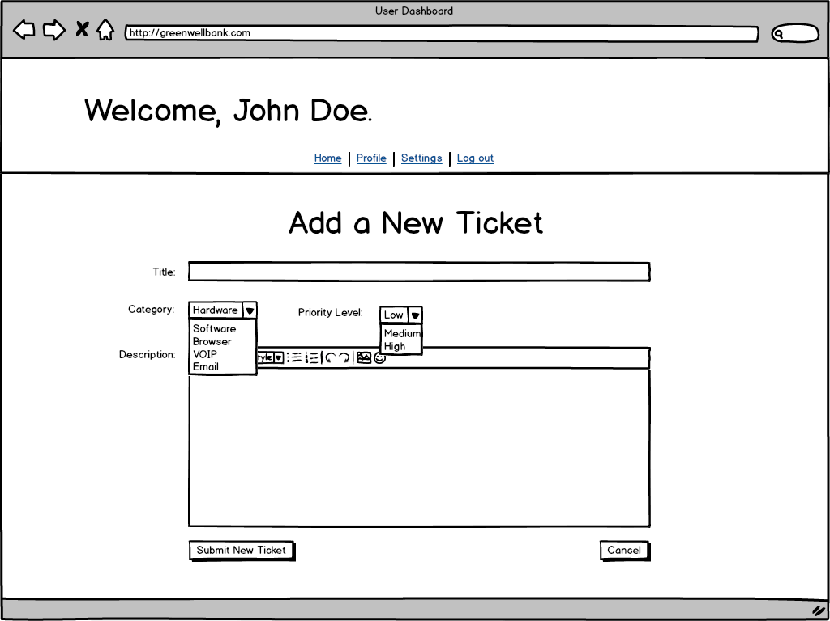
General User View
(New Ticket)

Slide 5
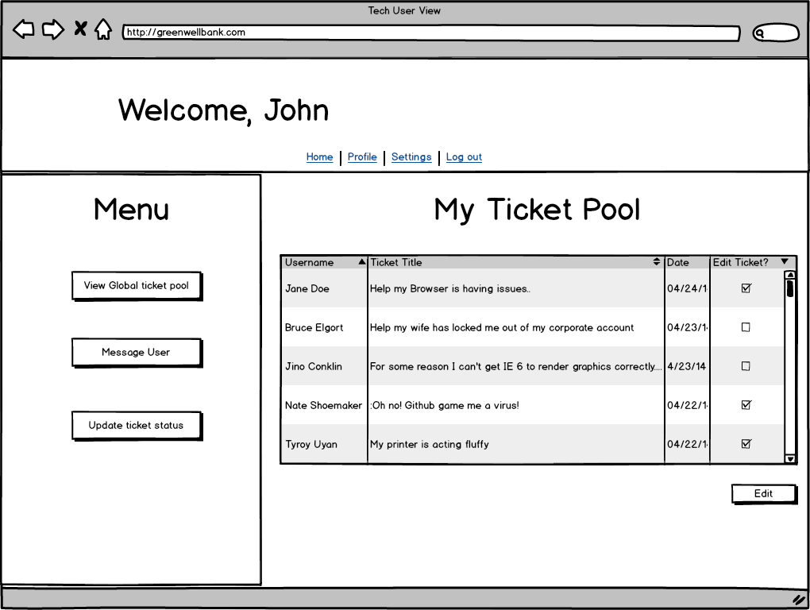
IT Tech Global Ticket View

Slide 6
IT Tech My Ticket view

Slide 7
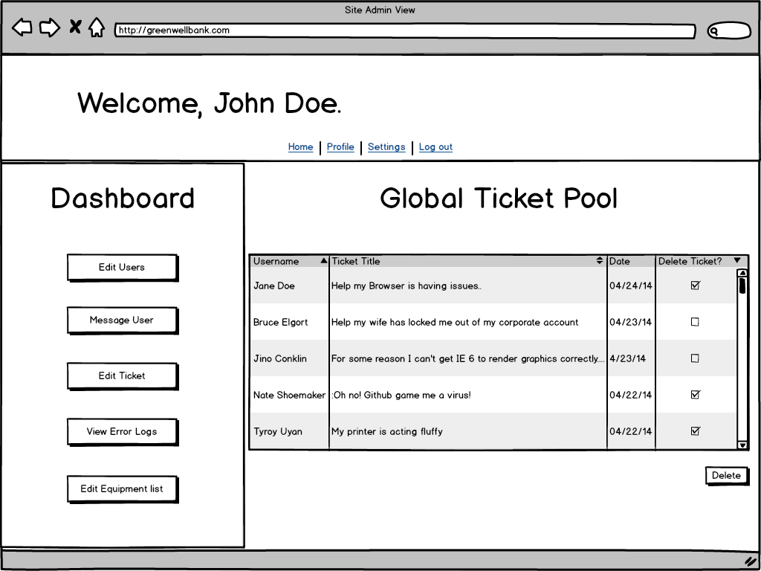
Admin User View

Slide 8
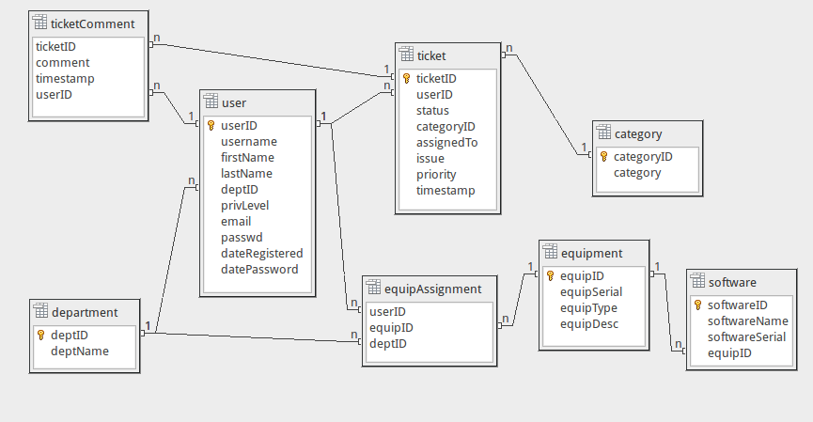
Database Table Diagram

