Slide 1

Firma convenzione Politecnico di Milano e Veneranda Fabbrica del Duomo di Milano
Marco WENZEL
Francesco TINARELLI
PRESENTAZIONE DEI CONTENUTI
Requirements Analysis and Specification Document
Aula Magna – Rettorato
Mercoledì 27 maggio 2015

Slide 2
Goals, Domain Assumptions and Requirements
[G1]: Allow to register on the system
[R1]: The system check if the input data are correct and if these one are not already exist.
[Domain Assumptions]: An user drive only if he has got driving license.
[G2]: Allow to log in on the system.
[R2]: The system must be able to check if the password and username are correct.
[G3]: Allow to find the locations of available cars within a certain distance from their current position or from a specified address.
[R3]: The system checks the syntactical correctness of the input address
[R4]: System must show only the available cars into 2km.
[R5]: System must capture the current position user if he chooses this option.
[R6]: For each available car, the system must show how much battery has the car.
[Domain Assumptions]:
All the GPS always give the right position.
The GPS of the cars cannot be switched off.
System battery car always show the right battery.
Each car is registered on system.
Car state could be only available or not-available.

Slide 3
Goals, Domain Assumptions and Requirements
[G4]: Allow to reserve a single car for up to 1 hour.
[R7]: The system must show the reservation timer.
[R8]: The system must change the car state whenever a car is reserved.
[R9]: The system must forbids more reservation at the same time from the same user.
[G5]: Allow to pay a fee if he misses the reservation.
[R10]: The system must add a fee on the user bank account.
[R11]: The system must change the car state from not-available to available.
[R12]: The system must allow user to make a new reservation.
[Domain Assumptions]:
A user doesn’t make a reservation until he pays last ride of fee.
Car state could be only available or not-available.
[G6]: Allow to tell the system she’s nearby.
[R13]: The system must capture the user position when he wants unlock the car.
[R14]: The system must forbid the car unlocking if the distance between user position and the car is not near or he doesn’t have a reservation for that car.
[R15]: The system must stop the reservation timer
[Domain Assumptions]:
All the GPS always give the right position.
The GPS of the cars cannot be switched off.
A car is nearby if the distance between this one and the user is less than 3 meters.

Slide 4
Goals, Domain Assumptions and Requirements
[G7]: Allow to see the current charges
[R16]: The system must charge money when the motor ignites.
[R17]: The system must notify in real time how much the client is paying for the ride.
[R18]: The system stops charging when the engine is shut down.
[Domain Assumptions]:
There are no pauses during the ride.
The potential discounts will be counted only after plugging time.
[G8]: Allow to reach grid stations location.
[R19]: During the ride, the system visualizes the position of grid station to the map (through the car screen).
[R20]: The system must calculate the path to the nearest grid station or grid station chosen by the user.
[Domain Assumptions]:
Power grid area location is registered on the system.
[G9]: Allow to receive a discount if the user has at least two passengers.
[R21]: The system must apply a discount of 10% for the last ride if there isn’t any other discount.
[R22]: The system must be able to recognize if there are passengers.
[Domain Assumptions]:
There is a software that allow to recognize the right number of passengers.
If a user takes more than 1 discount he takes only the biggest one.
The potential discounts will be counted only after plugging time.
If a user takes a discount and a fee, at the end of the ride system counts only the fee.

Slide 5
Goals, Domain Assumptions and Requirements
[G10]: Allow to receive a discount if the user left the car with no more than 50% battery empty.
[R23]: The system must read the state of the battery.
[R24]: The system apply a discount of 20% if battery left is more than 50%.
[Domain Assumptions]:
If a user takes more than 1 discount he takes only the biggest one.
The potential discounts will be counted only after plugging time.
If a user takes a discount and a fee, at the end of the ride system counts only the fee.
System battery car always show the right battery.
[G11]: Allow to receive a discount if the user left the car in a Power grid station and takes care of plugging the car.
[R25]: The system must recognize if a car is parked in a power grid station.
[R26]: The system applies a discount of 30% if a car is left in a power grid station and user takes care of plugging the car.
[Domain Assumptions]:
If a user takes more than 1 discount he takes only the biggest one.
The potential discounts will be counted only after plugging time.
If a user takes a discount and a fee, at the end of the ride system counts only the fee.
Power grid area location is registered on the system.
If a car is recharging, its state is not-available until the battery left is almost 70%.
The plugging time is 3 minutes.

Slide 6
Goals, Domain Assumptions and Requirements
[G12]: Allow to receive a fee if the user left the car more than 3km far from the nearest power station or left the car with more than 80% of the battery empty.
[R27]: The system must calculate the distance from the nearest power grid station.
[R28]: The system must read the state of the battery.
[R29]: The system must apply a fee of 30% on last ride if user lefts the car more than 3km far from the nearest power station or left the car with more than 80% of the battery empty.
[Domain Assumptions]:
If a car is left with more 80% of battery empty, the car state ’ll change into not-available and a maintenance guy will go to the place for plugging the car.
If a user takes a discount and a fee, at the end of the ride system counts only the fee.
All the GPS always give the right position.
The GPS of the cars can not be switched off.
[G13]: Allow to see an e-mail sent by the system with the bill ride and payment resume at the end of this one.
[R30]: The system must send an e-mail containing the bill at the end of the plugging time and the resume of the bank transaction.

Slide 7
Goals, Domain Assumptions and Requirements
[G14]: Allow user to pay immediately after at the end of the ride.
[R31]: The system must send the amount of money that user pays to external agency.
[Domain Assumptions]:
The payment is provided by an external agency.
When the user finishes the ride and the plugging time is over, the external agency provides an immediate payment if the user has enough money for pay.
If the user doesn’t have enough money on the bank count, the external agency notifies the system and this one notifies user with an e-mail.

Slide 8
CRITICAL parts of the process
Unlock Car: we suppose the unlock car process to start with pushing the unlock car button via mobile application.
Clicking on this button will start the checking process, through which the system verifies if the user has done a reservation and if he is in time.
In a more specific way if in “reservation” database tables there is a tuple with same username(e-mail) and same driving license.
Payment handling: there is the same process of payment for Reservation time fee and ride bill.
When the user ends a ride, the part of system on the car sends ride data to central system.
Central System verifies if there are some discounts or fees, then creates the ride bill() and sends the amount of money that the user must pay to an external agency.
This agency provides payment service, when ride charge arriving agency makes the transaction and notifies the system about transaction result.
If the transaction goes well, the system notifies the user with the bill ride, else the system notifies user with a warning message.

Slide 9
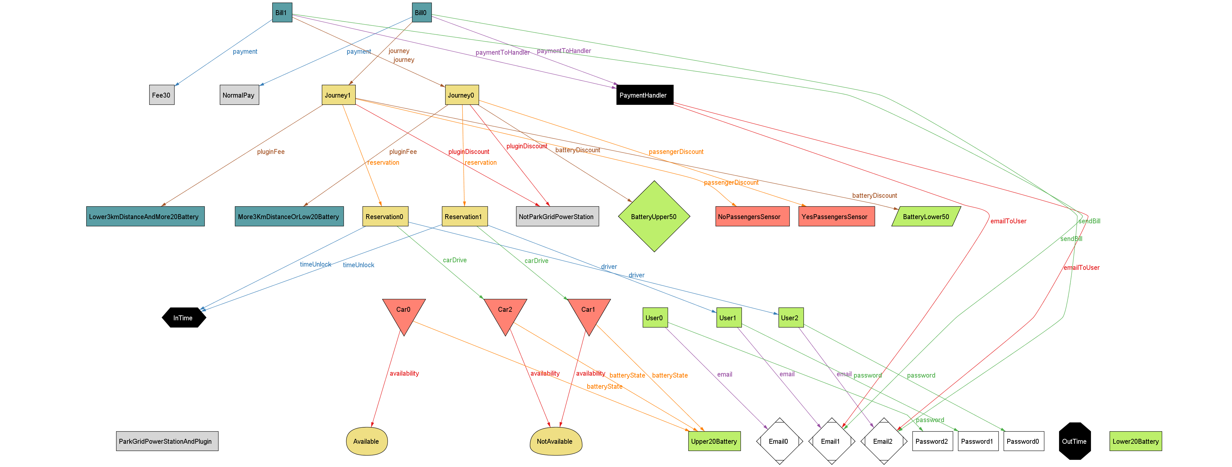
Alloy world

Slide 10
Service Table
 | Mobile Application | Web Application | Car Screen
Registration |  | X
Password Recovery |  | X
Log in | X | X
Make a Reservation | X | X
Unlock Car | X
Search Grid Station |  |  | X
Payment History |  | X
Calculate Shortest Path |  |  | X
Payment |  | (X)

Slide 11
Design Document
General Overview
Component Overview

Slide 12
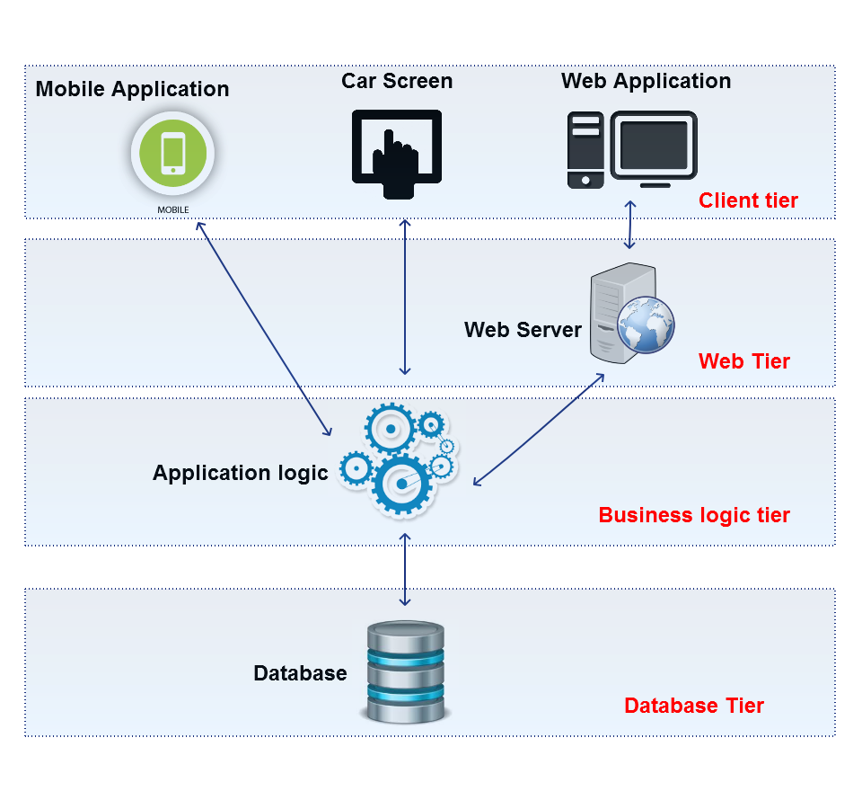
General Overview
Each arc has a double directions, reflects the possibilities to capture the response and send the request
The web tier dynamically updates the web application
Business logic tier : manages the data
Database tier : where data is stored
Client tier : user interfaces
How we can support this architecture?
JEE (Java Enterprise Edition)

Slide 13
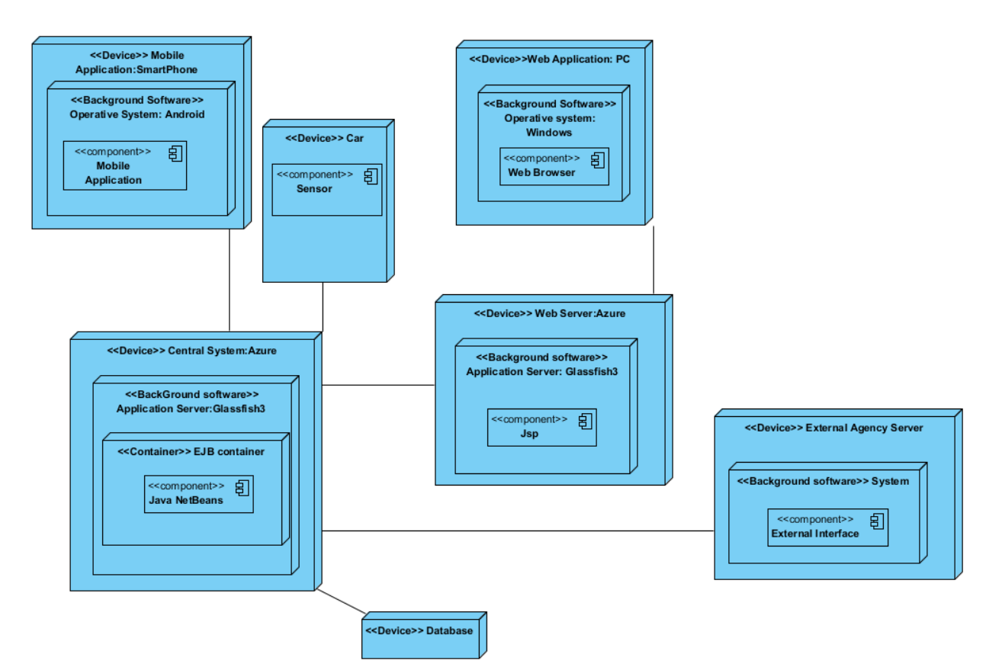
JEE
Advantages of using JEE
Java Enterprise Beans
Containers
Advantages in terms of (non)functional requirements
Application server: Glassfish 3
Reusability of the code
Advantages in terms of (non)functional requirements

Slide 14
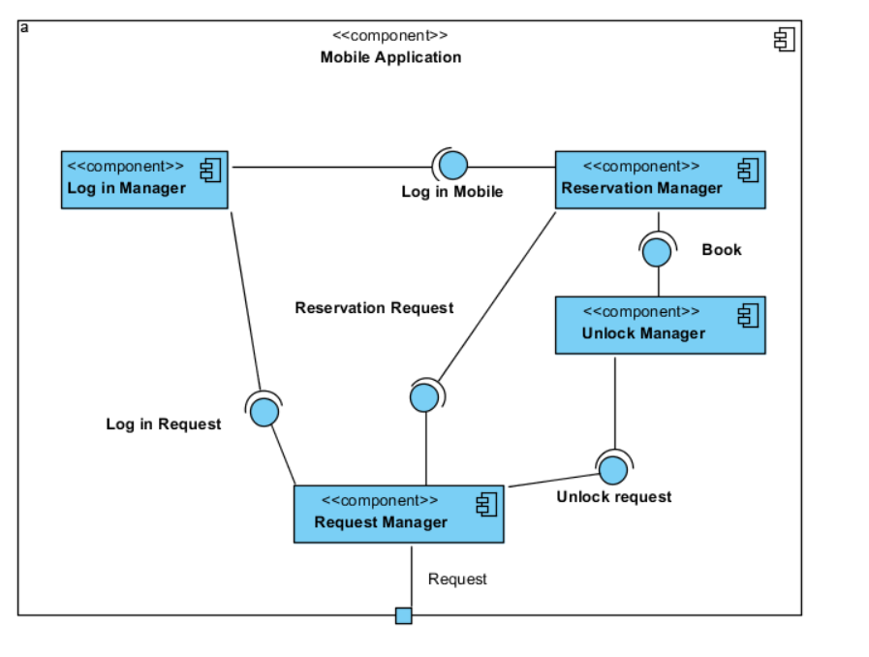
Component view
Front-end application
Two phase manager
Request manager example
How is the interaction among components?
Login manager: login (String email, String password)
Reservation manager: reserve (Car carToReserve, User userWhoReserve)
Unlock manager: unlockCar (Car carToUnlock, User userWhoWantToUnlock)
Request manager: sendRequest (Request request)

Slide 15
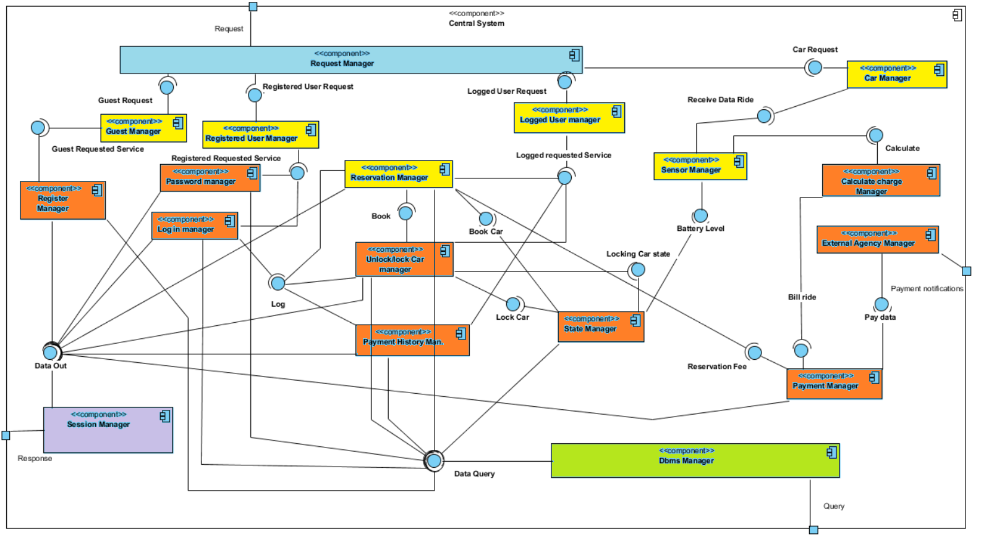
Component view
Back-end component
We divide this diagram in 5 part:
Light blue: for request manager, that aims to receive request from clients.
Yellow: for all component manager that aims to sort the various type of the requests.
We treat this part all-in-one because all components have the same input requirements and have the same outputs.
Orange: for all component that provide a service and check the requirements for that service.
Green: dbms manager that aims to create the query for the database
Purple: session manager that aims to manager the response to send to clients.
Bottom-up integration test
Reason of this choice

Slide 16
An example of a goal in RASD is reflected in our architecture…
[G1]: Allow to register on the system
Registration manager
Request manager(Client)
Request manager(Server)
Guest manager
Register manager
Dbms manager
Session Manager

