Slide 1

Coursework Documentation
COMP1004

Slide 2
Overview
Here, I will be documenting the:
SLDC (including sprints)
Personal Research
Project vision and scope
The user flow and basic interfaces
UML diagrams

Slide 3
SDLC - approach
I will be completing this project in an agile-like manor. This will allow me some flexibility in the development of the webpage. This method consists of: planning, design, implementation, testing/feedback. I will be completing this loop in two week ‘sprint’ intervals, receiving feedback at the end of the two weeks so that I can improve upon my next iteration. These two-week sprints will run between the ‘scrum meetings’ offered by my course.
The agile approach is great for this scale of project (compared to other approaches like the waterfall) as I will be completing it by myself. Documentation doesn’t have to be as thorough as I can always go back and change aspects as the project grows or the scope changes. It also works well as a student as I am quite new to a project of this size and depth so will allow me to make mistakes (and as such, adjustments) with smaller consequences.

Slide 4
Research – Purpose of website
When considering the scope of this module, I decided to build it for a specific reason. This will increase my opportunities for outside input and feedback for the project.
With this in consideration, I will be building this website for my old highshcool’s mathematics department. Due to the popular software ‘Adobe Flashplayer’ shutting down in 2020, it rendered a lot of their teaching tools useless. This is where I hope to fill in for the lack of resources. I aim to make learning fun and engaging for the students through a gaming medium. This will allow for a more interactive learning experience that will educate in a more relaxed setting.
I can take inspiration from their previous resources to help me with my project. I will also be conducting an interview with one of the teachers from the department to get a better understanding of what works and what doesn’t for their students. Interview questions and answers are on the next two slides.

Slide 5
Interview - Background
Question | Answer
The reason you are in need of these math games is due to the shutdown of flash a few years ago? | Yes. All previous games used flash.
Have you found any alternatives since then? | Kind of - using ‘Kahoot’ and ‘Blooket’ but they don’t offer the same level of interactivity and customisability. Likes the competitiveness of ‘Blooket’ going head-to-head with powerups and such.
What year groups/key stages do you tend to use these games with the most? | More adaptable question input is, more variety it offers. ks1-ks4.
Would you like to use these games with different year groups (develop more 'mature' games)? | As there isn't a specific age demographic, no.

Slide 6
Interview - Games
Question | Answer
Basketball game - what exactly stood out the most about it? | Liked the manual input of questions and answers. Offered a good level of skill usage with quick time events and inference with a power meter
How important is it to you to be able to create your own math problems/solutions? | Very. Offers replay-ability and can be applied to the end of any lesson allowing for a wide range of applications
Balance between the maths and skill - would you prefer the 50/50 style of this or leaning one way rather than another? | I like the balance of mostly 50/50 topic knowledge to game skill
Advertised for whiteboard usage - would you like more games that work in this style? | Yes. Just received new ones and would like to utalise them.

Slide 7
Project Vision and Scope
From this interview, I have been able to refine my vison for this website. It has shown me exactly what is and isn’t needed for my website. Previous to the interview, I had been sent some images and descriptions of the games used to give me an idea of how to form my questions. I asked specific questions about these games to find what exactly worked well about them to then use the information to form my game.
It is clear to me that a basketball game is the best option for me to develop as it looks relatively resource un-intensive and had very high engagement with staff and students. I will be attempting to create a basketball game for this reason.
I will be implementing both educational and interactive experiences so that I can strike a balance that engages both types - not too ‘boring’ for the students and not too ‘game-y’ for the teachers.
If time allows, I will consider implementing similar games for variety.

Slide 8
Game Requirements
Implement Phaser3 to help with gaming elements
Graphics (animations)
Timer
Levels with increasing difficulty
Home page with navigation bar
Input/Output files to local storage for statistics and custom questions
Time played
Fail requirements
Dynamic levels

Slide 9
Designs
Home page
Basketball game – question stage
Basketball game – catch stage
Basketball game – throw stage
Artwork sourced from internet – only used for concept art*

Slide 10
Home | Basketball | Questions
Home Page
Welcome to *website name*! Click on the above prompts to
start a game.
*Enter a description of the game here. This should include step-by-step
instructions on how to play the game along with the controls of the game.
Make these instructions simple. They should be understandable to
any person that may want to play the game.*
*Mention the ‘questions’ page to guide the user to input questions with
more details on that page itself*

Slide 11
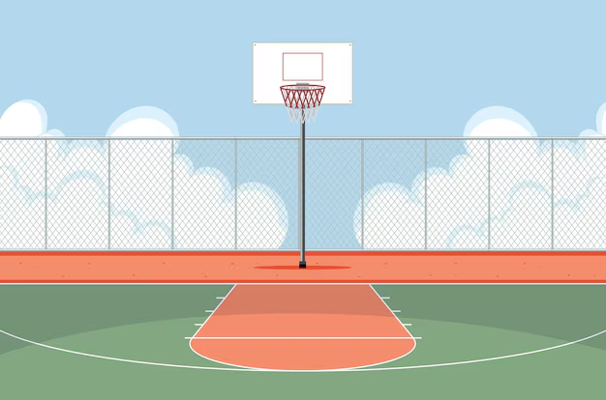
Home | Basketball | Questions
Question Time!
Question:
Answer:
Submit Answer
2 + x = 10
x = 8

Slide 12


Home | Basketball | Questions
Score: 100
Time: 60
Catch!

Slide 13

Home | Basketball | Questions
Score: 100
Time: 60
Distance: 5m
Power level: 50
Shoot

Slide 14
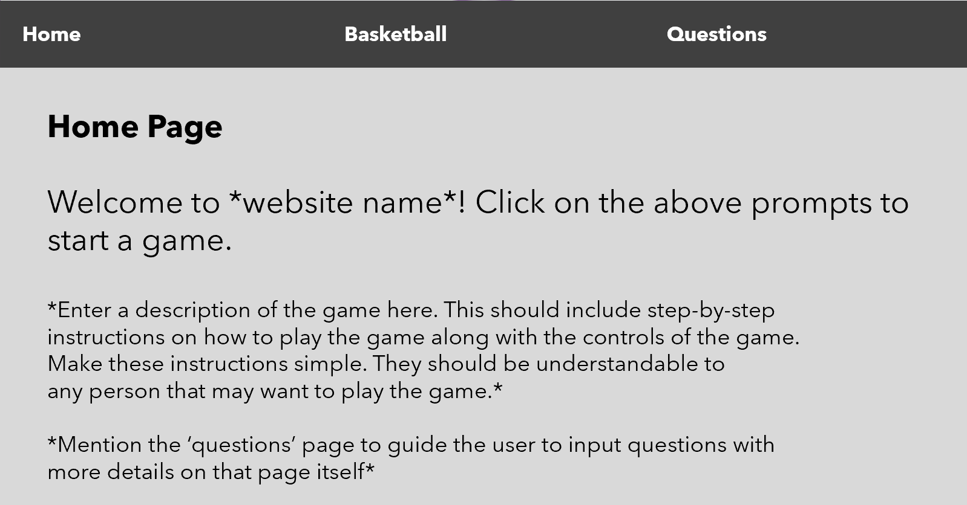
The Home Page
Here is where the user will first be placed when starting the website. It contains some descriptive text, a background (TBD) and a navigation bar to introduce the user. To continue to use the program, the user is expected to click an item in the nav bar.
Nav bar
Title
Welcome
Description

Slide 15
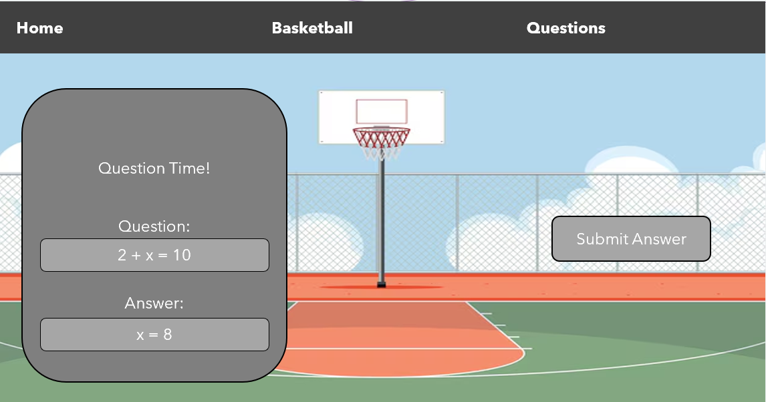
Answer Stage
Here is where the user will first be placed upon starting basketball game. It starts with displaying the question box over the basketball court background. A question will be displayed, and an empty input box will be displayed for the user. Clicking the submit button will confirm the users answer with the actual answer to move on.
Question box
Question
Answer field
Submit button

Slide 16
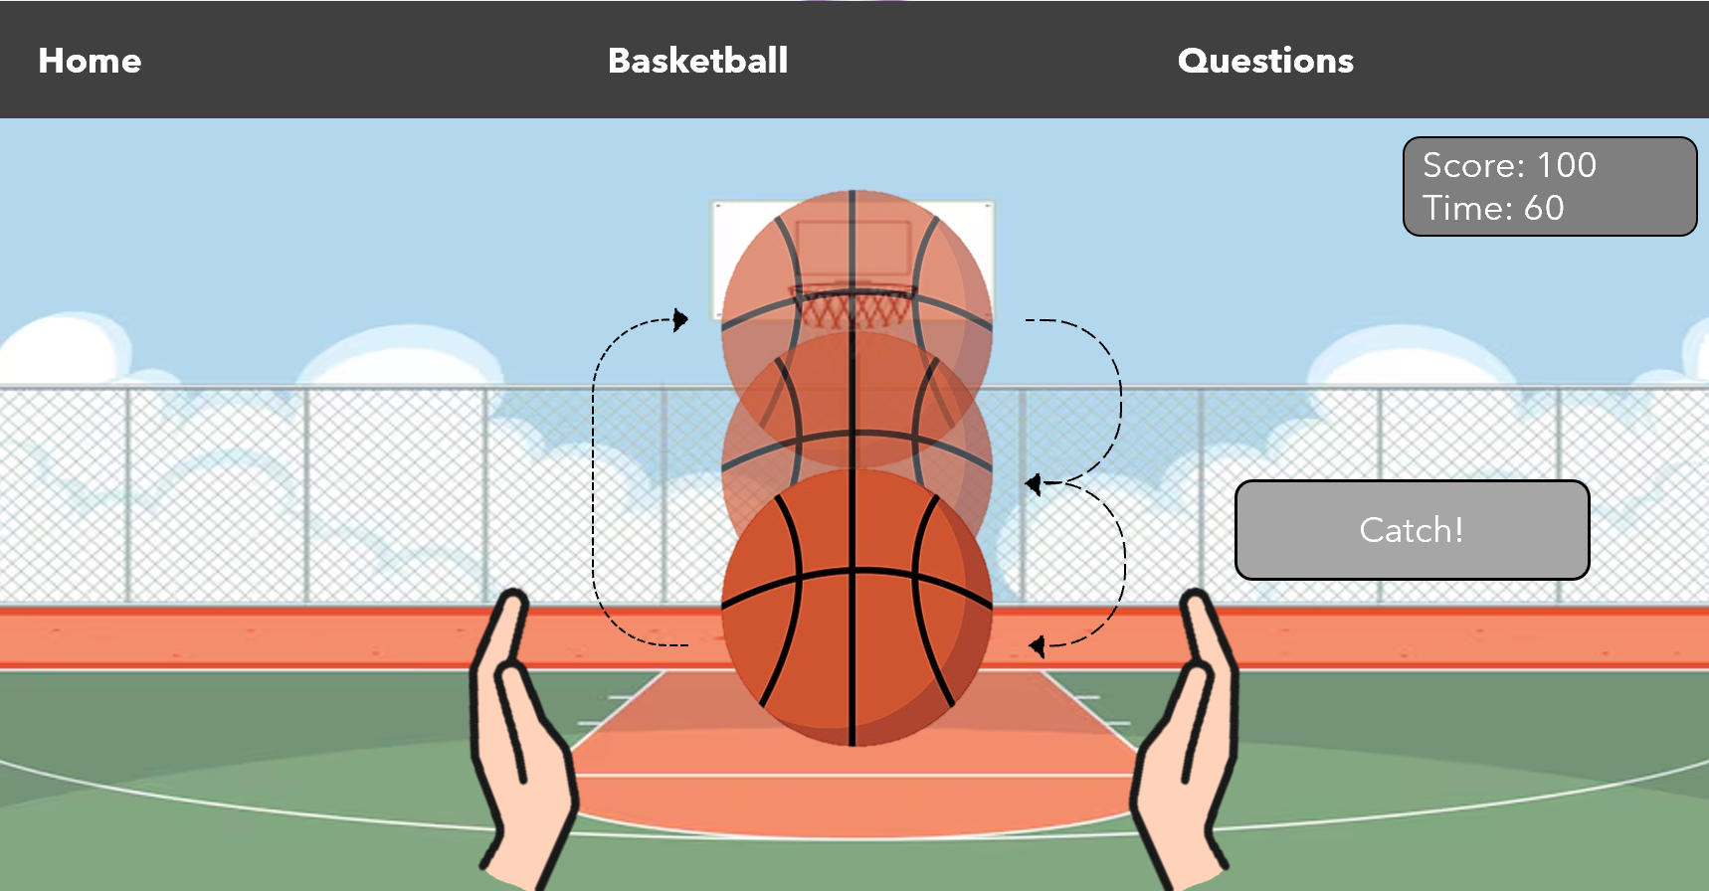
Catch Stage
Here is where the user will first be placed when completing the answer stage correctly. It will display a basketball falling downwards in increments. This is a quick time event where the user must stop the ball in between the hands to catch it. The ball will run through loops of starting at the top and falling downwards until the catch button is used to stop it.
Fall stages
Catch button
Basketball
Hands

Slide 17
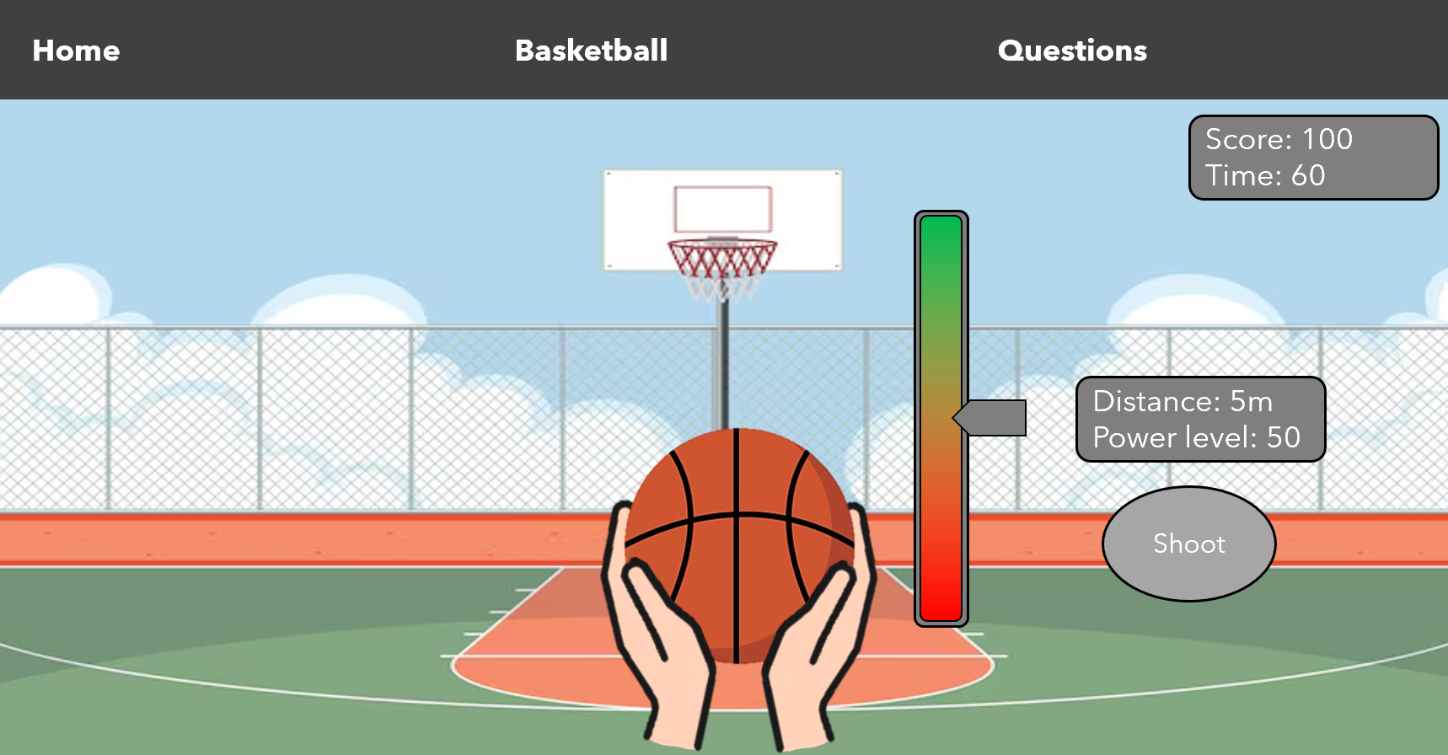
Throw Stage
Here is where the user will first be placed after successfully catching the ball. With the ball in hand, the player will need to determine the level of power needed to throw the ball into the hoop based off the distance from the hoop. The user will select the power using the power bar and confirm using the shoot button.
Power gauge
Distance/power level
Shoot button
Caught ball

Slide 18
UML diagrams
Activity diagram
User Stories

Slide 19

Website
Answer question
Clear (+score)
Catch Ball
<<generalize>>
<<generalize>>
Student
Throw ball
Fail
<<include>>
Question storage
<<extend>>
Timer
<<include>>
Add question/answers
Teacher

Slide 20
Game
|→ Play Basketball game
| |→ Has user input questions?
| |→ No |------------→ Yes
| |→ Use pre-existing Qs |→ Use these Qs
|
|→ Display question
| |→ Has user answered correctly?
| |→ Yes |→ No
| |→ Display new question
|
|→ Catch the ball
| |→ Has user stopped ball in-between hands?
| |→ Yes |→ No
| |→ Fail level
|
|→ Throw the ball
| |→ Input power level based on distance from hoop
| |→ Is the power suitable for distance?
| |→ Yes |→ No
| |→ Fail level
|→Level Cleared

Slide 21
Sprints
Sprints are as follows:
Dates: | 9/12 -> 23/12 | 1/1 -> 15/1
Objectives: | Familiarise HTML Complete background and research Build a basic home page | Build a basic prototype Create sketches of game loop

