Slide 1

Crash Detect
By Marc Levin

Slide 2
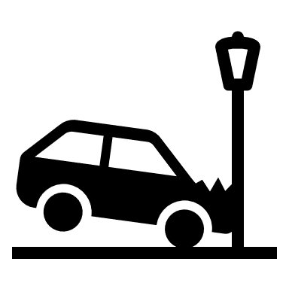
Problem Statement
The fundamental problem of today’s overuse of CCTV and speed cameras are that they are useless for most of their lifetime.
An analysis by Hill & Lindly, 2003, found that red light cameras in four US states found 3.2 red light violations per hour
This means 3.2 potential car crashes were caught on camera but were not processed until there was human intervention.
Not only are many crashes going uncovered, but lives are being lost as cameras watch and can do nothing autonomously, albeit without a human counterpart.

Slide 3

Methodology
The solution to this fundamental issue is a system that is smarter, and more usable than the current solution.
Introducing CrashDetect.
CrashDetect uses a custom made TensorFlow model combined with a rich image processing API to detect crashed cars.
CrashDetect works on JPGs primarily, as a limitation to improve accuracy.
CrashDetect has been trained on 600+ images of cars both crashed and completely safe.
CrashDetect utilizes the TensorFlow API and a custom saved model, all implemented in Java.
CrashDetect uses JavaFX for its front end.

Slide 4
The solution process:
The processed image is then converted to a Tensor that is fed to the model.
The image is processed using the provided image processing API
The model returns its predictions to the user, detecting crashes.

Slide 5

Limitations
CrashDetect is limited by several factors.
The quality of trained image data is poor in terms of classification as multiple angles and light levels were used. Better classification before training would improve results
The trained image data uses pre-processing in a blanket strategy; however, some images would benefit more from alternative processing and are therefor underfitting the model.
The current system is unable to process live image data, such as data from a live CCTV feed.
The current system would function poorly at night, as it has not been trained on night data as well as day data separately.

Slide 6
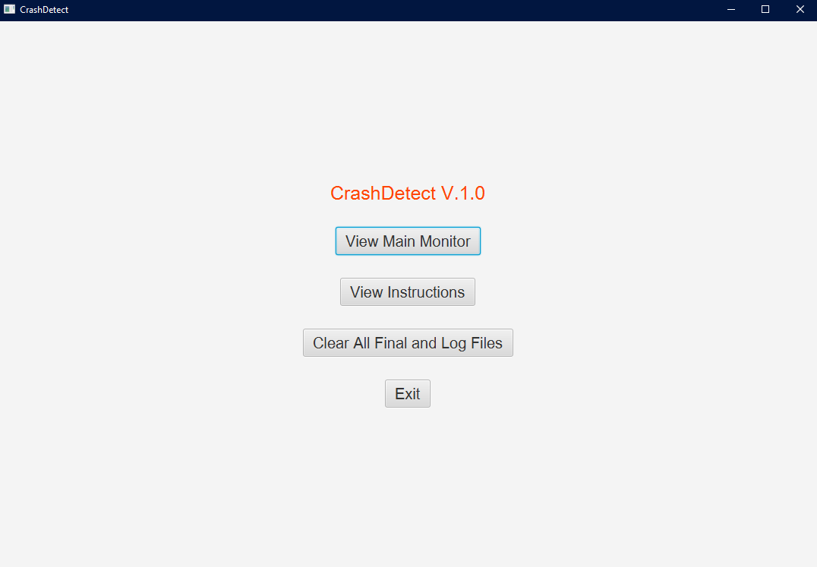
Main Menu
This is the main menu for the CrashDetect system.
The clear all final and log files allows the user to clean up all processing files left for their convenience.

Slide 7
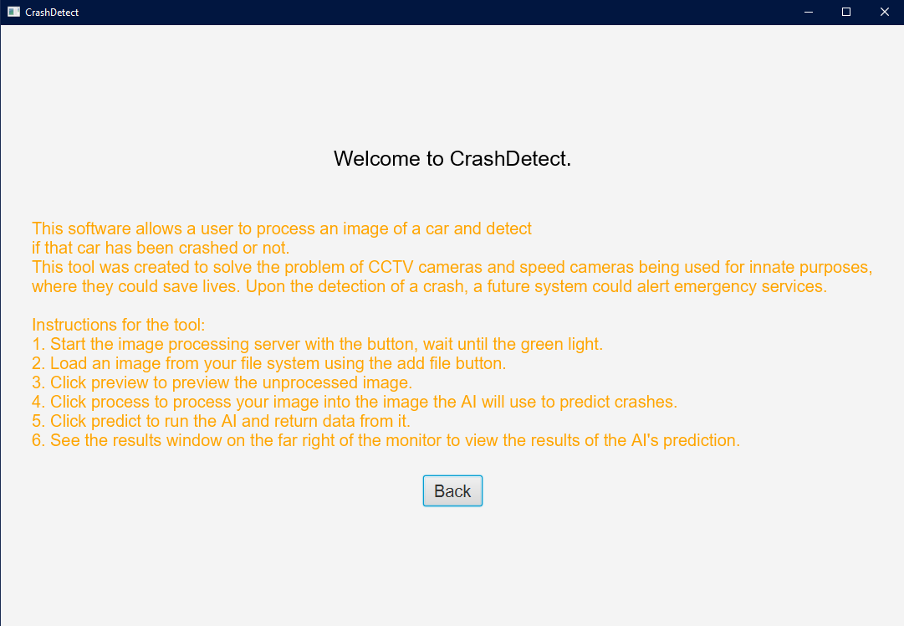
Instructions
This is the instructions panel.
It provides a comprehensive set of instructions to use the software.

Slide 8
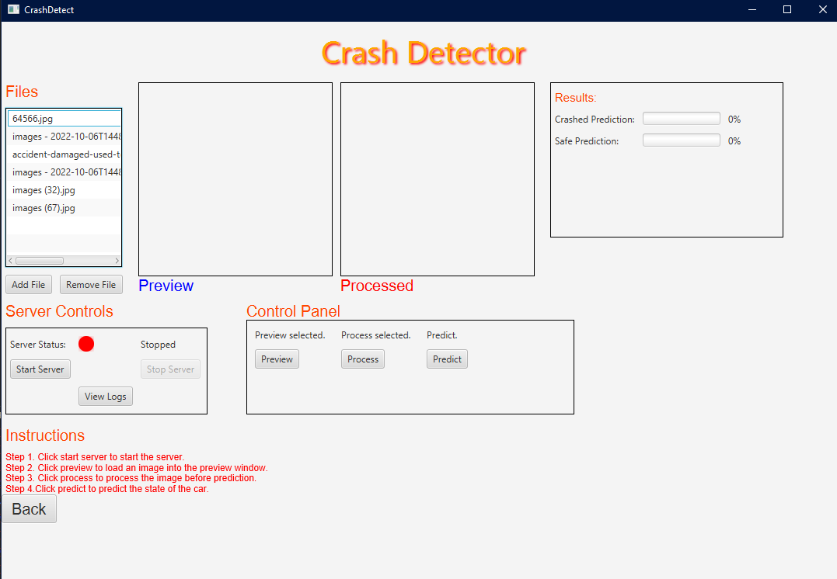
Main Monitor
This is the main monitor of the application.
This allows the user to complete the workflow mentioned in a previous slide

Slide 9
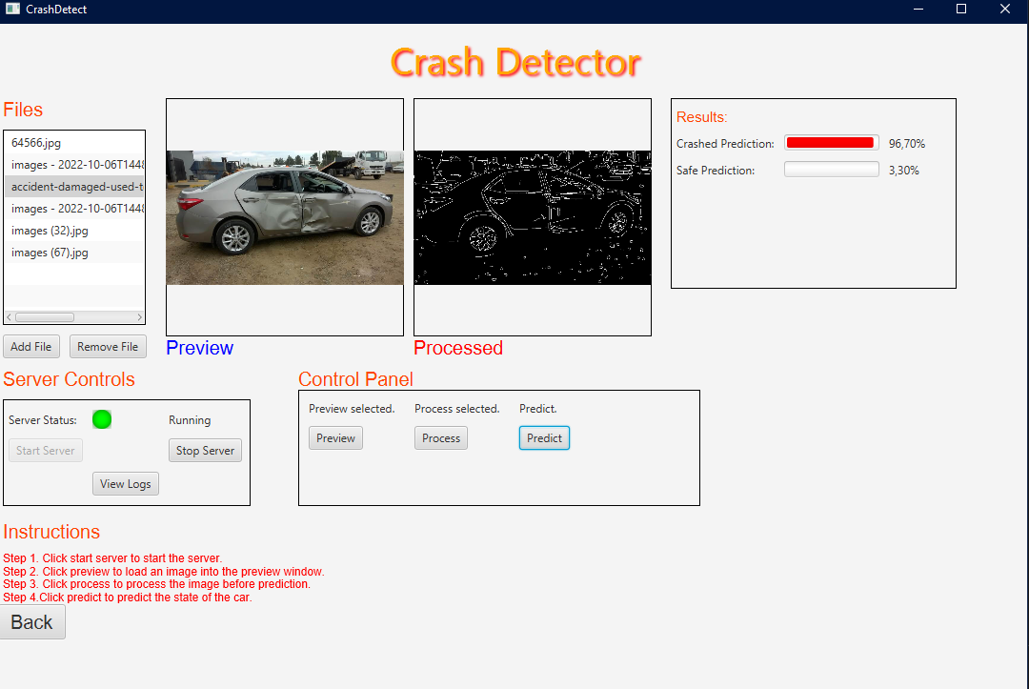
Main Monitor with Data
This shows the monitor in a typical use case environment.
Here we can see the user processed a given car with some damage.
We can also see the server is alive by the indicator light.
The model has predicted this to be a crashed car.

Slide 10
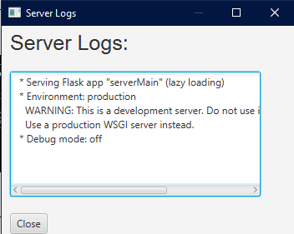
Server Log
This is the popup window that shows the logs for the server that we are using for pre-processing.

Slide 11
Further Meta Information
CrashDetect owns the Server Process in order to avoid the headache of the client having to run the server themselves.
CrashDetect uses the Maven as it’s project manager.
CrashDetect uses a first-principle method of communicating with the server.

Slide 12
Conclusion
CrashDetect is in its infancy and will continue to evolve if its underlying model is trained further and potentially even split into multiple models based on a given situation.
CrashDetect can be improved with a live video feed feature.
CrashDetect could be used to save lives.

