Slide 1
Jefferson County, KY
Marc Mascarenhas
Contextual Background
Analysis Question/ Motivation
Considerations/Next Steps

Slide 2
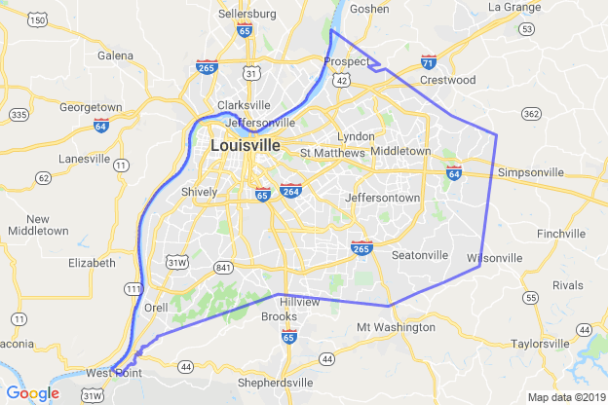
Context
Population: ~741,000 (2010)
Largest county in KY

Slide 3
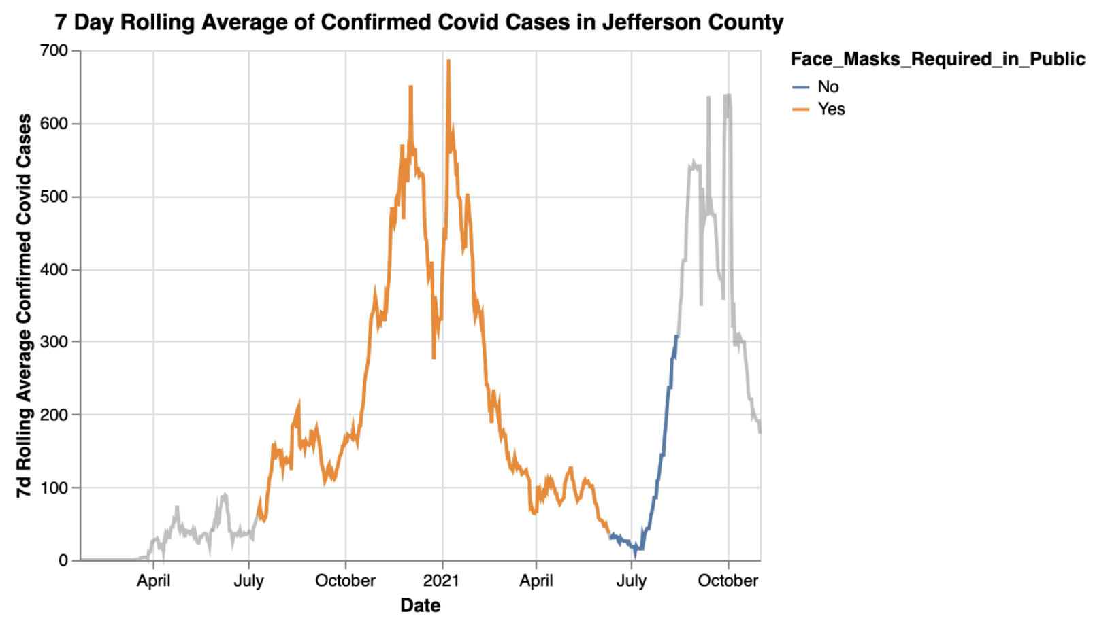
Context
Population: ~741,000 (2010)
Largest county in KY
June 11th:
Mask Mandate Removed

Slide 4
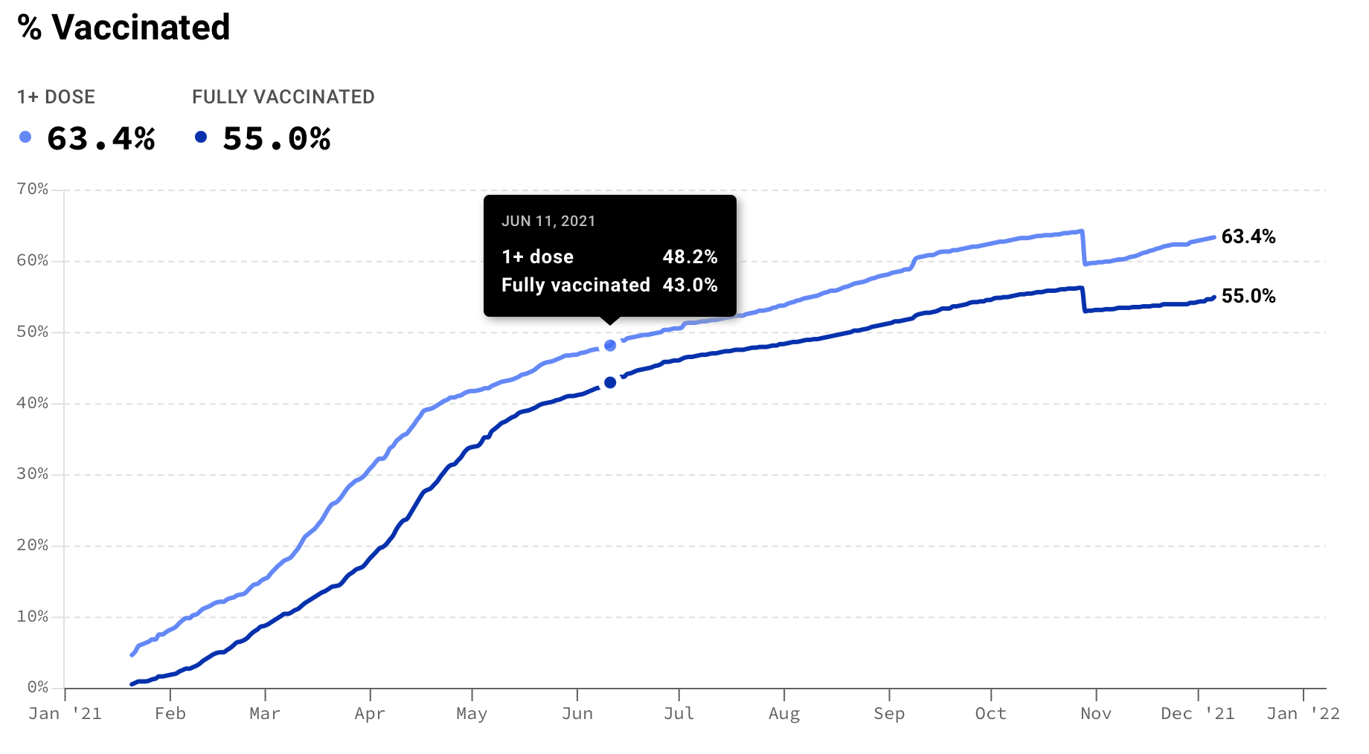
Context
Population: ~741,000 (2010)
Largest county in KY

Slide 5
Analysis Question:
June 11th:
Did people’s openness with going outside change after the mask mandate?

Slide 6
Setup
Is the average park mobility in the week after the relaxation of the mask mandate more than ‘usual’?
Step 1: What’s ‘Usual’?
Step 2: How extreme was the park mobility after the relaxation of the mask mandate?

Slide 7
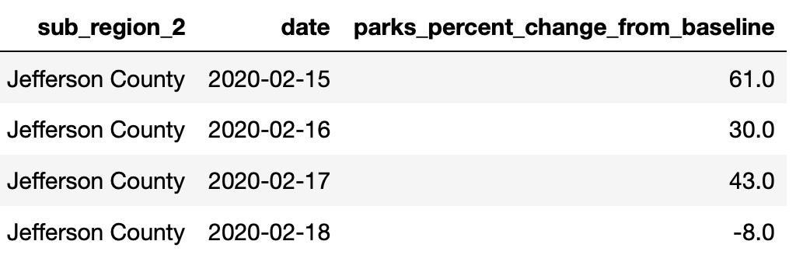
Data
USA Mobility Data, Google geolocation
% increase from the baseline
Baseline: Median value for that day of the week in a 5 week period in Jan/Feb 2020

Slide 8
Step 1: What’s “Usual” Park Mobility?
Look at data from 1.5 months before the mask mandate
Assumption: Minimal change in seasonality

Slide 9
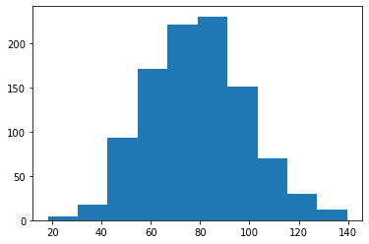
Step 1: What’s “Usual” Park Mobility?
Look at data from 2 months before the mask mandate
Assumption: Minimal change in seasonality
Calculate a random sample of the mean mobility of 1 week periods
Repeat 1000 times
Count
Park Mobility wrt Baseline

Slide 10
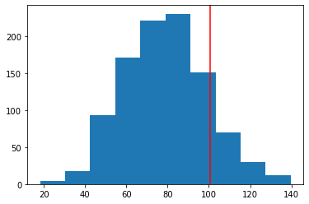
Step 2: How extreme is this park mobility?
P- Value: 0.14
June 11 - June 18
Count
Park Mobility wrt Baseline

Slide 11
Consideration
How good is our data?
Mobility information
Methodology in calculating population
Seasonality?
Can we normalise seasonality by considering pre pandemic data?

Slide 12
Hypotheses/Next Steps
Instead of the mask mandate, the vaccine may be the turning point for peoples openness wrt park mobility
Perform similar analysis

