Slide 1
Improving Patient Flow In Clinics Methodology and Progress So Far
5/11/16: “Administrator” meeting
Created ‘administrator list’ of probable problem areas
Plan: Collect problem lists from MD’s and PC’s working in the clinics
Herminia Hermogenese – MD info
John Mahon – PC info
5/24/16 – Problems identified by MD’s
Minnie created word document
Filled out by 10 MDs
50 problems identified by MDs
Prevalance (how many MDs identified issue as problem
Clinic that had the problem

Slide 2
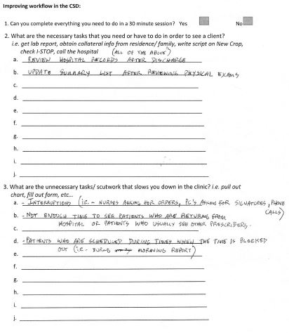

Slide 3
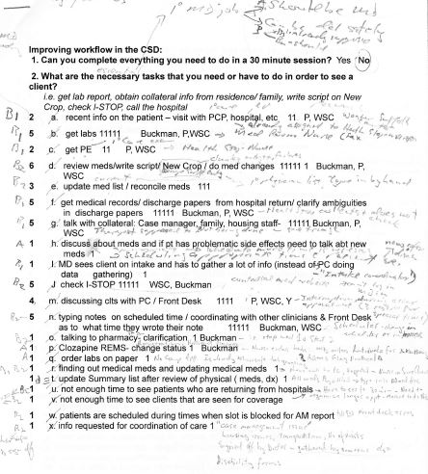

Slide 4
