Slide 1
Improving Patient Flow In Clinics Methodology and Progress So Far
5/11/16: “Administrator” meeting
Created ‘administrator perceived’ list of probable problem areas
Plan:
Collect problems as perceived by MD’s and PC’s working in clinics
Herminia Hermogenese – MD perceived problems
John Mahon – PC perceived problems
Give lists to Mentis to create ‘Clinic Questionnaire’
Mentis to Present ‘Clinic Questionnaire’ to committee in two weeks
5/24/16: MD perceived problems to Mentis
6/16/16: PC perceived problems to Mentis

Slide 2
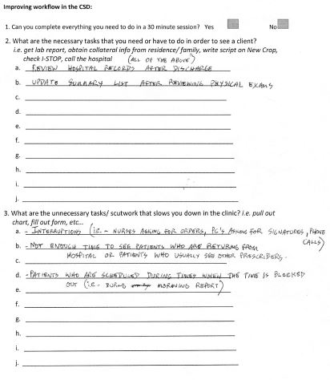
Minnie created word document
Ask MDs to corroborate/ identify new problems
Filled out by 10 MDs

Slide 3
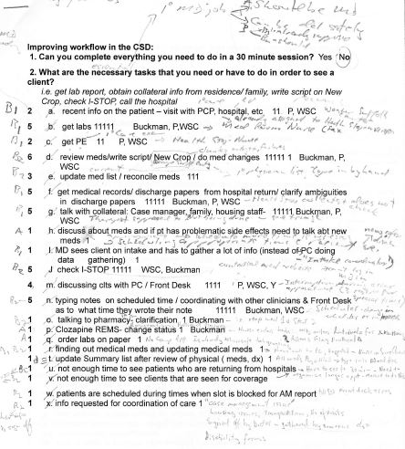
Minnie collated Forms from 10 MDs
50 problems identified by MDs
Prevalence of problem
How many MDs/prob
Which Clinics/prob
I went over collated data with Minnie
Good idea of problems as perceived by MDs
Formed backbone of the “Clinic Questionnaire”

Slide 4
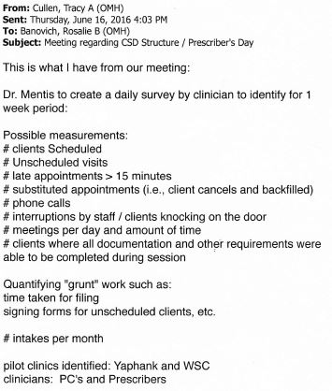
No data from John Mahon
6/16/16 Tracy Cullen sent data
Think just summary of data from original 5/11/16 meeting
No PC perceived problems
?? wrt: PC perceived problems:
Not identified
Not evaluated by “Clinic Questionaire”
No interventions tried in Pilot
No chance of improvement

Slide 5
Improving Patient Flow/Care In Clinics Methodology and Progress So Far
5/11/16: “Administrator” meeting
5/24/16: MD perceived problems to Mentis
6/16/16: PC perceived problems to Mentis
6/28/16: ‘Clinic Questionnaire’ completed
7/7/16: Admin ‘Tweek’ meeting
Show and revise Clinic Questionnaire
Choose dates for implementation
1st week: Reason: Date:
2nd week: Reason: Date:
Choose sites for implementation (? Yaphank, WSC)
How to get Questionnaire to staff
?Staff copy onto desktop from common server, ?? Staff give computer No to IT who place on Desktop
How to train staff in best way to fill out Questionnaire
Pre-Pilot Questionnaire Completion in Real-Time in Pilot-Clinics, by MDs and PCs
By MDs/PCs during day in pilot clinics during two one-week periods
Pre-Pilot Questionnaire Analysis (Mentis)
Formulation of Pilot Interventions based on results of analysis (Mentis)
‘Pilot Interventions’ Meeting – finalize:
What interventions to implement
How to make implementations
How long implementation need to be in place for any benefit to be seen
Post-Pilot Questionnaire Completion (after implementation ) AT ALL CLINICS not just Pilot sites
Analyze Pre- and Post-Pilot Questionnaires’ (Mentis)
Pilot Results Meeting
Present Results of Pilot Interventions
If Statistically Significant Improvement found:
How to present this information To Albany to get whatever is necessary to
IMPROVE PATIENT FLOW/CARE IN CLINICS

