Slide 1
Improving Patient Flow In Clinics Methodology and Progress - So Far
5/11/16: “Administrator” meeting
Created ‘administrator perceived’ list of probable problem areas
Plan:
Collect problems as perceived by MD’s and PC’s working in clinics
Herminia Hermogenese – MD perceived problems
John Mahon – PC perceived problems
Give lists to Mentis to create ‘Clinic Questionnaire’
Mentis to Present ‘Clinic Questionnaire’ to committee in two weeks
5/24/16: MD perceived problems to Mentis
6/16/16: PC perceived problems to Mentis

Slide 2
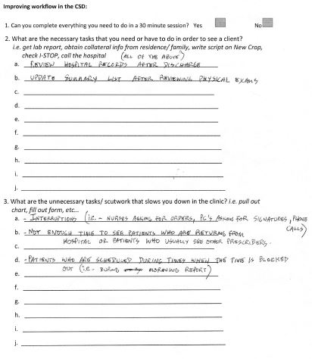
Minnie created word document
Ask MDs to corroborate/ identify new problems
Filled out by 10 MDs

Slide 3
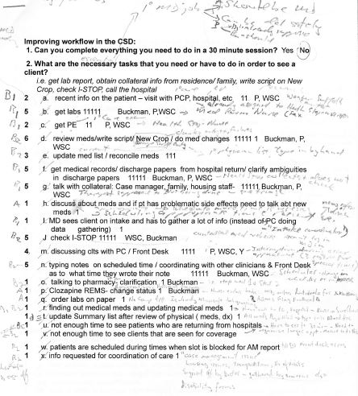
Minnie collated Forms from 10 MDs
50 problems identified by MDs
Prevalence of problem
How many MDs/prob
Which Clinics/prob
I went over collated data with Minnie
Good idea of problems as perceived by MDs
Formed backbone of the “Clinic Questionnaire”

Slide 4
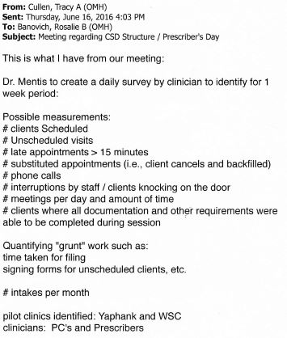
No data from John Mahon
6/16/16 Tracy Cullen sent data
I think this is summary of data from original 5/11/16 meeting
If true that PCs have problems that have not been identified then:
Not evaluated by “Clinic Questionaire”
No new interventions will be tried in Pilot
Reduced chance of improving their working situation wrt. these issues
(Can be given voice: - If PCs enter these issues in “OTHER” section of Clinic Questionnaire)

Slide 5
Improving Patient Flow/Care In Clinics Methodology and Progress So Far
5/11/16: “Administrator” meeting
5/24/16: MD perceived problems to Mentis
6/16/16: PC perceived problems to Mentis
6/28/16: ‘Clinic Questionnaire’ completed by Mentis
7/7/16: Admin ‘Tweek’ meeting
Show and revise Clinic Questionnaire
Aim: Identify and Quantify Problems in real-time. Validate against Staff Perceptions of problems
Quick/easy to fill out, but still be valid and comprehensive enough for data to be useful
Choose dates for implementation
1st week: Reason: Date:
2nd week: Reason: Date:
Choose sites for implementation (? Yaphank, WSC)
How to get Questionnaire to staff
?Staff copy onto desktop from common server/memory stick ?? Staff give computer No to IT who place on Desktop
How to train staff in best way to fill out Questionnaire
Pre-Pilot Questionnaire Completion in Real-Time, over two weeks in Pilot-Clinics, by MDs and PCs
Pre-Pilot Questionnaire Analysis (Mentis)
Formulation of Pilot Interventions based on results of analysis (Mentis)
‘Pilot Interventions’ Meeting – finalize:
What interventions to implement
How to make implementations
How long implementation need to be in place for any benefit to be seen
Implement Pilot – Institute changes into chosen clinics for chosen amount of time
Post-Pilot Questionnaire Completion (after implementation ) AT ALL CLINICS not just Pilot sites
Analyze Pre- and Post-Pilot Questionnaires’ (Mentis)
Pilot Results Meeting - Present Results of Pilot Interventions
If Statistically Significant Improvement found:
How to present this information To Albany to get whatever is necessary to IMPROVE PATIENT FLOW/CARE IN CLINICS

