Slide 1

Michael bublé
“Life is not a battle to win.. but a melody to sing.” ― Amit Ray
Marco Antonio Béjar Villalba

Slide 2


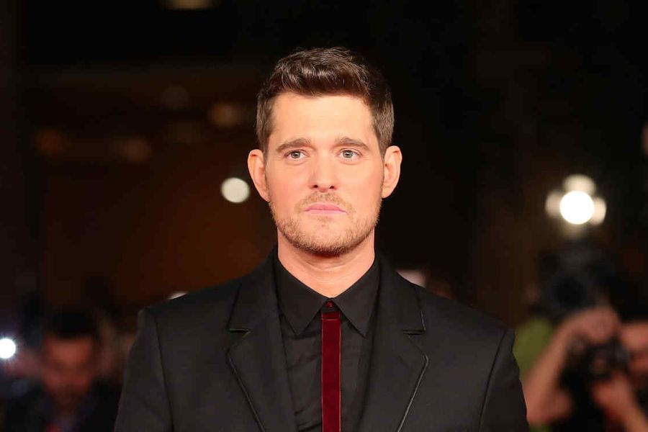
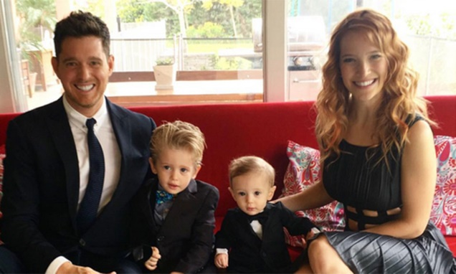
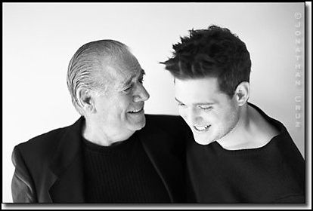
Fast Facts
Michael Bublé is a Canadian singer born in 1975 in Burnaby, British Columbia Canada.
He is a big fan of hockey; one condition for singing in a concert is having a hockey puck of the local team in his dressing room as part of the contract.
Every one of his girlfriends has had a participation in his disks or video clips, Debbie Timuss sang the vocals for «It’s time», Emily Blunt sang «Me and Mrs. Jhons» and «Everything», and Luisana Lopilato appeared in the video «Haven’t meet you yet».
His son Noah was diagnosed with Hepatoblastoma a kind of liver cancer, Bublé cancelled every compromise and spended the time with his son while the chemotherapy and radiotherapy lasted.
His first singing engagements were in nightclubs at age of 16 and were facilitated by his Italian grandfather Demetrio Santagà, a plumber from Preganziol, Treviso, who offered his plumbing services in exchange for stage time for his grandson.

Slide 3
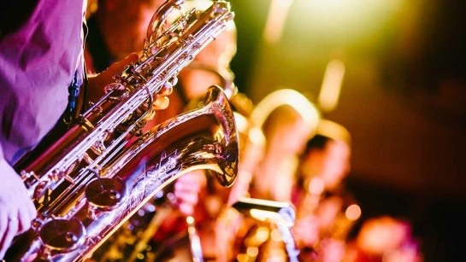
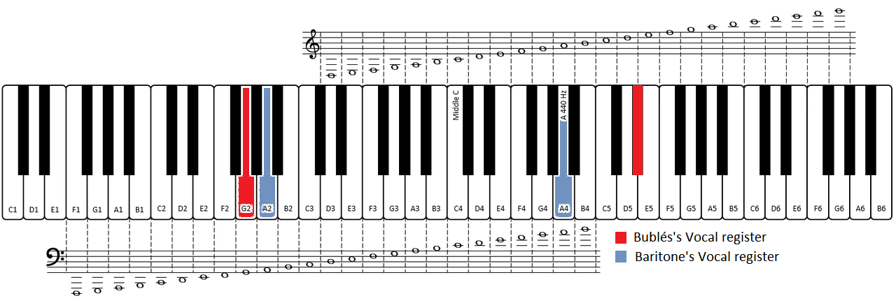
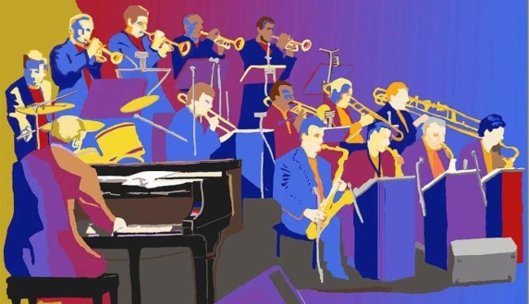
Technical performance and influences
Voice Type: Lyric Baritone
Range: E2-Bb4-Eb5
He claims having influences of Frank Sinatra, Stevie Wonder, and Ella Fitzgerald.
His style is mainly aimed to Jazz but he has performed pop songs with flat influence of classical rock (which in fact has jazz influence).
The musical arrangements have a big use of “Bing Band” and “Classical Orchestra” using percussions, cords, and metals.

Slide 4
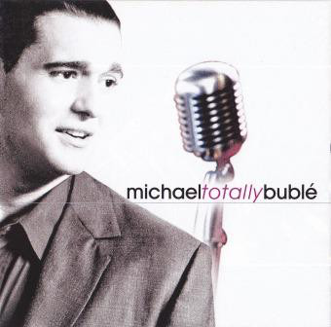
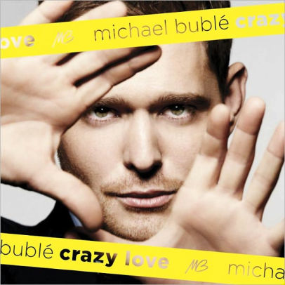
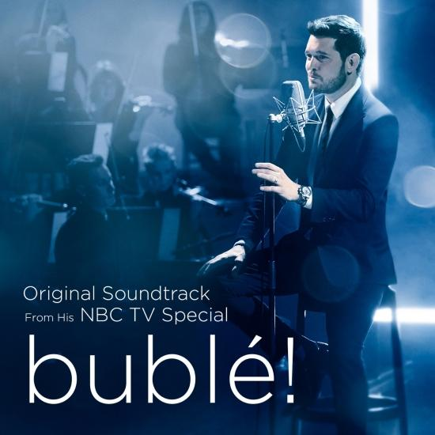
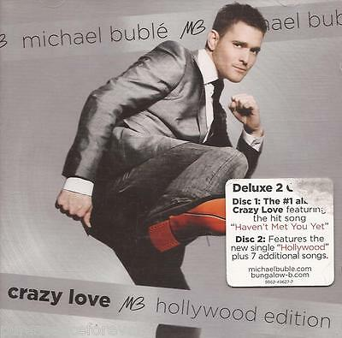
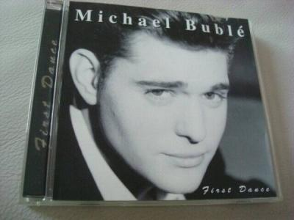
Suggested playlist
Feeling Good
Heartache tonight
Cry me a river
Spiderman theme
You Must Have Been A Beautiful Baby
What A Wonderful World
It's a Beautiful Day
I Believe in You
Someday (feat. Meghan Trainor)
Try A Little Tenderness
Fever
Call Me Irresponsible
I'm Your Man

Slide 5
Short introspection, why do I listen Bublé?
I grew up with music from many classical movies in which Frank Sinatra played or singed.
I’m fond of classical music and opera, music that needs a big orchestra with a wide variety of instruments.
Bublé’s music is full of extreme sounds, very powerful low-pitched tones and high tones made with cords that results in a deeply emotional music.
Very romantic lyrics with sweet narrative.
Didn’t know until I made the present, but the story of Bublé is similar to those of Andrea Bocelli and Alessandro Safina, two tenors that I admire and that makes me sympathize more with him.

Slide 6
Music makes you braver
THANK YOU !
t

