Slide 1
ONDEX & GrapH DBs
Marco Brandizi, 16/10/2017

Slide 2
Goals
Evaluate graph databases (GDBs)/frameworkd/etc in relation to ONDEX needs
Assess GDBs as kNetMiner/ONDEX backends
Evaluate a new architecture where raw data access is entirely based on a GDB
Evaluate a new data exchange format, possibly integrated with one GDBs
and hence, evaluate the data models too
Assess data query/manipulation languages (expressivity, ease of use, speed)
Assess that performance fits to ONDEX needs

Slide 3

Test Data
Trait Ontology (TO) | 1500 nodes, is-a and part-of relations (i.e., mostly tree)
Gene Ontology (GO) | Tree with 46k nodes
AraCyc/BioPAX | Heterogeneous net, 23k nodes, 40k relations
Ara-kNet | Heterogeneous net, 350k nodes 1.150M relations

Slide 4
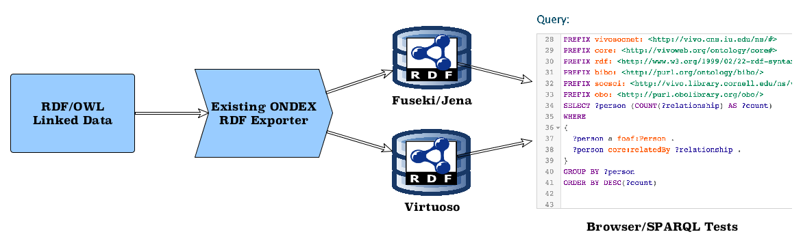
Test Settings (RDF)

Slide 5
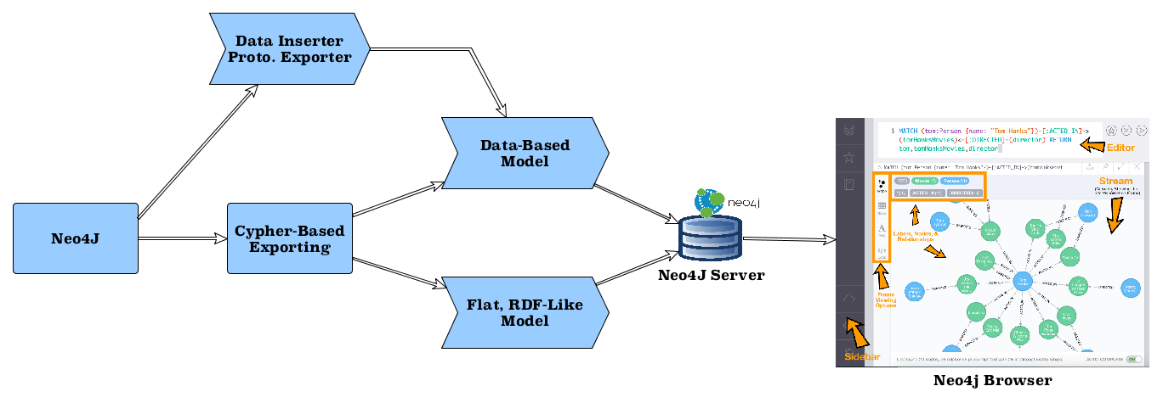
Test Settings (Neo4J)

Slide 6
RDF

Slide 7
RDF/Linked Data Essentials
Simple, Fine-Grained Data Model: Property/Value Pairs & Typed Links
Designed for Data Integration:
Universal Identifiers, W3C Standards
Strong (even too much) emphasis on knowledge modelling via schemas/ontologies
Designed for the Web: Resolvable URIs, Web APIs

Slide 8
RDF/Linked Data Essentials
Integration as native citizen, strong emphasis on knowledge modelling, schemas, ontologies

Slide 9
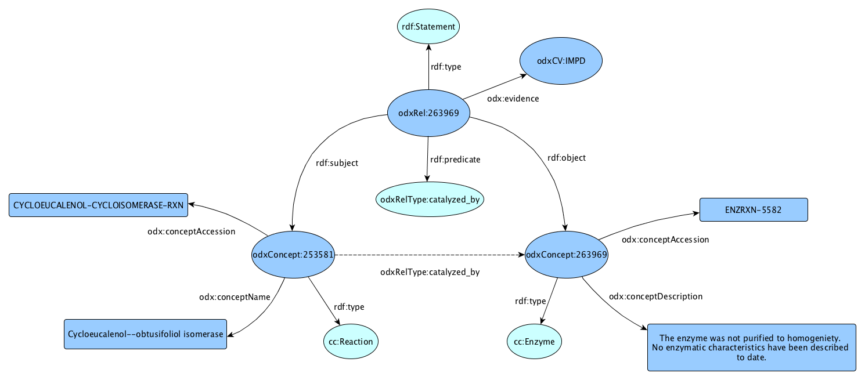
Data MODEL: ONDEX in RDF

Slide 10
Example QuerieS
Count concepts (classes) in Trait Ontology: select count (distinct ?c) WHERE { ?c a odxcc:TO_TERM. }
Proteins related to pathways: select distinct ?prot ?pway { ?prot odxrt:pd_by|odxrt:cs_by ?react; a odxcc:Protein. ?react a odxcc:Reaction.
?react odxrt:part_of ?pway. ?pway a odxcc:Path. } LIMIT 1000
Parts of membrane (transitively): select distinct ?csup ?supName ?c ?name WHERE { ?csup odx:conceptName ?supName. FILTER ( ?supName = "cellular membrane" )
?c odxrt:part_of* ?csup. ?c odx:conceptName ?name. } LIMIT 1000
‘|’ for property paths
optimised order

Slide 11
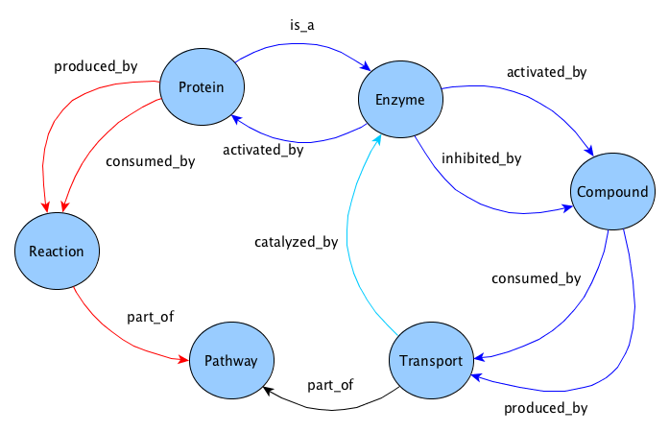
Example QuerieS
Proteins related to pathways:
prefix odx: <http://ondex.sourceforge.net/ondex-core#> prefix odxcc: <http://www.ondex.org/ex/conceptClass/> prefix odxc: <http://www.ondex.org/ex/concept/> prefix odxrt: <http://www.ondex.org/ex/relationType/> prefix odxr: <http://www.ondex.org/ex/relation/> prefix rdfs: <http://www.w3.org/2000/01/rdf-schema#>
select distinct ?prot ?pway { where { # Branch 1 ?prot odxrt:pd_by|odxrt:cs_by ?react. ?prot a odxcc:Protein. ?react a odxcc:Reaction. ?react odxrt:part_of ?pway. ?pway a odxcc:Path. } # to be continued…
# part 2 union { # Branch 2 ?prot ^odxrt:ac_by|odxrt:is_a ?enz. ?prot a odxcc:Protein. ?enz a odxcc:Enzyme. { # Branch 2.1 ?enz odxrt:ac_by|odxrt:in_by ?comp. ?comp a odxcc:Compound. ?comp odxrt:cs_by|odxrt:pd_by ?trns ?trns a odxcc:Transport } union { # Branch 2.2 ?enz ^odxrt:ca_by ?trns. ?comp a odxcc:Compound. ?trns a odxcc:Transport } ?trns odxrt:part_of ?pway. ?pway a odxcc:Path. } } LIMIT 1000

Slide 12
RDF PerformancE
Simple, common queries (Fuseki)

Slide 13
RDF PerformancE
Queries over ONDEX paths (Fuseki)

Slide 14
RDF PerformancE
Queries over ONDEX paths, Virtuoso

Slide 15
neo4j

Slide 16
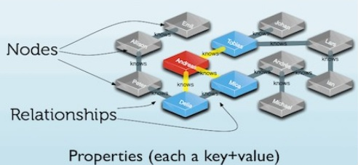
Neo4j Essentials
Designed to backup applications
much less about standards or Web-based sharing
Very little to manage schemas (more later)
No native data format (except Cypher, support for GraphML, RDF)
Initially based on API only, now Cypher available
Compact, easy, no URIs (can be used as strings)
Very performant
Hasn’t much for clustering/federation, but Cypher can be used in TinkerPop
More commercial (not necessarily good)
Cool management interface
Probably easier to use for the average Java developer
Image credits: https://goo.gl/YLhCXG

Slide 17
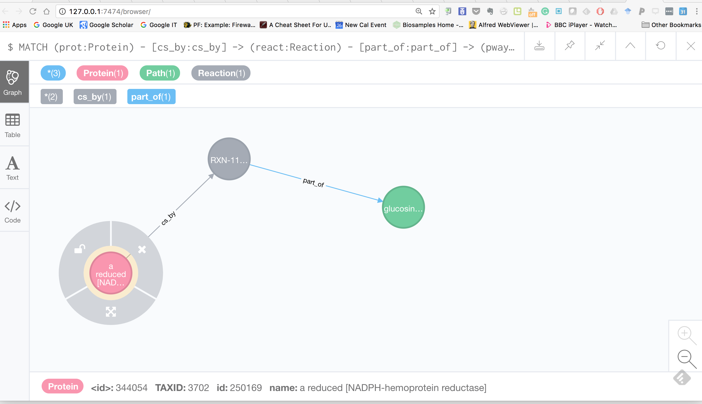
Neo4j Data Model
Cool management interface (SPARQL version might be a student project)
Nodes & relations have labels (i.e., string-based types)
Both nodes and relations can have attributes

Slide 18
Cypher Query/DM Language
Proteins->Reactions->Pathways: // chain of paths, node selection via property (exploits indices) MATCH (prot:Protein) - [csby:consumed_by] -> (:Reaction) - [:part_of] -> (pway:Path{ title: ‘apoptosis’ }) // further conditions, but often not performant WHERE prot.name =~ ‘(?i)^DNA.+’ // Usual projection and post-selection operators RETURN prot.name, pway // Relations can have properties ORDER BY csby.pvalue LIMIT 1000
Single-path (or same-direction branching) easy to write: MATCH (prot:Protein) - [:pd_by|cs_by] -> (:Reaction) - [:part_of*1..3] -> (pway:Path) RETURN ID(prot), ID(pway) LIMIT 1000 // Very compact forms available, depending on the data MATCH (prot:Protein) - (pway:Path) RETURN pway

Slide 19
Cypher Query/DM Language
DML features: MATCH (prot:Protein{ name:’P53’ }), (pway:Path{ title:’apoptosis’}) CREATE (prot) - [:participates_in] -> (pway)
DML features, embeddable in Java/Python/etc: UNWIND $rows AS row // $rows set by the invoker, programmatically MATCH (prot:Protein{ id: row.protId }), (pway:Path{ id:row.pathId }) CREATE (prot) - [relation:participates_in] -> (pway) SET relation = row.relationAttributes

Slide 20
Cypher/Neo4j Performance
Simple, common queries

Slide 21
Cypher/Neo4j Performance
Path Queries

Slide 22
Sounds Good, But…
select distinct ?prot ?pway { where { # Branch 1 … } union { # Branch 2 … { # Branch 2.1 } union { # Branch 2.2 } … } }
In Cypher?!
I couldn’t find a decent way, although it might be possible (https://goo.gl/Rpa9SM)
Partially possible in straightforward way, but redundantly, e.g., Branch 2.2:
MATCH (prot:Protein) <- [:ac_by] - (:Enzyme) <- [:ca_by] - (:Transport) <- [:part_of] - (pway:Path) RETURN prot, pway LIMIT 100 UNION MATCH (prot:Protein) - [:is_a] -> (:Enzyme) <- [:ca_by] - (:Transport) <- [:part_of] - (pway:Path) RETURN prot, pway LIMIT 100

Slide 23
ADDENDUM
In Cypher?! Unions+branches partially possible by means of paths in WHERE:
select distinct ?prot ?pway { where { # Branch 1 … } union { # Branch 2 … { # Branch 2.1 } union { # Branch 2.2 } … } }
// Branch 2 MATCH (prot:Protein), (enz:Enzyme), (tns:Transport) - [:part_of] -> (path:Path) WHERE ( (enz) - [:ac_by|:in_by] -> (:Comp) - [:pd_by|:cs_by] -> (tns) // Branch 2.1 OR (tns) - [:ca_by] -> (enz) ) //Branch 2.2 (pt1) AND ( (prot) - [:is_a] -> (enz) OR (prot) <- [:ac_by] - (enz) ) // Branch 2.2 (pt2) RETURN prot, path LIMIT 30 UNION // Branch1 MATCH (prot:Protein) - [:pd_by|:cs_by] -> (:Reaction) - [:part_of] -> (path:Path) RETURN prot, path LIMIT 30
However,
41249ms to execute against wheat net.
it generates cartesian products and can easily explode

Slide 24
Sounds Good, But…
What about schemas/metadata/ontologies?
Node and relations can only have multiple labels attached, which are just strings. Rich schema-operations not so easy:
Select any kind of protein, including enzymes, cytokines
Select any type of ‘interacts with’, including ‘catalysed by’, ‘consumed by’, ‘produced by’ (might require ‘inverse of’)
Basically, has a relational-oriented view about the schemas

Slide 25
Sounds Good, But…
Basically, it’s relational-oriented about schemas
we might still be OK with metadata modelled as graphs, however:
MATCH (molecule:Molecule), (molType:Class)-[:is_a*]->(:Class{ name:’Protein’ }) WHERE LABELS molType IN LABELS (molecule)
It’s expensive to compute (doesn’t exploit indexes)
MATCH (molecule:Molecule:$additionalLabel) CREATE …
Parameterising on labels not possible
Requires non parametric Cypher string => UNWIND-based bulk loading impossible
=> bad performance
Programmatic approach possible, but a lot of problems with things like Lucene version mismatches (one reason being that ONDEX would require review and proper plug-in architecture)

Slide 26
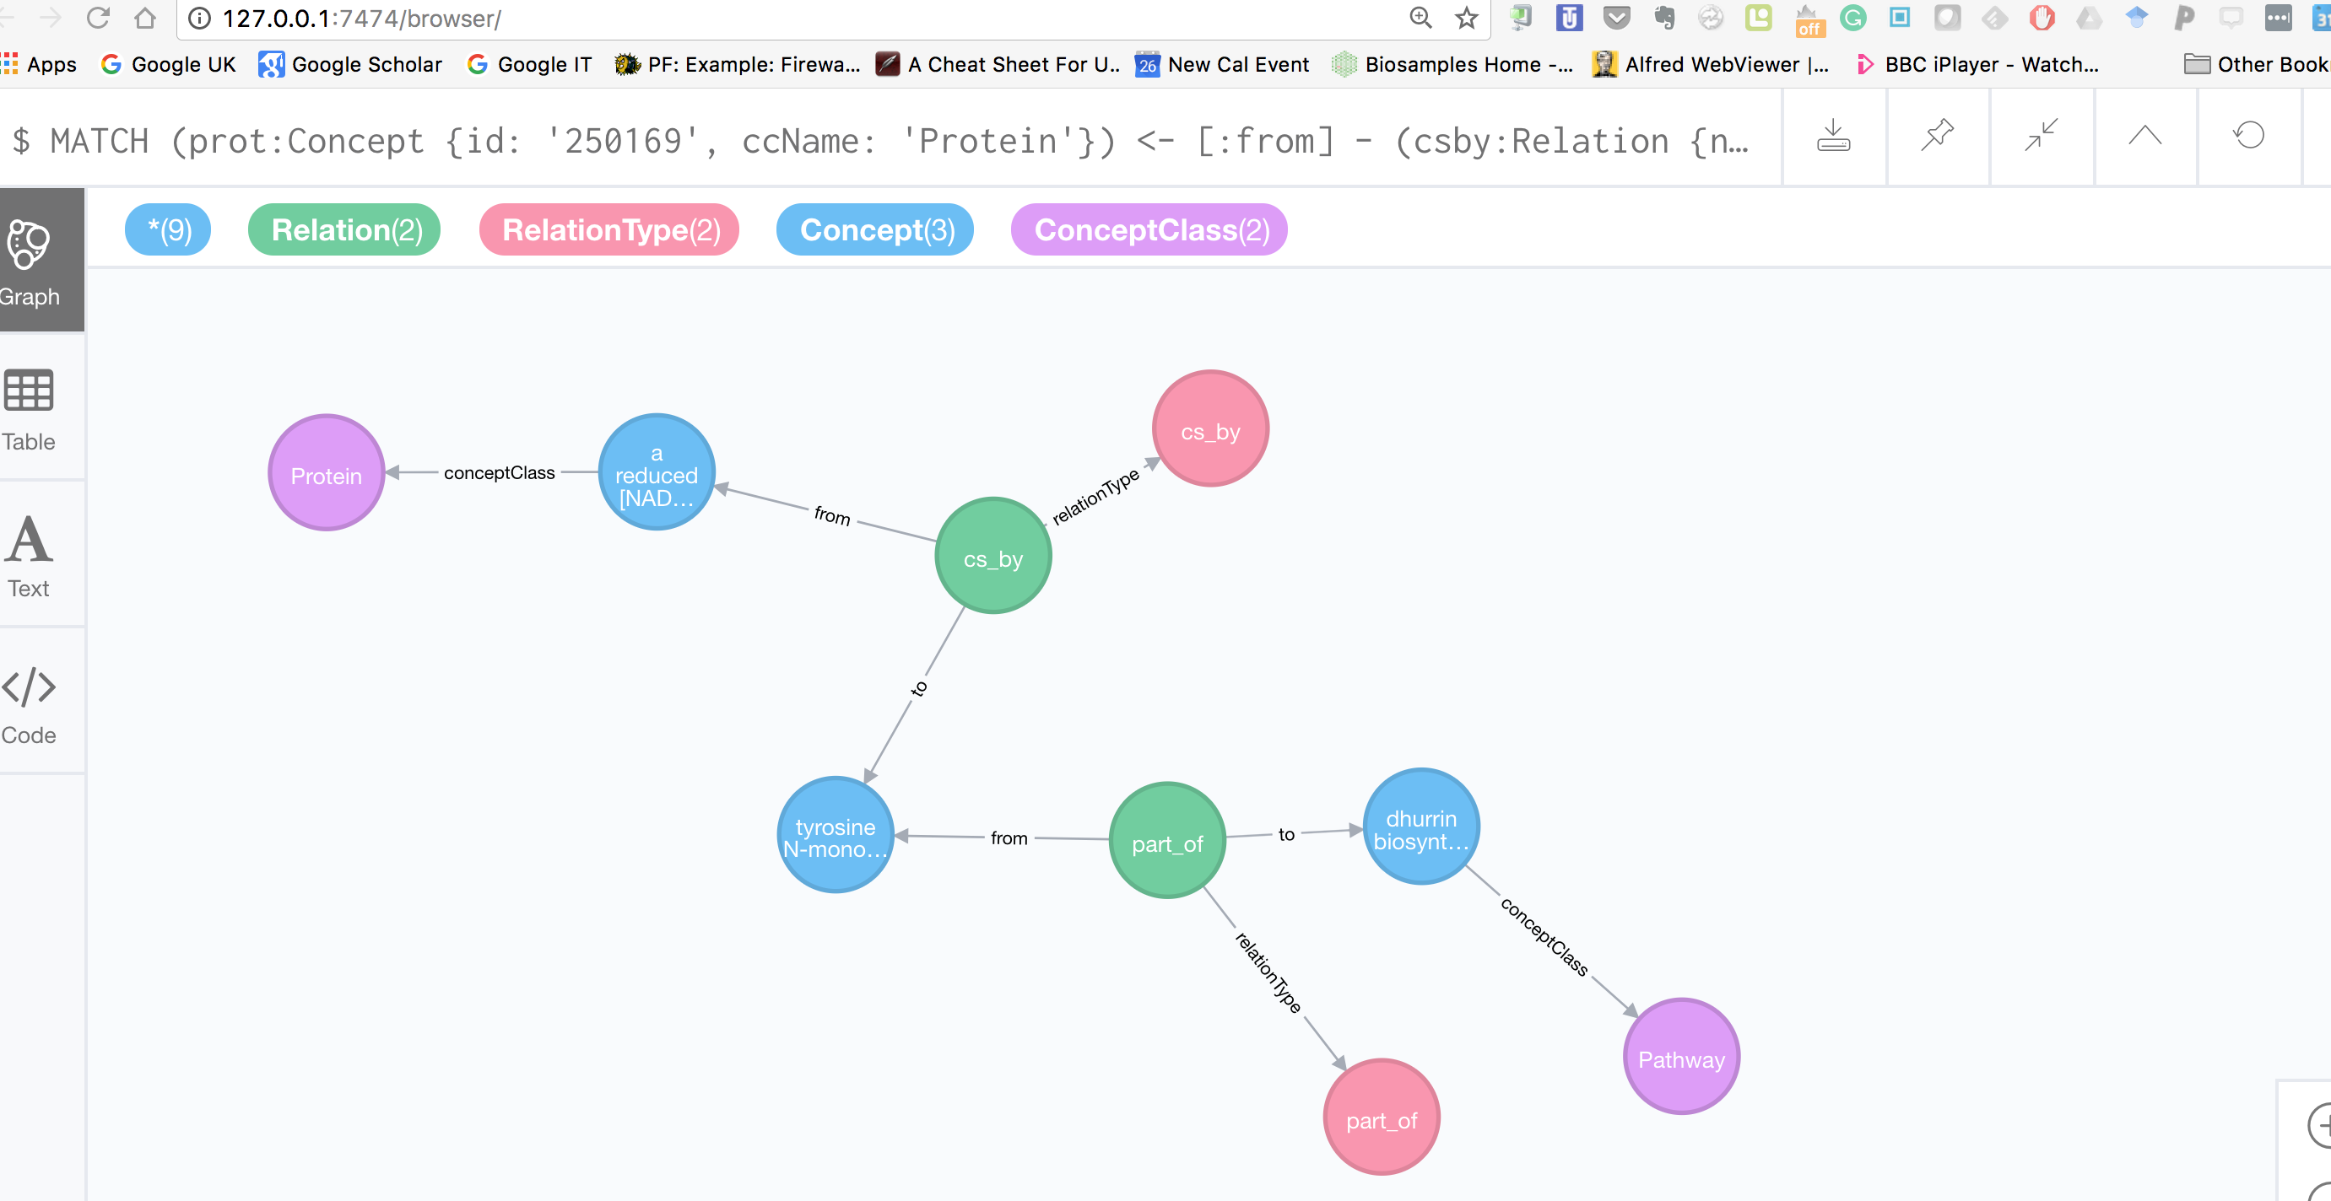
Flat, RDF-Like Model
Code for both converters: github:/marco-brandizi/odx_neo4j_converter_test

Slide 27
Flat Model Impact on Cypher
Structured model: MATCH (prot:Protein{ id: '250169' }) - [:cs_by] -> (react:Reaction) - [:part_of] -> (pway:Path) RETURN * LIMIT 100
Flat model: MATCH (prot:Concept {id: '250169', ccName: 'Protein'}) <- [:from] - (csby:Relation {name: 'cs_by' }) - [:to] -> (react:Concept { ccName: 'Reaction'}) <- [:from] - (partof:Relation {name:'part_of'}) - [:to] -> (pway:Concept {ccName:'Path'}) RETURN * LIMIT 100
Rich schema-based queries MATCH (mol:{Concept}) <- [:conceptClass] - (cc:ConceptClass), (cc) <- [:specializationOf*] - (:ConceptClass{name:’Protein’}

Slide 28
Flat Model Performance
Simple, common queries

Slide 29
Flat Model Performance
Typical ONDEX Graph Queries

Slide 30
Impact on Cypher
Rich schema-based queries From: MATCH (molecule:Molecule), (molType:Class)-[:is_a*]->(:Class{ name:’Protein’ }) WHERE molType.label IN LABELS (molecule) To: MATCH (mol:{Concept}) <- [:conceptClass] - (cc:ConceptClass), (cc) <- [:specializationOf*] - (:ConceptClass{name:’Protein’}
now it’s efficient-enough (especially with length restrictions)
However…

Slide 31
Impact on Cypher
Rich schema-based queries MATCH (mol:{Concept}) <- [:conceptClass] - (cc:ConceptClass), (cc) <- [:specializationOf*] - (:ConceptClass{name:’Protein’}
now it’s efficient-enough (especially with length restrictions)
However… from: MATCH (react:Reaction) - [:part_of] -> (pway:Path) to: MATCH (react:Concept {ccName: ‘Reaction’}) <- [:from] - (partof:Relation {name:'part_of'}) - [:to] -> (pway:Concept {ccName:'Path'}) What if we want variable-length part_of? Not currently possible in Cypher (nor in SPARQL), maybe in future (https://github.com/neo4j/neo4j/issues/88) => Having both model, redundantly, would probably be worth => makes it not so different than RDF

Slide 32
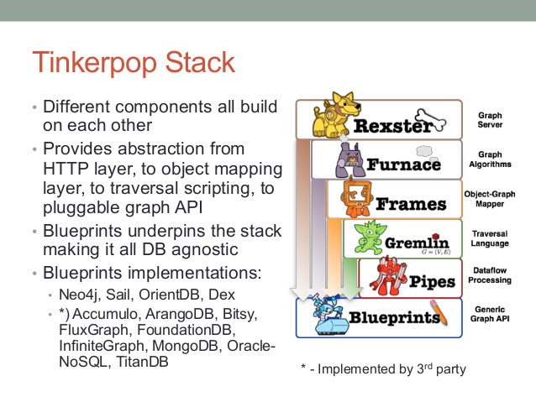
Other Issues
Data Exchange format?
None, except Cypher
DML not so performant
In particular, no standard data exchange format
Could be combined with RDF
Is Neo4j Open Source?
Produced by a company, only the Community Edition is OSS
OpenCypher is available
Cypher backed by Gremlin/TinkerPop
Apache project, more reliable OSS-wide
Performance comparable with Neo4j (https://goo.gl/NK1tn2)
More choice of implementations
Alternative QL, but more complicated IMHO (Cypher supported)
Image credits: https://goo.gl/ysBFF2

Slide 33
Conclusions
 | Neo4J/GraphDBs | Virtuoso/Triple Stores
Data X format | - | +
Data model | + Relations with properties - Metadata management | - Relations cannot have properties (req. reification) + Metadata as first citizen
Performance | + | - (comparable)
QL | + Easier (eg, compact, omissions)? - Expressivity for some patterns (unions, DML) | - Harder? (URIs, namespaces, verbosity) + More expressive
Standardisation, openness | - | +
Scalability, big data | - TinkerPop probably better | LB/Cluster solutions Over TinkerPop (via SAIL implementation)

Slide 34
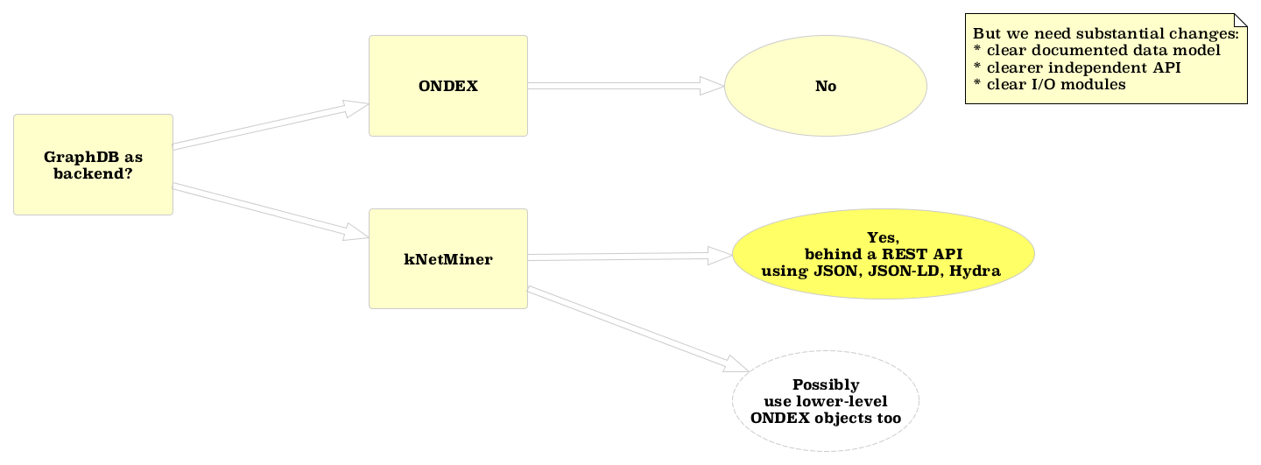
Conclusions

Slide 35
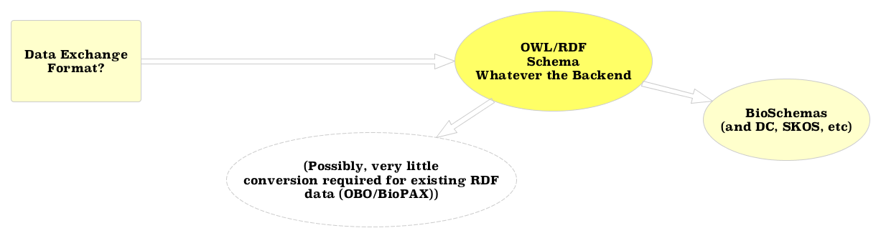
Conclusions

Slide 36
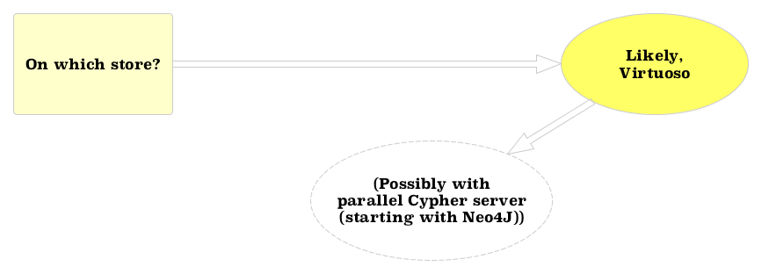
Conclusions

Slide 37
Why?
Graph + APIs
Clearer architecture, open to more applications, not only kNetMiner
QL makes it easier to develop further components/analyses/applications
Standard Data model and format
Don’t reinvent the wheel
Data sharing
Data and app integration

Slide 38
Conclusions

