Slide 1
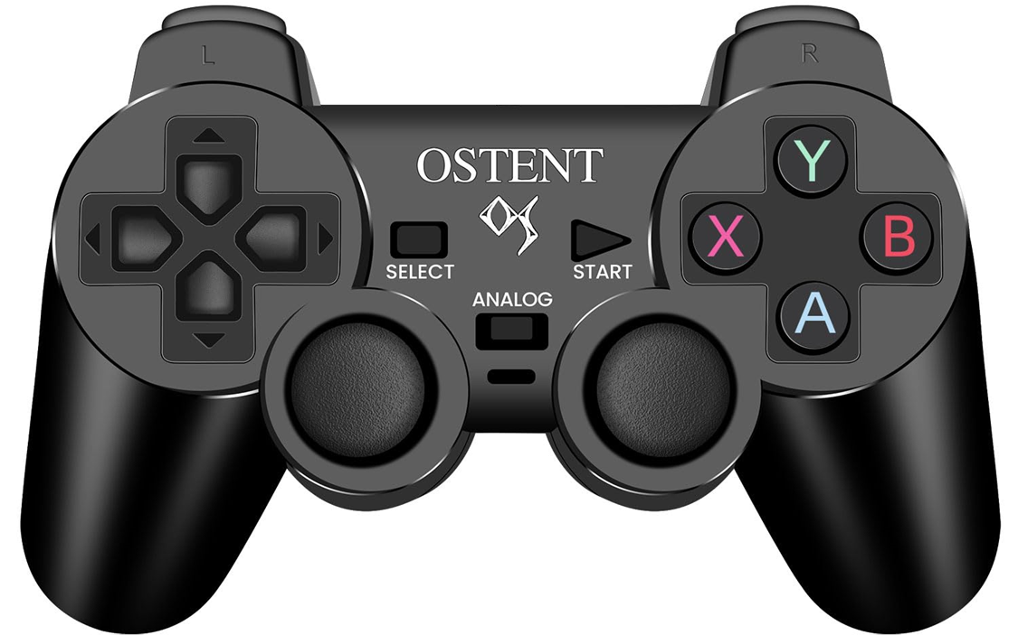
L2/R2: decrease or increase the robot's maximum speed
Reactivates the joystick if it enters standby mode
Long press: switch between the main control modes in a circular list
Short press: switch between sub-modes where applicable

Slide 2
L1: switch between Wi-Fi and hotspot mode
R1: turn on/off ROS2 connection for VR control
Strafe left and right
Cycle through internal light patterns
Cycle through GPIO LED colors
Turn on/off lidar-based collision avoidance
Sound the buzzer (beep)
Move forward and backward
Rotate left and right

Slide 3
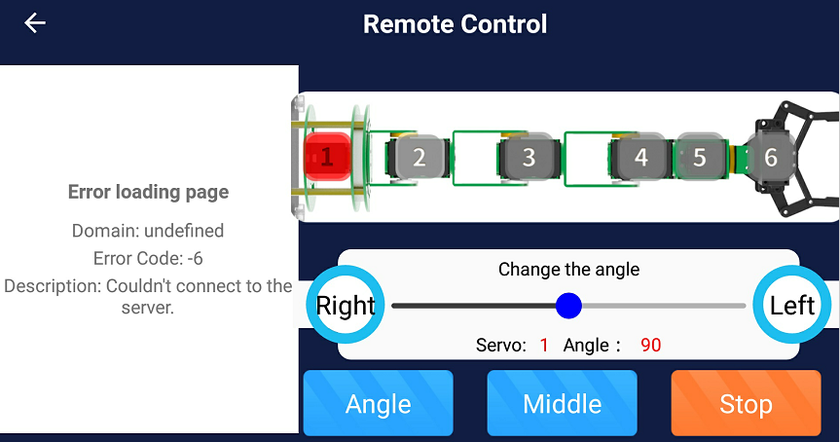
Long press: save the current arm position
Short press: to move the arm to that saved position
Motor 6: open/close gripper
Motor 4:
bend arm
Pre-registered positions (can be overwritten):
A: vertical
B: folded
X: forward
Motor 3:
bend arm
Motor 2:
bend arm
Motor 1: rotate arm base
Lock/unlock the arm motors for manual positioning
Motor 5:
rotate gripper

Slide 4
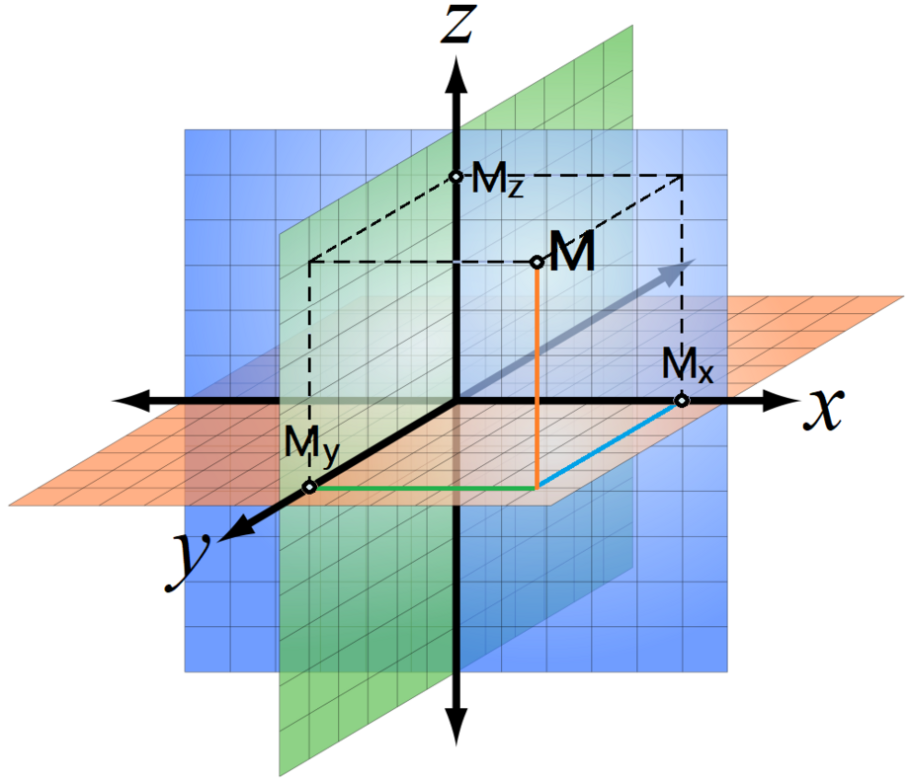
Long press: save the current arm position
Short press: to move the arm to that saved position
Motor 6: open/close gripper
M: gripper position
Pre-registered positions (can be overwritten):
A: vertical
B: folded
X: forward
Lock/unlock the arm motors for manual positioning
Motors 1-4: move gripper along the X-axis
Motors 1-4: move gripper along the Y-axis
Motors 1-4: move gripper along the Z-axis
Motor 5:
rotate gripper

Slide 5
The robot actively seeks a specified object
Cycle through targets:
Person
Orange
Cat
Cycle through internal light patterns
Cycle through YOLO models:
V11 small
V11 small TPU
V11 medium TPU
V11 big TPU
Sound the buzzer (beep)

Slide 6
The robot moves towards the nearest detected sound
Cycle through internal light patterns
Sound the buzzer (beep)

