Slide 1
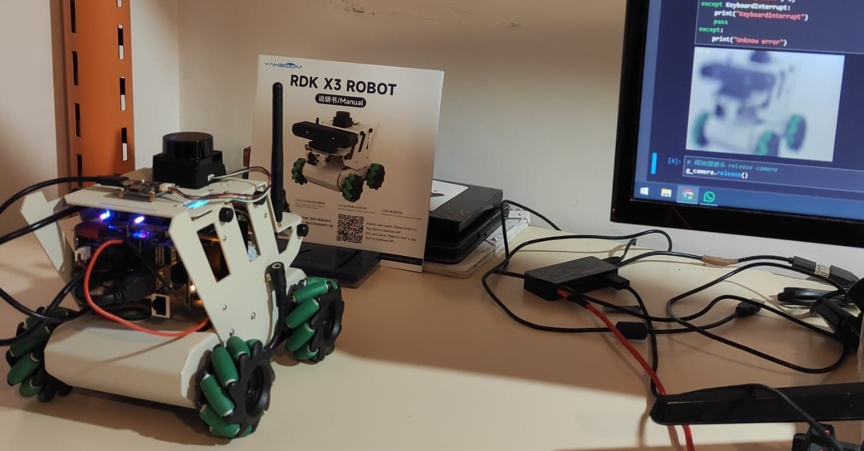
Real object
Camera view

