Slide 1
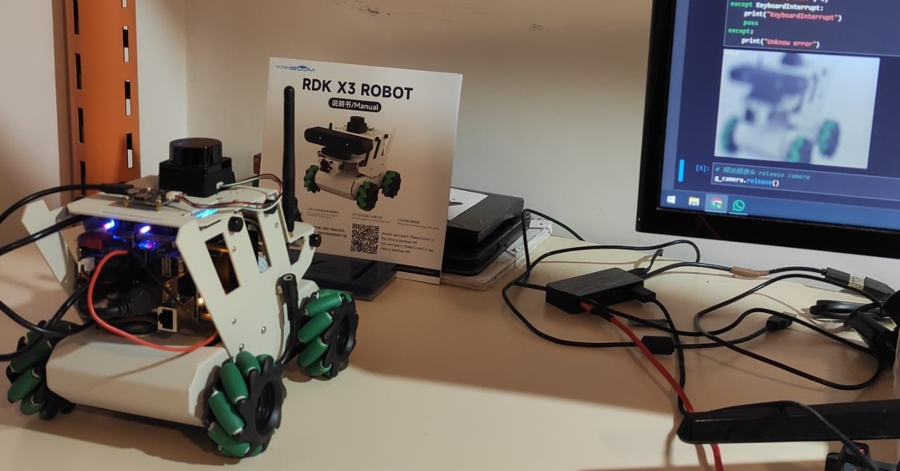
Real Scene
Camera View

