Slide 1
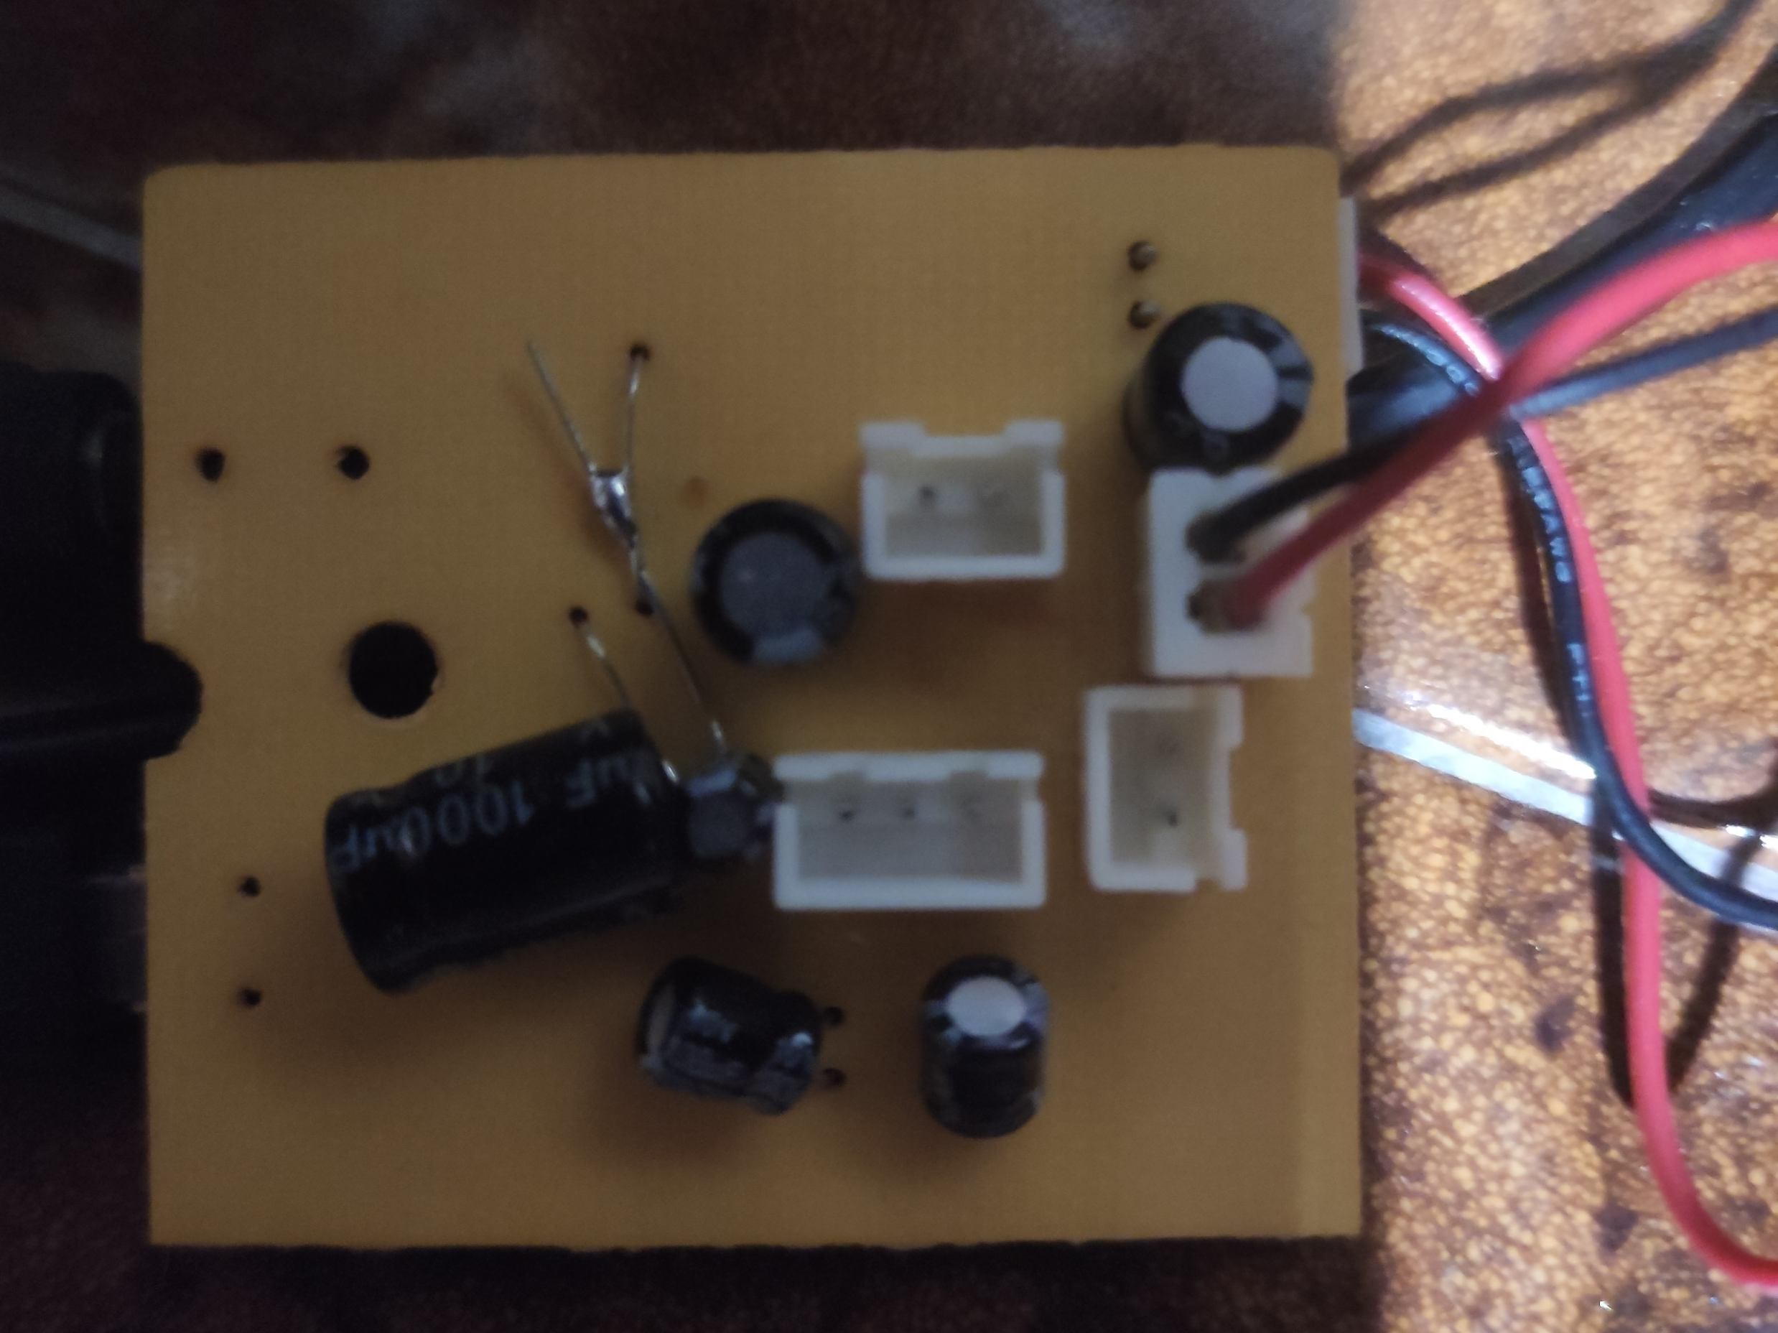
Speaker
LEDs
Motor

