Slide 1
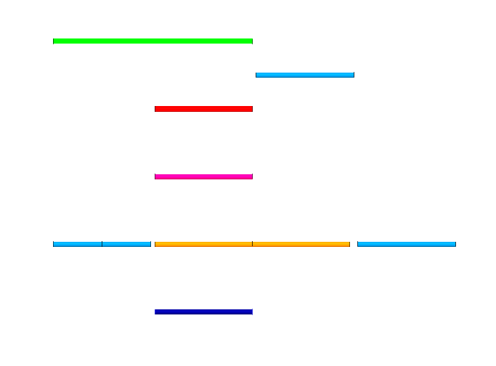
Model E
8
Line 5
10
7
Line 4 – 0.10
Line 7
Model B
Model A
6
Line 3 – 0.05
1
2
4
Line 2 – 0.70
5
9
Line 0
Model D
Line 6
3
Line 1 - 0.15
Model C

