Slide 1

Grid Wizard Enterprise
Basic
Tutorial

Slide 2
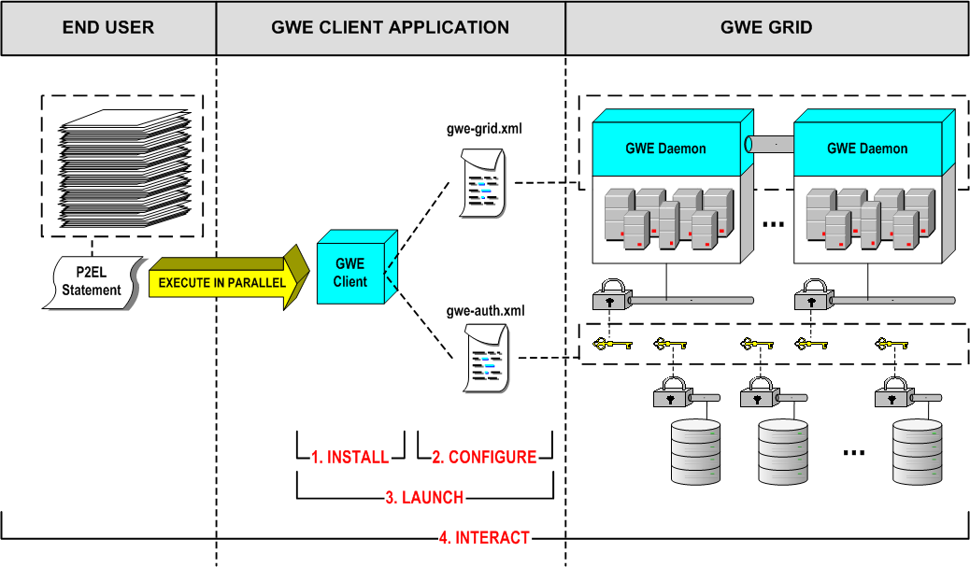
Steps Overview

Slide 3
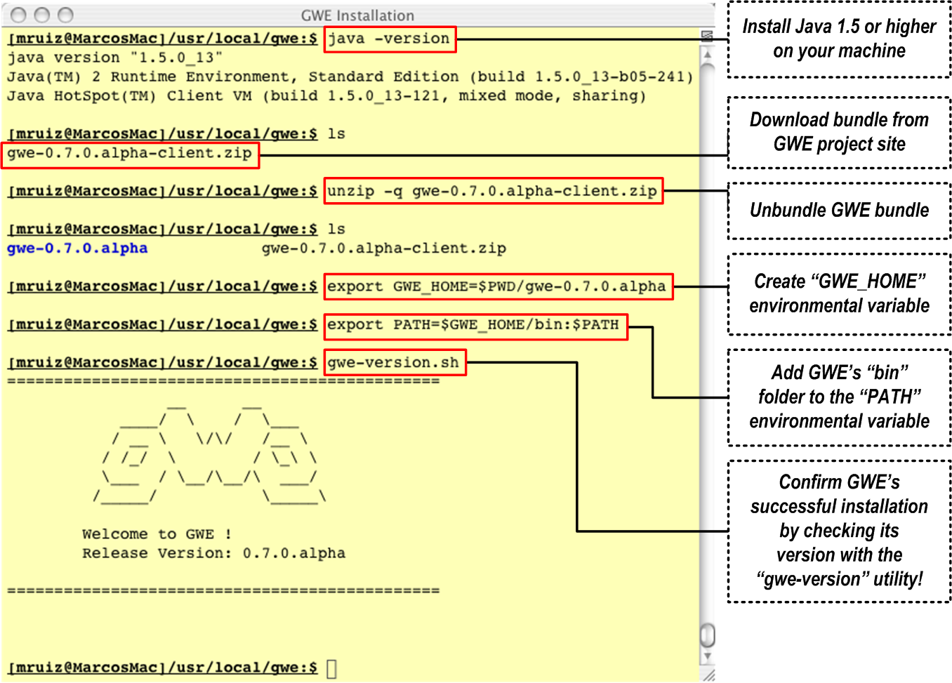
Step 1: Installation

Slide 4
Step 2: Configuration
GWE comes out-of-the-box with a default configuration; which allows the user to operate GWE right away with the following restrictions:
  Cluster to use: “local emulated cluster”.
  “Local emulated cluster”) behavioral parameters: default.
  File systems access (read or write): local or remote UNSECURED.
In this tutorial we will explore basic usage, so these restrictions are not conflictive with our goal and we will skip this step.
This step will be explored in detail in the advanced tutorial.

Slide 5
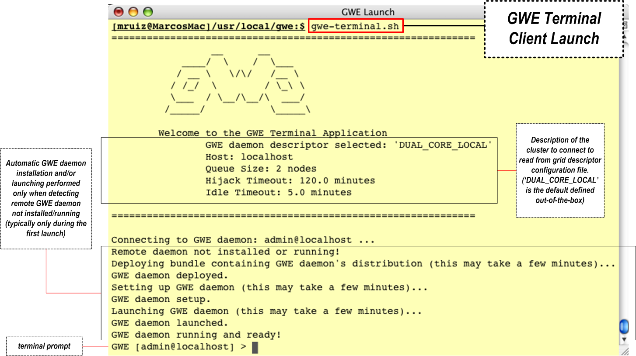
Step 3: Launching

Slide 6
Step 4: Interacting
GWE Commands - Usage
The following applies to all GWE commands required:
  Are to be input at the GWE Terminal prompt.
  Start with an command identifier followed by user parameters.
  Have an associated output response from the GWE system which is relevant to follow up the internal status of the operations and the command submitted.
A detailed documentation about these commands and how to use them can be found at: http://www.gridwizardenterprise.org/guides/user.html

Slide 7
Step 4: Interacting
GWE Commands - List
Queuing Order (‘queue-order’ command). Adds an order (set of jobs) to the GWE system processing queue for asynchronous processing.
Listing Orders (‘list-orders’ command). Outputs the list of orders queued into the GWE system.
Reviewing Order (‘view-order’ command). Outputs the details of a particular order.
Listing Jobs (‘list-jobs’ command). Outputs the list of jobs that compose a particular order.
Reviewing Job (‘view-job’ command). Outputs the details of a particular job of a particular order.
Reviewing Job Results (‘view-results’ command). Outputs the standard output of the process associated with a particular executed job of a particular order.

Slide 8
Study Case 1:
Inspecting FASTA Files from Online Expasy Database

Slide 9
Study Case 1. Step 4.1:
Creating Order’s P2EL Statement
Our target is to read 10 selected fasta sequences from the online expasy database.
The P2EL statement to express this will look like this:
A P2EL statement is composed by iteration variables followed by the actual process invocation template.
This particular statement states the process invocation template is “cat ${FASTA}” and that “${FASTA}” is a remote file that should be locally staged (“$in()” function). This remote file is templated as well, depending on another variable (“${I}”) which must be permutated over the range between 0 and 9 (inclusive).
For each OVERALL permutation of a P2EL statement a new job is generated, so 10 jobs will be generated for this statement.
A detailed P2EL specification can be found at: http://www.gridwizardenterprise.org/guides/p2el.html
${I}=$range(0,9) ${FASTA}=$in(http://www.expasy.org/uniprot/P8010${I}.fas) cat ${FASTA}

Slide 10
Study Case 1. Step 4.2:
Queuing Order
To queue this P2EL statement issue the following command:
The “GWE Terminal” must look something like this thereafter:
The “order id” printed as a response is the one that has been internally associated with the order you just queued. This shall be used to reference this order with GWE query commands (following ones). In our specific case this order id is “1”.
That’s it! Your jobs will be processed in parallel now!
queue-order ${I}=$range(0,9) ${FASTA}=$in(http://www.expasy.org/uniprot/P8010${I}.fas) cat ${FASTA}
GWE [admin@localhost] > queue-order ${I}=$range(0,9) ${FASTA}=$in(http://www.expasy.org/uniprot/P8010${I}.fas) cat ${FASTA}
Order queued with id 1

Slide 11
Study Case 1. Step 4.3:
Gathering Results
The output of this particular P2EL statement is in its standard output (“cat” to the standard output).
To check the standard output of a particular job (lets say “9”) of the order we just submitted (“1”) we issue the following command:
The “GWE Terminal” must look something like this thereafter:
view-result 1 9
GWE [admin@localhost] > view-result 1 9
>sp|P80108|PHLD_HUMAN Phosphatidylinositol-glycan-specific
phospholipase D OS=Homo sapiens GN=GPLD1 PE=1 SV=3 MSAFRLWPGLLIMLGSLCHRGSPCGLSTHVEIGHRALEFLQLHNGRVNYRELLLEHQDAY
QAGIVFPDCFYPSICKGGKFHDVSESTHWTPFLNASVHYIRENYPLPWEKDTEKLVAFLF
GITSHMAADVSWHSLGLEQGFLRTMGAIDFHGSYSEAHSAGDFGGDVLSQFEFNFNYLAR
RWYVPVKDLLGIYEKLYGRKVITENVIVDCSHIQFLEMYGEMLAVSKLYPTYSTKSPFLV
EQFQEYFLGGLDDMAFWSTNIYHLTSFMLENGTSDCNLPENPLFIACGGQQNHTQGSKMQ
KNDFHRNLTTSLTESVDRNINYTERGVFFSVNSWTPDSMSFIYKALERNIRTMFIGGSQL
SQKHVSSPLASYFLSFPYARLGWAMTSADLNQDGHGDLVVGAPGYSRPGHIHIGRVYLIY
GNDLGLPPVDLDLDKEAHRILEGFQPSGRFGSALAVLDFNVDGVPDLAVGAPSVGSEQLT
YKGAVYVYFGSKQGGMSSSPNITISCQDIYCNLGWTLLAADVNGDSEPDLVIGSPFAPGG
GKQKGIVAAFYSGPSLSDKEKLNVEAANWTVRGEEDFSWFGYSLHGVTVDNRTLLLVGSP
TWKNASRLGHLLHIRDEKKSLGRVYGYFPPNGQSWFTISGDKAMGKLGTSLSSGHVLMNG
TLKQVLLVGAPTYDDVSKVAFLTVTLHQGGATRMYALTSDAQPLLLSTFSGDRRFSRFGG
VLHLSDLDDDGLDEIIMAAPLRIADVTSGLIGGEDGRVYVYNGKETTLGDMTGKCKSWIT
PCPEEKAQYVLISPEASSRFGSSLITVRSKAKNQVVIAAGRSSLGARLSGALHVYSLGSD

Slide 12
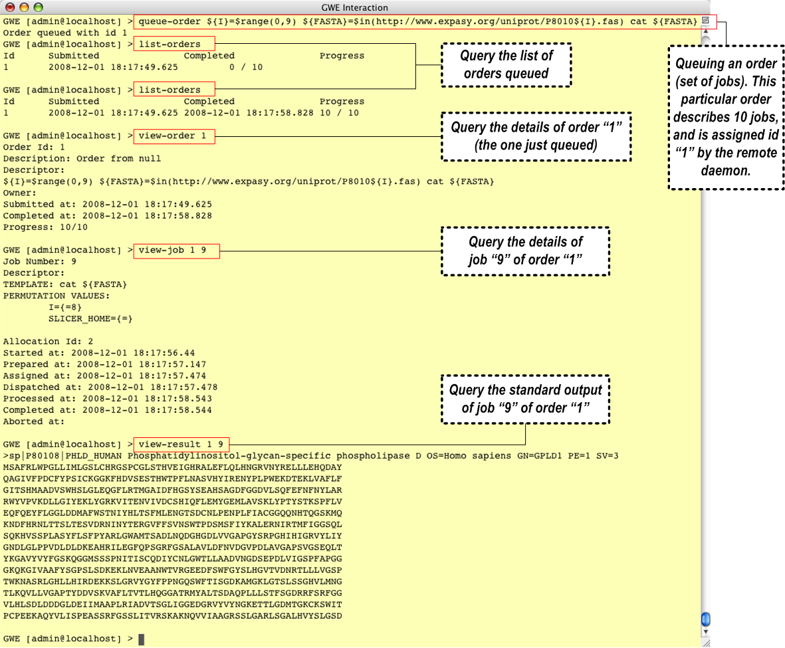
Study Case 1: Snapshot

Slide 13
Study Case 2:
Slicer’s BSpline Deformable Registration of Online Brain Scans
(OASIS Database)

Slide 14
Study Case 2. Step 4.1:
Creating Order’s P2EL Statement
Our target is to read a set of brain scans from the online OASIS database, extract their contents, process each one of them with Slicer’s BSpline Deformable Registration using different parameters (parameter exploration) and upload the generated output files to a specific directory.
The P2EL statement to express this will look like this:
${SLICER_HOME}=[LOCATION_WHERE_SLICER_IS_INSTALLED]
${URI}=http://www.oasis-brains.org/app/action/DownloadImages/template/ClosePage.vm?download_type=zip&search_element=xnat%3AmrSessionData&search_field=xnat%3AmrSessionData.ID&scanmpr1=true&scanmpr2=true&scanmpr3=true&scanmpr4=true&search_value=
${FIX_NAME}=OAS1_0101_MR1
${FIX}=$in(${URI}${FIX_NAME},${FIX_NAME}.zip,Y)
${MOV_NAME}=OAS1_00${MOV_NUM}_MR1 ${MOV_NUM}=$range(1,51,10)
${MOV}=$in(${URI}${MOV_NAME},${MOV_NAME}.zip,Y)
${SCAN}=$range(1,4)
${OUT}=${SYSTEM.USER_HOME}/oasis-results/out-${SYSTEM.JOB_NUM}.
${OUT_HDR}=$out(${OUT}hdr)
${OUT_IMG}=$out(${OUT}img)
${ITER}=$const(10,20) ${HIST}=$range(20,100,060) ${SAM}=$range(500,5000,3000)
${SLICER_HOME}/Slicer3 –launch ${SLICER_HOME}/lib/Slicer3/Plugins/BSplineDeformableRegistration --iterations ${ITER} --gridSize 5 --histogrambins ${HIST} --spatialsamples ${SAM} --maximumDeformation 1 --default 0 --resampledmovingfilename ${OUT_HDR}
${FIX}-contents/${FIX_NAME}/RAW/${FIX_NAME}_mpr-${SCAN}_anon.hdr
${MOV}-contents/${MOV_NAME}/RAW/${MOV_NAME}_mpr-${SCAN}_anon.hdr
Iteration Variables
Process Invocation Template

Slide 15
Study Case 2. Step 4.2:
Queuing Order
To queue this P2EL statement issue the following command with the appropriate P2EL statement (remember, all in a single line!):
That’s it! Your jobs will be processed in parallel now!
queue-order ${SLICER_HOME}=[LOCATION_WHERE_SLICER_IS_INSTALLED]
${URI}=http://www.oasis-brains.org/app/action/DownloadImages/template/ClosePage.vm?download_type=zip&search_element=xnat%3AmrSessionData&search_field=xnat%3AmrSessionData.ID&scanmpr1=true&scanmpr2=true&scanmpr3=true&scanmpr4=true&search_value= ${FIX_NAME}=OAS1_0101_MR1 ${FIX}=$in(${URI}${FIX_NAME},${FIX_NAME}.zip,Y) ${MOV_NUM}=$range(1,51,10) ${MOV_NAME}=OAS1_00${MOV_NUM}_MR1 ${MOV}=$in(${URI}${MOV_NAME},${MOV_NAME}.zip,Y) ${SCAN}=$range(1,4) ${OUT}=${SYSTEM.USER_HOME}/oasis-results/out-${SYSTEM.JOB_NUM}. ${OUT_HDR}=$out(${OUT}hdr) ${OUT_IMG}=$out(${OUT}img) ${ITER}=$const(10,20) ${HIST}=$range(20,100,060) ${SAM}=$range(500,5000,3000) ${SLICER_HOME}/Slicer3 –launch ${SLICER_HOME}/lib/Slicer3/Plugins/BSplineDeformableRegistration --iterations ${ITER} --gridSize 5 --histogrambins ${HIST} --spatialsamples ${SAM} --maximumDeformation 1 --default 0 --resampledmovingfilename ${OUT_HDR}
${FIX}-contents/${FIX_NAME}/RAW/${FIX_NAME}_mpr-${SCAN}_anon.hdr
${MOV}-contents/${MOV_NAME}/RAW/${MOV_NAME}_mpr-${SCAN}_anon.hdr

Slide 16
Study Case 2. Step 4.3:
Gathering Results
As with the previous example you can check the standard output of a particular job using the “view-result” command.
The upload instructions (and consequently the upload path) were stated in this part of the statement:
The highlighted portion is the path were you can expect your files to be automatically saved (uploaded) as your jobs complete their executions.
The system variable “${SYSTEM.USER_HOME}” is replaced with the home directory of the user that launched the GWE daemon (Local cluster always you).
The system variable “${SYSTEM.JOB_NUM}” is replaced with the unique number associated with the running job (to make results files unique and avoid overwriting one another).
The P2EL function “$out()” is the one that instructs GWE that those files are to be uploaded when a job completes.
…
${OUT}=${SYSTEM.USER_HOME}/oasis-results/out-${SYSTEM.JOB_NUM}.
${OUT_HDR}=$out(${OUT}hdr)
${OUT_IMG}=$out(${OUT}img)
…

Slide 17
Study Case 2.
P2EL Statement Analysis
Download, stage, rename to “*.zip” and finally decompress a set of remote bundles used as moving files (same pattern used for the single fixed image):
Parameter exploration value set (for each image being processed):
Moving file to be used in the process invocation. It uses the a priori knowledge of the file directory structure of the extracted bundle to reference it (same pattern used for the single fixed image):
…
${MOV_NUM}=$range(1,51,10)
${MOV_NAME}=OAS1_00${MOV_NUM}_MR1
${MOV}=$in(${URI}${MOV_NAME},${MOV_NAME}.zip,Y)
…
…
${ITER}=$const(10,20) ${HIST}=$range(20,100,060) ${SAM}=$range(500,5000,3000)
…
…
${MOV}-contents/${MOV_NAME}/RAW/${MOV_NAME}_mpr-${SCAN}_anon.hdr
…

Slide 18
Step 5. Exiting Terminal
Input “exit” command on the terminal:
This command just terminates the terminal client application and its connection to the particular GWE daemon.
All GWE daemons stay alive and running in the background (idle or processing its queue of orders) in their respective locations (clusters head nodes).
GWE [admin@localhost] > exit
Disconnecting...
Bye!

