Slide 1

Grid Wizard Enterprise
Basic Tutorial
Using
Web Control Panel

Slide 2
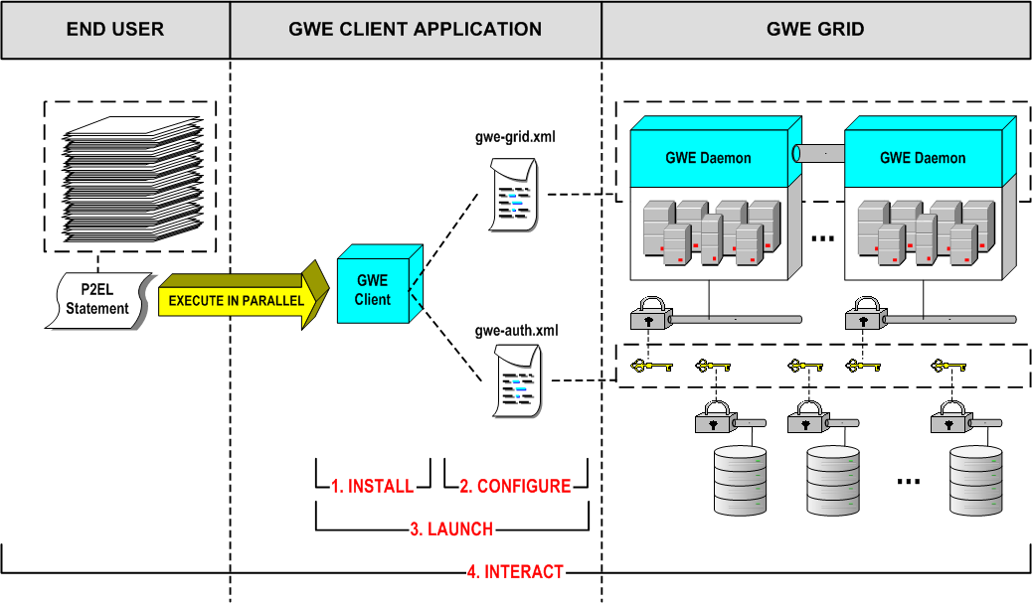
Steps Overview

Slide 3
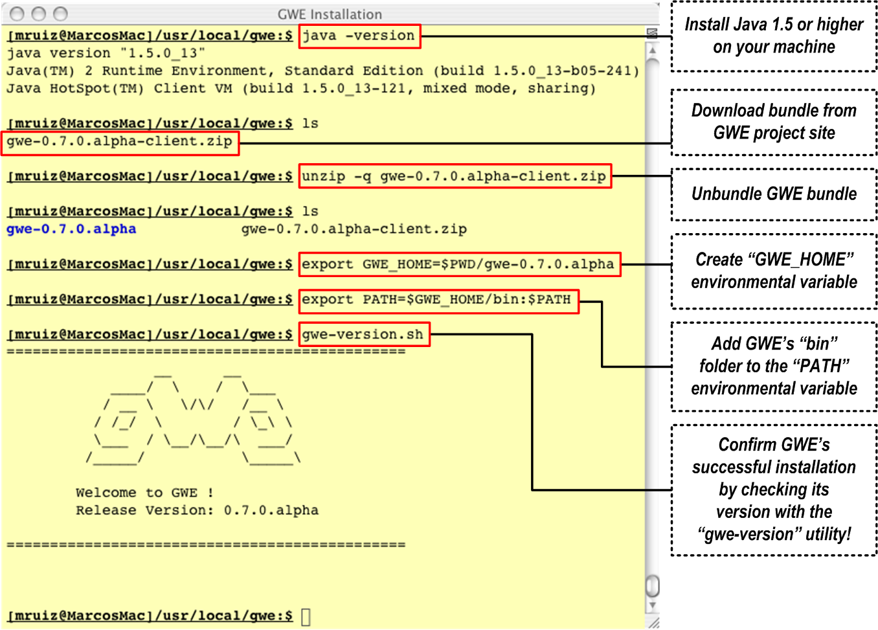
Step 1: Installation

Slide 4
Step 2: Configuration
GWE comes out-of-the-box with a default configuration; which allows the user to operate GWE right away with the following restrictions:
  Cluster to use: “local emulated cluster”.
  “Local emulated cluster”) behavioral parameters: default.
  File systems access (read or write): local or remote UNSECURED.
In this tutorial we will explore basic usage, so these restrictions are not conflictive with our goal and we will skip this step.
This step will be explored in detail in the advanced tutorial.

Slide 5
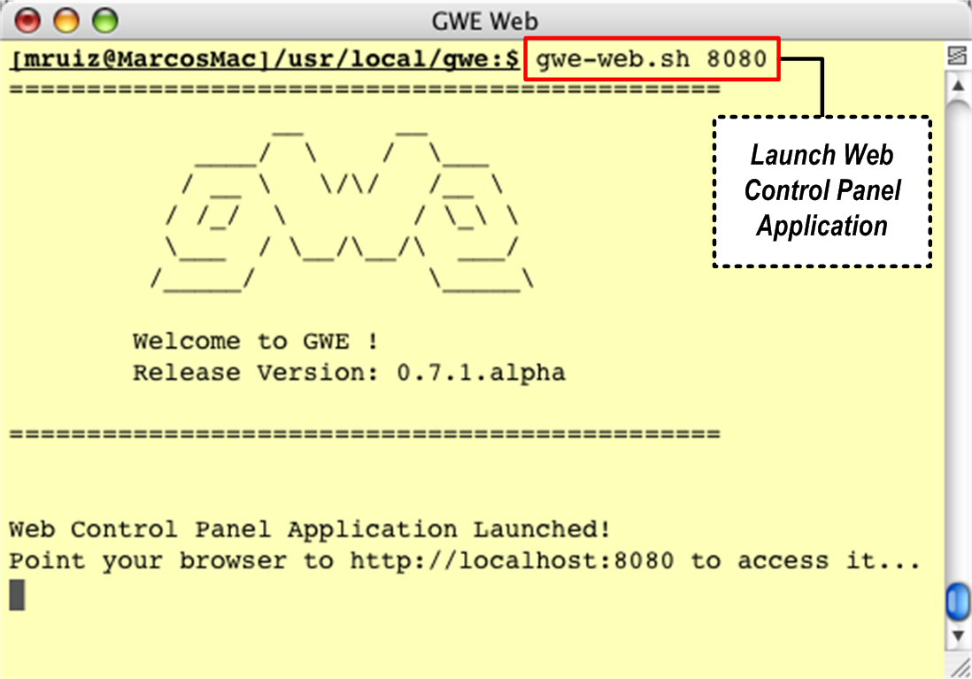
Step 2: Configuration

Slide 6
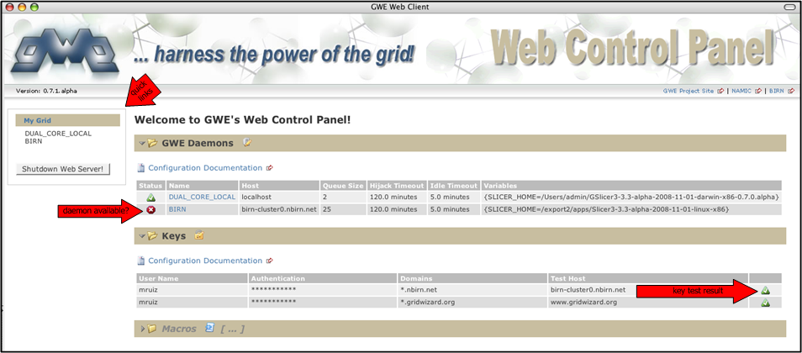
Step 2: Configuration
In a web browser open the URL ‘http://localhost:8080’
The welcome page will display the configuration stored in the respective GWE configuration files.
In the future, this application will include an interface to edit these values.
Notes:
Configuration 1

Slide 7
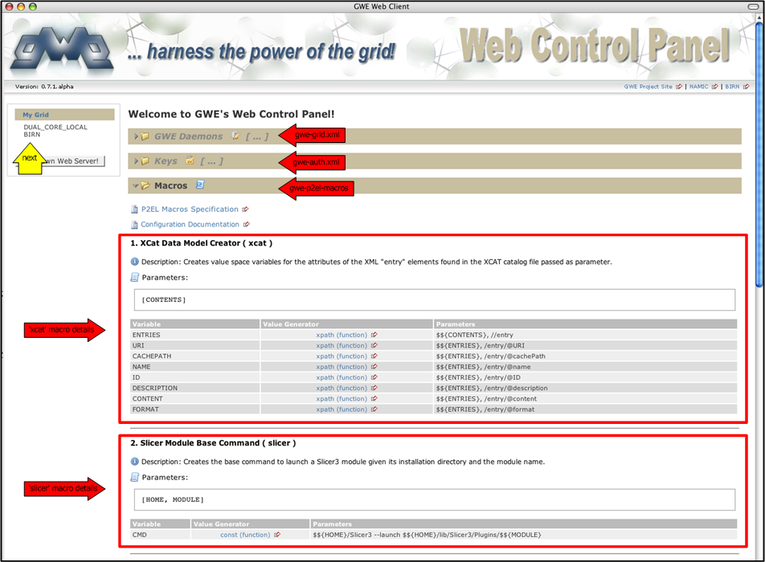
Step 2: Configuration
Notes:
Configuration 2

Slide 8
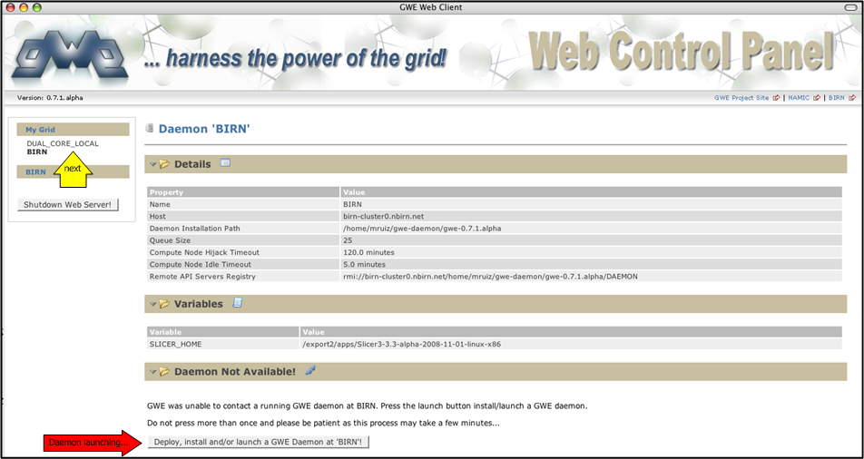
Step 3: Launching
If a daemon is not available in a particular cluster the option to deploy, install it and/or launch it is just a click away.

Slide 9
Step 4: Interacting
Summary
Queuing Order. Adds an order (set of jobs) to the GWE system processing queue for asynchronous processing.
Monitor:
  Listing Orders. Outputs the list of orders queued into the GWE system.
  Reviewing Order. Outputs the details of a particular order.
  Listing Jobs. Outputs the list of jobs that compose a particular order.
  Reviewing Job. Outputs the details of a particular job of a particular order.
  Reviewing Job Results. Outputs the standard output of the process associated with a particular executed job of a particular order.

Slide 10
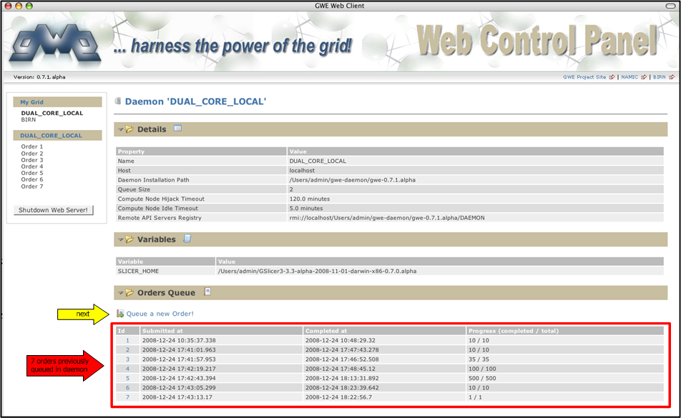
Step 4: Interacting
Accessing daemon already installed on local cluster.

Slide 11
Study Case 1:
Slicer’s BSpline Deformable Registration of Online Brain Scans
(OASIS Database)

Slide 12
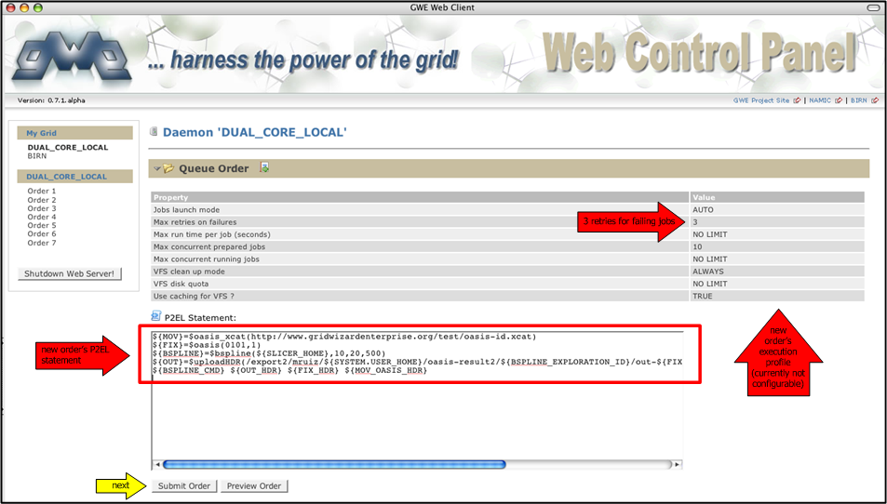
Step 4: Interacting (Queuing)
User may preview the order before queuing it as well.

Slide 13
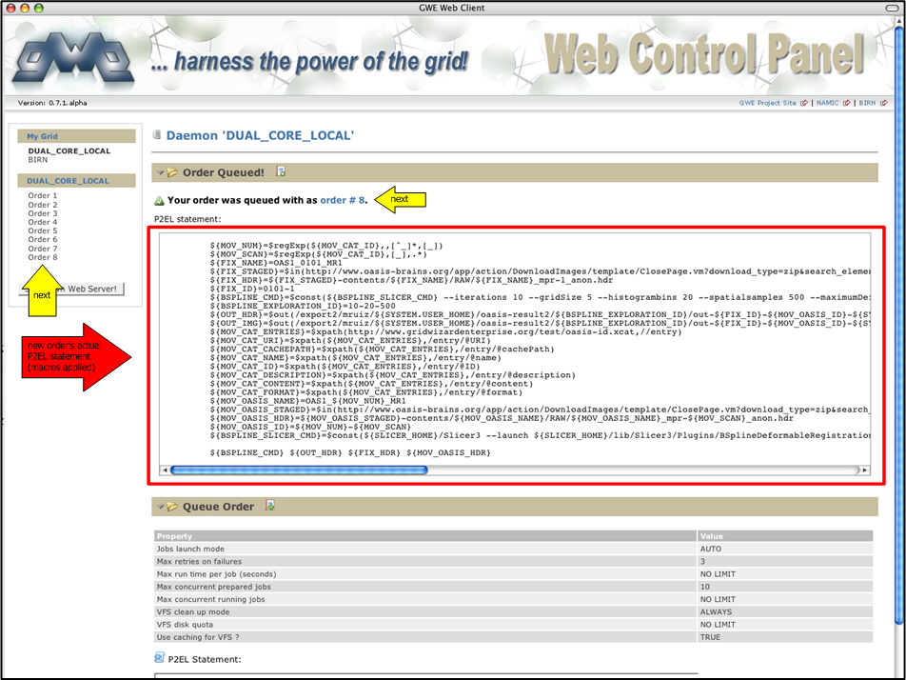
Step 4: Interacting (Queuing)

Slide 14
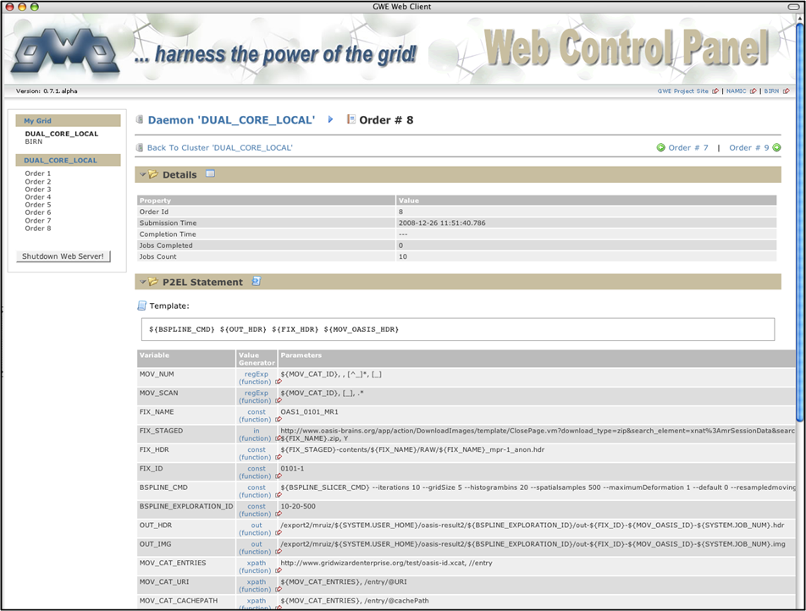
Step 4: Interacting (Monitor)

Slide 15
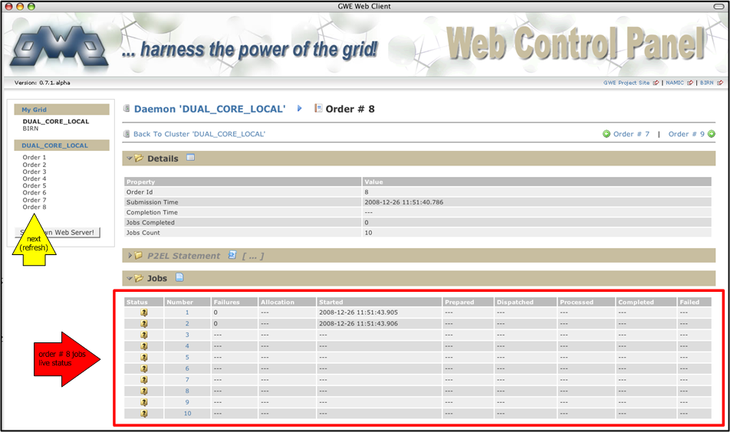
Step 4: Interacting (Monitor)
Execution of jobs just starting…

Slide 16
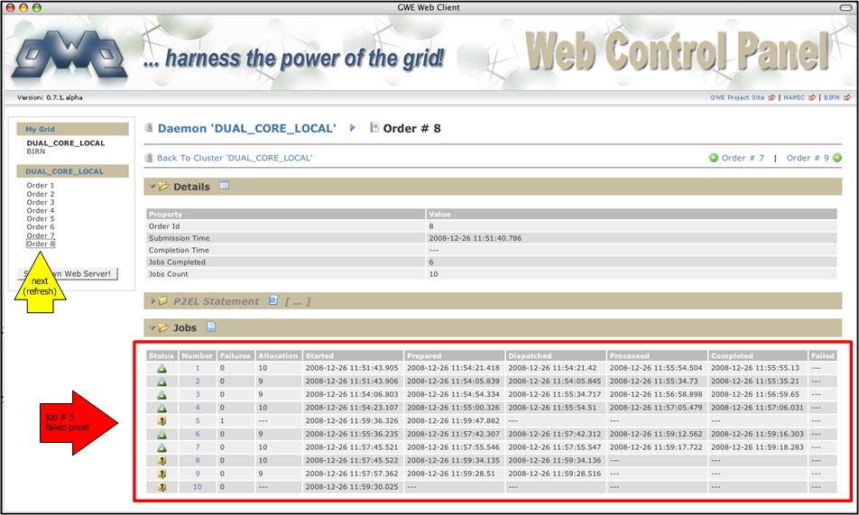
Step 4: Interacting (Monitor)
Execution of jobs progressing. Notice job 5 that failed and will be retried after all other jobs are tried at least once.

Slide 17
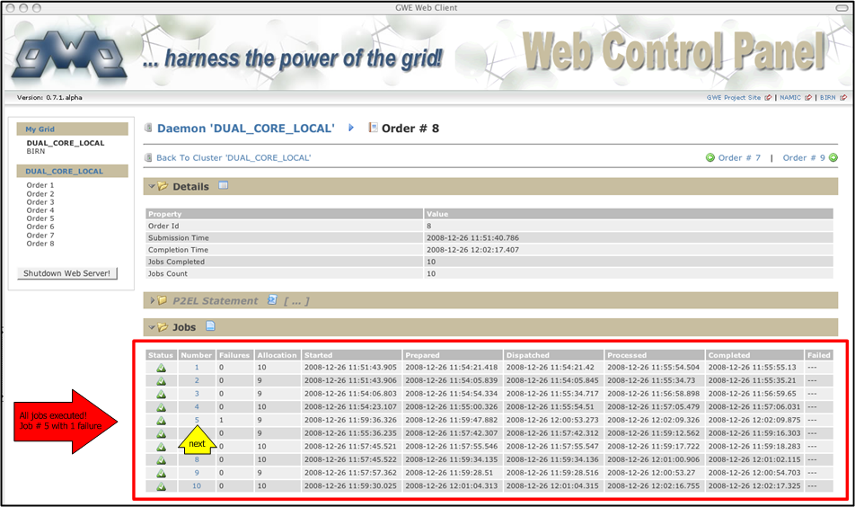
Step 4: Interacting (Monitor)
Jobs execution completed!

Slide 18
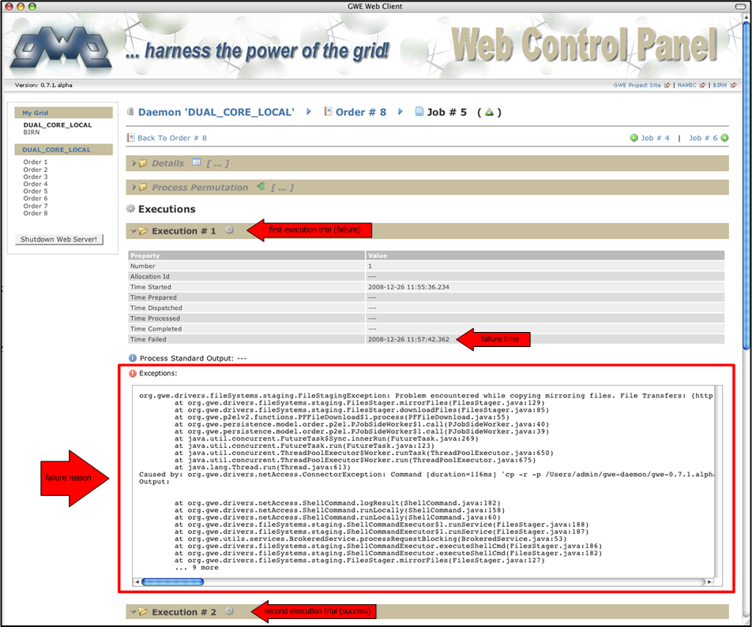
Step 4: Interacting (Monitor)

Slide 19
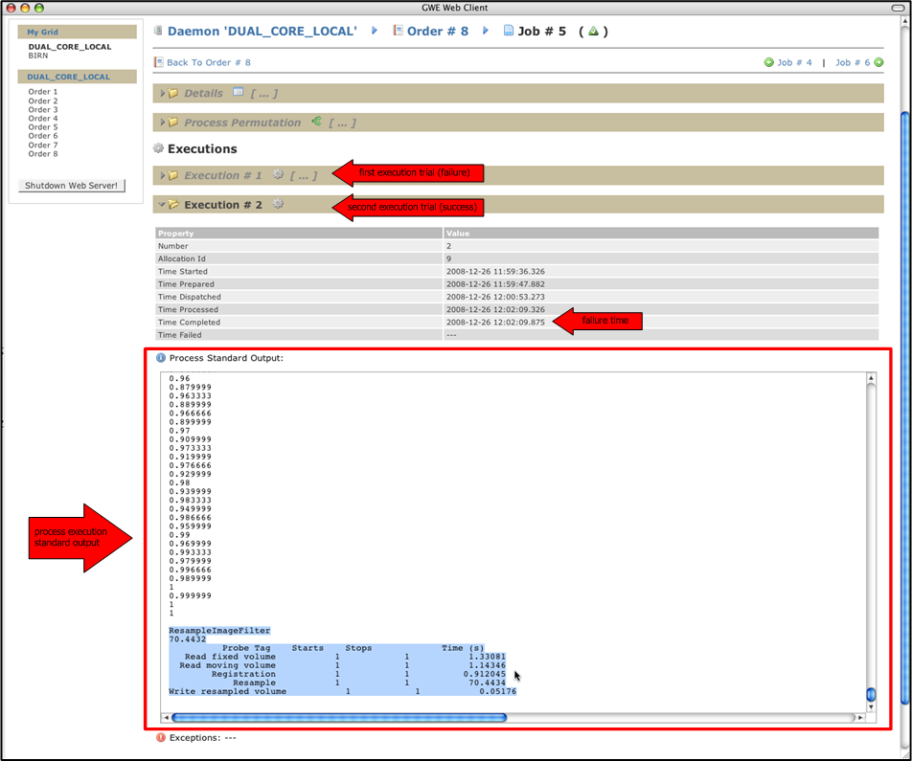
Step 4: Interacting (Monitor)

Slide 20
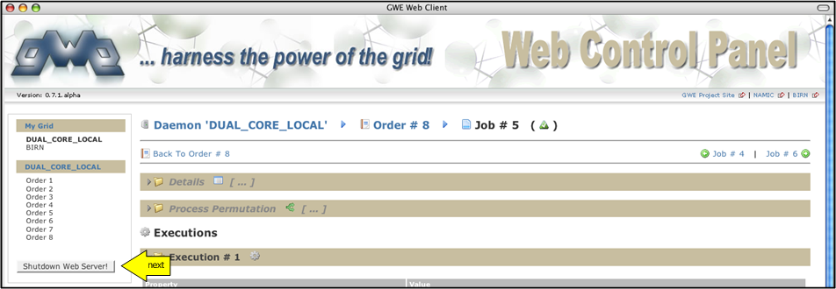
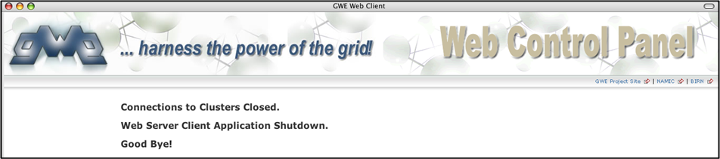
Step 5: Exit Client
Client shutdown! Although, all launched daemons will keep running in their respective clusters.

