Slide 1



Grid Wizard Enterprise
(http://www.gridwizardenterprise.org)
GWE and GSlicer3
National Alliance for Medical Image Computing
(NA-MIC - http://na-mic.org)
Biomedical Informatics Research Network
(BIRN - http://nbirn.net)

Slide 2
Introduction
Distributed enterprise system intended to ease all tasks related to the effort to parallelize the execution of inter-independent processes across clusters.
End User - You <=== Network ===> Cluster Head Node
GWE Client <== RMI over SSH Tunnels ==> GWE Daemon
Provides lots of granular control and features to grid “client”s.
Provides modular architecture carefully designed to allow third parties to extend its functionality.
Released as an open source project with an Apache 2.0 license.
Currently in alpha stage, under heavy construction.
Technology Requirements: SSH enabled clusters, Java 1.5.
Project Site: http://www.gridwizardenterprise.org

Slide 3
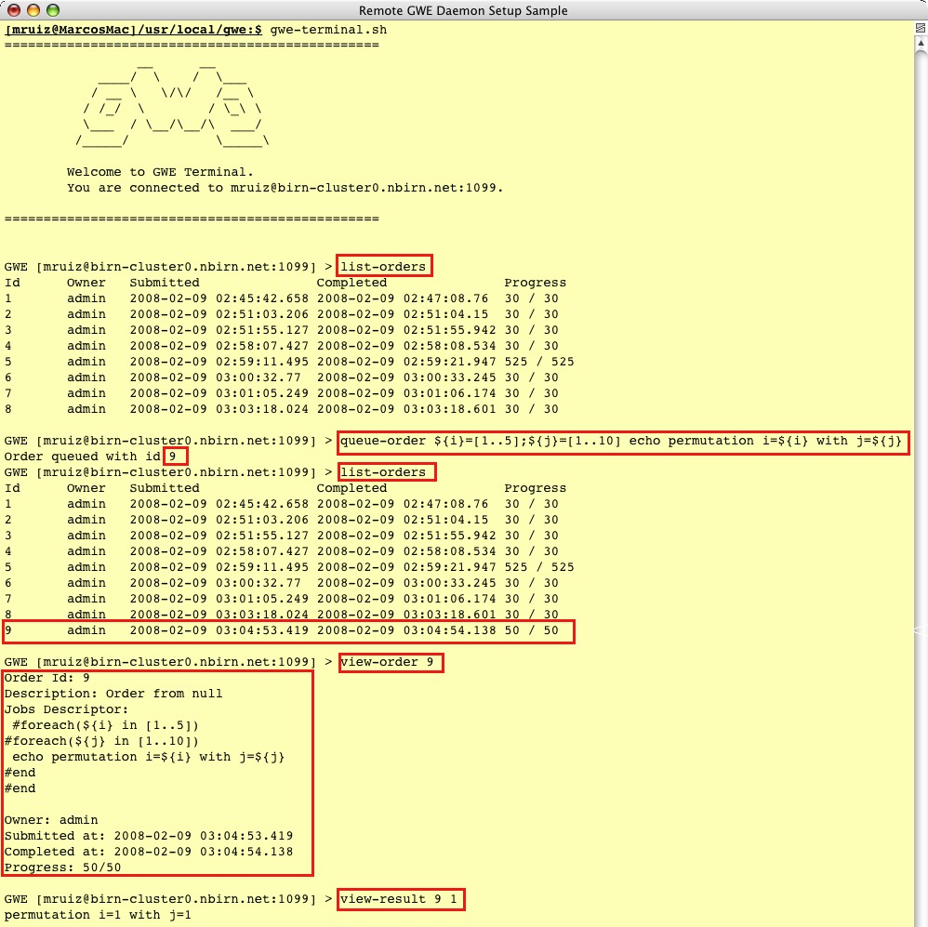
Tool Integration - Generic:
GWE Terminal
GWE comes with a full featured programmatic API (GWE Client API) to access “GWE Grid”s services.
The ‘GWE Client API’ securely communicates with “GWE Grid”s using RMI RPC over SSH Tunnels.
GWE includes generic command line tools to access “GWE Grid”s services. These tools have been built using the ‘GWE Client API’.

Slide 4
Tool Integration - Generic:
P2EL
P2EL Statement Syntax:
[PARAMETER SPACE DEFINITION] [TEMPLATED OS COMMAND]
[mruiz@rle-12-004]~:$ gwe-terminal.sh
ENTER KEYSTORE (gwe-auth.xml) MISSING VALUES
============================================
gwe@ssh;sftp://*.nbirn.net passphrase: *************
============================================
GWE User: mruiz
mruiz's password: *****
================================================
__ __
____/ \ / \___
/ __ \ \/\/ /__ \
/ /_/ \ / \_\ \
\___ / \__/\__/\ ___/
/_____/ \_____\
Welcome to GWE Terminal.
You are connected to mruiz@birn-cluster0.nbirn.net:1063.
================================================
GWE [mruiz@birn-cluster0.nbirn.net:1063] > queue-order ${ITER}=[1..5||0.5] ${ITER_2}=[2..200||20] echo ${ITER}--${ITER_2}
Order queued with id 16
GWE [mruiz@birn-cluster0.nbirn.net:1063] >queue-order ${ITER}=[10..50||10] ${HIST}=[20..100||020] /home/gwe/Slicer3/Slicer3 --launch /home/gwe/Slicer3/lib/Slicer3/Plugins/BSplineDeformableRegistration --iterations ${ITER} --gridSize 5 --histogrambins ${HIST} --spatialsamples f:anon([500..5000||0050]) --maximumDeformation 1 --default 0 --resampledmovingfilename f:out(sftp://birn-cluster0.nbirn.net/home/gwe/63Test/out-f:sys(ITER_ID).nrrd) f:in(fixed.nrrd,http://www.na-mic.org/ViewVC/index.cgi/trunk/Libs/MRML/Testing/TestData/fixed.nrrd?view=co) f:in(moving.nrrd,http://www.na-mic.org/ViewVC/index.cgi/trunk/Libs/MRML/Testing/TestData/moving.nrrd?view=co)

Slide 5
Tool Integration - GSlicer3:
Architecture
“Slicer3” and “GWE Client API” are two independent products.
GWE’s Slicer3 integration effort includes a utility to rebundle Slicer3 distributions integrated with all the components needed to have grid computing capabilities out of the box through GWE.
The end result is a product we call GSlicer3.
The components added to the Slicer3 distributions are a “GWE Client” distribution and “GWE CLM Proxys” (CLMP).

Slide 6
Tool Integration - GSlicer3:
Architecture
GWE CLM Proxys (CLMP): Slicer3 CLMs which will proxy into another (proxied CLM) to provide a “GWE Powered” version of the proxied CLM.
Technology Requirements: Out of all CLMs discovered in a Slicer3 distribution; only those complying with the “Standard Execution Model” specification will be able to have an automatic CLMP created for them.

Slide 7
Tool Integration - GSlicer3:
CLM Proxy Flow
Gathers proxied CLM “xml” and enhance it to add GWE support.
Generate P2EL commands based on GUI input and meta parameter values.
Submit GWE order representing the group of proxied CLM invocations (P2EL).

Slide 8
Tool Integration - GSlicer3:
CLM Proxy Flow
Monitors the execution on the user’s grid of the localized proxied CLM invocations.
Keeps track of the CLMP progress as the percentage of invocations executed.
Notifies Slicer3 of the CLMP progress using Slicer3’s XML based progress API.

Slide 9
Tool Integration - GSlicer3:
Registered Modules
Slicer3
Standalone CLMs.

Slide 10
Tool Integration - GSlicer3:
Registered Modules
GSlicer3:
Standalone CLMs.
1 autogenerated GWE CLM Proxy for each standalone CLM discovered (which complies with the Standard Execution Model).

Slide 11
Tool Integration - GSlicer3:
CLM Proxy Parameters

Slide 12
More Information
  Project site with a great wealth of information including detailed guides and GWE’s source code:
      http://www.gridwizardenterprise.org/
  Users mailing list to receive project news and announcements:
      gwe-users@nbirn.net
  Project community forum:
      http://groups.google.com/group/gwe-forum?hl=en
  Project team email address (questions, requests and/or feedback):
      gwe-support@nbirn.net
Thanks!

