Slide 1

NA-MIC
National Alliance for Medical Image Computing
http://na-mic.org
Simplifying the Utilization of
Grid Computation
using
Grid Wizard Enterprise

Slide 2
Introduction
Typical computation intensive problems in research in computation sciences:
  Refinement of computational protocol.
  Iteratively improve computational protocol by testing each round of the applications against different algorithmic parameters. (Parameter exploration).
  2. Usage of released computational protocol applications.
  Process large amounts of pathological inputs using the particular application. (Dataset processing).
Both of these are embarrassingly parallel problems.
Notes:
Research in the computational sciences seems to proceed, roughly speaking, in distinct phases. As an initial idea for a computational protocol is reﬁned, a researcher will iteratively debug and improve applications on a small amount of handpicked data, tweaking parameters and inspecting output for correctness. Once the idea returns plausible results and can be considered publication-worthy, the program gets run on more and more data, often involving a new round of debugging as new classes of pathological inputs are discovered. During this phase, the computational protocol undergoes systematic characterization: for what parameter ranges does it return valid results? Can any immediate conclusions or further hypotheses be derived from running on publicly available data? Finally, once the computational protocol is ready to be released to the scientiﬁc community, a researcher must decide how to distribute the code. Increasingly, providing a publicly accessible website is an attractive alternative to making code available for download: releasing new improvements or bug-ﬁxes to the code is substantially easier, and only the user interface requires documentation.
It is a lucky coincidence that the research process – including the hosting of an algorithm in a web environment – itself falls into the already useful class of embarrassingly parallel problems, that is to say, resource-intensive computational problems that can be broken into independent subunits that can run in parallel. A researcher who faces such a problem must deal with a number of tedious issues: how to determine what work needs to be done and how it should be broken into meaningful units (workload deﬁnition); how to assign individual work units to resources (application scheduling^{1,3}); how to run and monitor executables (grid execution; e.g. Globus²); and how to deal with system-related and program-related failures (failure detection). Though each of these problems can be solved in a straightforward way, the combined solutions to all of them leads to a maintenance problem, interferes with distribution, and presents an additional barrier to a scientist trying to investigate a particular problem. It is our view that a researcher expert in a particular scientiﬁc discipline should not need to also become an expert in grid computing in order to produce an application that uses grid technology. It is also our observation that the bulk of computational scientists do not have at their disposal dedicated programmers and system administrators to plan, install, conﬁgure, and maintain a complex heterogeneous network of computers.
To reﬂect these needs we have designed a system, Grid Wizard Enterprise (GWE) that facilitates the above considerations, which we derived based partly on our own experiences performing computational science in bioinformatics and partly on observing others doing the same. It is important to note that GWE is not meant to be another grid middleware package, rather, it is meant to be a large-scale job launching and management tool that bridges the gulf between the biomedical researcher and current grid middleware by:
· Providing the researcher with the ability to easily configure the heterogeneous clustered/grid resources that they have access to.
· Allowing a researcher to easily specify large parametric computational jobs using the same general syntax as is used in the command line invocation of the analysis algorithms (e.g. see P2EL in Section 4) or through integration with community developed biomedical applications (e.g. see Slicer in Section 5).
Managing the most common house keeping tasks required to ensure end-to-end success of a computation thereby relieving the researcher of this burden.

Slide 3
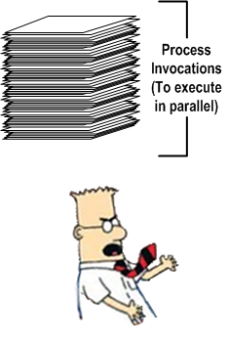
Embarrassingly Parallel Problem
Embarrassingly parallel problem (EPP) is the one faced when trying to execute in parallel a collection of inter-independent process invocations.
Inter-independent processes are those which don’t have any execution related dependencies from each other.
These processes are ideally suited to execute in parallel by distributing their execution across multiple processing units such as clusters of computers.
EPP is also known as “embarrassingly parallel workload”.
Notes:
In the jargon of parallel computing, an embarrassingly parallel workload (or embarrassingly parallel problem) is one for which no particular effort is needed to segment the problem into a very large number of parallel tasks, and there is no essential dependency (or communication) between those parallel tasks.[1]
A very common usage of an embarrassingly parallel problem lies within graphics processing units (GPUs) for things like 3D projection since each pixel on the screen can be rendered independently from any other pixel.
Embarrassingly parallel problems are ideally suited to distributed computing over the Internet (e.g. SETI@home), and are also easy to perform on server farms which do not have any of the special infrastructure used in a true supercomputer cluster.
Embarrassingly parallel problems lie at one end of the spectrum of parallelization, the degree to which a computational problem can be readily divided amongst processors.
[edit]

Slide 4
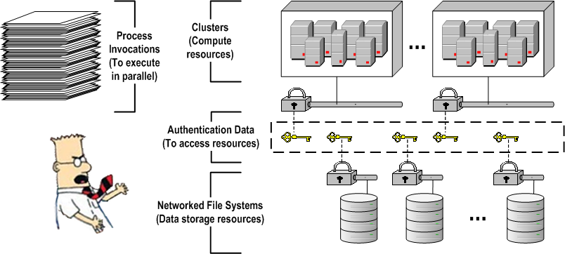
Distributed Solution for EPP
Solution: Distribute the execution of processes over an infrastructure consisting of cluster(s) of computers, their resource managers (Condor, PBS, SGE) and networked file systems (where inputs/outputs are/will be stored).
To use this infrastructure, researchers required programming and system administrator skills; which most of the time they don’t posses.

Slide 5
Distributed Solution for EPP
Even with such skills the implementing this solution is non-trivial.
Common tasks: describe processes, queue them for execution, prepare them, monitor their progress, collect and consolidate their results, wrap them up.
Users can take advantage of an easy to use solution that provides generic, cohesive strategies to address common tasks.

Slide 6
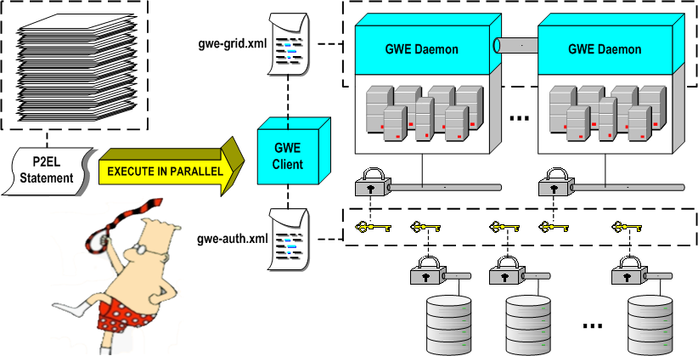
GWE’s Solution
GWE: Distributed system intended to ease the effort of executing in parallel inter-independent processes across clusters.
Low requirements! Only SSH enabled clusters and Java 1.5.

Slide 7
GWE Usage
Quick Start Guide:
  Install GWE on your machine.
  Configure GWE installed with:
    Authentication information to access clusters and file systems.
    Description of computational grid as a collection of clusters.
  Run “GWE daemons” installer utility.
  Launch a GWE client.
  Interact with your defined grid using your GWE client!
Interaction features:
  Queuing a set of process invocations described through P2EL.
  Real time and on demand progress monitoring and result status.
  Execution control: pause, resume, abort.

Slide 8
P2EL
P2EL = Processes Parallel Execution Language.
Language especially designed to allow a single statement to describe a collection of inter-independent process invocations.
Semantics to allow versatile permutations to generate process invocations.
P2EL statement composition:
  Variables. Set of variables each associated with a particular value set (evaluated through a value set generator function invocation).
  Process Invocations Template. Process invocation with variable to value substitution expressions.
Permutation of the variables values. Creates a set of all the unique variable to value resolution combinations of a statement’s variables, respecting the variables semantics (multidimensionality, co-dependency, etc).
The full language specification (syntactic and semantic rules) is described in the P2EL guide on the GWE’s project site.

Slide 9
P2EL Sample:
Dataset Processing
  “Free Surfer” Subject Cases Processor:
  This command instructs GWE to download all remote directories that match a given pattern and execute the RunFreesurfer.sh script against each one of them in parallel. That same command instructs GWE as well to upload the directory generated by the script, to a remote host with the given, parameterized name.
${PATH}=sftp://sourceHost/subjectsPath
${FILES}=$dir(${PATH},.*)
${SUBJ_ID}=$regExp(${FILES}, /, [^/]*, $)
${INPUT_DIR}=$in(${FILES})
${OUTPUT_DIR}=$out(${PATH}/results/${SUBJ_ID})
${SYSTEM.USER_HOME}/RunFreesurfer.sh ${INPUT_DIR} ${OUTPUT_DIR}

Slide 10
P2EL Sample:
Parameter Exploration
  Slicer’s BSpline Deformable Image Registration:
  This command instructs GWE to execute in parallel 700 BSplineDeformableRegistration parameter exploration type of invocations and, upon completion, upload each result image to a remote host with a given parameterized name.
${ITER}=$range(10,50,5)
${HIST}=$range(20,100,010)
${SAM}=$range(500,5000,0750)
${OUTPUT}=$out(sftp://destinationHost/path/out-${ITER}-${HIST}-${SAM}.nrrd)
${FILES_DIR}=http://www.na-mic.org/ViewVC/index.cgi/trunk/Libs/MRML/Testing/TestData
${FIXED}=$in(${FILES_DIR}/fixed.nrrd?view=co,fixed.nrrd)
${MOVING}=$in(${FILES_DIR}/moving.nrrd?view=co,moving.nrrd)
${SYSTEM.USER_HOME}/Slicer3/Slicer3 --launch ${SYSTEM.USER_HOME}/Slicer3/lib/Slicer3/Plugins/BSplineDeformableRegistration --iterations ${ITER} --gridSize 5 --histogrambins ${HIST} --spatialsamples ${SAM} --maximumDeformation 1 --default 0 --resampledmovingfilename ${OUTPUT} ${FIXED} ${MOVING}

Slide 11
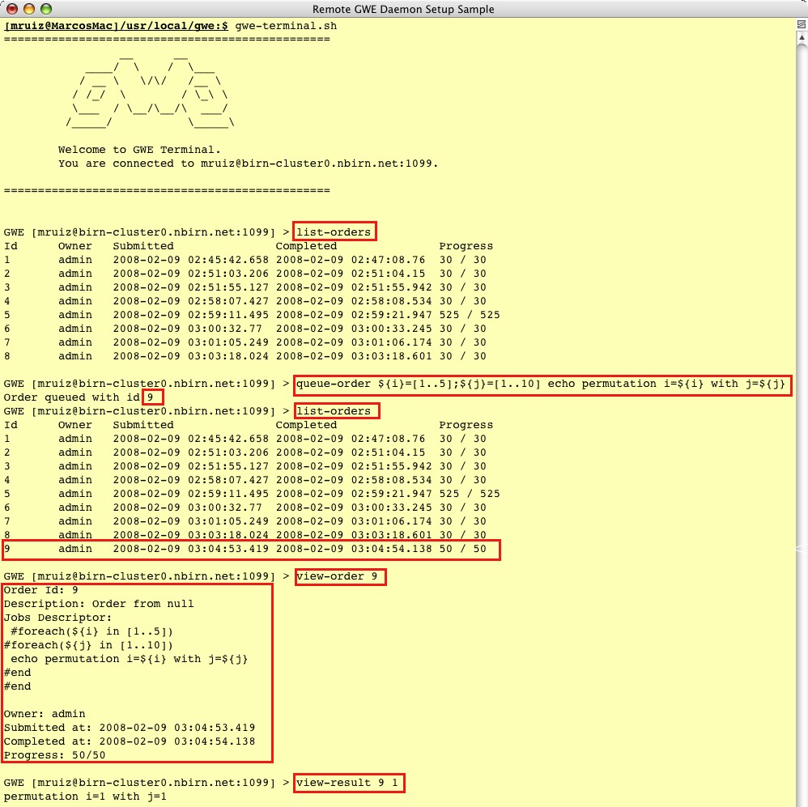
GWE Client API
Programmatic, full featured, API to access “GWE Grid”s services (interact with “GWE daemons”).
Secured RPC communications layer using RMI over SSH Tunnels.
“GWE Client”s are applications built on top of this API.
Samples: GWE Terminal GWE Commands and GSlicer3.

Slide 12
Tool Integration - GSlicer3:
Architecture
“Slicer3” and “GWE Client API” are two independent products.
The goal of the integration effort is to provide Slicer3 with grid computing capabilities out of the box through GWE.
This effort consists on merging a Slicer3 distribution, a “GWE Client API” distribution and “GWE CLM Proxys” (CLMP).
The result is a “GWE Client” application we call GSlicer3.
The integration effort also includes a utility that generates GSlicer3 bundles out of Slicer3 and GWE distributions.

Slide 13
Tool Integration - GSlicer3:
Architecture
GWE CLM Proxys (CLMP): Slicer3 CLMs which will proxy into another (proxied CLM) to provide a “GWE Powered” version of the proxied CLM.
Technology Requirements: Out of all CLMs discovered in a Slicer3 distribution; only those complying with the “Standard Execution Model” specification will be able to have an automatic CLMP created for them.

Slide 14
Tool Integration - GSlicer3:
CLM Proxy Flow
Gathers proxied CLM “xml” and enhance it to add GWE support.
Generate P2EL commands based on GUI input and meta parameter values.
Submit GWE order representing the group of proxied CLM invocations (P2EL).

Slide 15
Tool Integration - GSlicer3:
CLM Proxy Flow
Monitors the execution on the user’s grid of the localized proxied CLM invocations.
Keeps track of the CLMP progress as the percentage of invocations executed.
Notifies Slicer3 of the CLMP progress using Slicer3’s XML based progress API.

Slide 16
Tool Integration - GSlicer3:
Registered Modules
Slicer3
Standalone CLMs.

Slide 17
Tool Integration - GSlicer3:
Registered Modules
GSlicer3:
Standalone CLMs.
1 autogenerated GWE CLM Proxy for each standalone CLM discovered (which complies with the Standard Execution Model).

Slide 18
Tool Integration - GSlicer3:
CLM Proxy Parameters

Slide 19
More Information
  Project site with a great wealth of information including detailed guides and GWE’s source code:
      http://www.gridwizardenterprise.org/
  Users mailing list to receive project news and announcements:
      gwe-users@nbirn.net
  Project community forum:
      http://groups.google.com/group/gwe-forum?hl=en
  Project team email address (questions, requests and/or feedback):
      gwe-support@nbirn.net
Thanks!

