Slide 1



Grid Wizard Enterprise
(http://www.gridwizardenterprise.org)
Simplifying the Utilization of
Grid Computation
using
Grid Wizard Enterprise
National Alliance for Medical Image Computing
(NA-MIC - http://na-mic.org)
Biomedical Informatics Research Network
(BIRN - http://nbirn.net)

Slide 2
Introduction
Typical computation intensive problems in research in computation sciences:
  Refinement of computational protocol (Algorithm parameter exploration). Iteratively improve computational protocol by testing each round of the applications against different algorithmic parameters.
  Usage of released computational protocol applications (Data set processing). Process large amounts of pathological inputs using the particular application.
Both of these are embarrassingly parallel problems.
Notes:
Research in the computational sciences seems to proceed, roughly speaking, in distinct phases. As an initial idea for a computational protocol is reﬁned, a researcher will iteratively debug and improve applications on a small amount of handpicked data, tweaking parameters and inspecting output for correctness. Once the idea returns plausible results and can be considered publication-worthy, the program gets run on more and more data, often involving a new round of debugging as new classes of pathological inputs are discovered. During this phase, the computational protocol undergoes systematic characterization: for what parameter ranges does it return valid results? Can any immediate conclusions or further hypotheses be derived from running on publicly available data? Finally, once the computational protocol is ready to be released to the scientiﬁc community, a researcher must decide how to distribute the code. Increasingly, providing a publicly accessible website is an attractive alternative to making code available for download: releasing new improvements or bug-ﬁxes to the code is substantially easier, and only the user interface requires documentation.
It is a lucky coincidence that the research process – including the hosting of an algorithm in a web environment – itself falls into the already useful class of embarrassingly parallel problems, that is to say, resource-intensive computational problems that can be broken into independent subunits that can run in parallel. A researcher who faces such a problem must deal with a number of tedious issues: how to determine what work needs to be done and how it should be broken into meaningful units (workload deﬁnition); how to assign individual work units to resources (application scheduling^{1,3}); how to run and monitor executables (grid execution; e.g. Globus²); and how to deal with system-related and program-related failures (failure detection). Though each of these problems can be solved in a straightforward way, the combined solutions to all of them leads to a maintenance problem, interferes with distribution, and presents an additional barrier to a scientist trying to investigate a particular problem. It is our view that a researcher expert in a particular scientiﬁc discipline should not need to also become an expert in grid computing in order to produce an application that uses grid technology. It is also our observation that the bulk of computational scientists do not have at their disposal dedicated programmers and system administrators to plan, install, conﬁgure, and maintain a complex heterogeneous network of computers.
To reﬂect these needs we have designed a system, Grid Wizard Enterprise (GWE) that facilitates the above considerations, which we derived based partly on our own experiences performing computational science in bioinformatics and partly on observing others doing the same. It is important to note that GWE is not meant to be another grid middleware package, rather, it is meant to be a large-scale job launching and management tool that bridges the gulf between the biomedical researcher and current grid middleware by:
· Providing the researcher with the ability to easily configure the heterogeneous clustered/grid resources that they have access to.
· Allowing a researcher to easily specify large parametric computational jobs using the same general syntax as is used in the command line invocation of the analysis algorithms (e.g. see P2EL in Section 4) or through integration with community developed biomedical applications (e.g. see Slicer in Section 5).
Managing the most common house keeping tasks required to ensure end-to-end success of a computation thereby relieving the researcher of this burden.

Slide 3
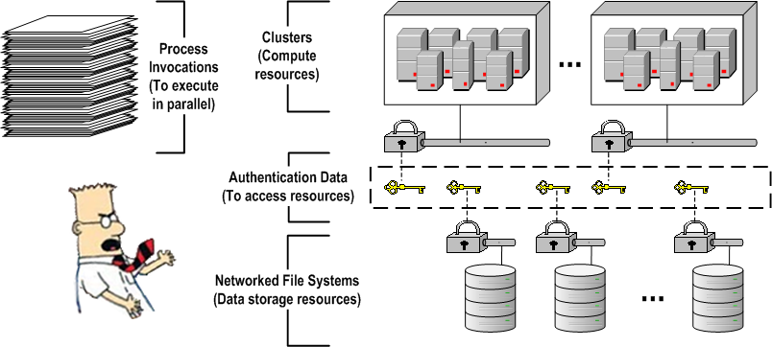
Embarrassingly
Parallel Problem
Problem: User needs to execute a collection of inter-independent process invocations.
Context: User has access (authentication) to cluster(s) and to networked file systems (where his/her data is stored).

Slide 4
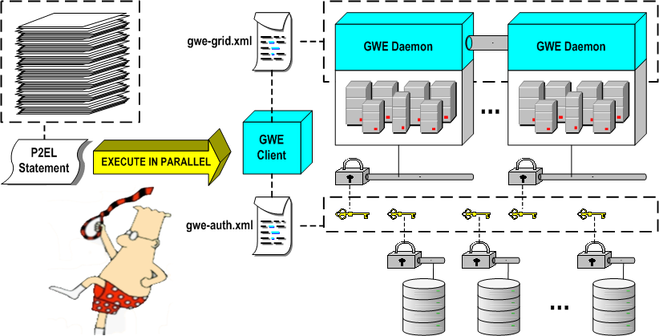
GWE’s Solution
GWE: Distributed system intended to ease the effort of executing, in parallel, inter-independent processes across clusters.
Technology Requirements: SSH enabled clusters, Java 1.5.

Slide 5
GWE’s Quick Start Guide
Install GWE on your machine.
Configure GWE installed with:
  Authentication information to access networked remote resources (file systems and clusters).
  Description of their computational grid as a collection of clusters.
Run “GWE daemons” installer utility.
Launch GWE client.
Issue P2EL commands within your GWE client!

Slide 6
P2EL
P2EL = Processes Parallel Execution Language.
Language designed with the goal to to allow a single statement to describe a collection of inter-independent process invocations.
P2EL statement composition:
  Variables. Collection of variables with their respective permutation values.
  Process Invocations Template. Process invocation with variable to value substitution expressions.
  Value Spaces (Implicitly generated). A set of all the unique variable to value resolution combinations of the statement’s variables. This property is implicitly defined through the permutation of the variables values. These permutations are done respecting the variables semantics (multidimensionality, co-dependency, etc).
The full language specification (syntactic and semantic rules) is described in the P2EL guide on the GWE’s project site.

Slide 7
P2EL
Medical Imaging Processing Samples:
  Slicer’s BSpline Deformable Registration (Algorithm Parameter Exploration):
  “Free Surfer” Subject Cases Processor (Dataset Processing):
${FILES_DIR}=http://www.na-mic.org/ViewVC/index.cgi/trunk/Libs/MRML/Testing/TestData
${FIXED}=$in(${FILES_DIR}/fixed.nrrd?view=co,fixed.nrrd)
${MOVING}=$in(${FILES_DIR}/moving.nrrd?view=co,moving.nrrd)
${OUTPUT}=$out(sftp://destinationHost/path/${SLICER_MODULE}/out-${ITER}-${HIST}-${SAM}.nrrd)
${ITER}=$range(10,50,5)
${HIST}=$range(20,100,010)
${SAM}=$range(500,5000,0750)
${SYSTEM.USER_HOME}/Slicer3/Slicer3 --launch ${SYSTEM.USER_HOME}/Slicer3/lib/Slicer3/Plugins/ BSplineDeformableRegistration --iterations ${ITER} --gridSize 5 --histogrambins ${HIST} --spatialsamples ${SAM} --maximumDeformation 1 --default 0 --resampledmovingfilename ${OUTPUT} ${FIXED} ${MOVING}
${PATH}=sftp://sourceHost/subjectsPath
${FILES}=$dir(${PATH},.*)
${INPUT_DIR}=$in(${FILES})
${SUBJ_ID}=$regExp(${FILES}, /, [^/]*, $)
${OUTPUT_DIR}=$out(${PATH}/results/${SUBJ_ID})
${SYSTEM.USER_HOME}/RunFreesurfer.sh ${INPUT_DIR} ${OUTPUT_DIR}

Slide 8
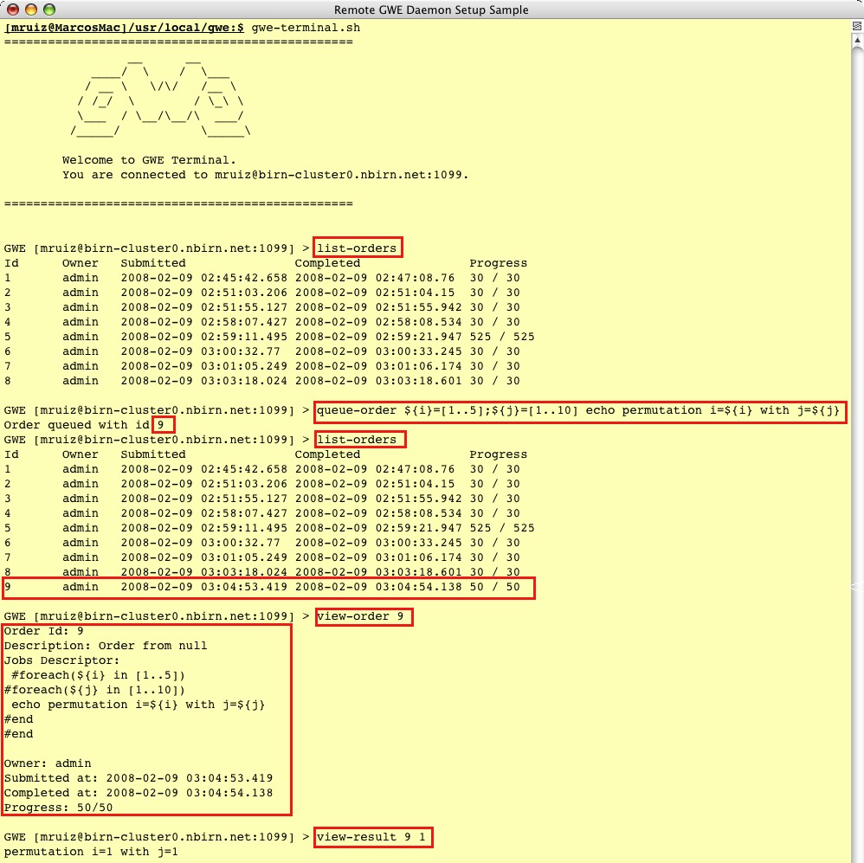
GWE Client API
Programmatic, full featured, API to access “GWE Grid”s services (interact with “GWE daemons”).
Secured RPC communications layer using RMI over SSH Tunnels.
“GWE Client”s are applications built on top of this API.
Samples: GWE Terminal GWE Commands and GSlicer3.

Slide 9
Tool Integration - GSlicer3:
Architecture
“Slicer3” and “GWE Client API” are two independent products.
GWE’s Slicer3 integration effort includes a utility to rebundle Slicer3 distributions integrated with all the components needed to have grid computing capabilities out of the box through GWE.
The end result is a “GWE Client” we call GSlicer3.
The components added to the Slicer3 distributions are a “GWE Client” distribution and “GWE CLM Proxys” (CLMP).

Slide 10
Tool Integration - GSlicer3:
Architecture
GWE CLM Proxys (CLMP): Slicer3 CLMs which will proxy into another (proxied CLM) to provide a “GWE Powered” version of the proxied CLM.
Technology Requirements: Out of all CLMs discovered in a Slicer3 distribution; only those complying with the “Standard Execution Model” specification will be able to have an automatic CLMP created for them.

Slide 11
Tool Integration - GSlicer3:
CLM Proxy Flow
Gathers proxied CLM “xml” and enhance it to add GWE support.
Generate P2EL commands based on GUI input and meta parameter values.
Submit GWE order representing the group of proxied CLM invocations (P2EL).

Slide 12
Tool Integration - GSlicer3:
CLM Proxy Flow
Monitors the execution on the user’s grid of the localized proxied CLM invocations.
Keeps track of the CLMP progress as the percentage of invocations executed.
Notifies Slicer3 of the CLMP progress using Slicer3’s XML based progress API.

Slide 13
Tool Integration - GSlicer3:
Registered Modules
Slicer3
Standalone CLMs.

Slide 14
Tool Integration - GSlicer3:
Registered Modules
GSlicer3:
Standalone CLMs.
1 autogenerated GWE CLM Proxy for each standalone CLM discovered (which complies with the Standard Execution Model).

Slide 15
Tool Integration - GSlicer3:
CLM Proxy Parameters

Slide 16
More Information
  Project site with a great wealth of information including detailed guides and GWE’s source code:
      http://www.gridwizardenterprise.org/
  Users mailing list to receive project news and announcements:
      gwe-users@nbirn.net
  Project community forum:
      http://groups.google.com/group/gwe-forum?hl=en
  Project team email address (questions, requests and/or feedback):
      gwe-support@nbirn.net
Thanks!

