Slide 1

Grid Wizard Enterprise
GSlicer3
Tutorial

Slide 2
Introduction
This tutorial assumes you already completed the basic and advanced tutorial.
GSlicer3 is a Slicer3 distribution that has been re-bundled with gwe to provide an out-of-the-box interface to GWE systems for Slicer3 modules.
For each regular Slicer3 module, GSlicer3 comes with a GWE enabled version of it (“proxy” module).
“Proxy” modules are capable to execute multiple runs of the “proxied” module (and in parallel) by submitting their requests to a GWE system.
These multiple runs are described using P2EL constructs; which “proxy” modules are designed to accept.

Slide 3
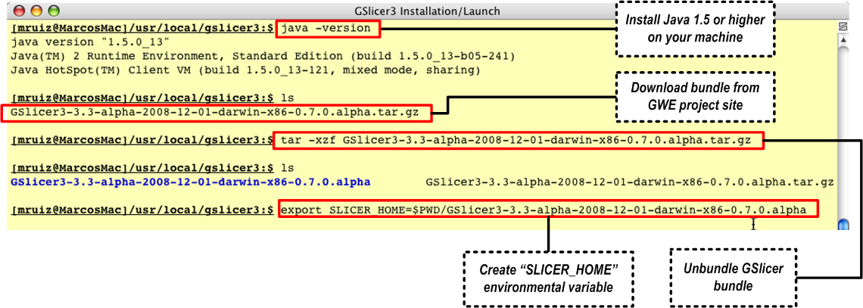
Step 1: Installation
IMPORTANT: This terminal must be an X11 one. Keep it open to launch GSlicer3 from it, after completing the next step (configuration).

Slide 4
Step 2: Configuration
Grid Descriptor
This configuration file provides GWE with the description of each of the “GWE daemon”s GWE can access (and install if required).
For each GWE daemon to access, a “cluster” entry must be found.
Additionally, each cluster entry accepts a list of default P2EL variables.
Each of these variables which will be brought into the scope of any P2EL statement queued into the particular daemon.
Edit your “$GWE_HOME/conf/gwe-grid.xml” to look like this:
Replace the “SLICER_LOCATION” placeholder with the value of SLICER_HOME just defined in the installation step.
<grid>
<cluster name="DUAL_CORE_LOCAL" host="localhost" queueSize="2" maxHijackMins="120" maxIdleMins="5">
<p2elVar name="SLICER_HOME" value="[VALUE_OF_SLICER_HOME_ENVIRONMENTAL_VARIABLE]" />
</cluster>
</grid>

Slide 5
Step 2: Configuration
Key Store
This tutorial will only show how to use GSlicer3 in local mode and with no access to secured remote hosts or file systems.
Therefore there is no need to edit the default key store, so we can skip this step.

Slide 6
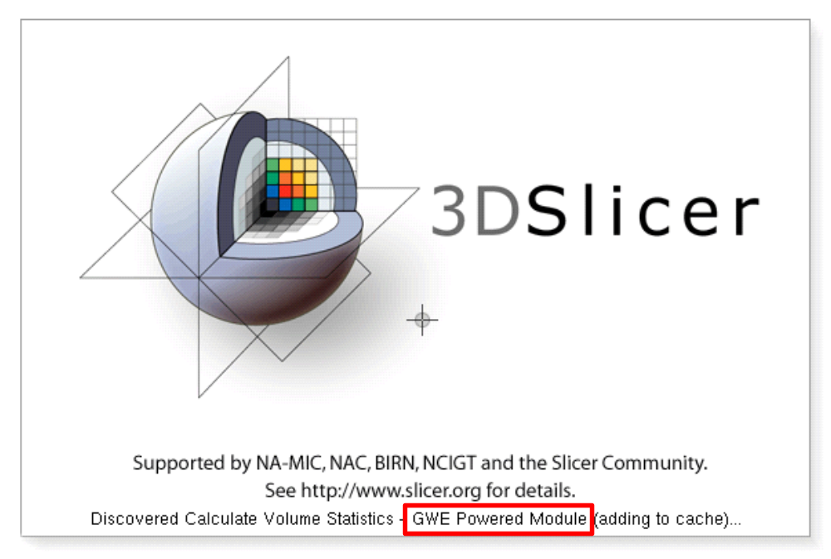
Step 3: Launching
In the X11 terminal console used to install GSlicer3 issue the command “$SLICER_HOME/Slicer3” to launch GSlicer3.
Let GSlicer3 to start - it will take a few minutes the first time you launch it.

Slide 7
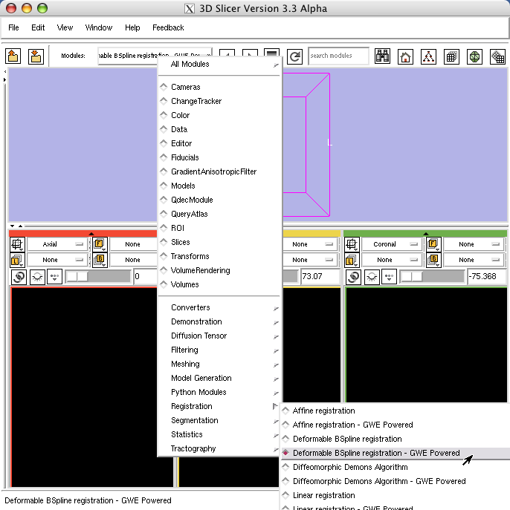
Step 4.1: Select Module
Select the module “Deformable BSpline registration – GWE Powered”:

Slide 8
Step 4.2: Input Parameters
Select Cluster “DUAL_CORE_LOCAL”
Input the following values for each of the parameters of the module:
This will generate multiple invocations of this module following the same logic explained in the previous tutorials when inspecting the P2EL statements.
Leave every other parameter untouched and press apply!
Watch as the progress bar reports what the module is doing:
  Deploying and installing GWE daemon (first run only)
  Interactive GWE progress bar reporting asynchronously from remote daemon.
Pressing cancel, does not cancel this execution, just progress reporting.
Iterations = $range(10,40,10)
Histogram Bins = $range(20,100,025)
Spatial Samples = $range(500,2000,0750)
Fixed Image = $in(http://www.na-mic.org/ViewVC/index.cgi/trunk/Libs/MRML/Testing/TestData/fixed.nrrd?view=co,fixed.nrrd)
Moving Image = $in(http://www.na-mic.org/ViewVC/index.cgi/trunk/Libs/MRML/Testing/TestData/moving.nrrd?view=co,moving.nrrd)
Output Image = $out(${SYSTEM.USER_HOME}/gslicer-test/${SYSTEM.JOB_NUM}.nrrd)

Slide 9
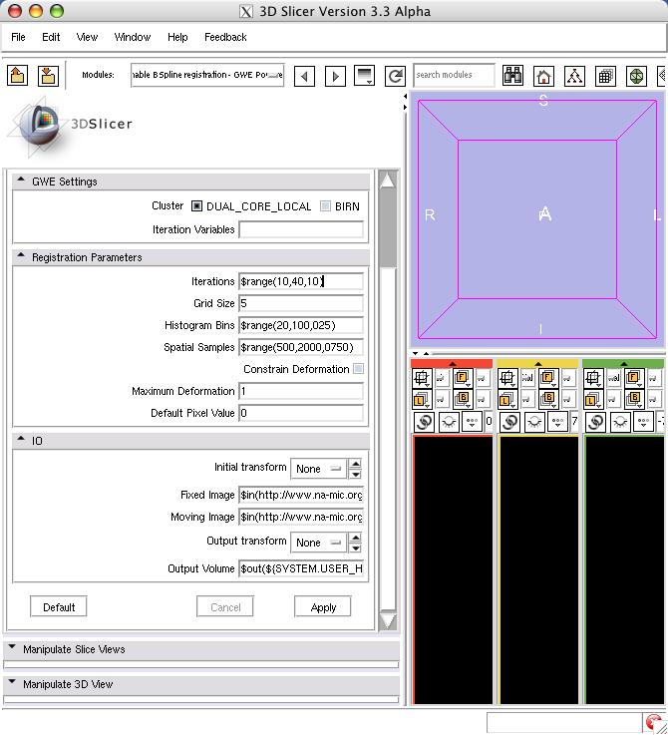
Step 4.2: Input Screenshot

Slide 10
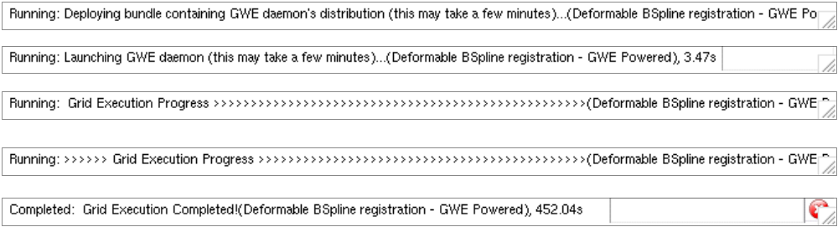
Step 4.3: Submit P2EL
Leave every other parameter untouched and press apply!
GSlicer3 will transform all these parameters and contextual information into a P2EL statement and queue it into the selected GWE daemon (DUAL_CORE_LOCAL)
Watch as the progress bar reports what the module is doing:
  Deploying and installing GWE daemon (first run only)
  Interactive GWE progress bar reporting asynchronously from remote daemon.
Pressing cancel, does not cancel this execution, just progress reporting.

Slide 11
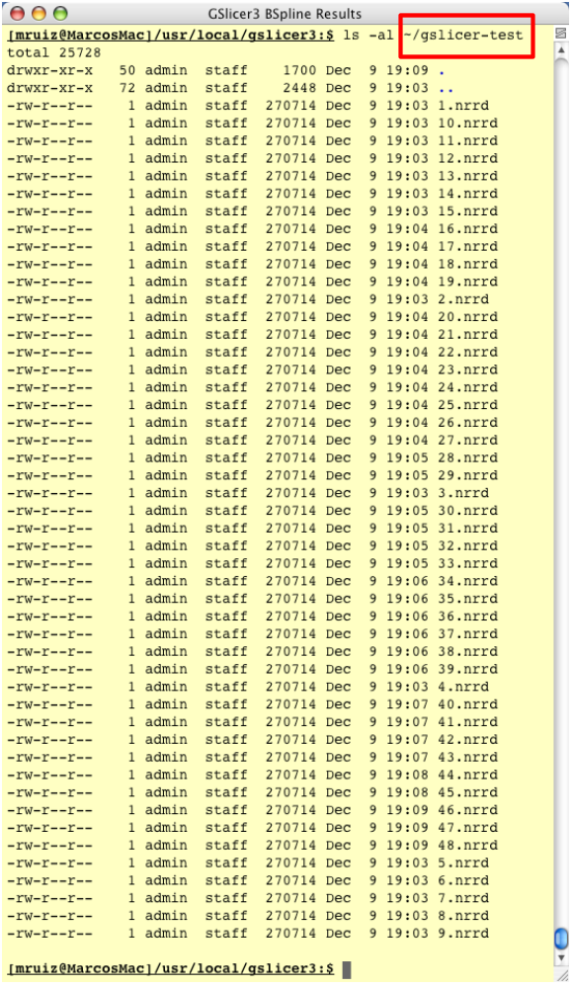
Step 4.4: Review Results
Reviewing the input parameters you can find that the output files specified were to have the form:
${SYSTEM.USER_HOME} translates to the user’s home directory in the host where the GWE daemon is running (in our case local).
${SYSTEM.JOB_NUM} translates to the unique job number assigned to the particular run.
So you can find your resulting images under “~/gslicer-test/*.nrrd” as the screenshot on the left shows.
${SYSTEM.USER_HOME}/gslicer-test/${SYSTEM.JOB_NUM}.nrrd

