Slide 1
IOT SECURITY Project presentation

Slide 2
Summary
Project purpose
Hardware used
Technology used
Library used
Implementation
Security
Vulnerability
Privacy

Slide 3
Project Purpose
The project consist in a simple temperature monitoring application
Has been used a esp32 that host temperature sensor and a card reader.
The temperature will be read and after sended when an authorized card has been read by card reader.
The communication between client and server is performed through TLS.

Slide 4
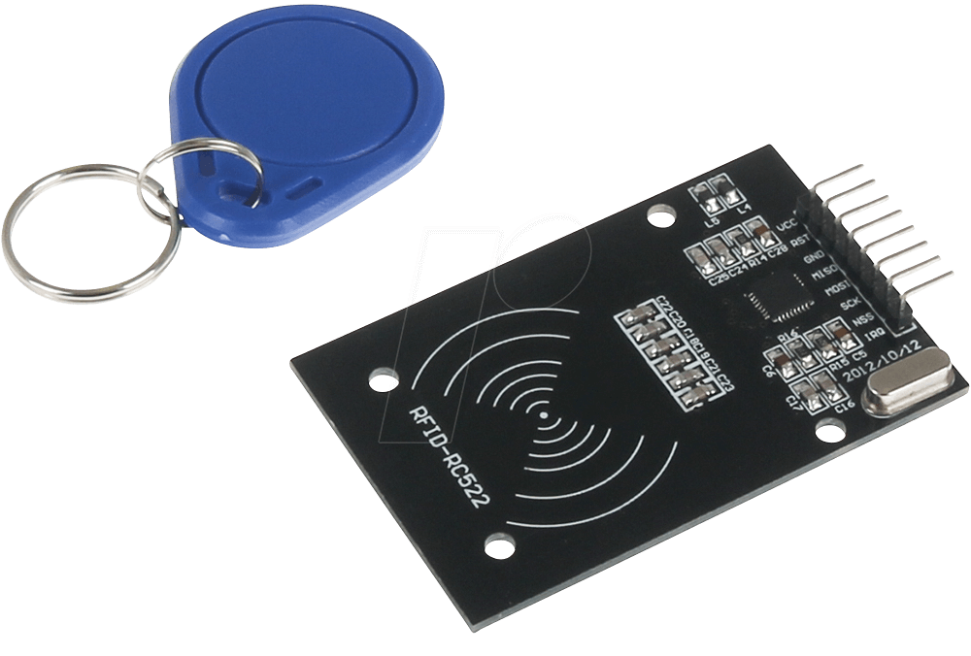
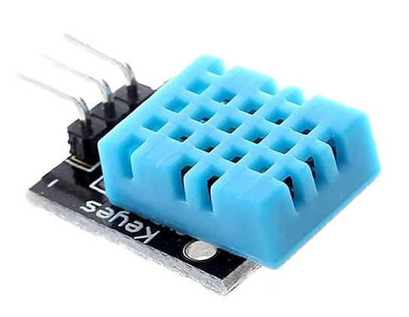
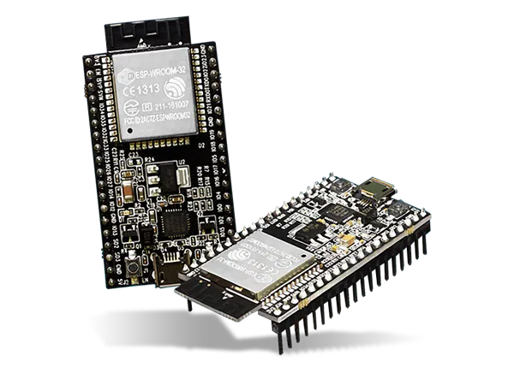
Hardware used

Slide 5
ESP32 BOARD
The board DevKitC v4 used for the development has 36 pins, WiFi and Bluetooth connectivity. It is based on chip ESP 32-D0WDQ6 and has the following features:
Processor Xtensa 32-bit dual-core LX6
448 KBytes ROM
520 KBytes SRAM
4 MB EEPROOM
WiFi 802.11 2.4GHz
Bluetooth v4.2 BR/EDR and Bluetooth Low Energy (BLE)

Slide 6
RFID-RC522
The RC522 is a RFID module that is based on the MFRC522 controller from NXP semiconductors. The module can support I2C, SPI and UART communication. The RC522 has the following features:
13.56MHz RFID module
Operating voltage: 2.5V to 3.3V
Communication : SPI, I2C protocol, UART
Maximum Data Rate: 10Mbps
Read Range: 5cm
Current Consumption: 13-26mA

Slide 7
DHT11
The DHT11 is a commonly used Temperature and humidity sensor that comes with a dedicated NTC to measure temperature and an 8-bit microcontroller.
The DHT11 has the following features:
Operating Voltage: 3.5V to 5.5V
Operating current: 0.3mA (measuring) 60uA (standby)
Output: Serial data
Temperature Range: 0°C to 50°C
Humidity Range: 20% to 90%
Accuracy: ±1°C and ±1%

Slide 8



Technology used

Slide 9
Libraries used
WolfSSL Library for Lightweight Crittografy and Secure comunication
MFRC522 Library for the interaction with RFID-reader
WiFi library allows an Arduino board (and similars) to connect to the internet
Adafruit Library for the interaction with DHT11 sensor.
Go-Crypto standard Library for Crittografy and Secure comunication Server side
ArduinoJson library that grant serialization and deserialization of a JSON document

Slide 10

Implementation

Slide 11
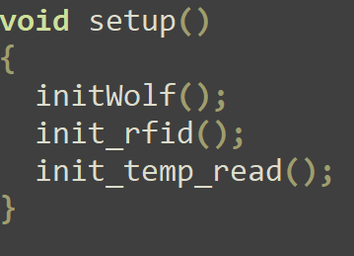
Initialization
Notes:
The setup method of Arduino will inizialize our function and sensor. In particular way «initWolf» will connect Arduino to a designed wireless network. The other just inizialize the sensor.

Slide 12
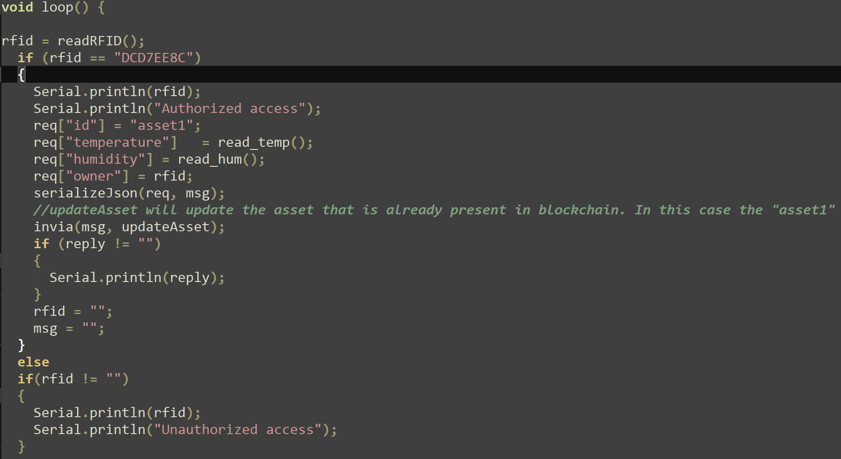
Client logic
Notes:
This is the main execution of the Arduino client. Initially there is a check if there are a reading of a card or tag. If the card read the right card they will read temperature and humidity from DHT11 sensor and send its to server with the «invia» function. In this function call are specified the message that is a JSON document, using «serializeJson» from ArduinoJSON library, and the function that the client want to make, in this case «updateAsset». This function will update an asset already present in blockchain, this have been made for only update the value.

Slide 13
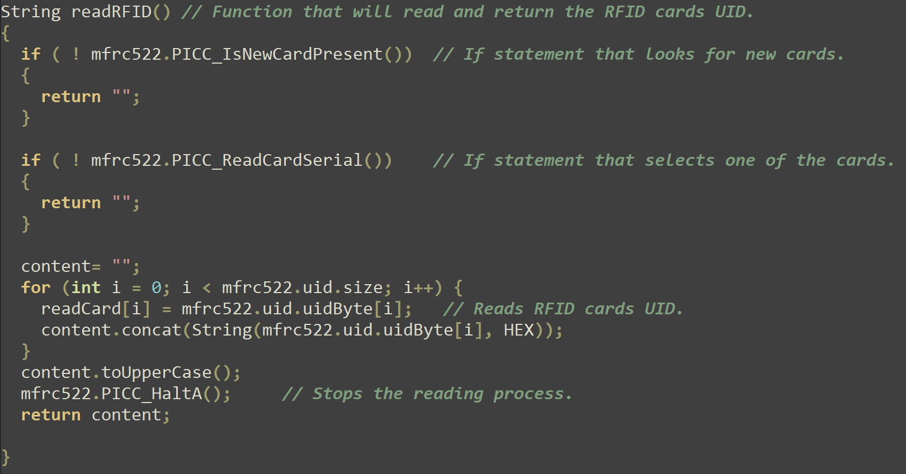
readRFID function
Notes:
The readRFID function will return a String that represent the Unique Identifier reader of a certain card.

Slide 14
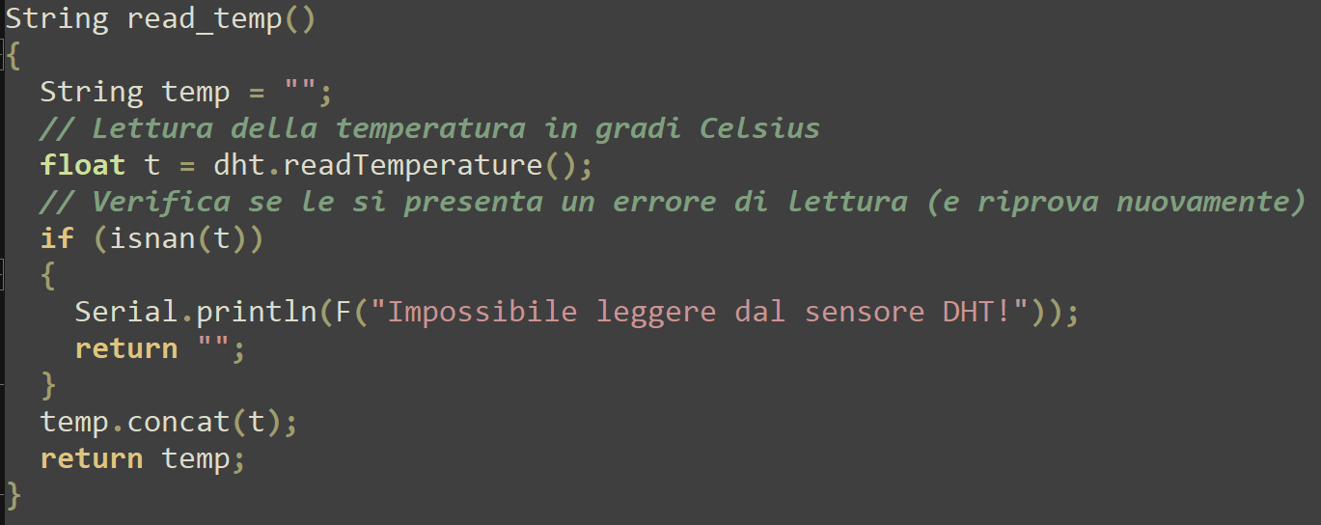
read_temp
Notes:
The read_temp function will return a String that represent the temperature read from DHT11 sensor.

Slide 15
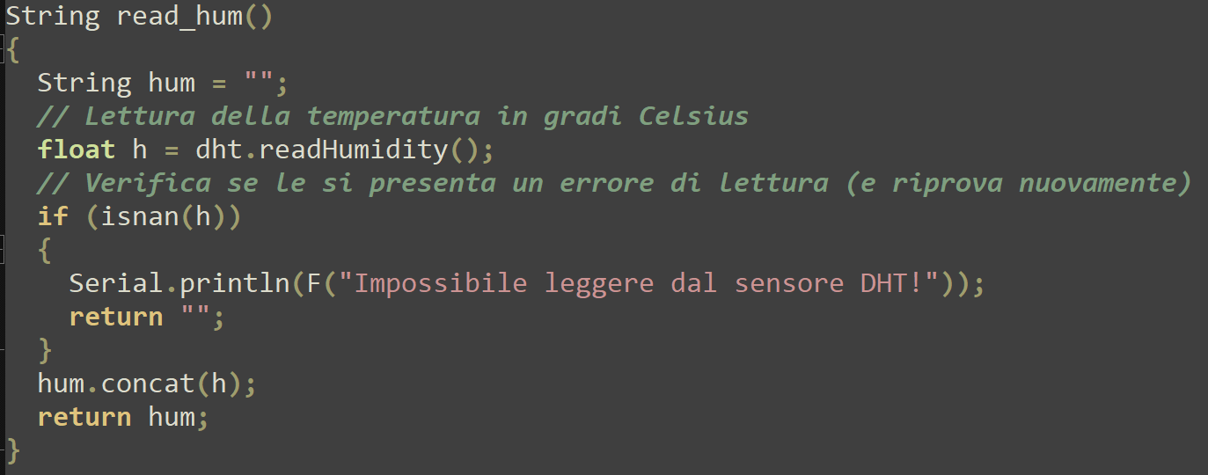
read_hum
Notes:
The read_hum function will return a String that represent the humidity read from DHT11 sensor.

Slide 16
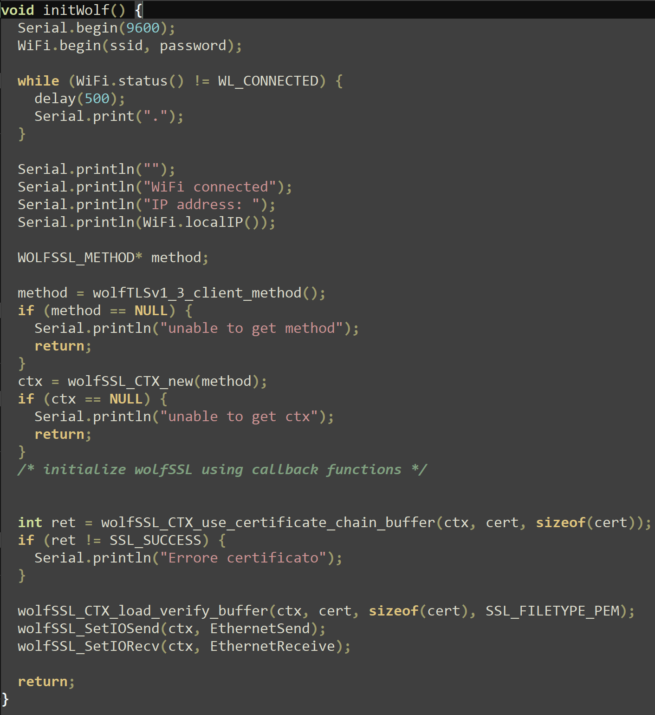
wolfSSL
Notes:
The inizialization of wolfSSL connect the arduino to wireless connectivity to a previous set ssid and password. After that is specified the protocol used, in this case «wolfTLS1_3> TLS 1.3 and the certificate to use.

Slide 17
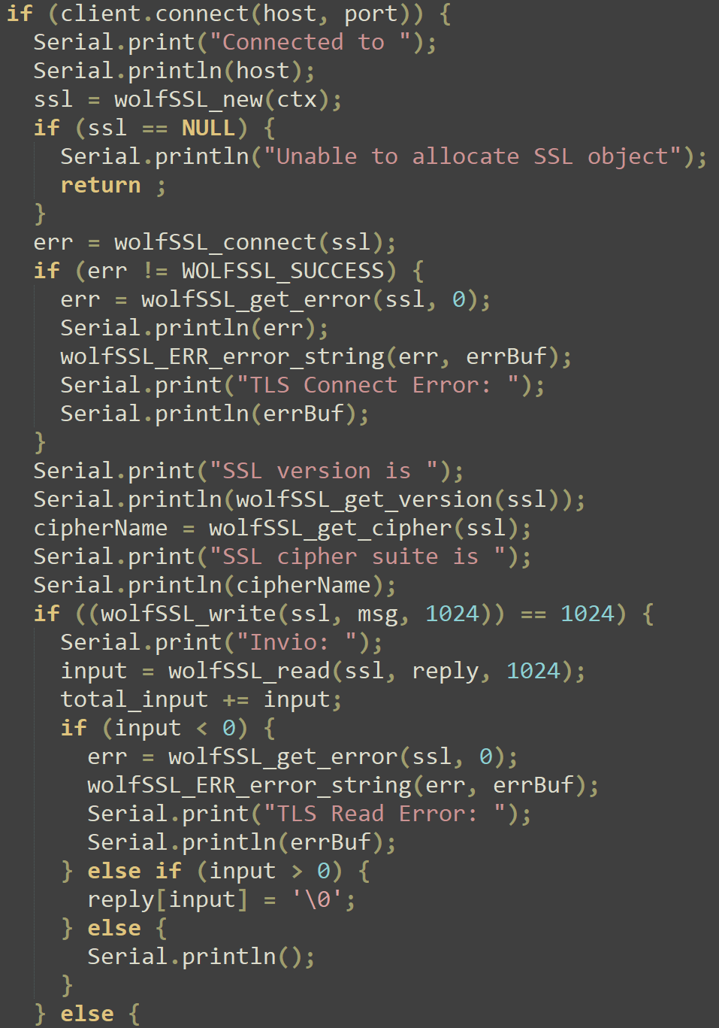
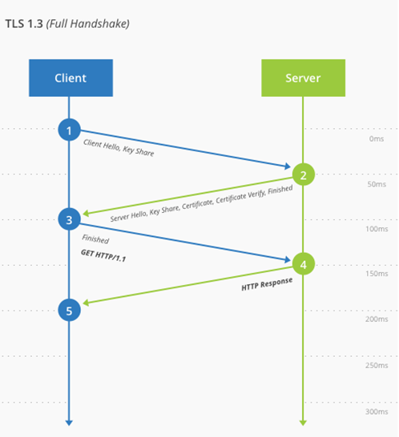
wolfSSL invia Function
Notes:
The «invia» function will send the HTTPS request previously passed and inizialize the TLS connection.

Slide 18
TLS
Negotiation: Phase aims at finding common ground between the client’s and the server’s configurations
Key exchange: between two participants.
Authentication: are made by certificated that client use.
Session Resumption: mechanism to fast-track secure session without redoing key exchange.
Notes:
The negotiation phase of the handshake are made in order to securely connect the two peers.
The whole point of the handshake is to perform a key exchange. What key exchange algorithm to use? This is one of the things decided as part of the negotiation process.
It is trivial for a MITM attacker to impersonate any side of a key exchange. For this reason, key exchanges must be authenticated.
As browsers often connect to the same websites again and again, key exchanges can be costly and slow down a user’s experience. For this reason, mechanisms to fast-track secure sessions without redoing a key exchange are integrated into TLS.

Slide 19
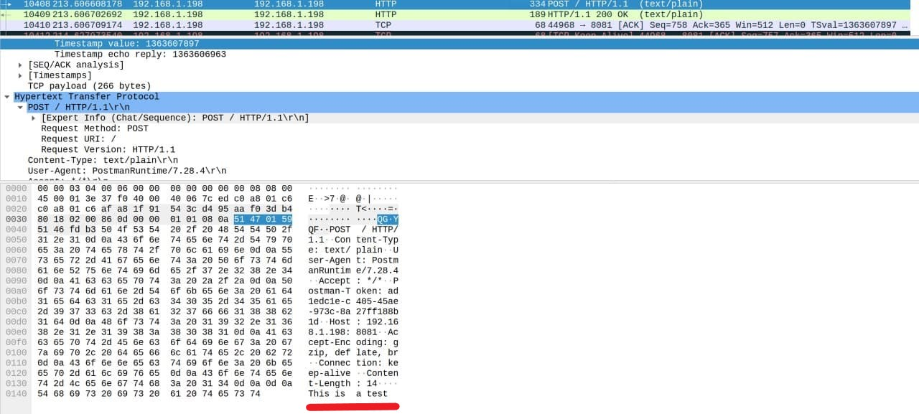
Communication without TLS

Slide 20
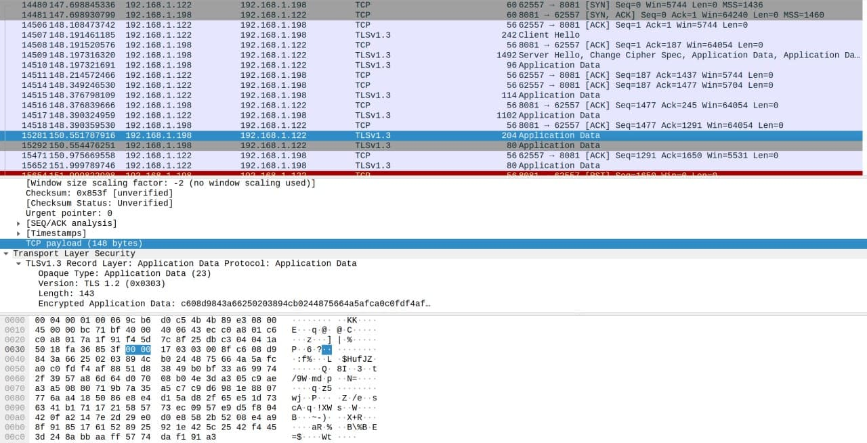
Communication with TLS

Slide 21
Hyperledger Fabric Blockchain

Slide 22
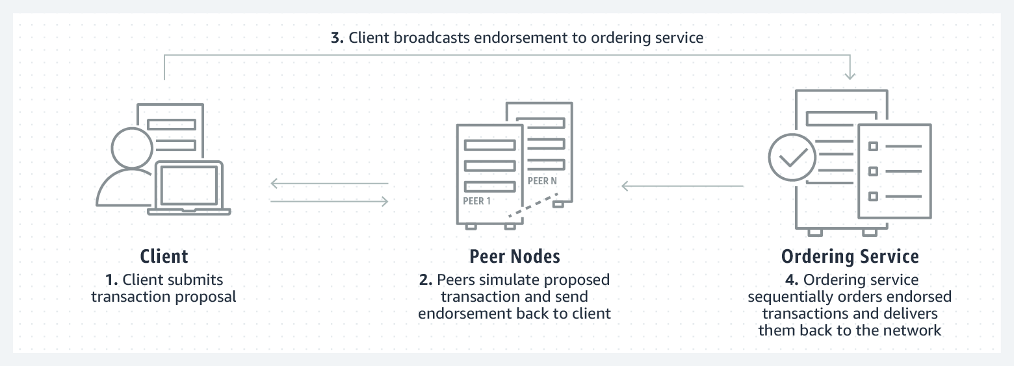

Hyperledger Fabric
Notes:
Hyperledger Fabric is an open source, permissioned blockchain framework. It is a modular, general-purpose framework that offers unique identity management and access control features.
Fabric networks are permissioned, meaning all participating member’s identities are known and authenticated.
Fabric networks consist of channels, which are a private “subnet” of communication between two or more specific network members, members on the network can transact in a private and confidential way. Each transaction on the blockchain network is executed on a channel, where each party must be authenticated and authorized to transact on that channel.

Slide 23
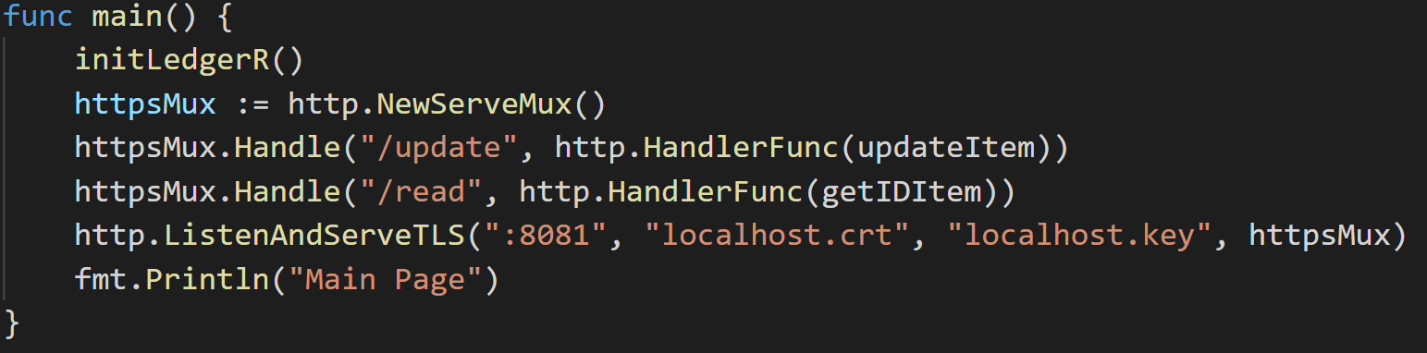
Server logic
Notes:
At the start of the server, will be executed the «initLedgerR» that will add to blockchain asset1 with blank value.
We have defined two function, update and read that can be called with an HTTPS request.
The http.ListandserveTLS will wait until an http request is recived. When this happen will use httpsMux to handle request and dispatch a response.

Slide 24
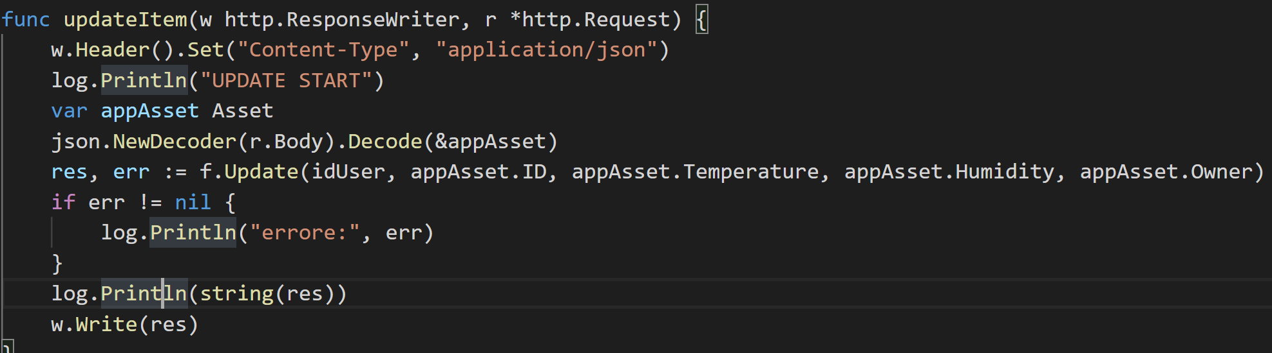
Update Item
Notes:
The update function decompose JSON document obtained from client. The various field of this JSON are used to call update function of the chaincode.
The result of the chaincode are used as a response for the HTTPS request.

Slide 25
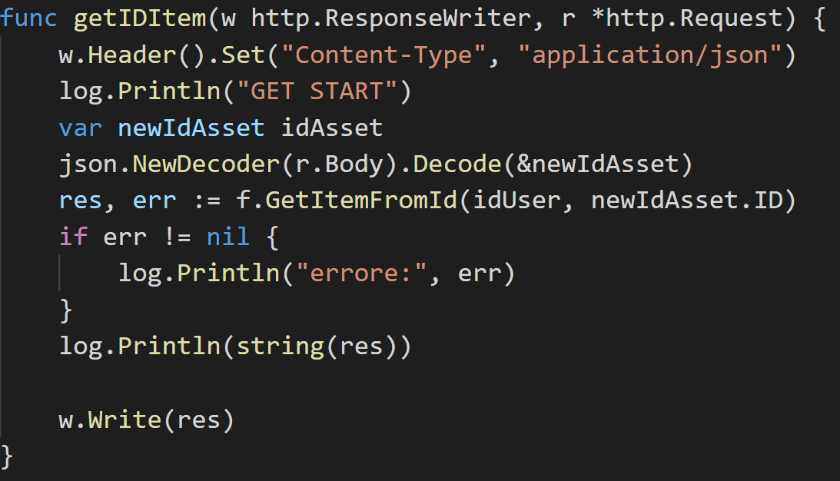
Read
Notes:
The read function will simply read the asset stored in blockchain of a determined asset identifier.

Slide 26
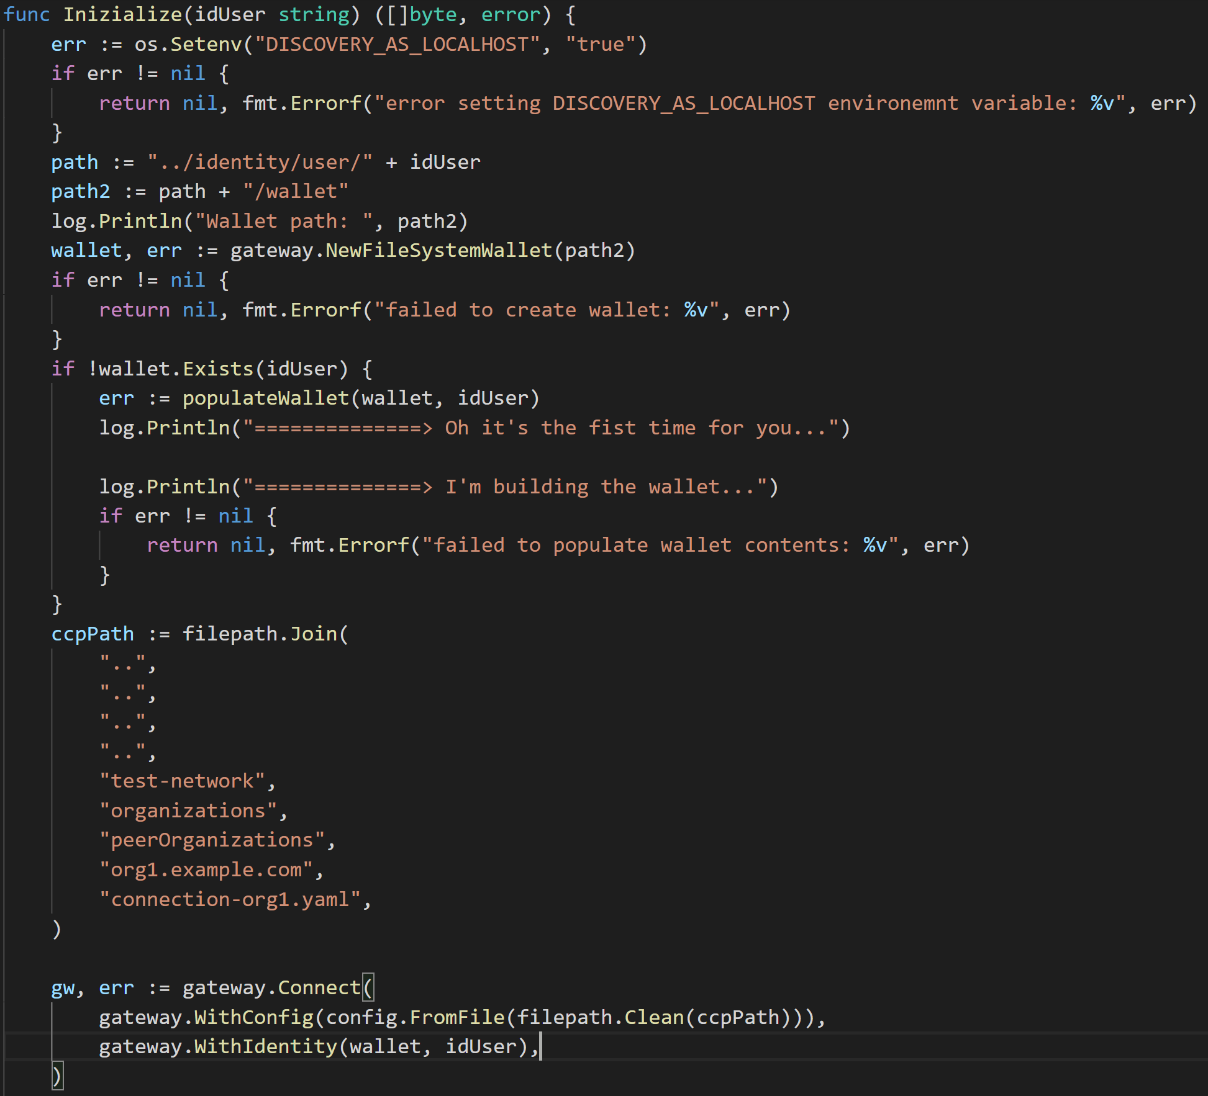
Fabric Certificate Autority
Notes:
Before calling chaincode functionality, fabric need to identify who is making the call.
Wallet is used to identify who is using a chaincode.

Slide 27
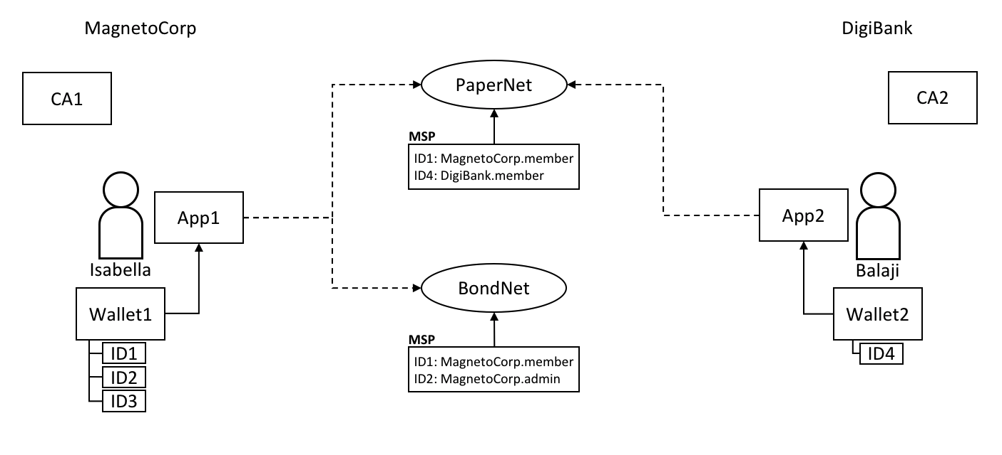
Fabric Wallet
Notes:
When an application connects to a network channel it selects a user identity to do so, for example ID1.
The channel MSPs (Membership Service Providers) associate ID1 with a role within a particular organization.
A single wallet can hold multiple identities, each issued by a particular Certificate Authority.

Slide 28
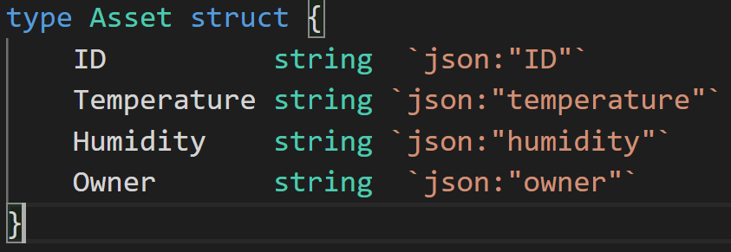
Chaincode
Notes:
In the chaincode we have a very simply struct that define the Asset temperature. The owner are represented of the unique identifier card instead of some sensible information.

Slide 29
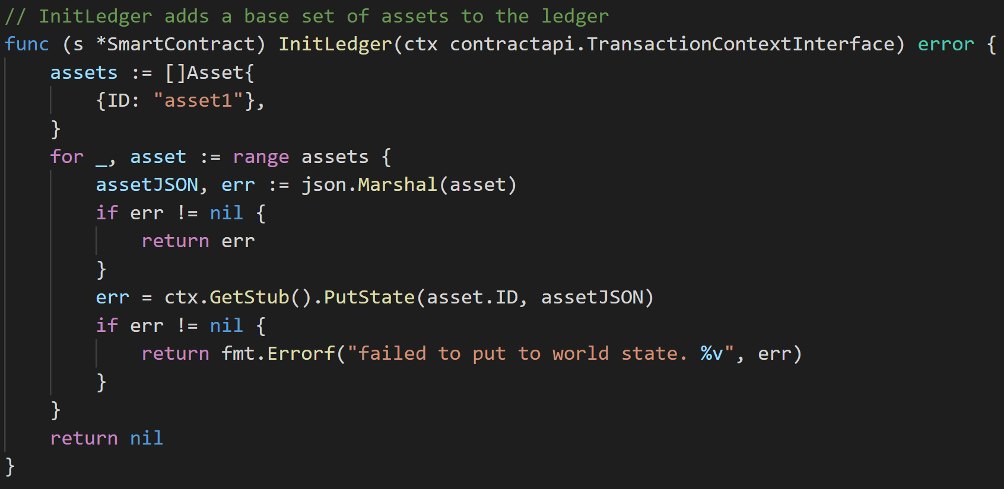
Chaincode
Notes:
InitLedger add some asset to the ledger of the blockchain, in this case only one that have as ID «asset1». The other parameter are null.
PutState Puts the specified key and value into the transaction’s Write set as a data-write proposal. PutState doesn’t affect the ledger until the transaction is validated and successfully committed.

Slide 30
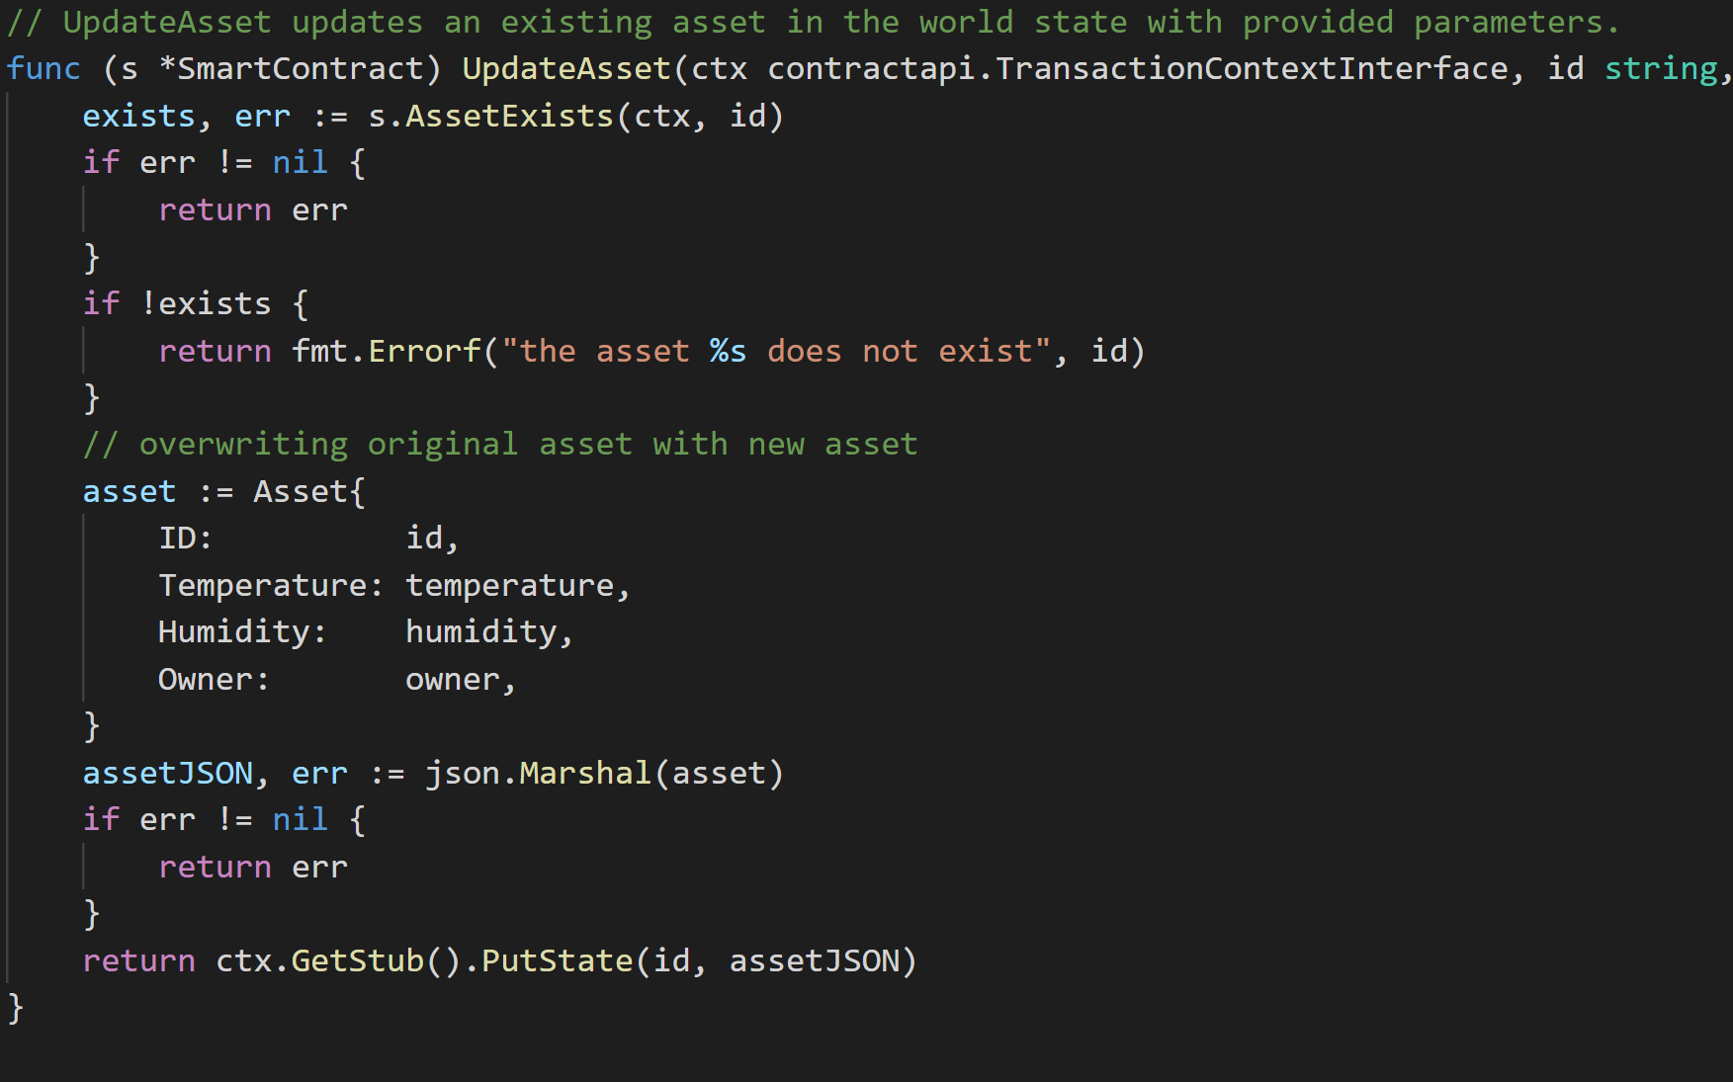
Chaincode
Notes:
UpdateAsset update an asset that already exist in blockchain.
There is a check if the asset exist then there will be overwriting the existing asset with new value otherwise there is return with an error.

Slide 31
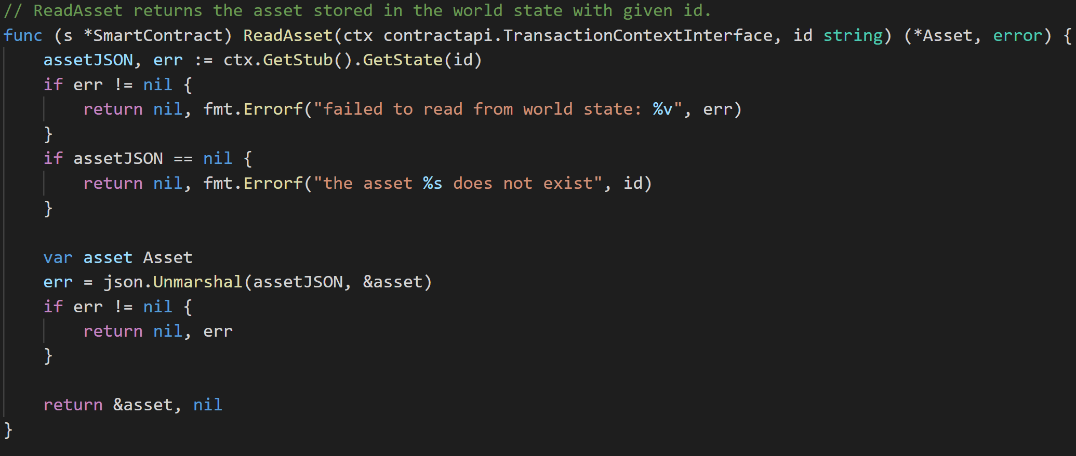
Chaincode
Notes:
ReadAsset read asset in blockchain and return this is exist, otherwise return error.

Slide 32
Security
System security: data is retrieved and sent if and only if the RFID reader reads the correct card.
Communication security: data is transferred between the client and server through a TLS 1.3 connection.
The usage of TLS on top of TCP provides Confidentiality and Integrity. The usage of certificates ensures Authentication.

Slide 33
Vulnerability
In order to setup a TLS connection we have to specify the location of the host certificate and of the private key. In this application, the server key is stored in the same directory of the script.
An adversary with physical access to the device filesystem could simply copy the .key file containing the private key and therefore he could impersonate the server from another host

Slide 34
Privacy
Under certain circumstances, temperature & humidity can become sensible information.
For instance, if we knew where the sensor node is (i.e., its physical location in a building) we might be able to reconstruct the habits of the people who usually employ that environment. (If there is crowd in a room, the temperature increases)
However, this kind of information alone (i.e., without knowing anything else than temperature data itself) does not represent an information that could identify anyone.
On a side note, data acquired in the sensor node is not stored in any way in the current version of client application.

Slide 35
THANKS!
Any questions?

