Slide 1
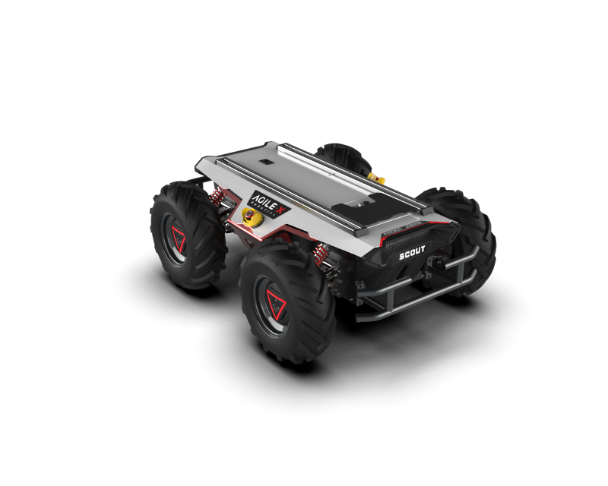

Perception, localization and mapping for mobile robots First project
Marco Cella 10578855
Giacomo Delcaro 10560602
Alessandro Colombo 10573335

Slide 2
FILES
- bags:
- bag1.bag
- bag2.bag
- bag3.bag
- cfg:
- parameters.cfg: file for the dynamic reconfigure
- launch:
- scout_launch.launch : launch file, launches the velpubsub, odompubsub and residual nodes. It is also possible to change the inital position of the robot.
-scout_launch2.launch : same as before, but uses bag2.bag, and contains the corresponding starting parameters values
-scout_launch3.launch : same as before, but uses bag3.bag, and contains the corresponding starting parameters values
- scout_launch_rviz.launch: launch the first .launch file but it also plays the bag and runs rviz with the right configuration.
- msg:
- OdomInt.msg: contains the custom message to publish odometry and integration method
- er_array.msg: custom message to publish the residuals between the ground truth and the estimated odometry

Slide 3
FILES
- srv:
- resetOdom.srv: empty, it does not need any input from the user since it simply resets the pose
- setOdom.srv: defines the types of the requested input from the user to set the pose to x, y, theta
- src:
- velpubsub.cpp: the node that subscribes to the rpm topics and publishes a twist message containing all of the robot’s speeds
- odompubsub.cpp: the node that subscribes to the topic advertised by velpubsub and publishes the complete odometry and the custom message
- residuals.cpp: the node publishes the residuals between /scout_odom and our computed odometry /our_odom and also the residuals between /gt_pose (in odom reference frame) and /our_odom
- scout_rviz.rviz: rviz configuration to visualize the computed odometry vs the ground truth

Slide 4
ROS PARAMETERS
x_init: initial x position in the odom frame
y_init: initial y position in the odom frame
theta_init: initial yaw angle wrt the odom frame
CHI : ratio between apparent and real base_line
Inv_RATIO: 1/ratio of the gearbox
TF TREE
- odom
- base_link
- world (static transform)
CUSTOM MESSAGES
er_array.msg:
std_msgs/Float64 dx
std_msgs/Float64 dy
std_msgs/Float64 dtheta
std_msgs/Float64 cumulateError
OdomInt.msg:
nav_msgs/Odometry odo
std_msgs/String int_method

Slide 5
HOW TO RUN EVERYTHING
I - catkin_make in the catkin workspace root
II- source catkin_ws/devel/setup.bash
1 - roslaunch project1 scout_launch.launch
2 - rosbag play -l bag1.bag
NB: for the second step you must cd to the folder where the bag files are.
It is now possible to echo the data from the different topics.
If you want to visualize the movement on rviz:
1 - Launch as before
2 - Open rviz with the scout_rviz.rviz configuration
3 - Play the bag
You can also simply launch the scout_launch_rviz.launch file, it will take care of everything.
For the dynamic reconfigure:
while the nodes are running, type in the bash:
-rosrun dynamic_reconfigure dynparam set /odompubsub intmethod value
"Value" can be either 0 for euler integration or 1 for runge – kutta
-rosrun rqt_reconfigure rqt_reconfigure, and then switch directly from the window
Reset service: rosservice call /reset_odom
Set service: rosservice call /set_odom x y theta
NB: theta must be in [deg]

Slide 6
APPARENT BASELINE AND TRANSMISSION RATIO
In order to find the parameters to match /scout_odom, we compared the estimated velocities values with the ground truth ones. For the transmission ratio we've used the values of the longitudinal velocity vx, whereas for the apparent baseline we've used the angular velocity wz.
The best values we've found are the following:
- Transmission ratio: 1:38.7
- Apparent baseline: 1.75 * B
To have a quantitative assessment of how we were improving when changing the parameters, we used plotJuggler on the residuals node mentioned above: the cumulateError is a filtered error, which means that it is the average of the last 100 quadratic errors. Each quadratic error is the square root of the sum of the square of deltaX, deltaY, deltaTheta (each multiplied by a particular quadratic weight).
In particular for the errors wrt /scout_odom an error of 1 cm is weighted as 60 degrees, while for the errors wrt /gt_pose 1 cm weights as 120 deg (since the orientation measurement was not smooth and had an offset problem mentioned below).
To find the parameters to match /gt_pose we also had to find the rototranslation from world to odom and find an orientation offset of /gt_pose with respect to its trajectory (see below). Since we did not have any velocities we used the following heuristic function: we started from the previous values and decreased the transmission ratio to match /gt_pose velocity, and then we decreased the apparent baseline so that the curves had a smaller radius (greater curvature)
We obtained the following results:
- Transmission ratio: 1:40.0
- Apparent baseline: 1.64 * B

Slide 7
"ODOM" TO "WORLD" ROTOTRANSLATION
To compute this rototranslation we copied 2 messages with rostopic echo from /scout_odom and /gt_pose.
/gt_pose is not accurate in the first seconds, so we waited for some seconds (about 16s) and as soon as we saw a coherent /gt_pose we copied its pose and the corresponding /scout_odom pose.
We assume that at the beginning /scout_odom is correct, so we can use its pose as reference to find the rototranslation from "odom" (frame_id of /scout_odom) and "world" (frame id of /gt_pose). This has been computed in MATLAB (in the script rototranslation.m).
Doing so we noticed that there was an inconsistency between the /gt_pose theta orientation and the direction of motion of /gt_pose, as if the orientation vector were not indicating the motion direction (so it was not tangent to the trajectory). As a matter of fact, the orientation was very accurate but the trajectory seemed to have a different rotation.
We made the hypothesis that the orientation field in /gt_pose could have an offset wrt the motion of the robot.
We tuned CHI, Inv_RATIO, the rotation of the trajectory (so the rotation from "world" to "odom") and the constant offset of the orientation of /gt_pose.
We noticed that this offset was very consistent (in the first 60 seconds of simulation it is almost constant), and was about 13.5 degrees.
Therefore we fixed the reference system accordingly (and we removed this offset in the residuals node when computing the difference between /gt_pose orientation and our computed orientation).
In the end the world reference frame has a yaw rotation of about 67 deg with respect to odom frame, and
/gt_pose has an orientation offset of about 13.5 degrees wrt its trajectory.

