Slide 1

Databases-2 Project
Authors:
Marco Petri,
Etion Pinari,
Giorgio Romeo,
Cristian Sbrolli

Slide 2
Databases diagrams

Slide 3
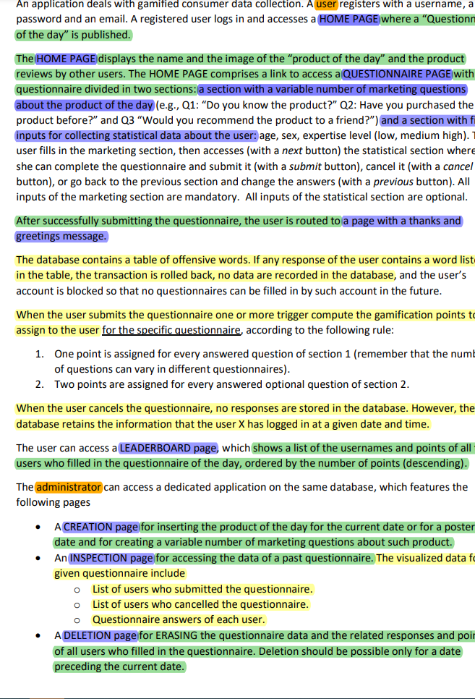
entity Extraction
Through the process of information extraction, we could find different entities and their attributes, relationships between them and web pages.

Slide 4
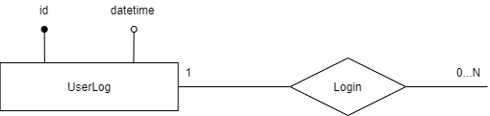
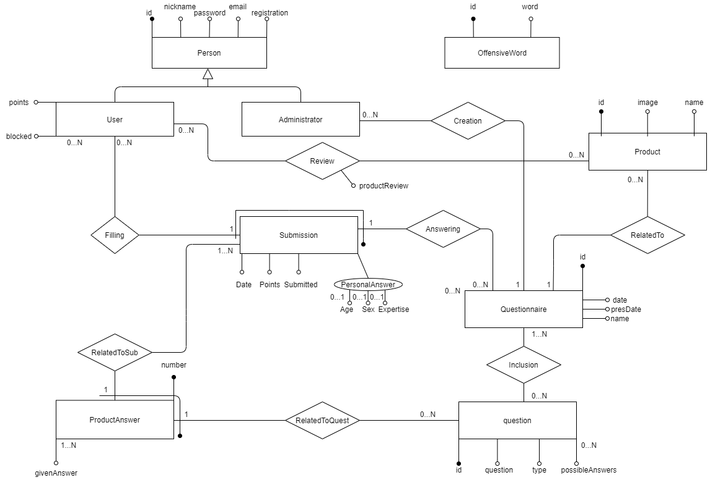
ER
DIAGRAM

Slide 5
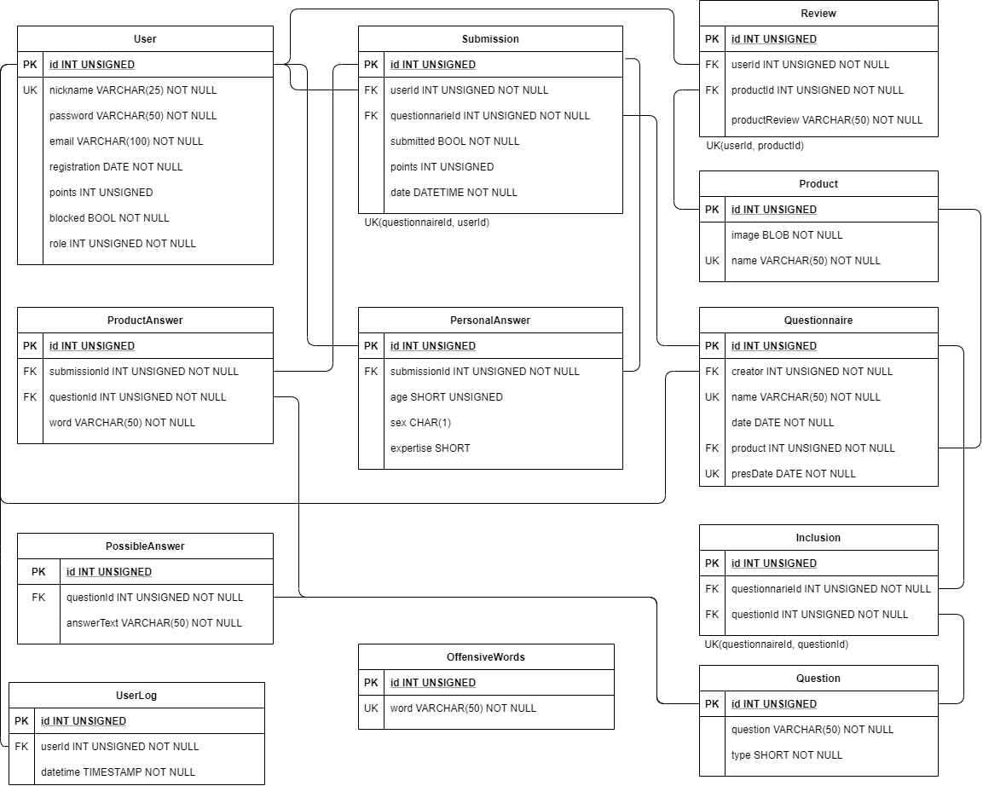
LOGICAL SCHEMA

Slide 6
Relational SCHEMAS DDL

Slide 7
User ddl
CREATE TABLE User (
id INT UNSIGNED PRIMARY KEY AUTO_INCREMENT,
nickname VARCHAR(25) NOT NULL,
password VARCHAR(50) NOT NULL, email VARCHAR(100) NOT NULL, registration DATE NOT NULL, points INT UNSIGNED,
blocked BOOL NOT NULL,
role INT UNSIGNED NOT NULL,
UNIQUE KEY(nickname), UNIQUE KEY(email), CHECK(role = 1 OR role = 2)) AUTO_INCREMENT = 1;
A common pattern in our DB is the use of an auto incremented integer called ID, as a primary key as to optimize all operations on the database.
For the entity User, role is the attribute that differentiates between a normal user of the website (1) or an administrator (2).

Slide 8
Submission & REVIEW DDL
CREATE TABLE Submission ( id INT UNSIGNED PRIMARY KEY AUTO_INCREMENT, userId INT UNSIGNED, questionnaireId INT UNSIGNED, submitted BOOL NOT NULL, points INT UNSIGNED NOT NULL, date DATETIME NOT NULL, UNIQUE KEY(questionnaireId,userId), FOREIGN KEY (questionnaireId) REFERENCES Questionnaire(id) ON UPDATE CASCADE ON DELETE CASCADE,
FOREIGN KEY (userId) REFERENCES User(id) ON UPDATE CASCADE ON DELETE CASCADE);
CREATE TABLE Review ( id INT UNSIGNED PRIMARY KEY AUTO_INCREMENT, userId INT UNSIGNED NOT NULL, productId INT UNSIGNED NOT NULL, productReview VARCHAR(50) NOT NULL, UNIQUE KEY(userId,productId), FOREIGN KEY (userId) REFERENCES User(id) ON UPDATE CASCADE ON DELETE CASCADE, FOREIGN KEY (productId) REFERENCES Product(id) ON UPDATE CASCADE ON DELETE CASCADE)
AUTO_INCREMENT = 1;

Slide 9
Questionnaire DDL
CREATE TABLE IF NOT EXISTS Questionnaire (
id INT UNSIGNED PRIMARY KEY AUTO_INCREMENT,
creatorId INT UNSIGNED,
name VARCHAR(50) NOT NULL,
date DATE NOT NULL,
presDate DATE NOT NULL,
product INT UNSIGNED NOT NULL,
UNIQUE KEY(name),
UNIQUE KEY(presDate),
FOREIGN KEY(creatorId) REFERENCES User(id) ON UPDATE CASCADE ON DELETE CASCADE,
FOREIGN KEY(product) REFERENCES Product(id) ON UPDATE CASCADE ON DELETE CASCADE
) AUTO_INCREMENT = 1;

Slide 10
Product & Question ddl
CREATE TABLE IF NOT EXISTS Product (
id INT UNSIGNED PRIMARY KEY AUTO_INCREMENT,
name VARCHAR(50) NOT NULL,
image BLOB NOT NULL,
UNIQUE KEY(name)
) AUTO_INCREMENT = 1;
-- Additional info: questions can be checkbox (1), selection (2), string (3) or comment (4).
CREATE TABLE IF NOT EXISTS Question (
id INT UNSIGNED PRIMARY KEY AUTO_INCREMENT,
question VARCHAR(50) NOT NULL,
type SMALLINT NOT NULL,
CHECK(type = 1 OR type = 2 OR type = 3 OR type = 4)
) AUTO_INCREMENT = 1;

Slide 11
PossibleAnswer & productanswer ddl
CREATE TABLE IF NOT EXISTS PossibleAnswer (
id INT UNSIGNED PRIMARY KEY AUTO_INCREMENT,
questionId INT UNSIGNED,
answerText VARCHAR(50) NOT NULL,
FOREIGN KEY (questionId) REFERENCES Question(id) ON UPDATE CASCADE ON DELETE CASCADE
) AUTO_INCREMENT = 1;
CREATE TABLE IF NOT EXISTS ProductAnswer (
id INT UNSIGNED PRIMARY KEY AUTO_INCREMENT,
submissionId INT UNSIGNED,
questionId INT UNSIGNED,
word VARCHAR(50) NOT NULL,
FOREIGN KEY (questionId) REFERENCES Question(id) ON UPDATE CASCADE ON DELETE CASCADE,
FOREIGN KEY (submissionId) REFERENCES Submission(id) ON UPDATE CASCADE ON DELETE CASCADE
);

Slide 12
personalanswer ddl
-- Additional info sex: M = male, F = female, U = undefined; Expertise: 0 = none, 1 = low, 2 = medium, 3 = high
CREATE TABLE IF NOT EXISTS PersonalAnswer (
id INT UNSIGNED PRIMARY KEY AUTO_INCREMENT,
submissionId INT UNSIGNED,
age SMALLINT UNSIGNED,
sex CHAR(1),
expertise SMALLINT UNSIGNED,
FOREIGN KEY (submissionId) REFERENCES Submission(id) ON UPDATE CASCADE ON DELETE CASCADE,
CHECK(sex = 'M' OR sex = 'F' OR sex = 'U'),
CHECK(expertise = 0 OR expertise = 1 OR expertise = 2 OR expertise = 3)
) AUTO_INCREMENT = 1;

Slide 13
inclusion & offensiveword & userlog ddl
CREATE TABLE IF NOT EXISTS Inclusion (
id INT UNSIGNED PRIMARY KEY AUTO_INCREMENT,
questionnaireId INT UNSIGNED,
questionId INT UNSIGNED,
UNIQUE KEY(questionnaireId,questionId),
FOREIGN KEY (questionnaireId) REFERENCES Questionnaire(id) ON UPDATE CASCADE ON DELETE CASCADE,
FOREIGN KEY (questionId) REFERENCES Question(id) ON UPDATE CASCADE ON DELETE CASCADE
);
CREATE TABLE IF NOT EXISTS OffensiveWord (
id INT UNSIGNED PRIMARY KEY AUTO_INCREMENT,
word VARCHAR(50) NOT NULL,
UNIQUE KEY(word)
) AUTO_INCREMENT = 1;
CREATE TABLE IF NOT EXISTS UsersLog (
id INT UNSIGNED PRIMARY KEY AUTO_INCREMENT,
userId INT UNSIGNED,
datetime TIMESTAMP NOT NULL,
FOREIGN KEY(userId) REFERENCES User(id) ON UPDATE CASCADE ON DELETE CASCADE) AUTO_INCREMENT = 1;

Slide 14
TRIGGERS
QuestionnairesCreatorIsAdministrator
UserDoesQuestionnairesAfterRegistration
AdministratorCreatesQuestionnairesAfterRegistration
ResponseNumberForAQuestionIsPositiveAndLessThanMaximum
NicknamesDoNotContainOffensiveWordOnUpdate
NicknamesDoNotContainOffensiveWordOnCreation
QuestionsDoNotContainOffensiveWordOnCreation
ReviewDoNotContainOffensiveWordOnCreation
QuestionnairesResponsesDoNotContainOffensiveWordOnCreation
UpdatePointsOnInsertOnProductAnswer
UpdatePointsOnInsertOnPersonalAnswer
UpdatePointsOnDeletedQuestionnaire
UpdatePointsOnUpdateSubmission
CancelQuestionOnNoMoreInclusions
AdminCannotReviewProduct

Slide 15
ALL RELATIONSHIPS OF THE DATABASE

Slide 16
Relationship “Review”
This side is not implemented because it is neither used nor requested by specifications
User is owning side, needed to show reviews of a product. Tagged with @ElementCollection and @MapKeyJoinColumn. Fetched lazy so that workload is decreased when reviews are not needed.
Owner
User
Product
0:N
0:N
User
*
Product
*
User
Product

Slide 17
Relationship “Filling”
Owner
This side is not implemented because it is neither used nor requested by specifications
This is the owner side, needed to see if one has already submitted an answer to the questionnaire. @ManyToOne
User
Submission
0:N
1:1
User
*
Submission
1
User
Submission

Slide 18
Relationship “Creation”
Owner
This side is not implemented because it is neither used nor requested by specifications.
This is the owner side, needed to see who has created the questionnaire. @ManyToOne
Admin
Questionnaire
0:N
1:1
Admin
*
Questionnaire
1
Admin
Questionnaire

Slide 19
Relationship “Answering”
Owner
This is the owner side. Tag @ManyToOne
This side is not implemented because we fetch data through a JPQL query.
Submission
Questionnaire
1:1
0:N
Submission
1
Questionnaire
*
Submission
Questionnaire

Slide 20
Relationship “RelatedTo”
Owner
This side is not implemented because it is neither used nor requested by specifications.
This is the owner side. Tag @ManyToOne
Product
Questionnaire
0:N
1:1
Product
*
Questionnaire
1
Product
Questionnaire

Slide 21
Relationship “RelatedToSub”
Owner
This is the owner side. Tag @ManyToOne.
This is mapped to successfully create a submission we need a list of all the relative product answers. @OneToMany @Fetch(Eager) @OrphanRemoval @Cascade(Persist, Remove)
ProductAnswer
Submission
1:1
0:N
ProductAnswer
1
Submission
*
ProductAnswer
Submission

Slide 22
Relationship “RelatedToQuest”
Owner
This is the owner side. Tag @ManyToOne.
This side is not implemented because it is neither used nor requested by specifications.
ProductAnswer
Question
1:1
0:N
ProductAnswer
1
Question
*
ProductAnswer
Question

Slide 23
Relationship “Inclusion”
Owner
This is owner side, mapped through @ManyToMany and @JoinTable @Fetch(Eager) @Cascade(Persist, Merge)
This side is not implemented because it is neither used nor requested by specifications.
Questionnaire
Question
1:N
0:N
Questionnaire
*
Question
*
Questionnaire
Question

Slide 24
Relationship “Login”
This side is not implemented because it is neither used nor requested by specifications.
This is owner side, mapped through @ManyToOne and @JoinTable. UserLog is just stored in database for recording users logins, but never used in the application, so there is no need for cascade.
Owner
User
UserLog
0:N
1:1
User
*
UserLog
1
User
UserLog

Slide 25
Our application
For ease of readability setters, getters and constructors have been emitted.

Slide 26
@Entity
@Table(name = "user", schema = "db2_project")
@NamedQueries(value = {
@NamedQuery(name = "User.findByName", query = "SELECT u FROM User u WHERE u.nickname = ?1"),
@NamedQuery(name = "User.findByEmail", query = "SELECT u FROM User u WHERE u.email = ?1"),
@NamedQuery(name= "User.getAllTimeLeaderBoard", query= "SELECT u.nickname, u.points FROM User u WHERE u.role=1 ORDER BY u.points DESC")
})
public class User implements Serializable {
private static final long serialVersionUID = Const.EJBVersion;
@Id
@GeneratedValue(strategy = GenerationType.IDENTITY)
private int id;
@Column(unique=true)
private String nickname;
private String password;
private String email;
/**
* Usage of the annotation Temporal is needed to translate a java.util.Date object type (https://javaee.github.io/javaee-spec/javadocs/javax/persistence/Temporal.html).
*/
@Temporal(TemporalType.DATE)
private Date registration;
/**
* The points column of the database can be null, so an object is needed because a primitive type cannot be null.
*/
private Integer points;
private boolean blocked;
private int role;
public User() {
}
public User(String nickname, String password, String email, Date registration, Integer points, boolean blocked, int role) {
this.nickname = nickname;
this.password = password;
this.email = email;
this.registration = registration;
this.points = points;
this.blocked = blocked;
this.role = role;
}
Entity User
- Named query ‘findByName’ is useful for checking the uniqueness of a name and to retrieve the entity of the user when logging in, because the user inserts his name and the password, so not the userID.
Named query ‘findByMail’ is useful for checking the uniqueness of the email while registering.
- @Column(unique = true) because users have no idea of the id assigned to them, so they log in with the nickname which necessarily needs to be one per user.

Slide 27
@Entity
@Table(name = "submission", schema = "db2_project",
uniqueConstraints = @UniqueConstraint(columnNames={"questionnaireId","userId"}))
@NamedQueries(value = {
@NamedQuery(name = "Submission.findByNameAndQuestionnaire", query = "SELECT s FROM Submission s WHERE s.userSender.id = ?1 AND s.submissionQuestionnaire.id = ?2")
})
public class Submission implements Serializable {
private static final long serialVersionUID = Const.EJBVersion;
@Id
@GeneratedValue(strategy = GenerationType.IDENTITY)
private int id;
@ManyToOne
@JoinColumn(name = "questionnaireId")
private Questionnaire submissionQuestionnaire;
@ManyToOne
@JoinColumn(name = "userId")
private User userSender;
@OneToMany (fetch = FetchType.LAZY, mappedBy = "submission", cascade = { PERSIST, REMOVE }, orphanRemoval = true)
private List<ProductAnswer> productAnswers;
@OneToOne(mappedBy = "submission", cascade = CascadeType.ALL, orphanRemoval = true)
private PersonalAnswer personalAnswer;
private int submitted;
/**
* The points column of the database can be null, so an object is needed because a primitive type cannot be null.
*/
private Integer points;
/**
* Usage of the annotation Temporal is needed to translate a java.util.Date object type (https://javaee.github.io/javaee-spec/javadocs/javax/persistence/Temporal.html).
*/
@Temporal(TemporalType.DATE)
private Date date;
public Submission() {}
public Submission(Questionnaire submissionQuestionnaire, User userSender, int submitted, Integer points, Date date) {
this.submissionQuestionnaire = submissionQuestionnaire;
this.userSender = userSender;
this.submitted = submitted;
this.points = points;
this.date = date;
this.productAnswers = new ArrayList<>();
}
public void addProductAnswer(ProductAnswer productAnswer) {
getProductAnswers().add(productAnswer);
productAnswer.setSubmission(this);
}
public void setPersonalAnswers(PersonalAnswer personalAnswers) {
this.personalAnswer = personalAnswers;
personalAnswers.setSubmission(this);
}
public void setProductAnswers(List<ProductAnswer> productAnswers) {
this.productAnswers = productAnswers;
for (ProductAnswer p : productAnswers) {
p.setSubmission(this);
}
}
Entity Submission
- cascade = CascadeType.ALL, orphanRemoval = true ensure that the answers are deleted when the user (and submission) is deleted from the system
- Named Query ‘findByNameAndQuestionnaire’ is used to retrieve the submission of a user with respect to a question
- The points column of the database can be null, so an object is needed because a primitive type cannot be null

Slide 28
@Entity
@Table(name = "product", schema = "db2_project")
@NamedQueries(value = {
@NamedQuery(name="Product.getAll", query="SELECT p FROM Product p"),
@NamedQuery(name="Product.getByName", query="SELECT p FROM Product p WHERE p.name=:pName")
})
public class Product {
private static final long serialVersionUID = Const.EJBVersion;
@Id
@GeneratedValue(strategy = GenerationType.IDENTITY)
private int id;
@ElementCollection(fetch = FetchType.LAZY)
@CollectionTable(name = "review",joinColumns = @JoinColumn(name="productId"))
@MapKeyJoinColumn(name = "userId")
@Column(name = "productReview")
private Map<User, String> reviews;
@Basic(fetch=FetchType.EAGER)
@Lob
private byte[] image;
@Column(unique=true)
private String name;
public Product() {}
public Product(byte[] image, String name) {
this.image = image;
this.name = name;
}
Entity Product
-reviews are mapped as a key from user to his/her review, through the tag @ElementCollection, fetched only when
needed, so fetch=LAZY
-image is fetched EAGER so to have the product thumbnail always available for client-side navigation.
-Named queries are used to get all products and to get a product by his name

Slide 29
@Entity
public class ProductAnswer implements Serializable{
private static final long serialVersionUID = 1L;
@Id
@GeneratedValue(strategy = GenerationType.IDENTITY)
private int id;
@ManyToOne
@JoinColumn(name = "questionId")
private Question question;
@ManyToOne
@JoinColumn(name = "submissionId")
private Submission submission;
private String word;
public ProductAnswer() {}
public ProductAnswer(Question question,String word) {
this.question = question;
this.word = word;
}
}
Entity ProductAnswer

Slide 30
@Entity
@Table(name = "personalanswer", schema = "db2_project")
public class PersonalAnswer implements Serializable{
private static final long serialVersionUID = 1L;
@Id
@GeneratedValue(strategy = GenerationType.IDENTITY)
private Integer id;
private Integer age;
private Character sex;
private Integer expertise;
@OneToOne
@JoinColumn(name = "submissionId")
private Submission submission;
public PersonalAnswer(Questionnaire questionnaire,Integer age,Character sex,Integer expertise) {
this.age=age;
this.sex=sex;
this.expertise=expertise;
}
public PersonalAnswer() {}
}
Entity PersonalAnswer

Slide 31
@Entity
@Table(name = "possibleAnswer", schema = "db2_project")
public class PossibleAnswer implements Serializable {
private static final long serialVersionUID = 1L;
@Id
@GeneratedValue(strategy = GenerationType.IDENTITY)
private int id;
@ManyToOne
@JoinColumn(name = "questionId")
private Question question;
private String answerText;
public PossibleAnswer() {};
public PossibleAnswer(String answerText) {
this.answerText = answerText;
}
}
Entity PossibleAnswer

Slide 32
@Entity
@Table(name = "question", schema = "db2_project")
@NamedQuery(name="Question.getAll", query="SELECT q FROM Question q")
public class Question implements Serializable {
private static final long serialVersionUID = Const.EJBVersion;
@Id
@GeneratedValue(strategy = GenerationType.IDENTITY)
private int id;
private String question;
private short type;
@OneToMany (mappedBy = "question", cascade = CascadeType.ALL, orphanRemoval = true,fetch = FetchType.EAGER)
private List<PossibleAnswer> questionAnswers;
public Question() {}
public Question(String question, short type) {
super();
questionAnswers= new ArrayList<>();
this.question = question;
this.type = type;
}
public void addAnswer(PossibleAnswer possAnswer) {
getQuestionAnswers().add(possAnswer);
possAnswer.setQuestion(this);
}
Entity Question
-questionAnswers is fetched EAGER so to have the possible answers to a question available for client-side navigation. This is always necessary for our application. Orphan removal is true since possible answers are weak entities wrt the question, and they should be removed when their question attribute is not set.
-Named query is used to get all the questions stored in the database, so to offer the functionality of adding to the new questionnaire an already present question from old questionnaires.

Slide 33
@Entity
@Table (name = "Questionnaire", schema = "db2_project")
public class Questionnaire implements Serializable{
private static final long serialVersionUID = Const.EJBVersion;
@Id
@GeneratedValue(strategy = GenerationType.IDENTITY)
private int id;
/**
* Usage of the annotation Temporal is needed to translate a java.util.Date object type (https://javaee.github.io/javaee-spec/javadocs/javax/persistence/Temporal.html).
*/
@Temporal(TemporalType.DATE)
private Date date;
@Temporal(TemporalType.DATE)
private Date presDate;
@Column(unique=true)
private String name;
@ManyToOne
@JoinColumn(name= "product")
private Product product;
@ManyToOne
@JoinColumn(name = "creatorId")
private User creator;
@ManyToMany ( cascade = { PERSIST, MERGE }, fetch = FetchType.EAGER)
@JoinTable(name="inclusion",
joinColumns=@JoinColumn(name="questionnaireId"),
inverseJoinColumns=@JoinColumn(name="questionId"))
private List<Question> questions;
public Questionnaire() {}
public Questionnaire(String name) {
questions = new ArrayList<>();
this.date = new Date();
this.name = name;
}
public void addQuestion(Question question) {
questions.add(question);
}
Entity Questionnaire
-fetch = FetchType.EAGER because the most important part of a questionnaire is its questions, and they are always necessary in our application when fetching a questionnaire.
-orphanRemoval = true for Submissions so once a questionnaire is deleted all its submissions (answers) will be deleted.

Slide 34
@Entity
@Table(name = "OffensiveWord", schema = "db2_project")
@NamedQueries(value = {
@NamedQuery(name = "OffensiveWord.findByWord", query = "SELECT w FROM OffensiveWord w WHERE w.word = ?1"),
@NamedQuery(name = "OffensiveWord.findAllWords", query = "SELECT w FROM OffensiveWord w")
})
public class OffensiveWord {
@Id
@GeneratedValue
private int id;
@Column(unique=true)
private String word;
/***** Setters *****/
public void setId(int id) {
this.id = id;
}
public void setWord(String word) {
this.word = word;
}
/***** Getters *****/
public int getId() {
return this.id;
}
public String getWord() {
return this.word;
}
}
Entity Offensive words
Named queries are used to get all the offensive words and to get a single offensive word.

Slide 35
@Entity
public class UserLog {
@Id
@GeneratedValue(strategy = GenerationType.IDENTITY)
private int id;
@ManyToOne
@JoinColumn(name = "userId")
private User userId;
@Temporal(TemporalType.TIMESTAMP)
private Date datetime;
public UserLog(User id2, Date date) {
this.userId= id2;
this.datetime=date;
}
}
Entity UserLog

Slide 36
Servlets and ejb
Client components are listed here and the business components EJB are listed too.

Slide 37
Servlet and html pages
Servlets used to get pages:
GetCreation
GetDeleteQuestion
GetDeleteQuestionnaire
GetDeletion
GetGreetings
GetInspection
GetLeaderboard
GetLogout
GetProductReview
GetUserSubmission
GetChangeNickname
GetHomepage
GetIndex
GetQuestionnaireResponse
Servlets used to check requests:
CheckQuestionCreation
CheckQuestionnaireCreation
CheckStoredQuestionAdd
CheckChangeNickname
CheckLogin
CheckRegistration
HTML Thymeleaf templates:
changeNickname.html
greetings.html
homepage.html
index.html
Leaderboard.html
QuestionnaireCreationHome.html
QuestionnaireDeletion.html
QuestionnaireInspection.html
questionnaireResponse.html
ReviewSubmission.html
UserSubmission.html

Slide 38
EJB
EJB:
AccountService
LeaderboardService
OffensiveWordsService
QuestionnaireAdminService
QuestionnaireCreationService
QuestionnaireOfTheDayService
QuestionnaireSubmissionService
ReviewService
SubmissionService

Slide 39
AccountService
public void createNewUser(String nickname, String password, String email, Date regDate) throws UserAlreadyPresentNicknameException, UserAlreadyPresentEmailException
public User findUser(int userId)
public User findUser(String nickname) throws UserException
public User findUserByEmail(String email) throws UserException
public boolean login(String nickname, String password) throws UserException
public void changeNickname(int id, String newNickname, String password) throws UserException, UserCredentialsException, UserAlreadyPresentNicknameException
public void banUser(int userId)

Slide 40
LeaderboardService
public Map<String, Integer> getGeneralLeaderboard()
public Map<String, Integer> getQuestionnaireLeaderboard(int questionnaireId) throws QuestionnaireException

Slide 41
OffensiveWordsService
public List<OffensiveWord> getAllBadWords()
public boolean isPresent(String word)

Slide 42
QuestionnaireAdminService
public void getQuestionnaireUserList(boolean submitted)
public Map<Question, List<String>> getUserSubmission(int userId)
public Integer getSelectedQuestionnaireId()
public void setSelectedQuestionnaireId(Integer selectedQuestionnaireId)
public List<Object[]> getUserSubmissionList()
public void refreshAnswers()
public List<Object[]> getUserCancelList()
public UserPersonalInfo getUserInfo(int userId)

Slide 43
QuestionnaireCreationService
public void addQuestion(FormQuestion question) throws IllegalArgumentException
public void removeQuestion(int questionId)
public void addStoredQuestion(int questionId)
public void removeStoredQuestion(int questionId)
public User createQuestionnaire(int userId, String name,Date presDate, int productId)
public List<Question> getAllStoredQuestions()
public int getNextQuestionId()
public List<FormQuestion> getFormQuestions()
public List<Question> getStoredQuestions()
public List<Product> getAllProducts()
public boolean addProduct(String name, byte[] imgByteArray)

Slide 44
QuestionnaireOfTheDayService
public Questionnaire getQuestionnaireByDate(String dateAsString) throws QuestionnaireException, ParseException
public Questionnaire getQuestionnaireByDate(Date date) throws QuestionnaireException
public Questionnaire getQuestionnaire(int id) throws QuestionnaireException
public Product getProduct(int id) throws QuestionnaireException
public Product getProduct(Questionnaire questionnaire) throws QuestionnaireException
public List<Question> getQuestions(int questionnaireId) throws QuestionnaireException
public List<Question> getQuestions(Questionnaire questionnaire) throws QuestionnaireException
public Questionnaire getQuestionnaireOfTheDay() throws QuestionnaireException, ParseException
public void deleteQuestionnaire(int questionnaireId) throws QuestionnaireCancellationException

Slide 45
QuestionnaireSubmissionService
public void setQuestionnaire(int questionnaireId) throws QuestionnaireException
public void modifyProductAnswers(List<FormProductAnswer> answers, int userId) throws IllegalArgumentException
public void modifyPersonalAnswers(FormPersonalAnswer answers, int userId) throws IllegalArgumentException
public void submitQuestionnaire(int userId)
public void cancelQuestionnaire(int userId)
public void clearResponses()
public boolean isQuestionnaireSet()
public boolean getOffensiveWords()
public boolean areAllQuestionsReplied()
public boolean isSubmissionWellFormed()
private void submitOrCancelQuestionnaire(int userId, boolean submit)

Slide 46
ReviewService
public Map<String, String> getProductReviews(int productId)
public void addProductReview(User user, int productId, String productReview) throws ProductException, ReviewAlreadyPresentException

Slide 47
SubmissionService
public Submission findSubmission(int userId, int questionnaireId)

