Slide 1
Hacka kah LABDATA - 07/03/2020
Eduardo Pereira da Costa Jr - edupcjr@faculdadefia.edu.br
Leonardo Xavier Lopes - leoxlopes@hotmail.com
Marco Antônio Olive Peres Barbosa - marco.barbos@gmail.com
Washington Miranda da Silva - oxto.wms@gmail.com
notebooks: https://github.com/marcoabarbosa/hackathon-labdata2

Slide 2
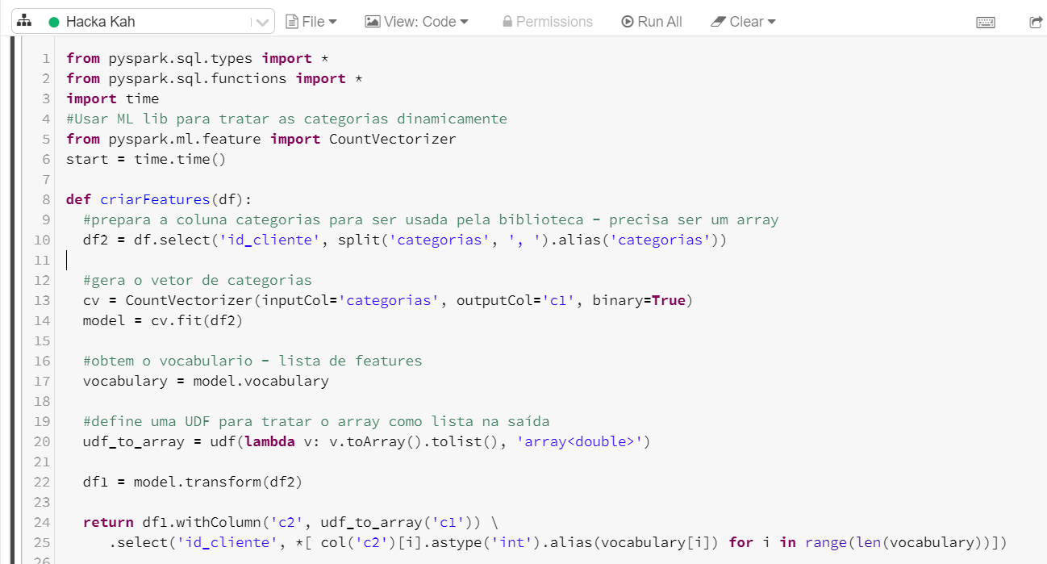
Desafio Programação pyspark

Slide 3
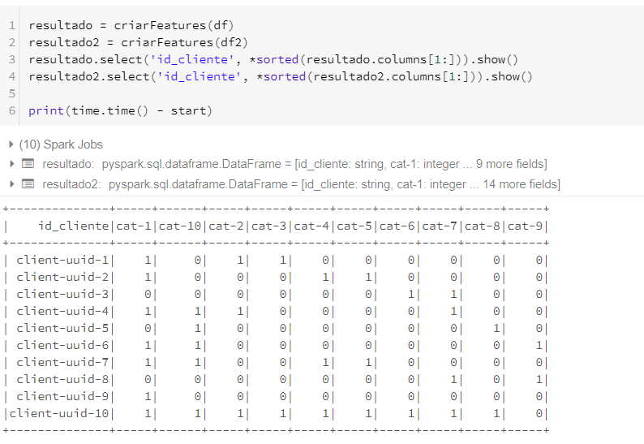
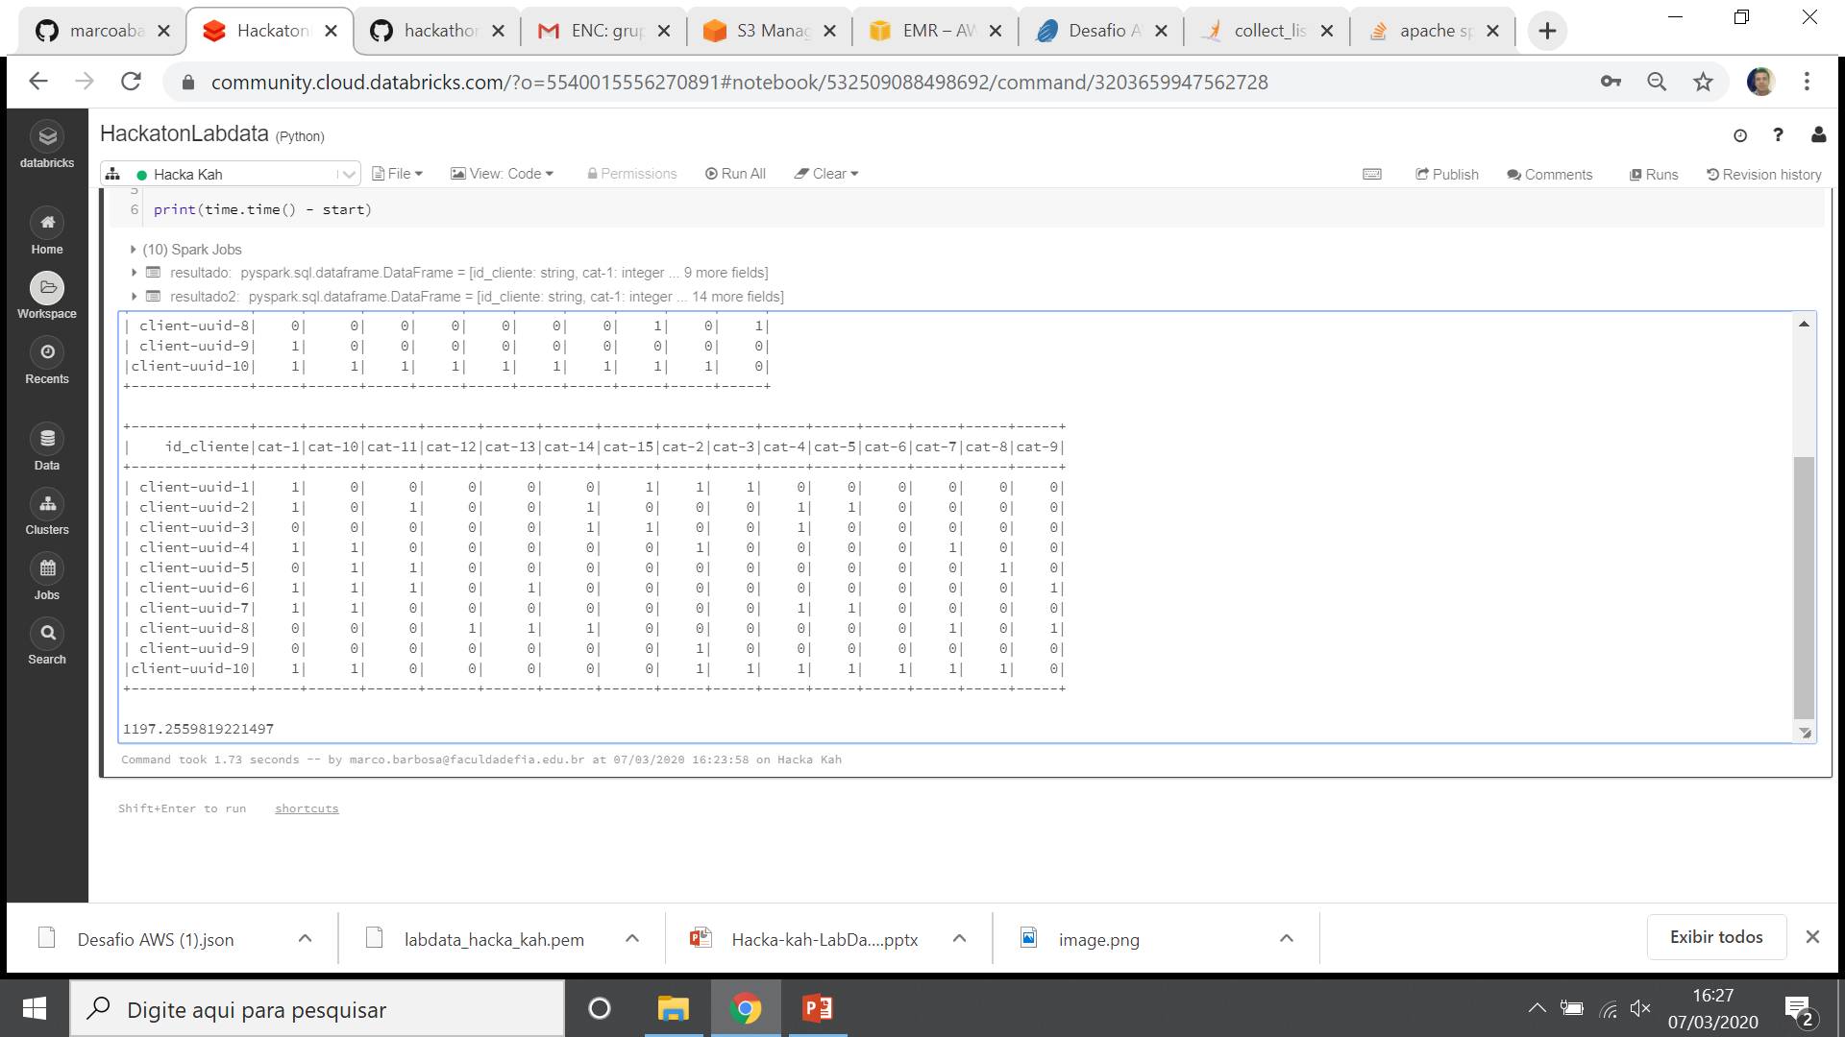
Desafio Programação pyspark

Slide 4
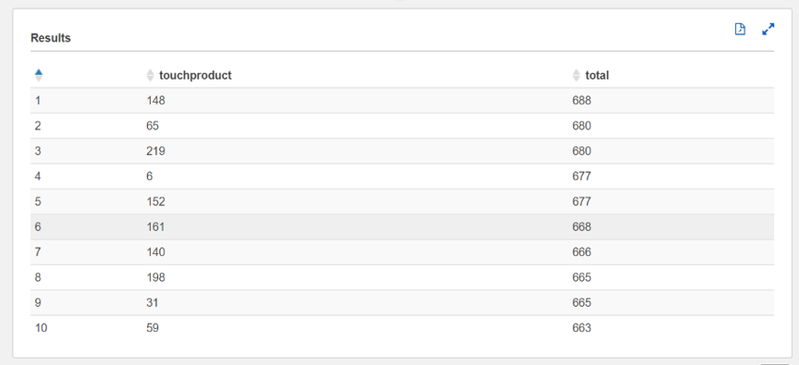
Desafio CASE ecommerce – Tarefa 1.1
SELECT touchproduct, count (touchproduct) as total FROM "sessions_ecommerce"."rawdata"
where touchproduct <> 0 group by touchproduct order by total desc limit 10;

Slide 5
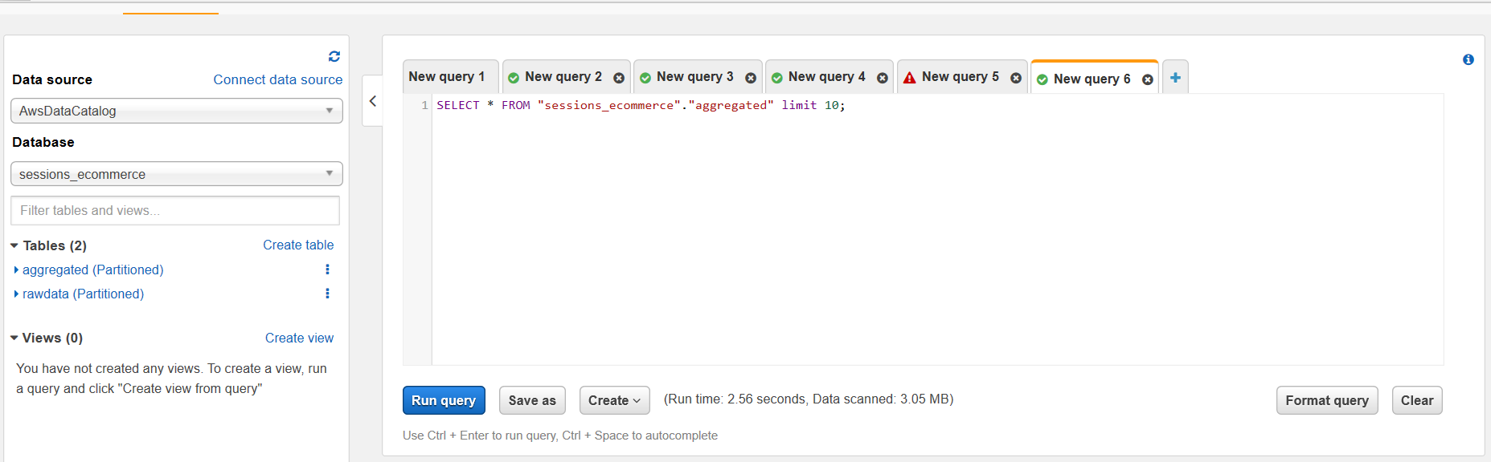
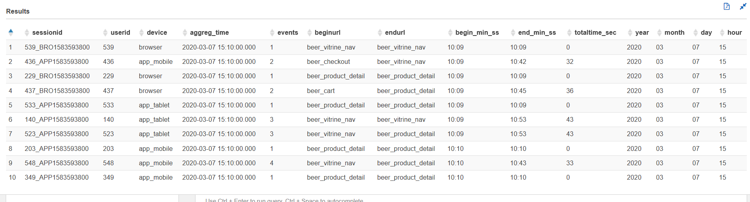
Desafio CASE ecommerce – Tarefa 1.2

Slide 6
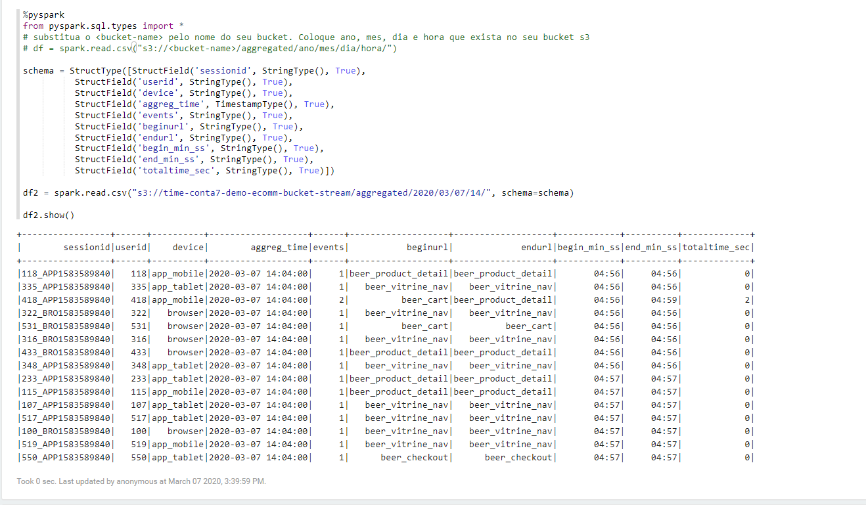
Desafio CASE ecommerce – Tarefa 1.3

Slide 7
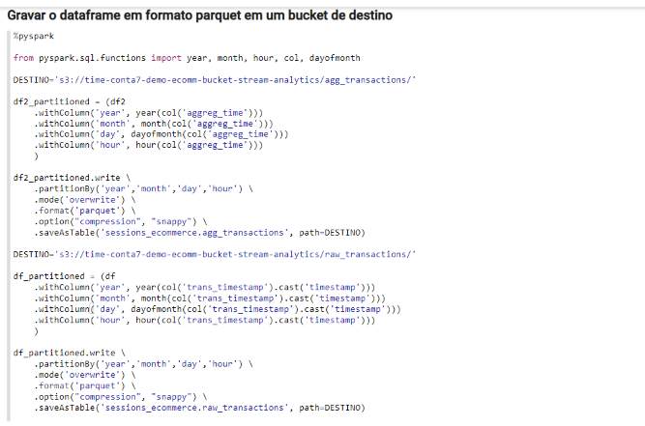
Desafio CASE ecommerce – Tarefa 1.3

Slide 8
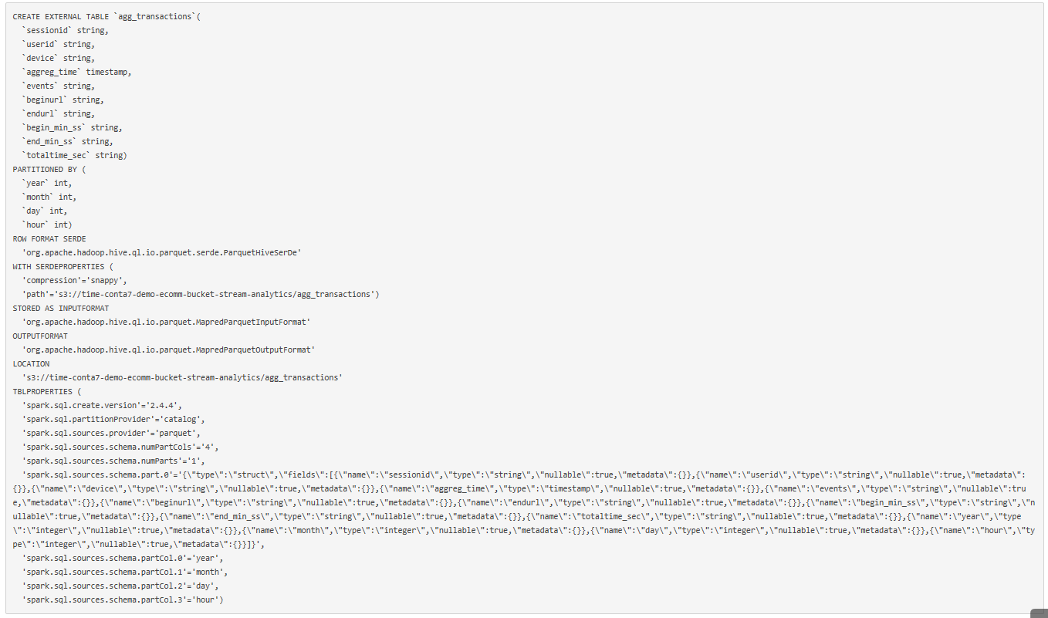
Desafio CASE ecommerce – Tarefa 1.3

Slide 9
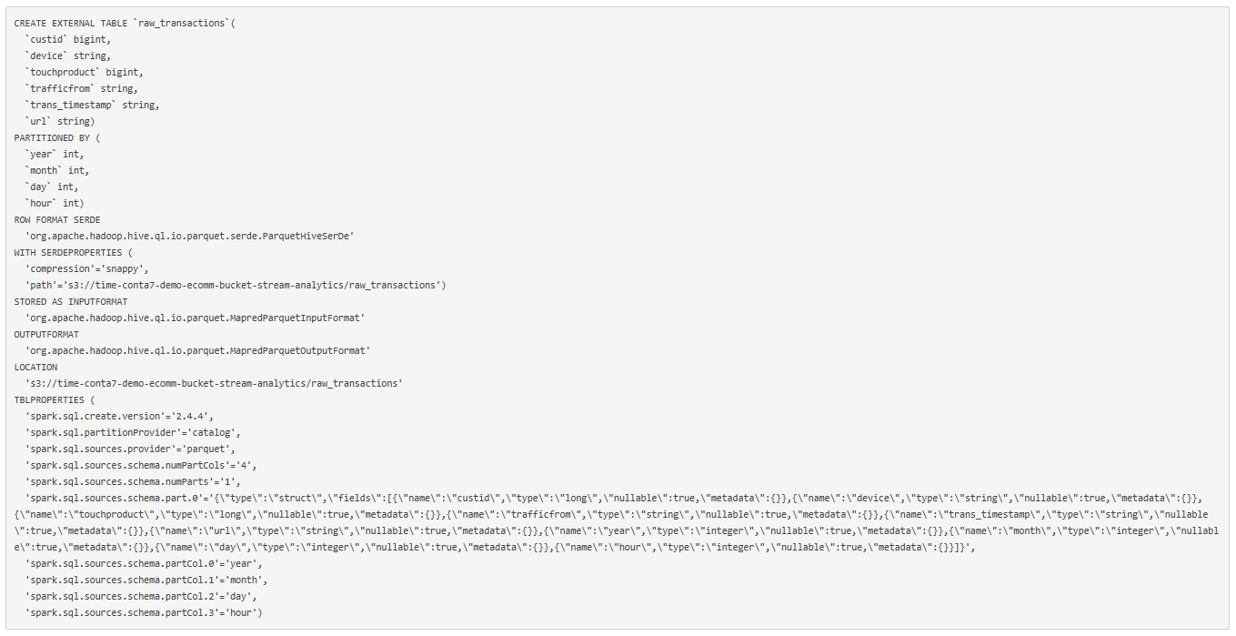
Desafio CASE ecommerce – Tarefa 1.3

Slide 10
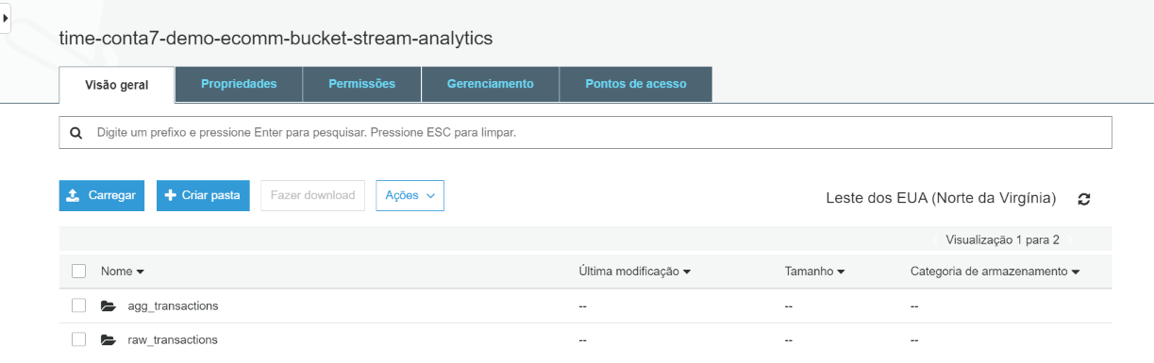
Desafio CASE ecommerce – Tarefa 2

Slide 11
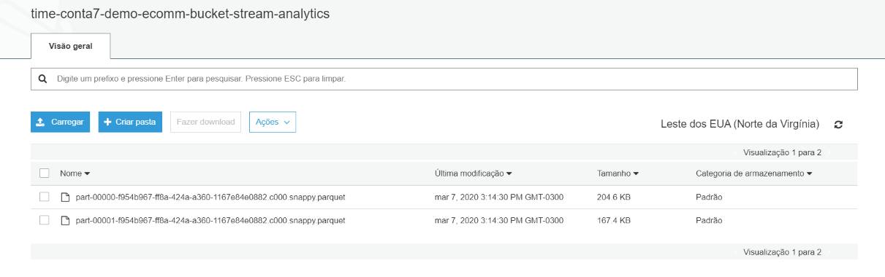
Desafio CASE ecommerce – Tarefa 2

Slide 12

Desafio CASE ecommerce – Tarefa 2

Slide 13
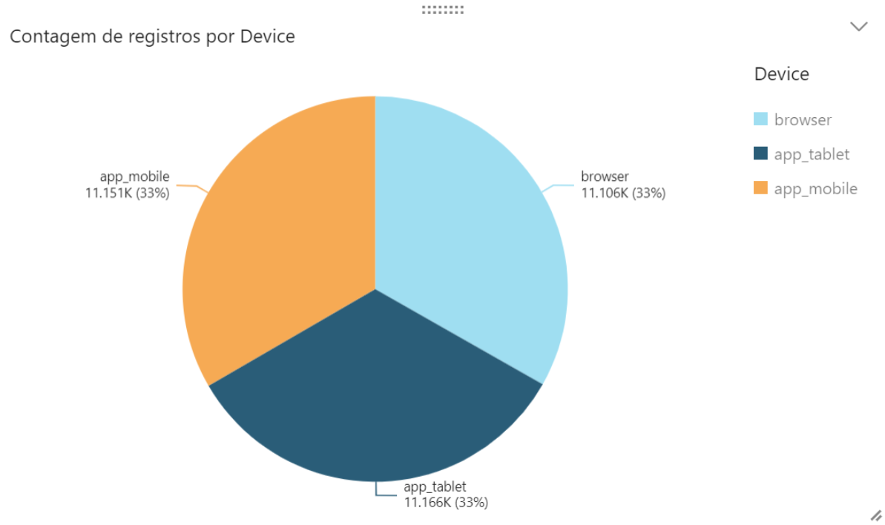
Desafio CASE ecommerce – Tarefa 3.1

Slide 14
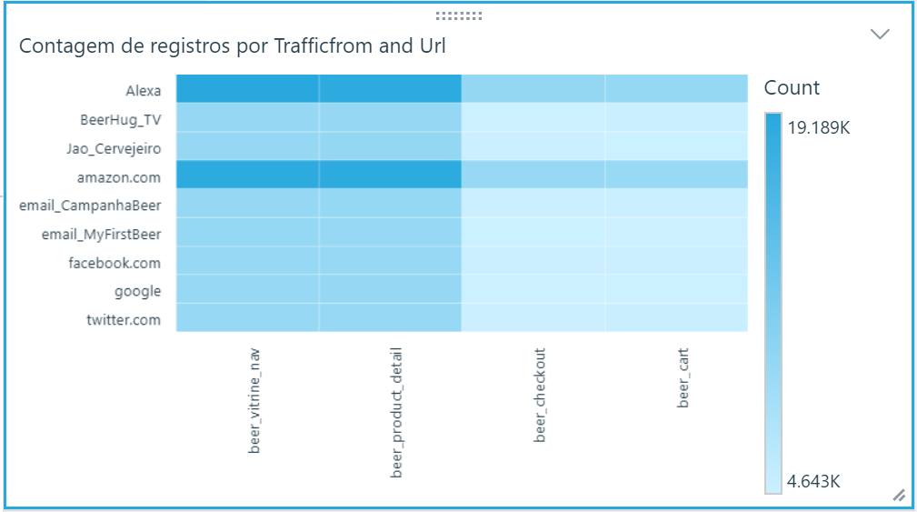
Desafio CASE ecommerce – Tarefa 3.2

