Slide 1

TRANSFORMERS APPLICATION
IN AUTOMATIC TEXT SUMMARIZATION
Master’s Project conducted by:
Marco Pietro Abrate
Supervised by:
Dr. Maxime Gabella, CEO of Magma Learning
Prof. Martin Jaggi, Professor at MLO, EPFL

Slide 2

Magma Learning
ARI 9000
Mobile and web application.
Generates micro-learning based on training material.
Adapts to interests, knowledge level and memory ability.
Consolidates long-term retention.
A key component is the extraction of important passages from the starting material, which is often long and complex.
Notes:
Magma Learning Sàrl start-up 2019 in Switzerland.
Radically enhance learning thanks to artificial intelligence.

Slide 3
Problem Statement
Extraction of key passages from natural language material
Automatic Text Summarization (ATS).
Extractive, abstractive, hybrid (El-Kassas et al., 2020).
Transformer, a revolutionary new approach introduced by Vaswani et al. (2017)
Relies entirely on an attention mechanism.
More parallelization than older models.
Quadratic time and memory complexity with respect to the input length.
Evaluation of computer-generated summaries
Simple manual evaluation of summaries requires very long hours of human efforts (Lin, 2004).

Slide 4
Master’s Project
Objective:
Explore the application of ATS systems, with an accent on Transformer models.
Automatically summarize and evaluate long text documents.
Problems to tackle:
Long input documents.
Quadratic time and space complexity of Transformers.
Automatic evaluation of computer-generated summaries.

Slide 5
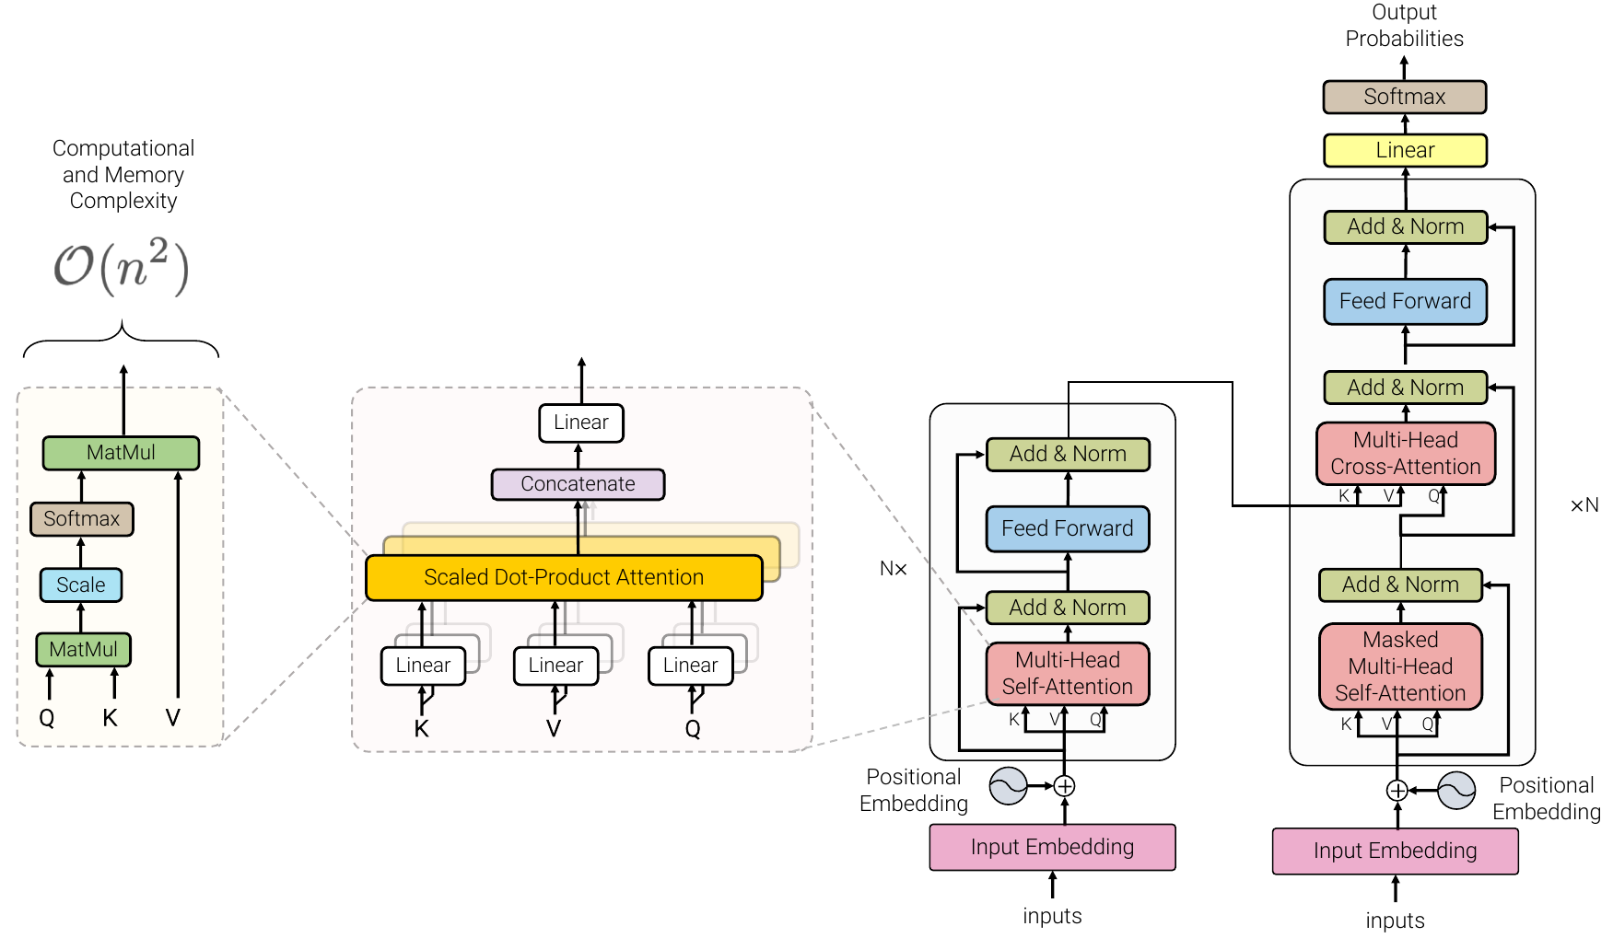
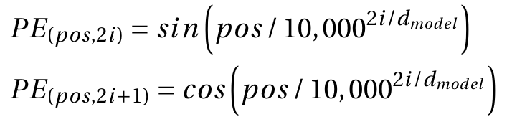
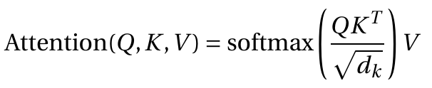
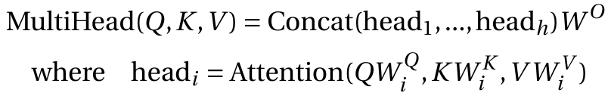
Self-Attention and Transformer
Notes:
The masking ensures that the predictions for position i can depend only on the known outputs at positions less than i.
The model is auto-regressive, consuming the previously generated symbols as additional input when generating the next.
Multi-head projects the queries, keys and values h times with linear projections. The attention function is performed in parallel.
Multi-head attention allows the model to jointly attend to information from different representation subspaces at different positions.

Slide 6
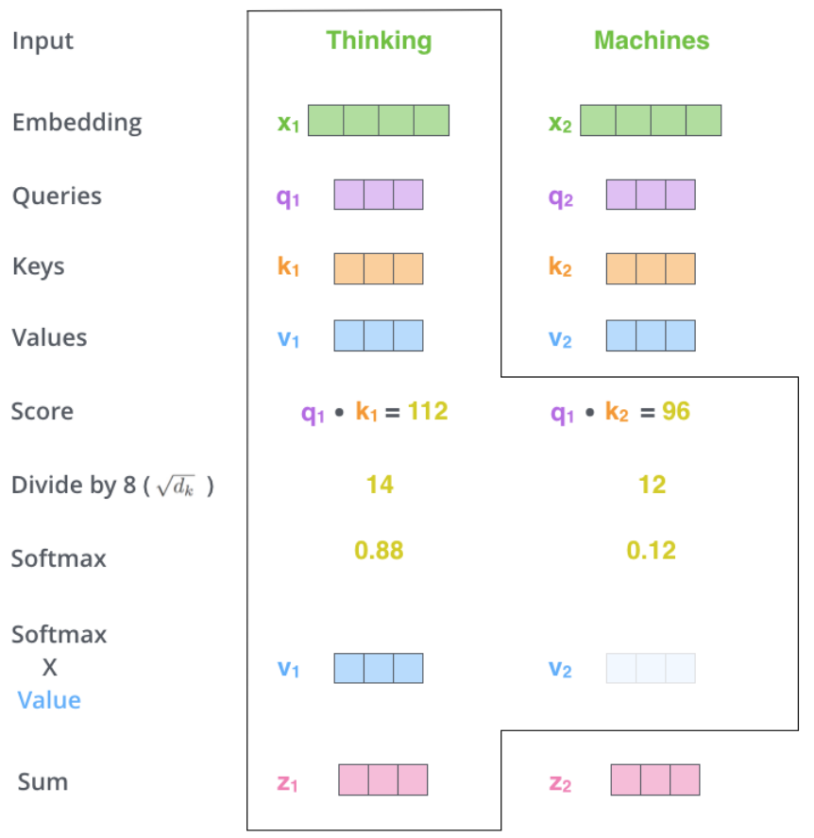
Self-Attention Example
Query, key and value are created from the words’ embeddings.
Self-attention for the word “Thinking”.
Score how much focus to place on other words while “Thinking” is processed.
Finally, keep intact the words with higher scores and drown-out irrelevant word.

Slide 7
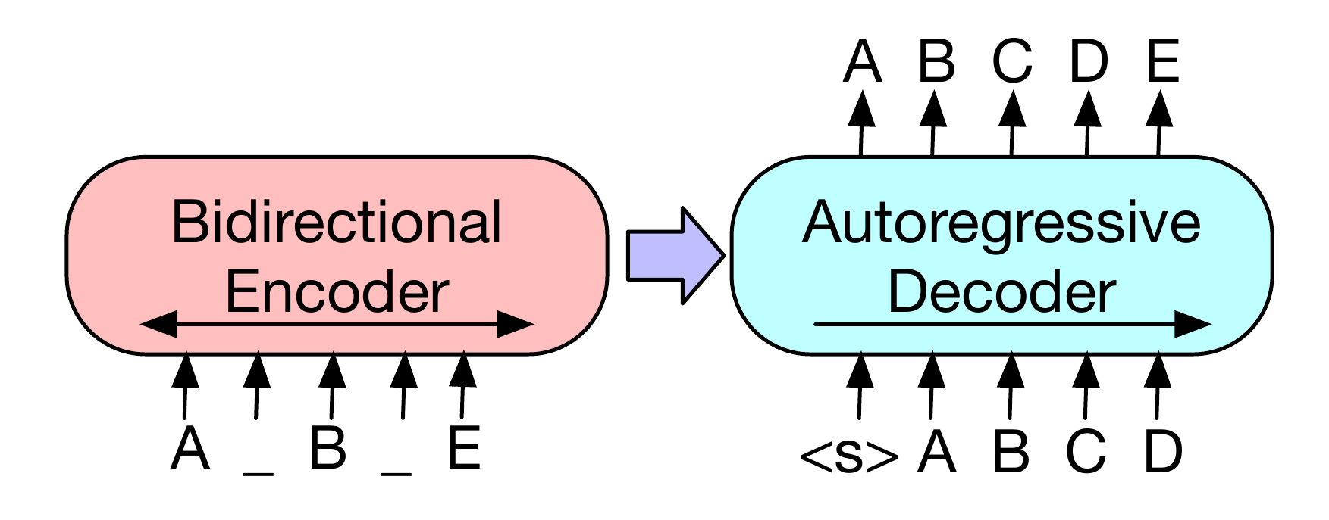
Unsupervised Pre-Training
Develop a general-purpose knowledge that allows the model to be transferred with fine-tuning to downstream tasks, such as summarization.
Unsupervised learning on unlabeled data.
Corrupt document and then optimize the cross-entropy loss between decoder’s output and original text.

Slide 8
Transformer Models
T5 (Raffel et al., 2019)
Pre-trained on 750 gigabytes of clean English text from the web.
Objective corrupts contiguous, randomly-spaced spans of tokens.
Maximum 512 tokens in input.
BART (Lewis et al., 2019)
Pre-trained on 160 gigabytes of news, books, stories and web text.
Objective corrupts the input text and permutes all sentences.
Maximum 1,024 tokens in input.
PEGASUS (Zhang et al., 2020)
Pre-trained on 4.5 terabytes of news and clean English text from the web.
Objective masks whole sentences that appear to be important in the input document.
Maximum 1,024 tokens in input.

Slide 9
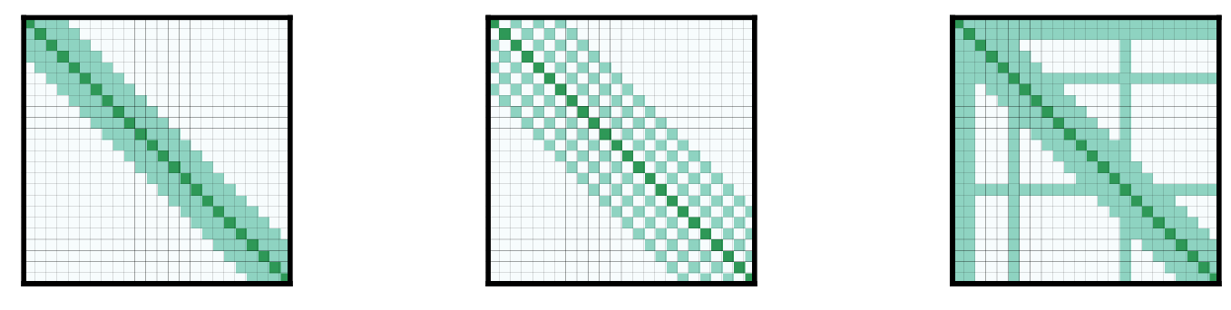
Transformer Models
Low-Resource Summarization
Often difficult to collect a large number of supervised examples.
Zhang et al. picked the first 10^{k} (k = 1, 2, 3, 4) training examples from each downstream dataset to fine-tune PEGASUS.
100 examples: PEGASUS results comparable to base Transformer.
1,000 examples: PEGASUS beats state-of-the-art on 6 out of 12 datasets.
Long Document Summarization
Sparsify attention matrix.
Compress attention matrix with LSH, pooling and convolution.
Simplify attention matrix with a decomposable kernel.
Longformer Encoder Decoder (LED) (Beltagy et al., 2020) has linear memory complexity (~ 8,000 input tokens).
Notes:
Sliding window
Dilated sliding window
Global attention on few pre-selected input locations

Slide 10
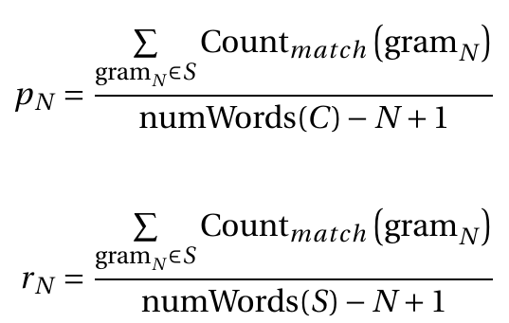
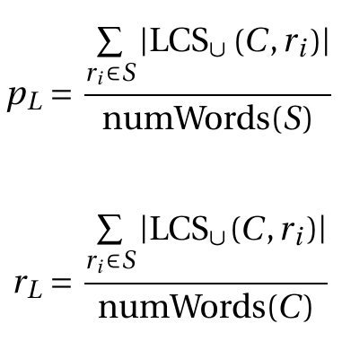
ROUGE Evaluation Metric (Lin, 2004)
ROUGE-N
ROUGE-L
r_{i} → Sentence i
C → Candidate summary
S → Reference summary
LCS → Longest Common Subsequence
C → Candidate summary
S → Reference summary

Slide 11
Methods: Computer Environment
Python 3.6.9 programming language.
Miniconda package manager.
GitHub version control manager.
Weights and Biases visualization platform.
HuggingFace Transformers
Container for multiple Transformer models.
Coded in PyTorch following a common template.
Continuously updated (~ 60 commits per week).
Google Colab and AWS EC2, S3 virtual machines.

Slide 12
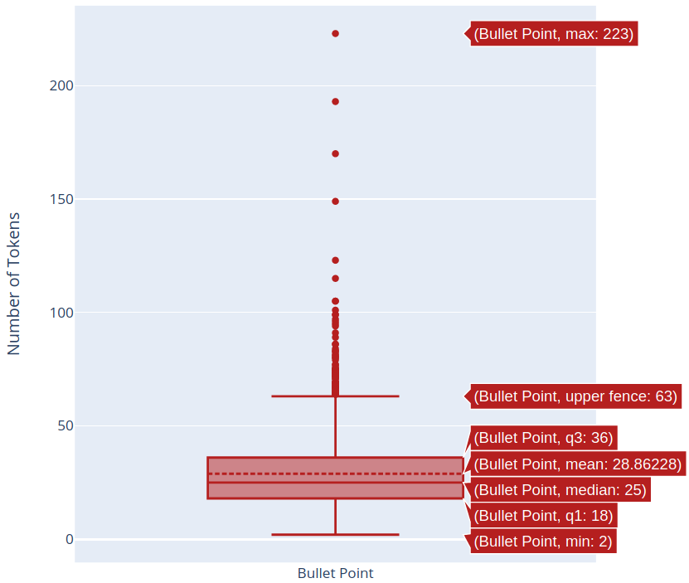
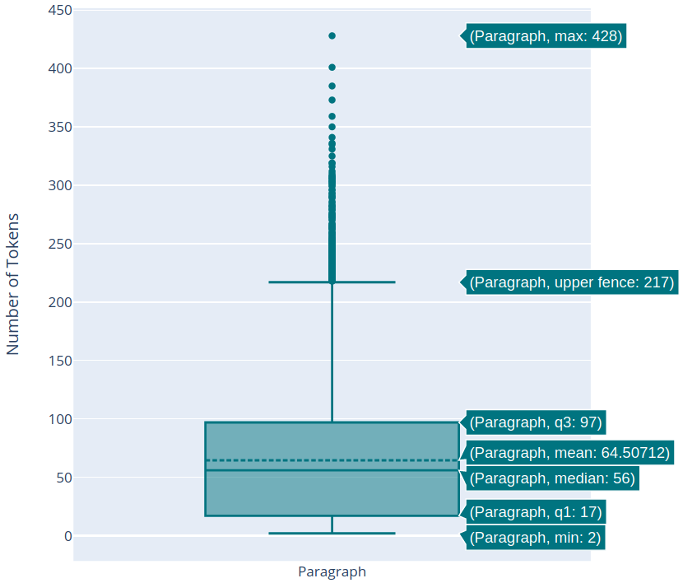
Methods: Data
53 Karger Publishers books in the field of medicine.
Key facts section with bullet points for each chapter.
On average 2,717 tokens per chapter.
Notes:
Pre-processing:
Replace Special and Unicode characters (e.g. ± replaced by +-).
Remove wrongly parsed characters.
Remove words that are too long and sentences that are too short.

Slide 13
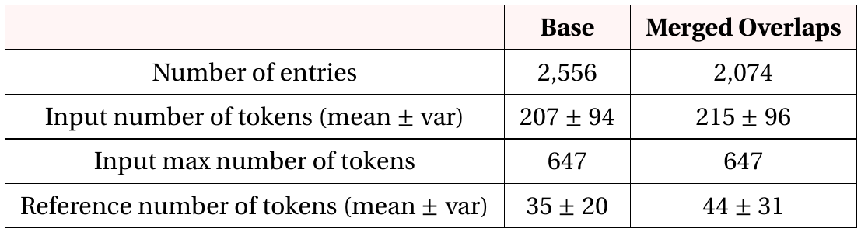
Methods: Dataset Generation
Due to the self-attention quadratic memory complexity, only the LED model can handle the data as is. The others need special datasets.
Bullet-Paragraph Dataset
Sentence-Transformer cosine similarity between paragraphs and bullet points.
Each bullet point associated to the most similar paragraph.
Each entry is expanded maximizing the similarity.
Base and Merged Overlaps
Notes:
Merged Overlaps is created by merging paragraphs which overlap for more than 90% of tokens and the corresponding bullet points.

Slide 14
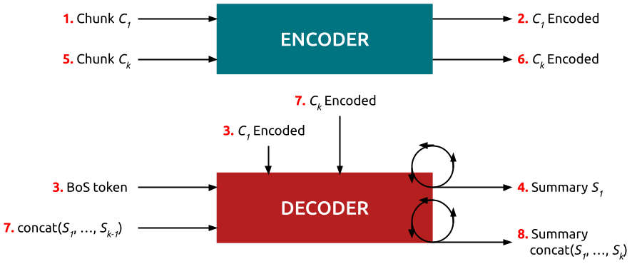
Methods: Recurrent Decoder
The final summary is compared to the concatenation of bullet points.
Cannot reproduce the bullet points structure.
Generative parameters must be changed at every iteration.
Notes:
A traditional model would generate a summary for one chunk at a time without information from the others.

Slide 15
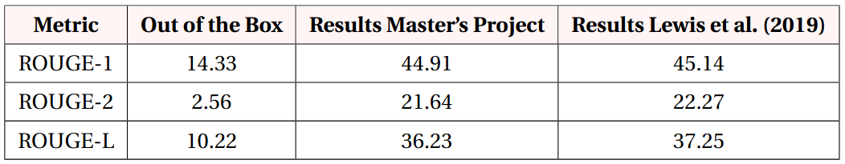
Fine-Tuning Transformers
T5, BART and PEGASUS are fine-tuned on the Bullet-Paragraph dataset.
Batch size limitation is solved using the Gradient Accumulation Steps (GAS) parameter.
To gain confidence with the HuggingFace environment, BART is fine-tuned to reproduce the results published by Lewis et al. (2019) on the XSum dataset.
Notes:
Gradient accumulation split the batch of samples into several mini-batches that run sequentially. GAS parameter is the number of steps the model runs without updating its variables while summing gradients then using them to compute the variable updates.
On average 0.61 points lower than the paper results.

Slide 16
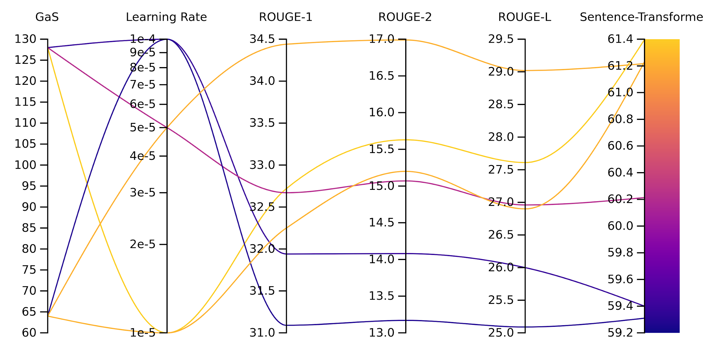
Hyperparameter Search
Find a good balance between GAS and learning rate.
r
Notes:
The metrics values are very different between each other. This is due to the way these metrics are defined and does not mean that the model is performing better in one metric than the others.

Slide 17
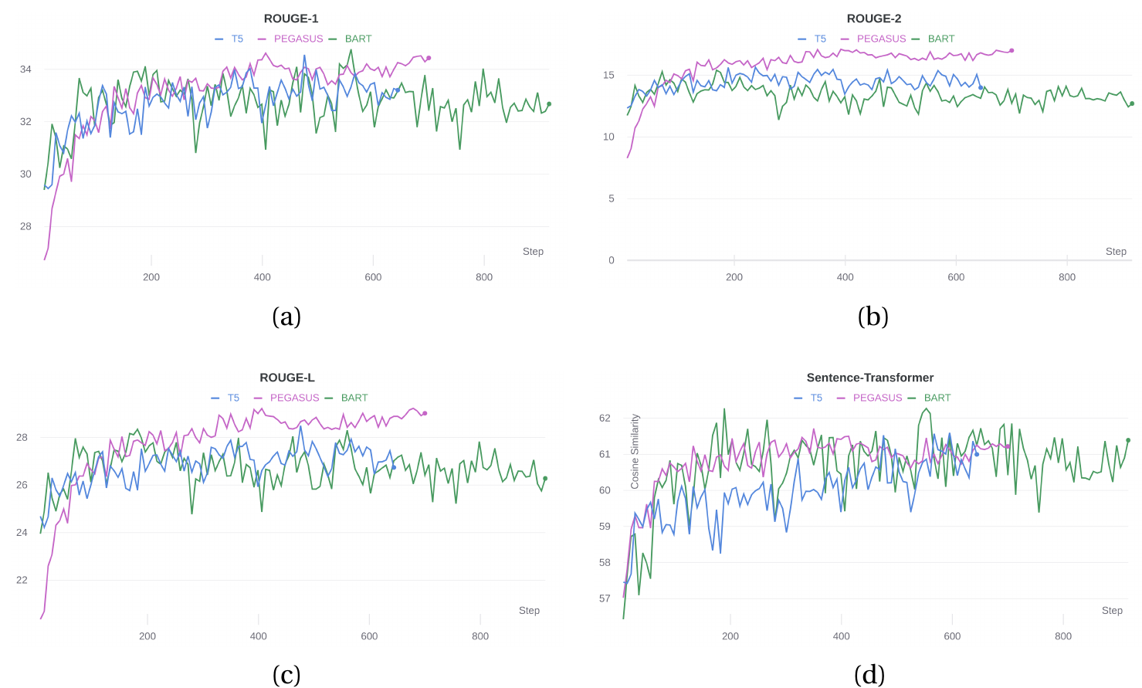
Fine-Tuning: Comparison
Evaluation results during fine-tuning.
Notes:
BART and T5’s evaluation functions are noisy. Choosing a checkpoint instead of another would change the quality of the summary accordingly. T5 is disadvantaged because of the halved input length. The noise might suggest that the wrong learning rate is chosen for fine-tuning T5 and BART. Hyperparameter search tries multiple learning rates.
The problem might come from using high GAS values with such a low batch size. To verify or rule out this hypothesis, a machine with higher GPU memory is needed.

Slide 18
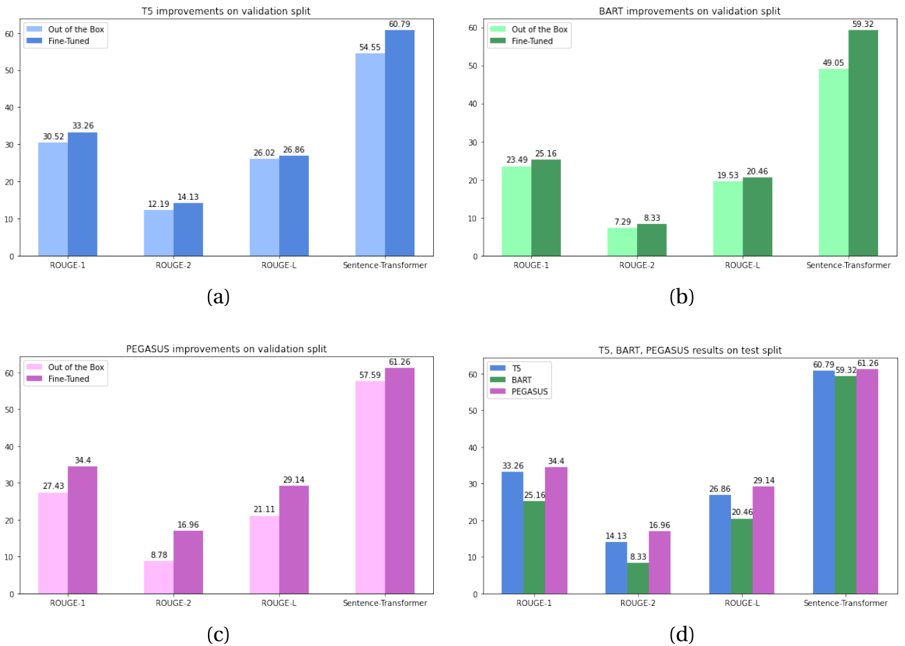
Fine-Tuning: Comparison
Evaluation results out of the box versus the best fine-tuned checkpoint.
Notes:
Comparing the plots to BART results on XSum, the models are already achieving quite good results before fine-tuning. The small magnitude of the improvement might be the consequence of a small training set.
The results reported by Zhang et al. on the 12 downstream datasets for PEGASUS on 1,000 examples are similar.

Slide 19
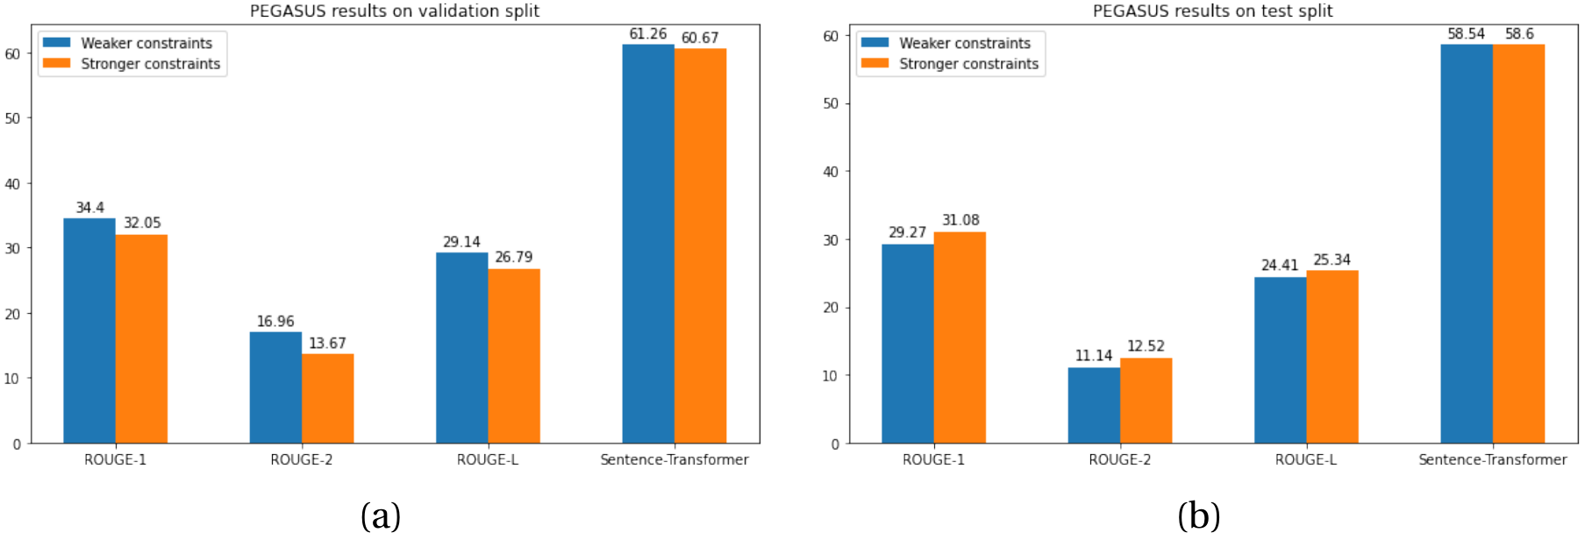
PEGASUS Results with Stronger Constraints
Train/validation/test split: Two entries coming from the same book cannot belong to two different sets.
Notes:
The model trained on the sets with stronger constraints should be preferred because it will generalize better for unseen books.

Slide 20
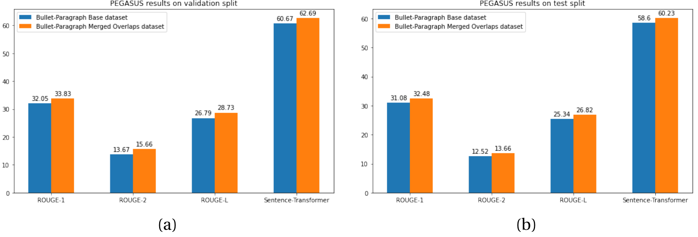
PEGASUS Results on Merged Overlaps Version
Comparison of the evaluation results on Base and Merged Overlaps versions of Bullet-Paragraph Dataset.
Notes:
In orange the evaluation results on Merged Overlaps dataset, compared to the results previously obtained in blue. One can clearly see that PEGASUS achieves better results on the Merged Overlaps version. This is probably due to the fact that redundant entries are not present in the new version of the dataset.

Slide 21
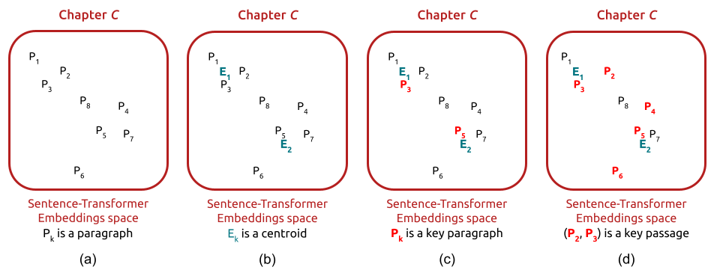
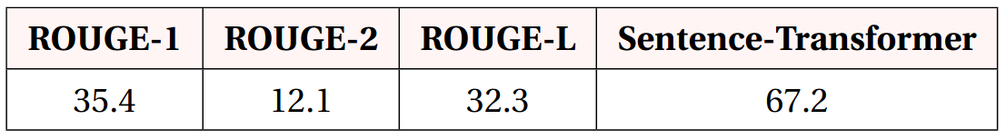
Summarization Pipeline
Unsupervised pipeline which can be used to summarize new chapters.
Chapter C with number of sections S=2 and composed of 8 paragraphs P_{k}.
Notes:
After (d) Passages which overlap for more than 90% of the tokens are merged. Finally, PEGASUS is applied to generate a bullet point for each key passage.
The number of generated bullet points with this unsupervised method diverges from the true number of bullet points.

Slide 22
Future Work
Try PEGASUS on material from other domains, it may perform poorly.
Bullet-Paragraph dataset assumes that Sentence-Transformer cosine similarity does not fail.
Efficient Transformers
Capable of processing an entire chapter.
No need to manually match bullet points to important paragraphs.
Human evaluation
Sentence-Transformer metric is not interpretable.
Amazon Mechanical Turk service.
Velocity and memory problems result in negative user experience and expensive setup, respectively.

Slide 23
THANK YOU!
Questions?

Slide 24
Bibliography
El-Kassas, W. S., Salama, C. R., Rafea, A. A., & Mohamed, H. K. (2020). Automatic text summarization: A comprehensive survey. Expert Systems with Applications, 113679.
Vaswani, A., Shazeer, N., Parmar, N., Uszkoreit, J., Jones, L., Gomez, A. N., Kaiser L., & Polosukhin, I. (2017). Attention is all you need. arXiv preprint arXiv:1706.03762.
Lin, C.-Y. (2004). Rouge: A package for automatic evaluation of summaries. Text summarization branches out, 74–81.
Raffel, C., Shazeer, N., Roberts, A., Lee, K., Narang, S., Matena, M., Zhou, Y., Li, W., & Liu, P. J. (2019). Exploring the limits of transfer learning with a unified text-to-text transformer. arXiv preprint arXiv:1910.10683.
Lewis, M., Liu, Y., Goyal, N., Ghazvininejad, M., Mohamed, A., Levy, O., Stoyanov, V., & Zettlemoyer, L. (2019). Bart: Denoising sequence-to-sequence pretraining for natural language generation, translation, and comprehension. arXiv preprint arXiv:1910.13461.
Zhang, J., Zhao, Y., Saleh, M., & Liu, P. (2020). Pegasus: Pre-training with extracted gap-sentences for abstractive summarization. International Conference on Machine Learning, 11328–11339.
Beltagy, I., Peters, M. E., & Cohan, A. (2020). Longformer: The long-document transformer. arXiv preprint arXiv:2004.05150.

