Slide 1
IFCS 2026 Data Challenge
Profiling & Predicting Financial Distress in Italian SMEs
~13,871 firms (FY2023) | distress rate 10.8% | 14 financial & structural features

Slide 2
The Challenge
Two goals.
Profile the SME population and flag those heading into distress - before it is too late.
Why it matters.
Lenders, policymakers and the firms themselves need early warning on financial distress.
Data.
One row per SME, 13,871 firms, monetary values in kEUR, geography at province level.
Task A - Clustering.
Unsupervised grouping by financial characteristics + economic interpretation + geography.
Task B - Classification.
Supervised prediction of Financial distress (TRUE/FALSE) on a held-out test set.
Interpretation counts as much as prediction.

Slide 3
Data & Preprocessing
Features used.
Sales Revenue, Employees, Net income, Operating Income, Max deductible amount, Total financial expenses, Tax shield, Operating cash flow, Current taxes, Alert Index.
Excluded.
Company ID, Province/sector (interpretation only), and the target.
Transform.
Log1p on heavy-tailed monetary/count variables; standardize (z-score) before clustering & modelling.
Reason.
Skewed distributions and differing scales would otherwise let a few large firms dominate distance metrics.
Cleaning.
Alert Index is mixed (numeric + 'EXCELLENT' -> 0, best risk class); 0 provinces unmapped.

Slide 4
Cleaning & Feature Selection
Rows.
13,956 -> 13,871: removed 3 impossible (Sales<=0) + 85 incongruent outliers.
Contextual rule.
Drop extreme only if its correlated vars are normal (erroneous); keep coherent extremes (real distress).
Derived vars dropped.
Max deductible, Tax shield, Alert Index (=NetInc/TotFinExp r=0.95), Current taxes (r=0.87 w/ OpInc).
Final model.
4 significant non-derived vars: OpInc, NetInc, TotFinExp, Sales/Employee (productivity; Wald all p<0.001; CV AUC 0.853).
Result.
Cleaner model, same/higher AUC - removed vars were redundant noise.

Slide 5
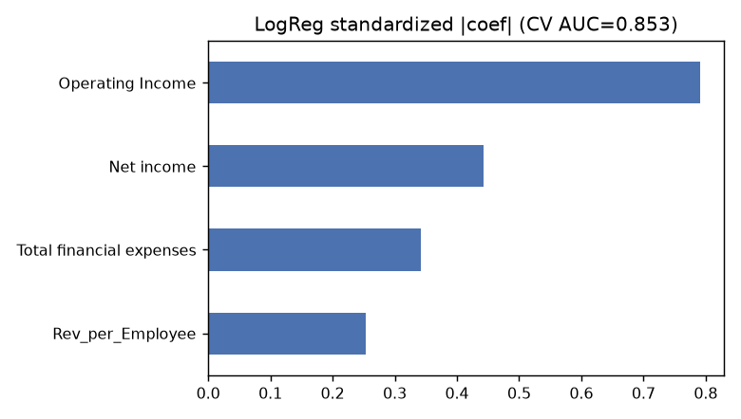
Task A - Clustering Method
Algorithm.
K-Means on standardized, log-transformed features.
Choosing k.
Silhouette over k=2..8 (max at k=2); K=5 selected for profiling granularity.
Result.
K = 5 clusters; silhouette at K=5 = 0.211.
Trade-off.
Separation vs interpretability: 5 segments are economically distinguishable.

Slide 6
Task A - Cluster Profiles
Cluster 0 (n=3828)
distress rate 7.0%
Cluster 1 (n=3328)
distress rate 12.6%
Cluster 2 (n=2849)
distress rate 3.0%
Cluster 3 (n=2449)
distress rate 0.7%
Cluster 4 (n=1417)
distress rate 50.5%

Slide 7
Task A - Geographic Patterns
North-heavy.
Every cluster is dominated by the North/industrial belt.
Distress is uneven.
Cluster 4 carries ~50% distress; cluster 3 ~0.6%.
Islands under-represented.
Sicilia & Sardegna are a small share in all clusters.

Slide 8
Task B - Predicting Distress
Models compared.
LogReg (scipy), Random Forest & GBM (numpy) - sklearn/xgb unavailable.
Eval.
5-fold CV + 80/20 holdout; Precision, Recall, F1, F2, ROC-AUC.
Winner.
Logistic Regression: highest F2 (0.564), AUC 0.857 ~ trees; recall 0.72.
Why.
F2 weights recall x2 - catching distressed firms matters most (false negative = costly).
Deliverable.
predictions.csv: Company ID + pred_class (TRUE/FALSE).

Slide 9
Conclusions & Next Steps
Profiling.
5 financially distinct SME segments identified and economically characterised.
Geography.
Clear macro-area skew; distress concentrates in specific profiles (cluster 4).
Prediction.
Logistic model reaches CV ROC-AUC 0.853 - strong early-warning signal.
Next steps.
Apply pipeline to official test_features.csv; refine clusters with sector constraints; calibrate threshold to risk appetite.
Thank you - questions welcome.

