Slide 1
Hall of Valhalla
Marco Almeida

Slide 2

Intro
Who am I?
What is Hall of Valhalla?

Slide 3
Architecture
System Context Diagram

Slide 4
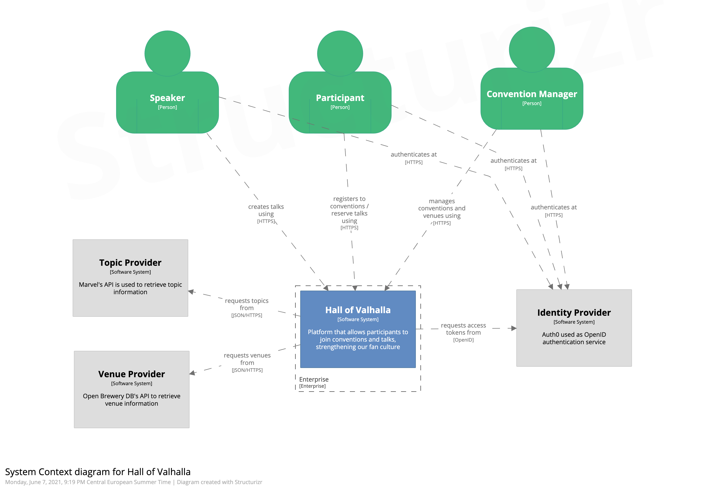
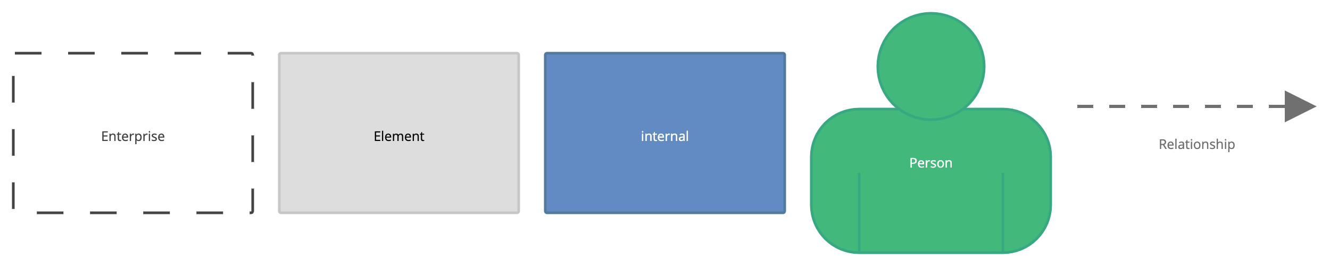

Slide 5
Architecture
Container Diagram – Managing Conventions

Slide 6
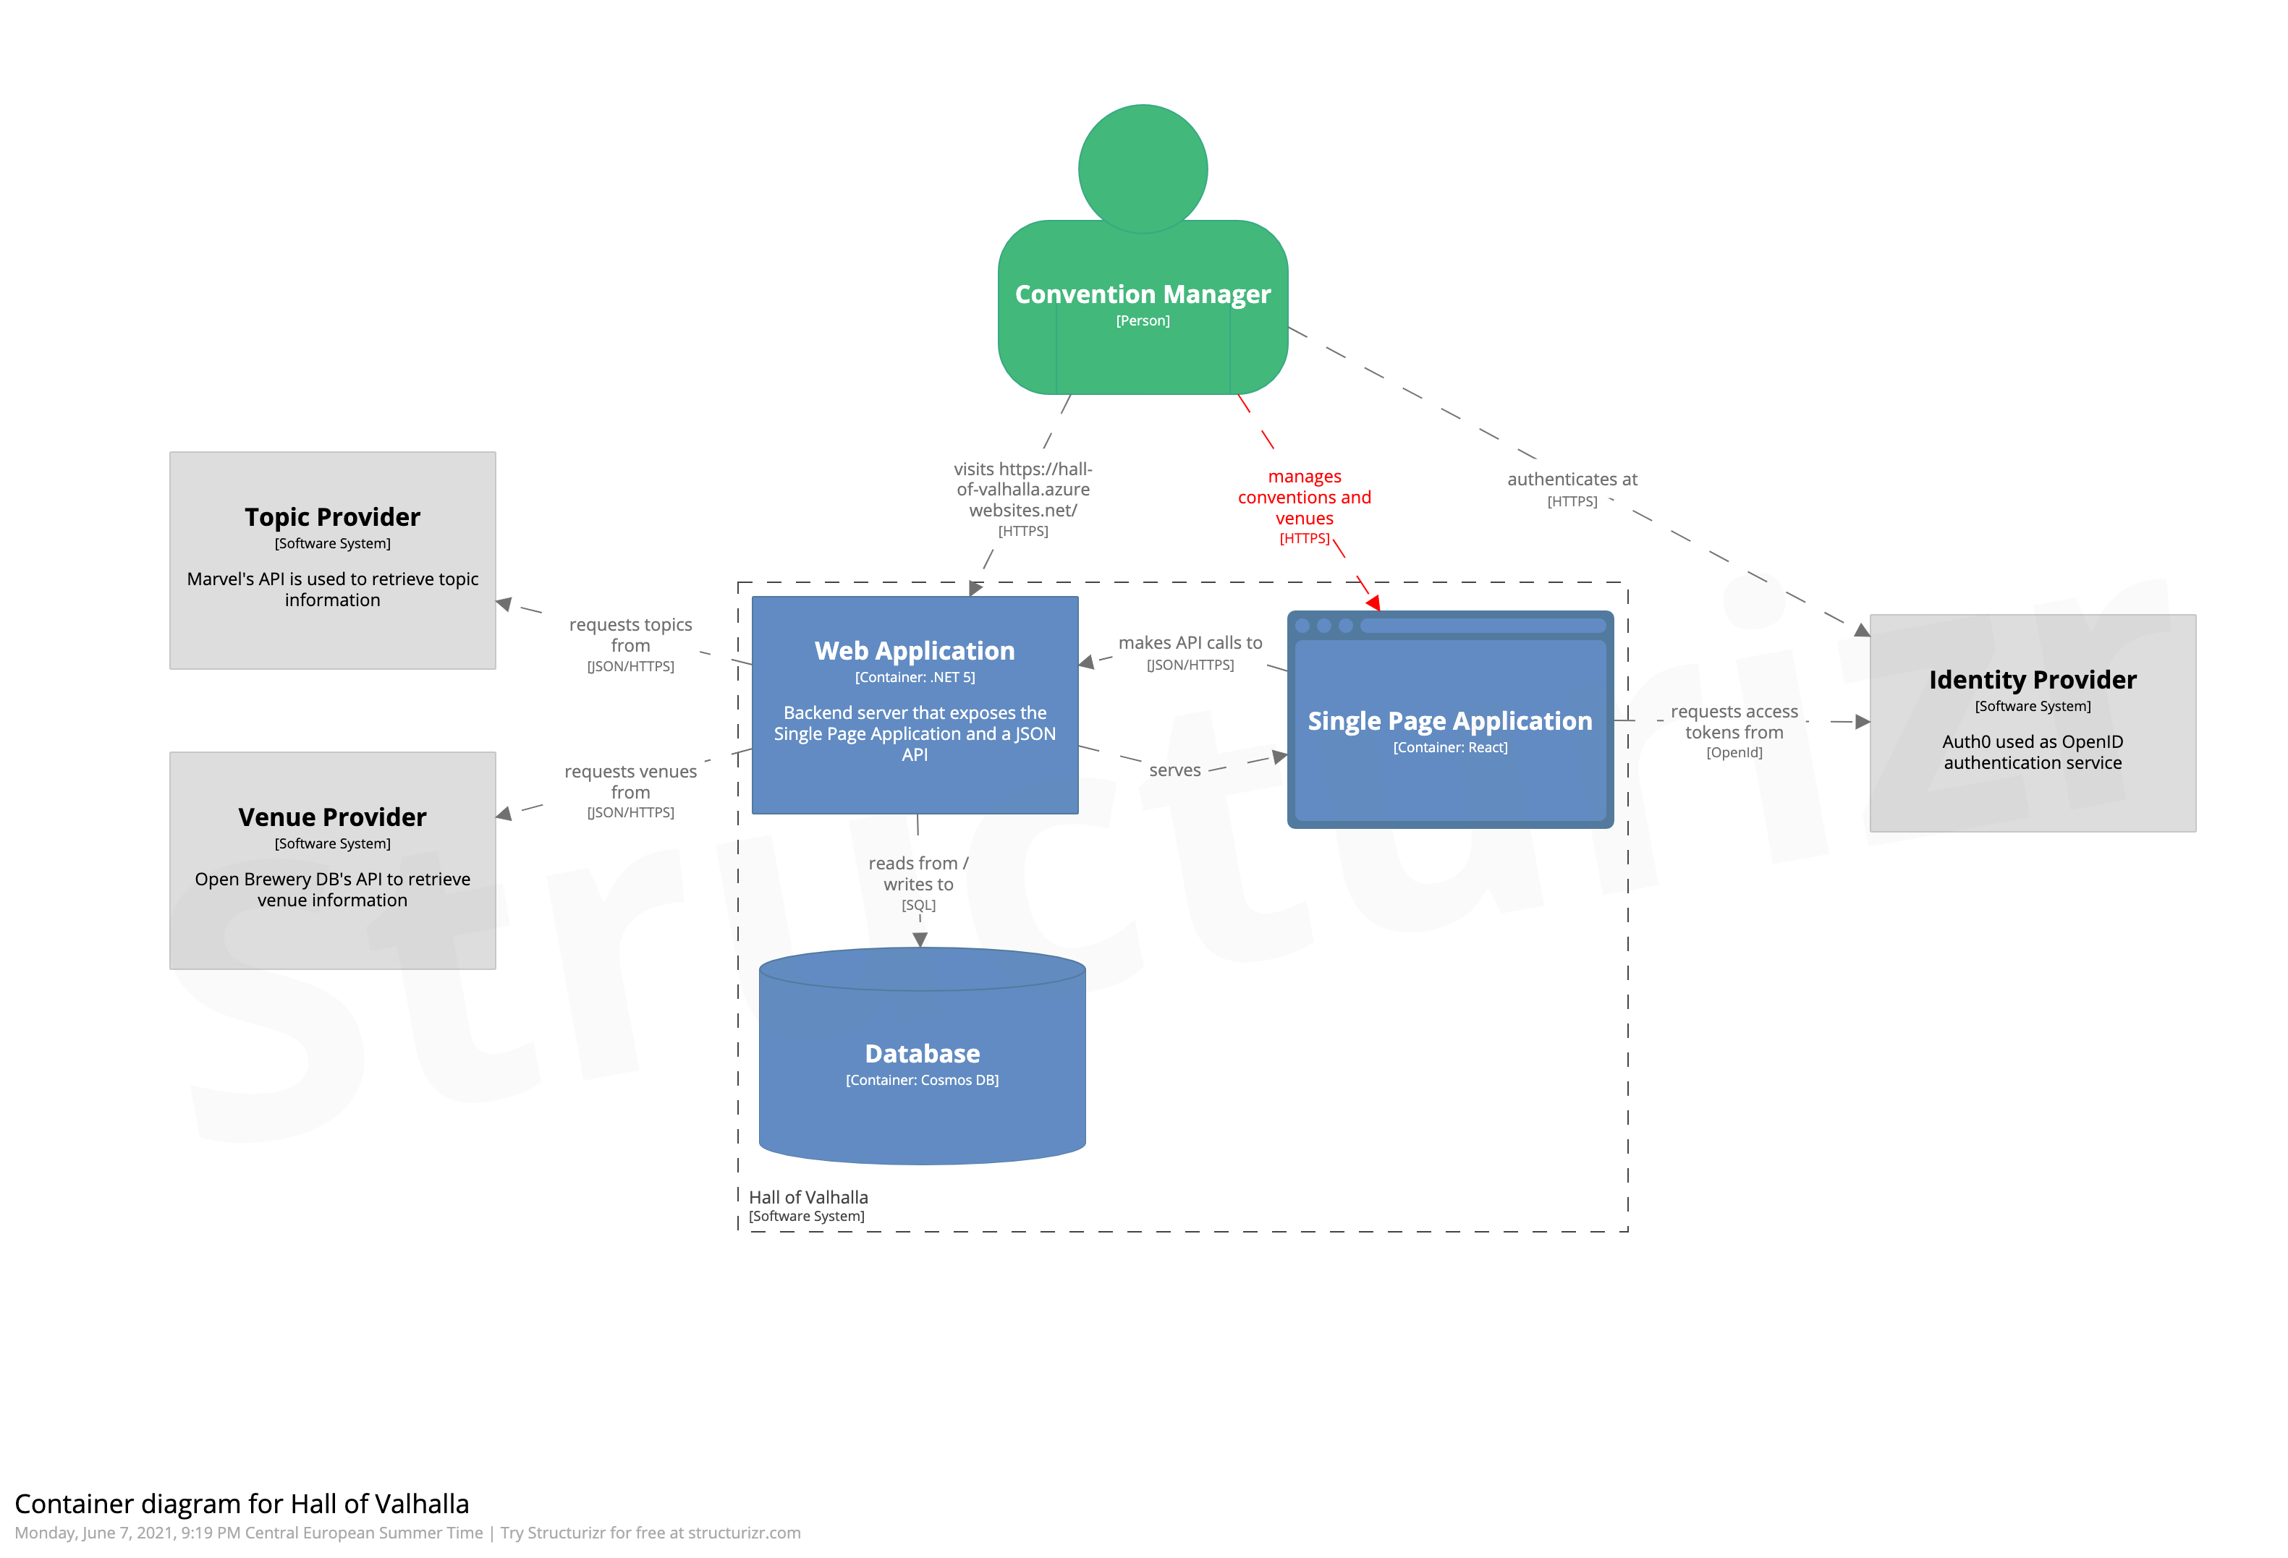
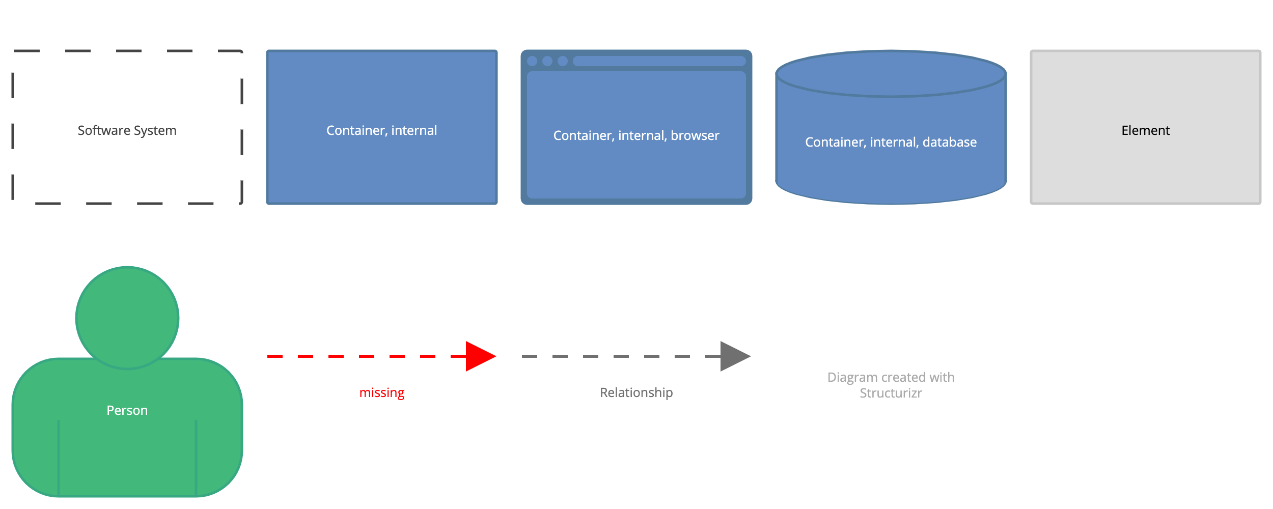

Slide 7



Approach
Developed in A hackathon

Slide 8
Three CORE Principles
Cloud enabled
Secure
Participant driven

Slide 9
Product Backlog
Setup Cloud Deployment
Setup Secrets
Setup Auth0
As a participant, I want to sign up
As a participant, I want to sign in
As a participant, I want to register to conventions
As a participant, I want to reserve a spot in talks
As a speaker, I want to submit talks
As a convention administrator, I want to manage conventions
As a convention administrator, I want to manage events

Slide 10

Cloud Deployment
An Integrated Ecosystem

Slide 11
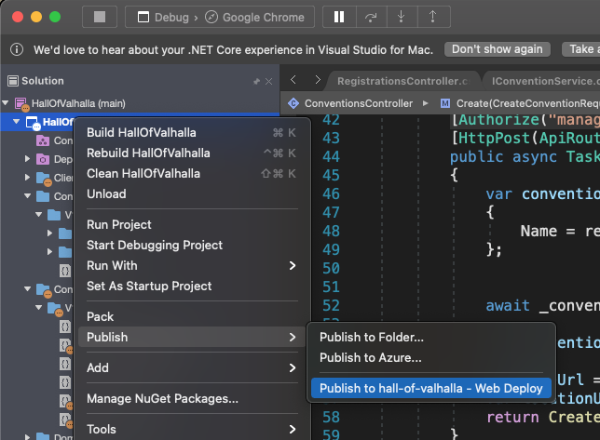
How To Deploy To The Cloud

Slide 12
Database
Database CHOICE
Database Design

Slide 13
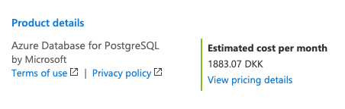
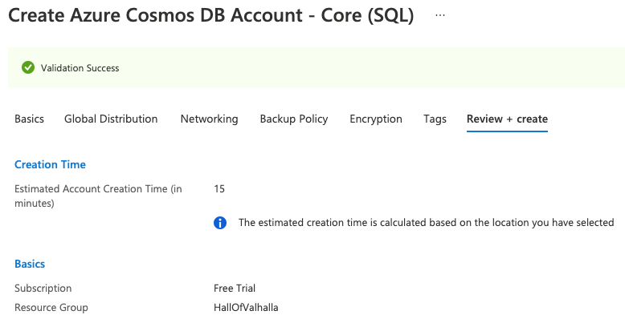
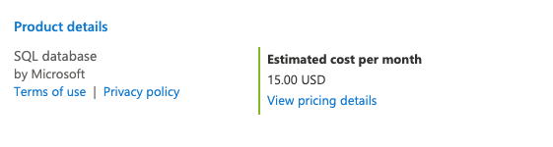
Database Choice

Slide 14

Secrets
Storing Locally Storing in the Cloud
$ dotnet user-secrets set "Movies:ServiceApiKey" "12345"
$ az keyvault secret set --name "Movies--ServiceApiKey" \
> --vault-name MyKeyVault --value "12345"

Slide 15
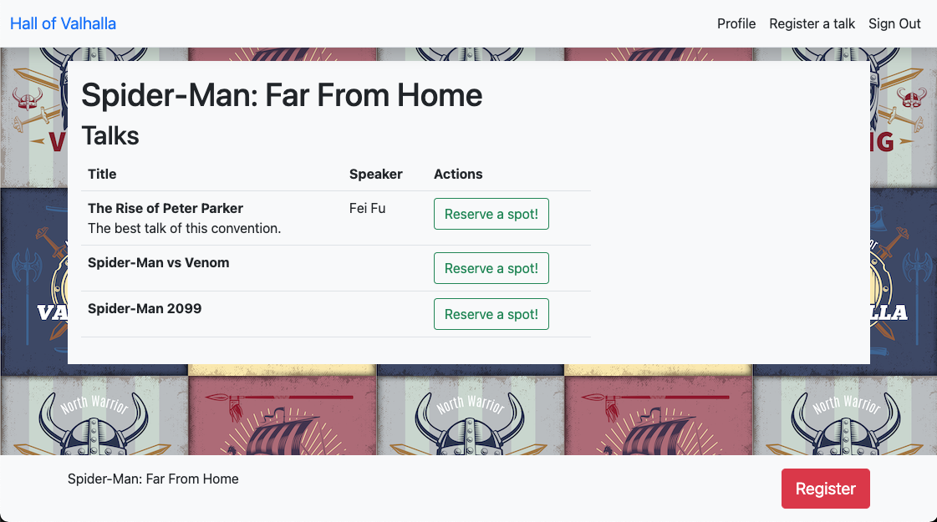
Demo

Slide 16
What Is Next
Update the database schema for improved scalability
Setting up a test framework (MSTest) and a CI/CD process
Introduce validations and exception handling

Slide 17

Questions

Slide 18
Thank You

Slide 19
Appendix A
Container Diagram – Authentication

Slide 20
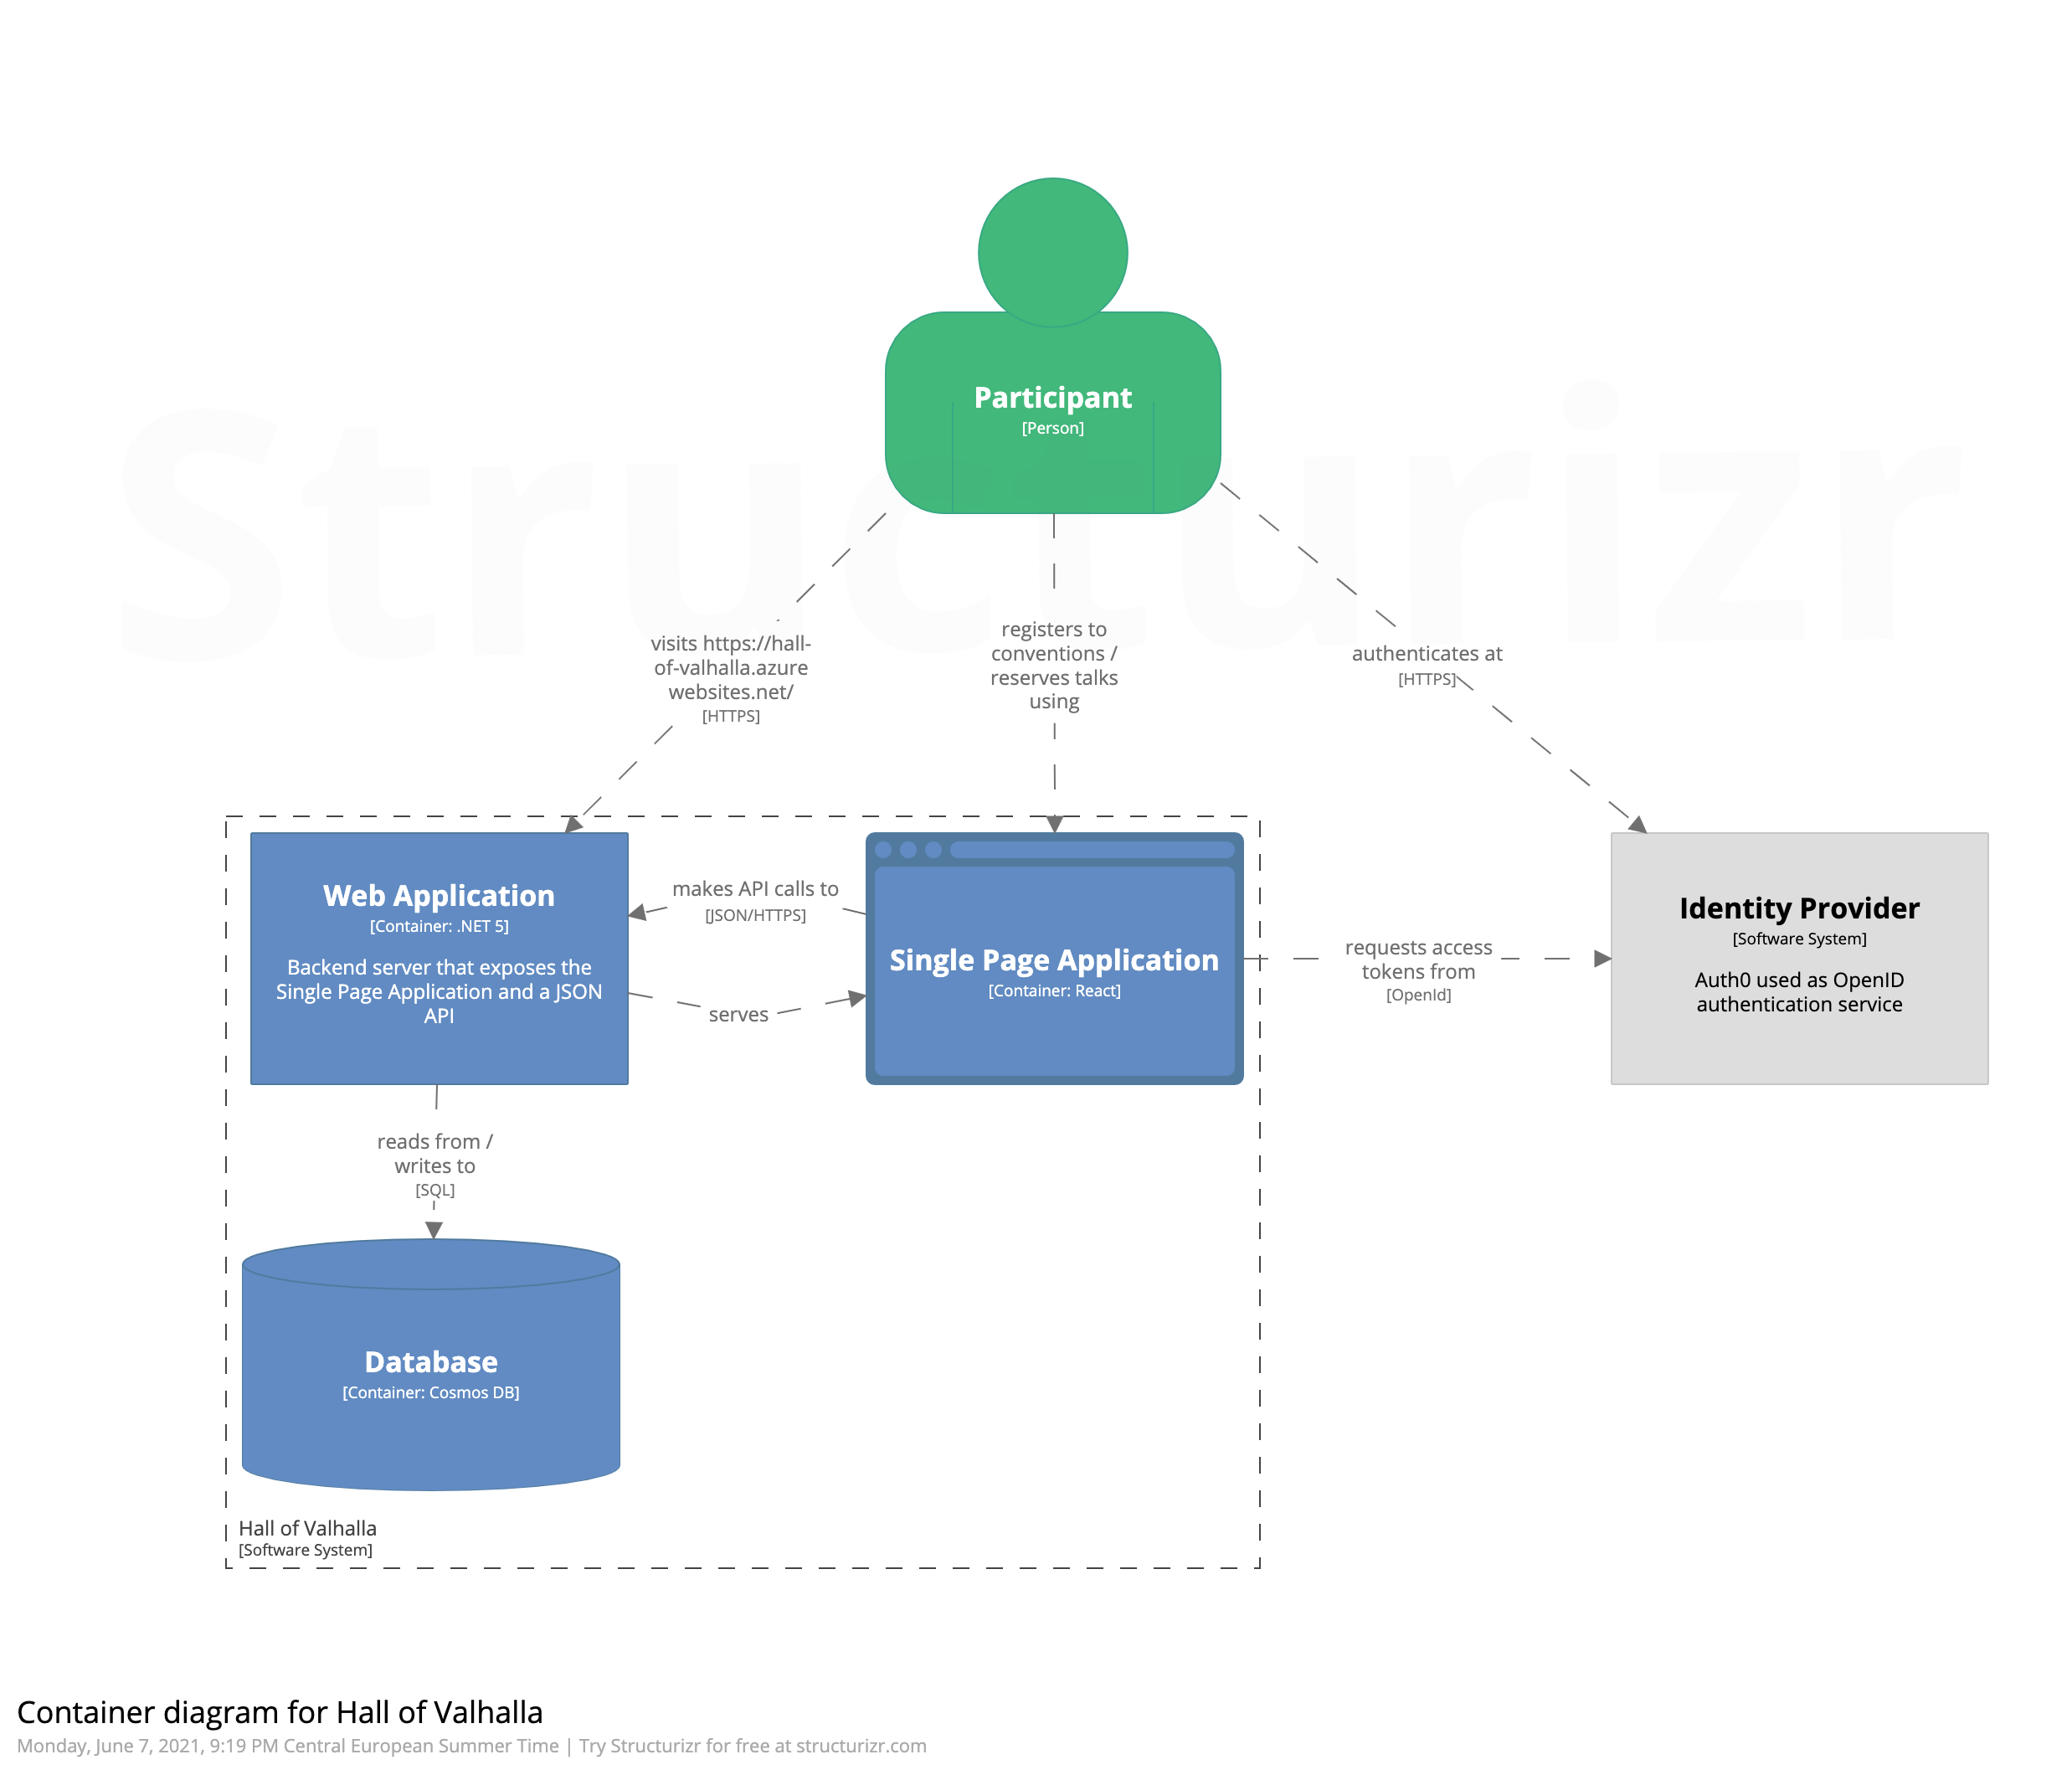
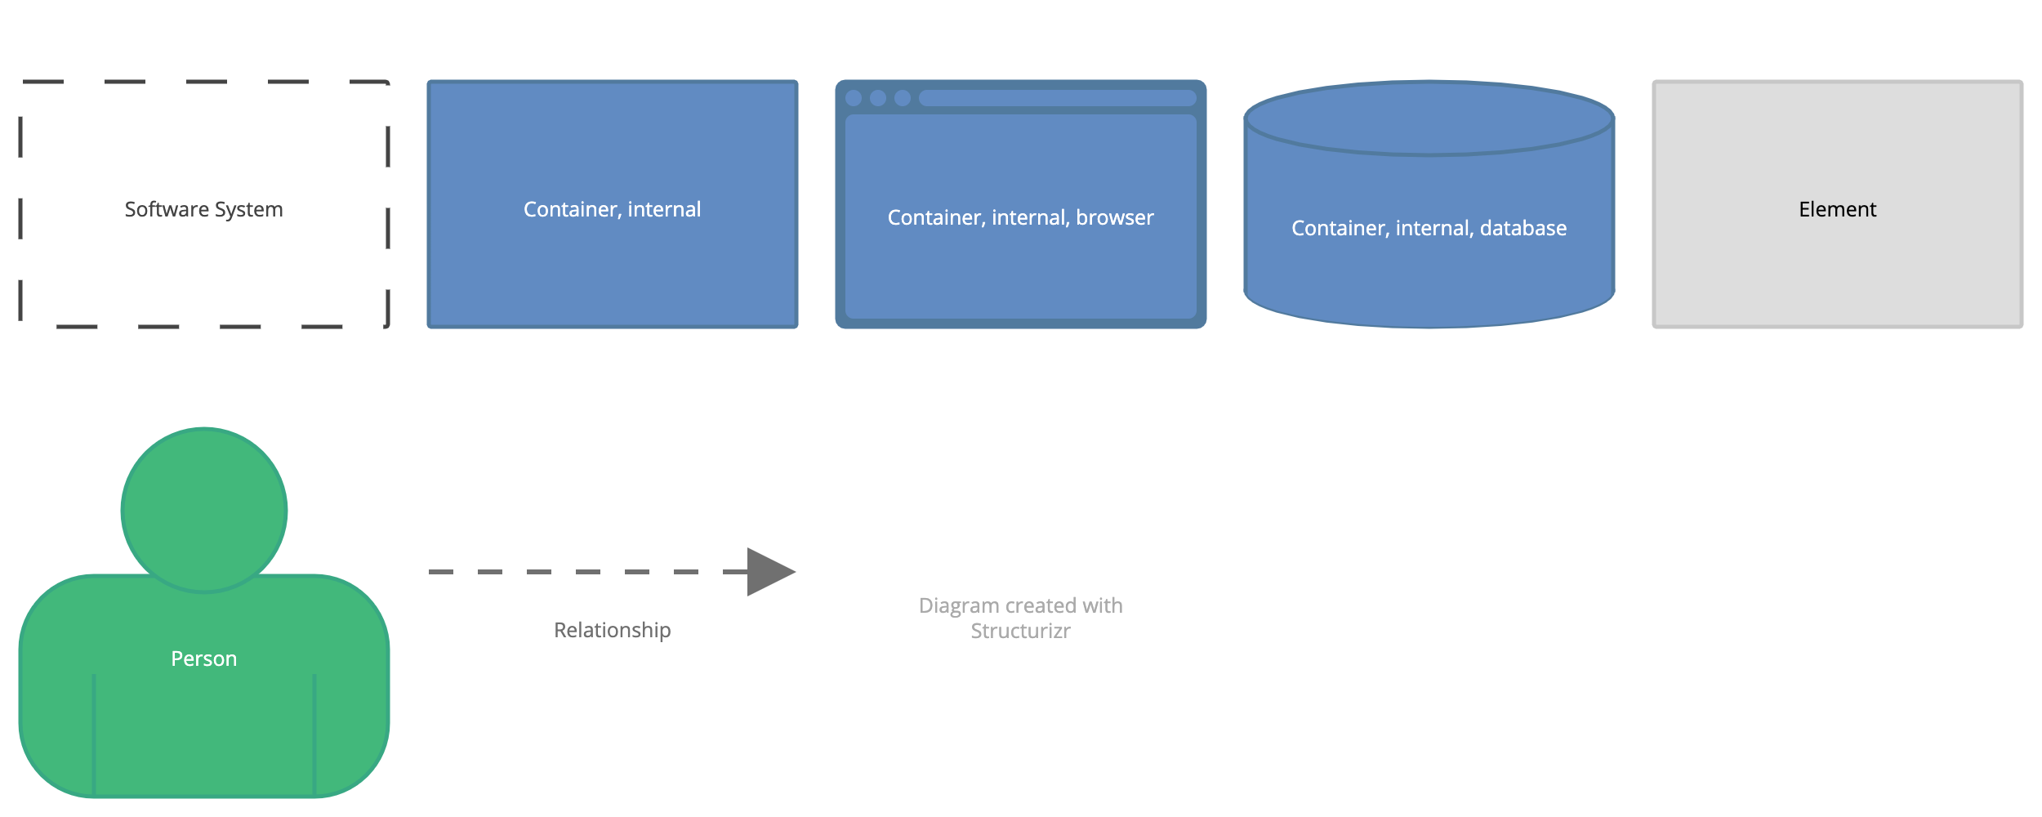

Slide 21
Appendix B
Container Diagram – Authentication

Slide 22
Database Schema
{
"id": "66e2167c-0691-4bd5-9382-ee859c3a357f",
"name": "Comic beer",
"start_date": "2021-06-09T09:00:00.000Z",
"end_date": "2021-06-09T10:30:00.000Z",
"topics": ["Spider-Man”]
"venues": [
{
"obdb_id": "boulder-beer-co-boulder",
"name": "Boulder Beer Co",
"brewery_type": "regional",
"street": "2880 Wilderness Pl",
"city": "Boulder",
"state": "Colorado",
"country": "United States",
"longitude": "-105.2480158",
"latitude": "40.026439"
}
],
"talks": [
{
"id": "76e2167c-0691-4bd5-1234-ee859c3a357f",
"title": "From zero to hero: A love story",
"description": "Excelsior! The Amazing Life of Stan Lee",
"speaker": "Stan Lee",
"participants": [
"auth0|1234567890"
]
}
],
"participants": [
"auth0|1234567890",
"auth0|0123456789"
],
"_rid": "kQs7ANxNscMGAAAAAAAAAA==",
"_self": "dbs/kQs7AA==/colls/kQs7ANxNscM=/docs/kQs7ANxNscMGAAAAAAAAAA==/",
"_etag": "\"00008300-0000-3c00-0000-60bfcba30000\"",
"_attachments": "attachments/",
"_ts": 1623182243
}

Slide 23
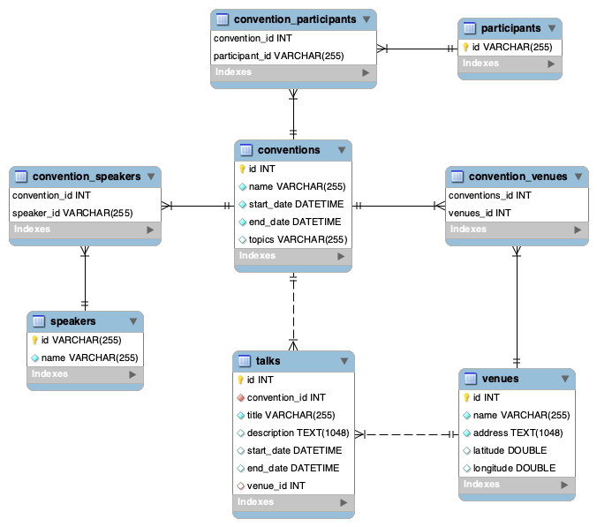
ER Diagram
An alternative perspective to the database design;

