Slide 1


Processing of big data
spark
session-1

Slide 2
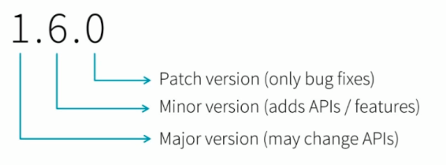
How to interpret version#

Slide 3
Spark versions
0.5.1
1.6.0
2.4.0

Slide 4
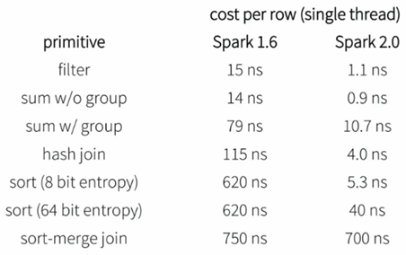
Perf. comparison

Slide 5
Install Spark 2.4.0 on Ubuntu
Install python pip
sudo apt-get install python-pip
Install pyspark using pip
sudo pip install pyspark
Install JRE
sudo apt install default-jre
Export JAVA_HOME in .bashrc file
Apply .bashrc file
source ~/.bashrc

Slide 6


FUN TIME

Slide 7
Reference
https://spark.apache.org/docs/latest/sql-programming-guide.html
https://community.cloud.databricks.com
https://docs.databricks.com/spark/latest/dataframes-datasets/introduction-to-dataframes-python.html

