Slide 1
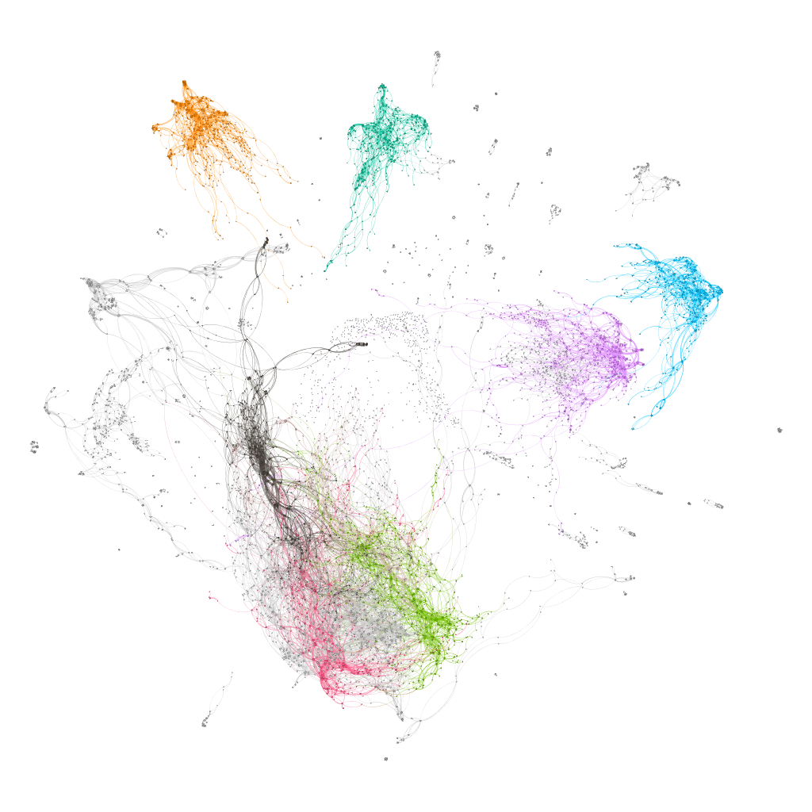
pcsPy: a python utility for generalized pitch class set classification and analysis
Marco Buongiorno Nardelli
CEMI – Center for experimental Music and Intermedia
iARTA – Initiative for Advanced Research in Technology and the Arts
Department of Physics
University of North Texas

Slide 2

pcsPy components
The PCSet class:
pcs operations generalized to arbitrary temperament:
Transpose
Inverse
Normal order
Prime form
Interval vector
LISV vector
pcs names
…etc.
Network and graph analysis functions:
Dictionary of pcs with arbitrary cardinality
Network construction with user-defined metric (distance)
Interval vector networks
Voice leading networks
ego-networks
… etc.

Slide 3
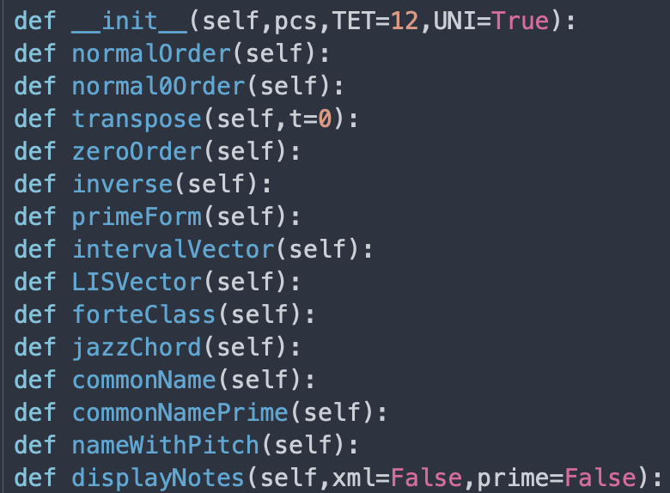
PCSet class
The PCSet class:

