Slide 1
Capillary breakup experiment

Slide 2
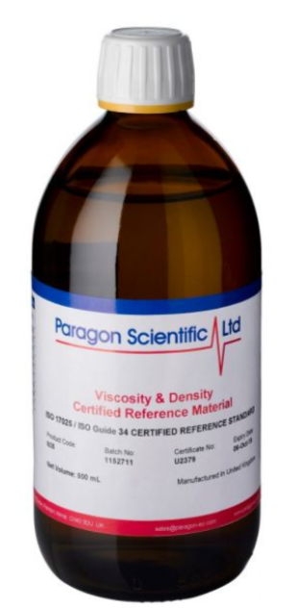
Sample
Viscosity standard 6000cp @20C

Slide 3
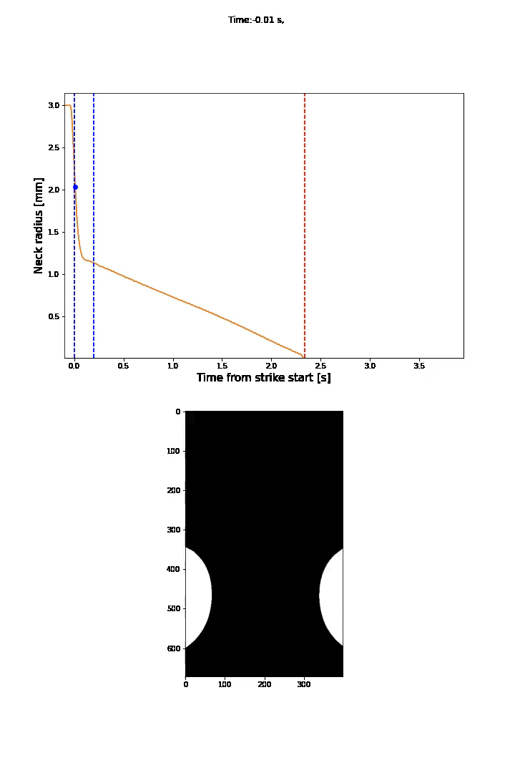
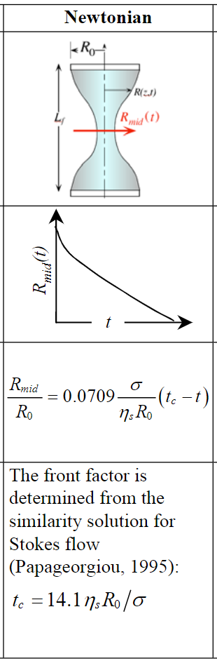
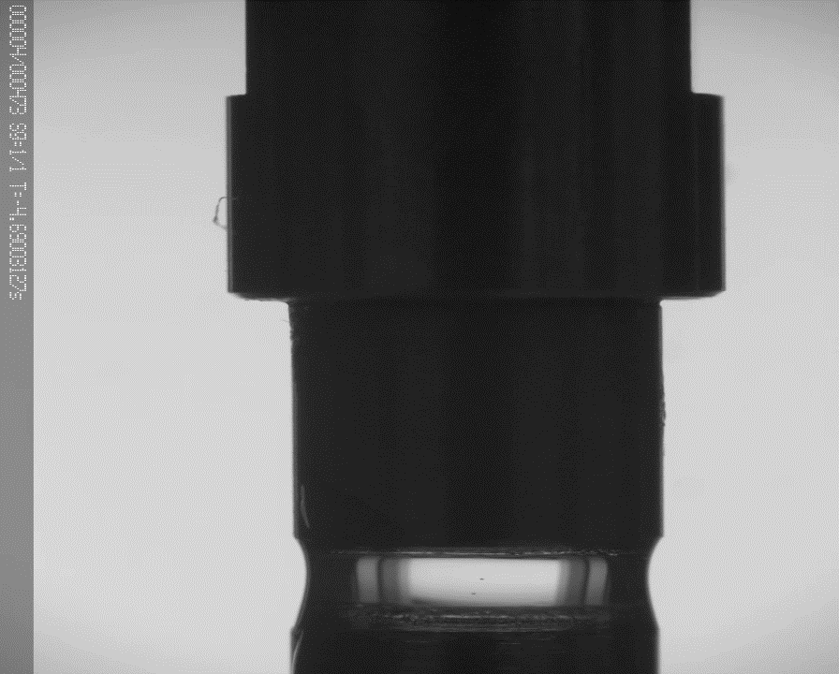
6mm

Slide 4
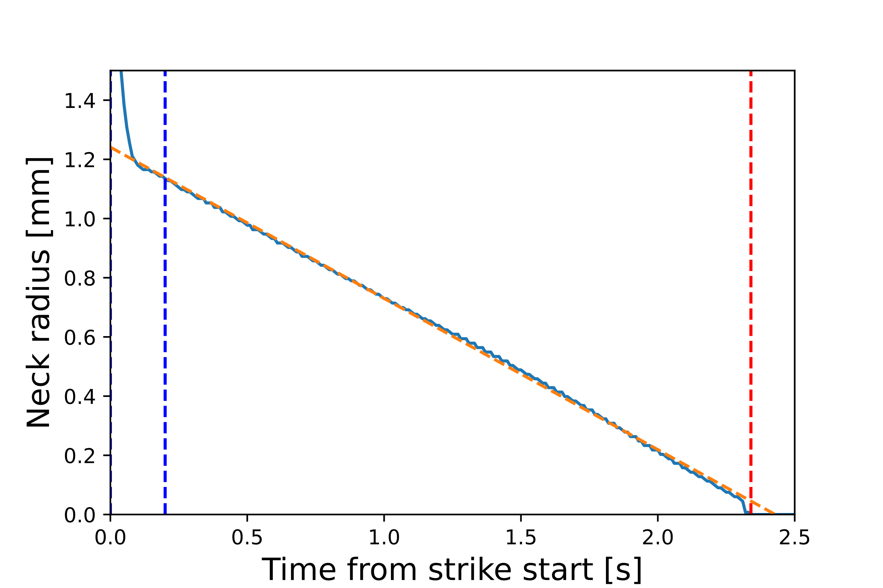
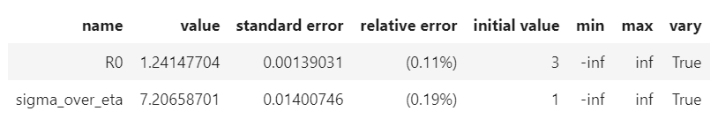
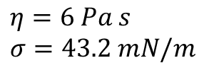
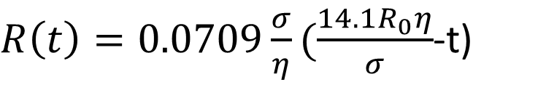
$R\left(t\right)=0.0709\frac{σ}{η}(\frac{14.1R_{0}η}{σ}$-t)
$$η=6 Pa s$$
$$σ=43.2 mN/m$$

