Slide 1


The usefulness of the VGG method in the problem of image classification
Matteo Di Stadio - 1794111
Marco Carfora - 1794568

Slide 2
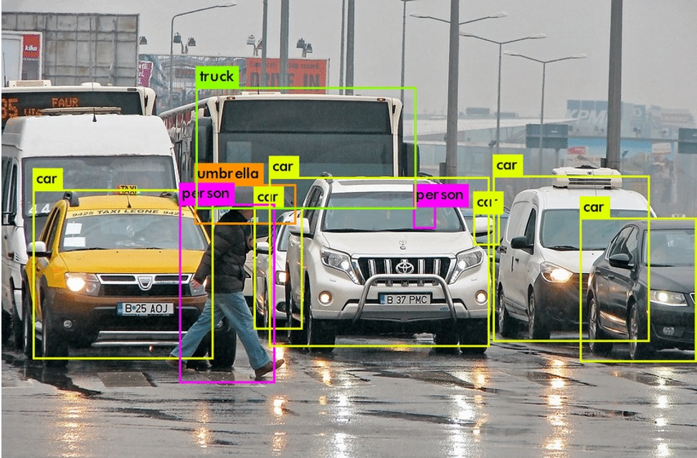
The problem of image recognition
Humans take action based on the study of their surroundings, especially through vision.
Computer vision is having the machine recognize the patterns of an object in order to discern what it can or is required to do in the given situation.
Neural networks would be the most adequate available technique.

Slide 3
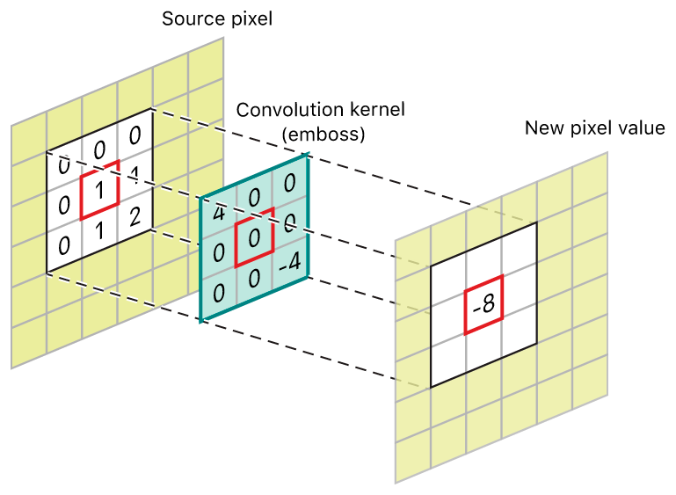
Convolutional neural networks
Images can be seen as 3D tensors, leaving the convolutional neural networks as the best type of nets to deal with them.
CNN make use of the mathematical operation of convolution, activation functions and aggregate functions to gain and exploit the main features of the tensor.
ImageNet is a large visual database designed for use in visual object recognition software research, which helped defining many famous CNN models for computer vision.

Slide 4
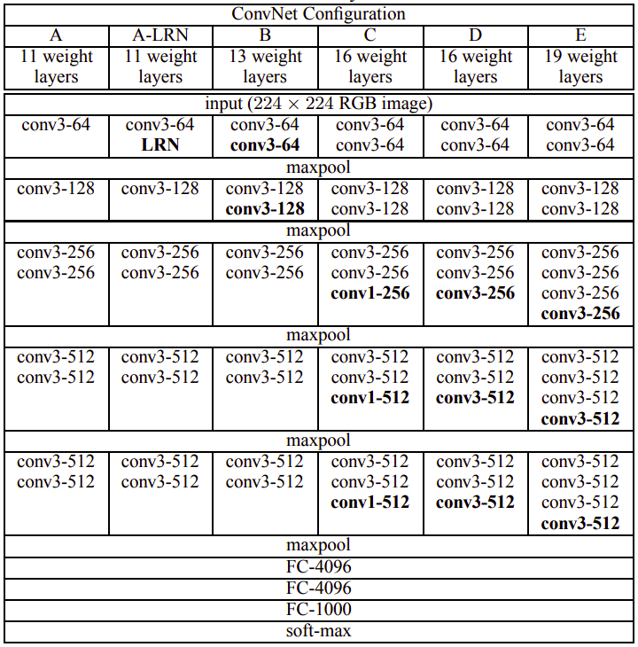
VGG method
The VGG network architecture was first described in the 2014 paper ”Very Deep Convolutional Networks for Large Scale Image Recognition”
A very simple architecture as it uses only 3x3 convolutional layers, followed by max pooling ones. At the end it also adds three fully connected layers.
Six possible variations, all following the same basic structure, with the main difference being in their depths.

Slide 5
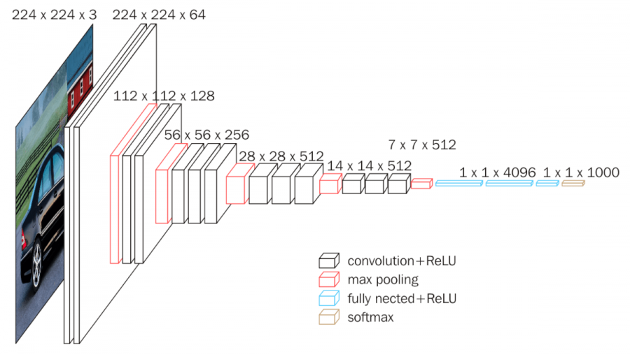
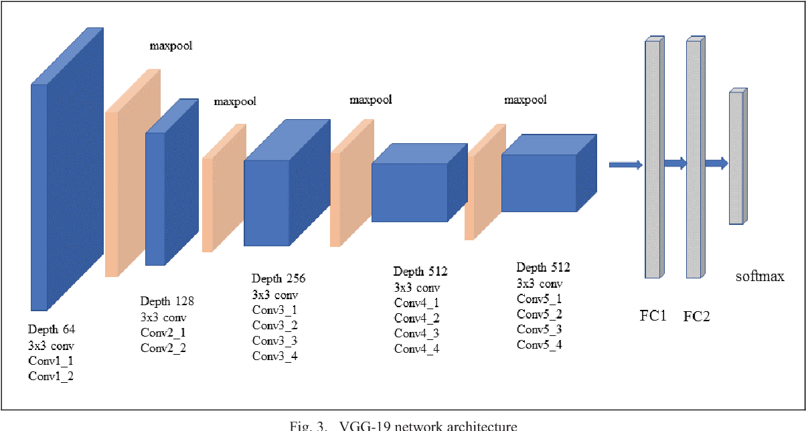
VGG16 and VGG19
Based on experimental and practical results, the most famous and used variants are the 16 and 19 one.
Both VGG16 and VGG19 retain the same basic structure of the VGG method.
The main difference lies in the weighted layers number, being a total of 16 and 19 respectively, but also in the filter sizes and number of times the ReLU activation function gets used.

Slide 6
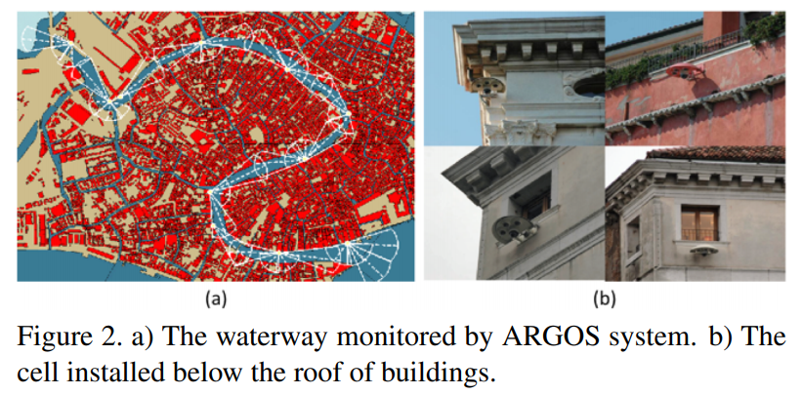
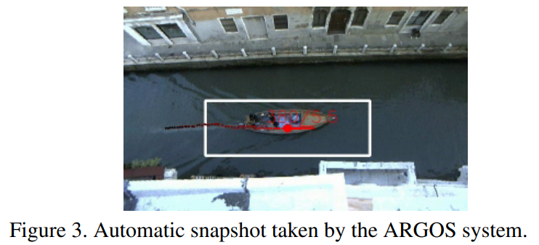
The dataset
ARGOS is a surveilance system operating 24/7 in the city of Venice.
Venice provides an incomparable environment, characterized by unique and challenging conditions like waves and reflections. Training on these terms can widely help with the study of intelligent surveillance systems.
The gathered images are then split up in testing and validation sets.

Slide 7
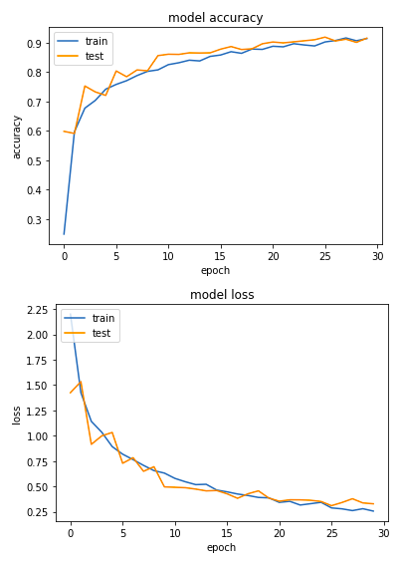
Metrics
With the need of training different nets using different parameters and strategies, a way to reliably confront them all was needed.
Accuracy
Loss
Precision
Recall
F1-Score
Confusion Matrix

Slide 8
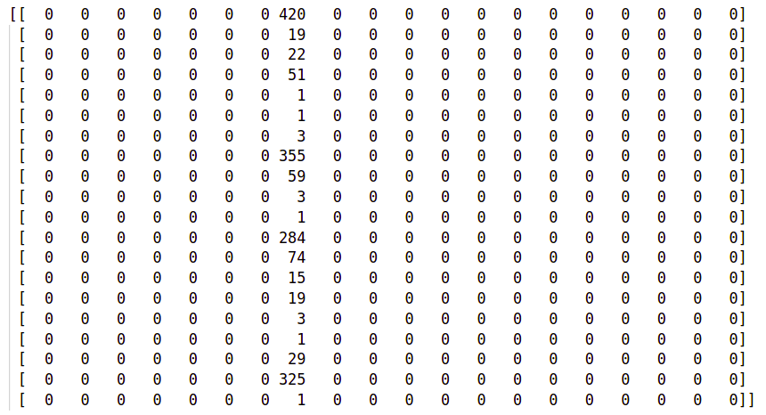
VGG16 – first experiment
First VGG16 was implemented following the specific directions found in the paper.
An Adam optimizer was then applied. Chosen for its suitability for image classifiers, it updates the network weights iteratively using different rates for each parameter.
An Early Stopping callback technique was also implemented to save on resources when it is needed and possible.

Slide 9
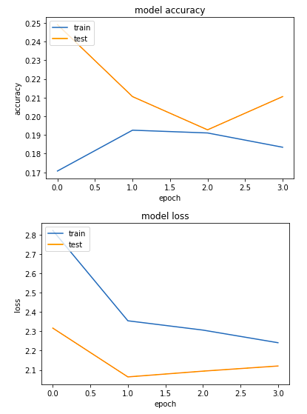
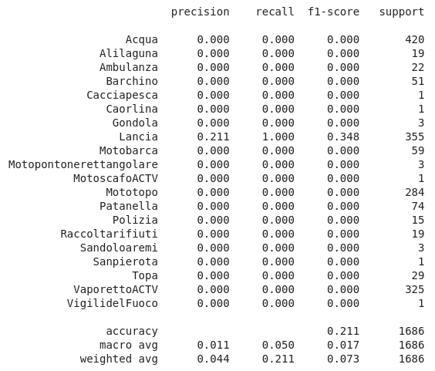
VGG16 – first experiment results

Slide 10
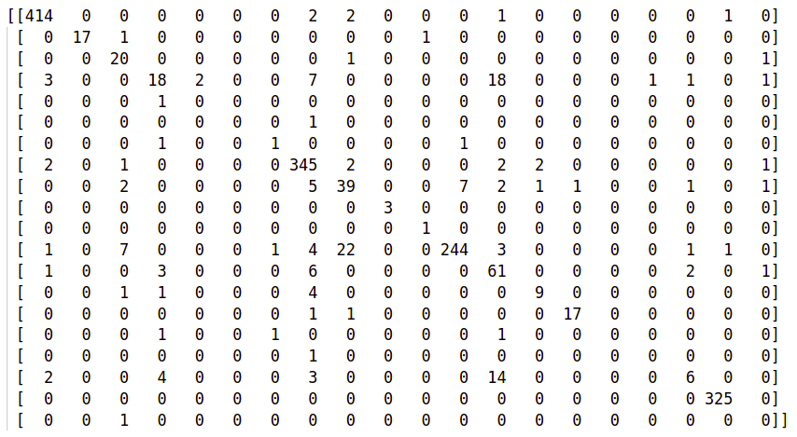
VGG16 – second experiment
The results of the first experiment are quite lackluster.
A possible explaination can be seen in the dataset lack of images among the two sets.
To compensate it was then introduced the concept of data augmentation.

Slide 11
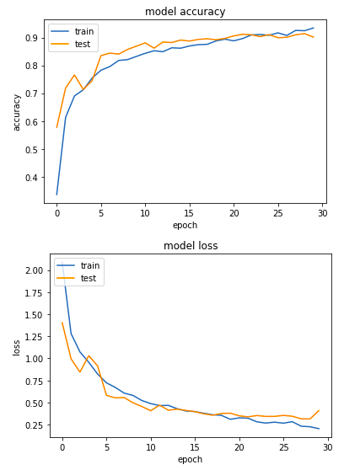
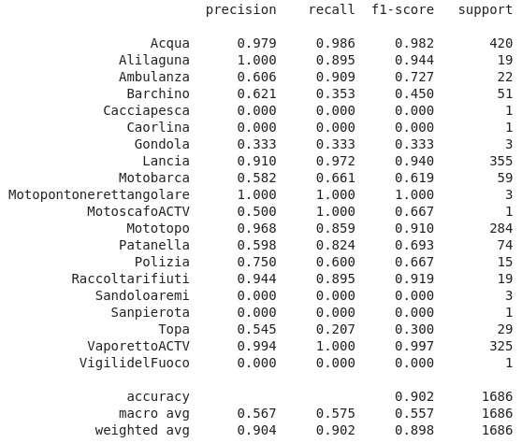
VGG16 – second experiment results

Slide 12
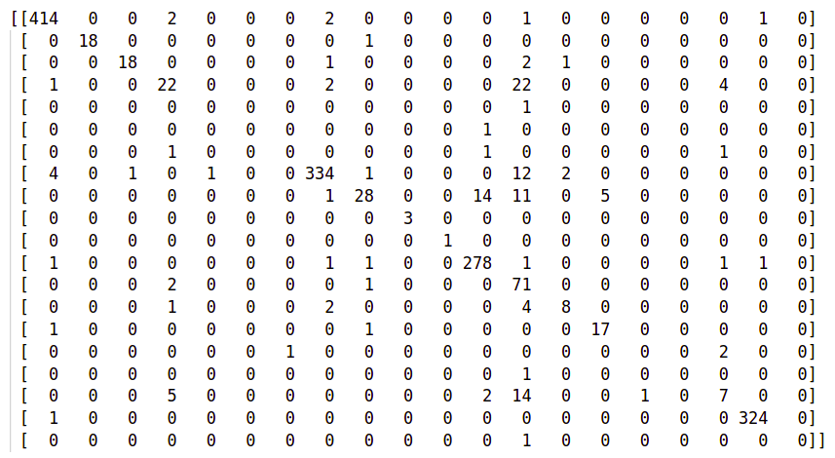
VGG16 – third experiment
More optimizations are possible to get even better outcomes.
An improvement can be given by Dropout, a cheap and effective regularization method to reduce overfitting and improve generalization error.
The idea is to use a single model to simulate having a large number of different network architectures by temporarily randomly dropping out nodes during training.

Slide 13
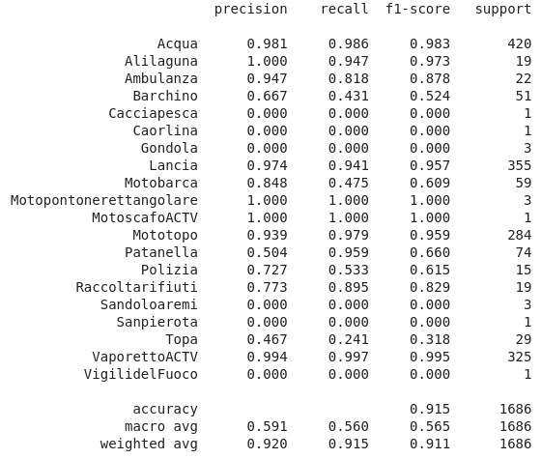
VGG16 – third experiment results

Slide 14
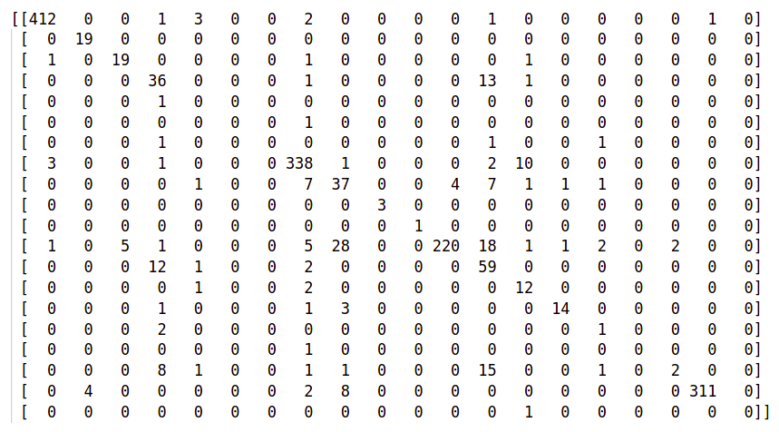
VGG16 – fourth experiment
One can beg the question if something more can still be applied.
Batch Normalization is a possible further improvement. A technique that was actually invented after the initial formulation of VGG.
Batch Normalization standardizes the inputs to a layer for each mini batch, stabilizing the learning task and reducing the number of training epochs.

Slide 15
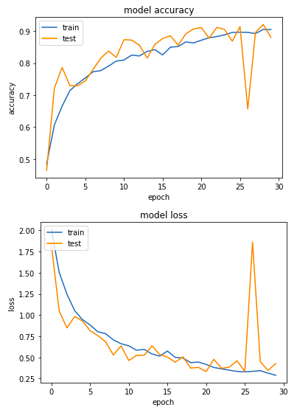
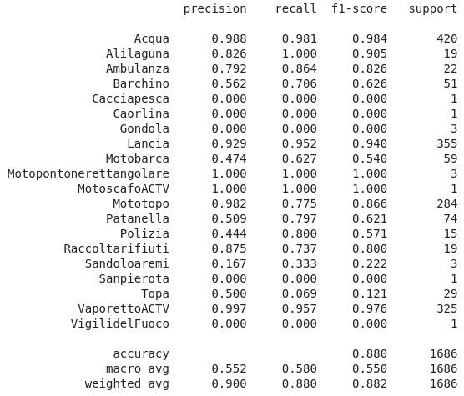
VGG16 – fourth experiment results

Slide 16
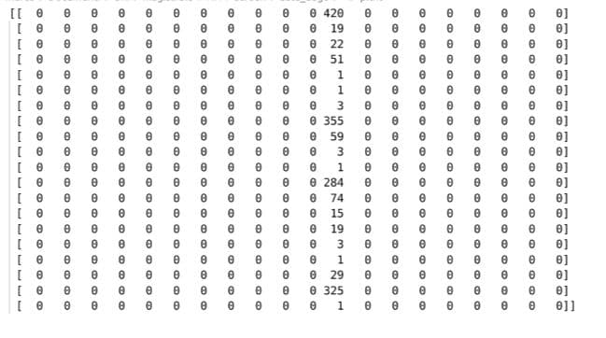
VGG19 – first experiment
Considering VGG19 instead, the modalities are almost similar to the ones we previously saw.
We make again use of both the Adam optimizer and the Early Stopping callback, but we also implement Dropout from the start this time around.
Like before, the first experiment replicates the standard formulation of VGG19.

Slide 17
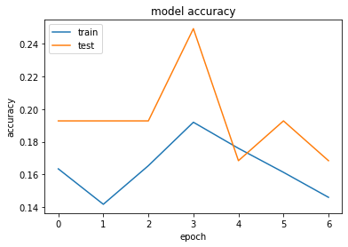
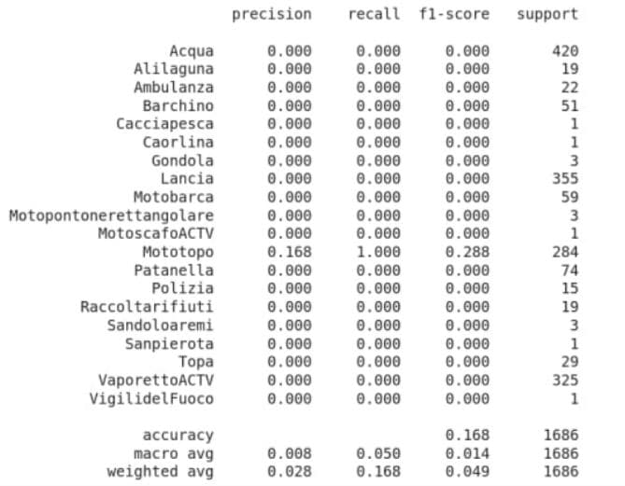
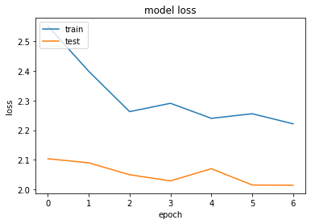
VGG19 – first experiment results

Slide 18
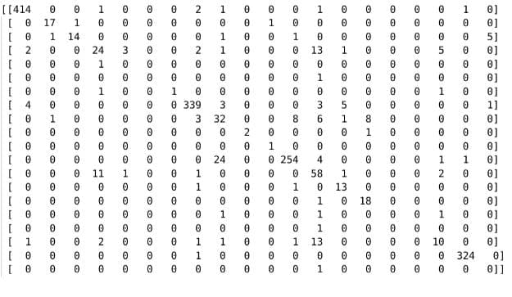
VGG19 – second experiment
Just like what we did with VGG16 we can now add a good level of data augmentation in order to gain better results.

Slide 19
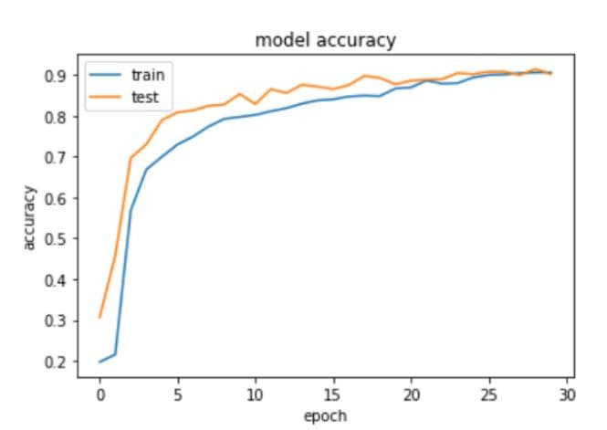
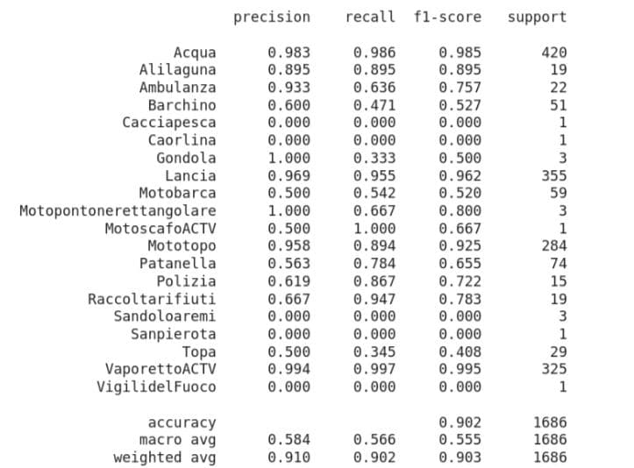
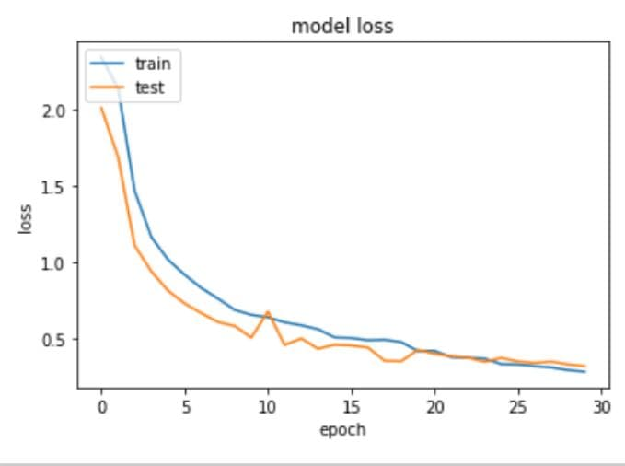
VGG19 – second experiment results

Slide 20
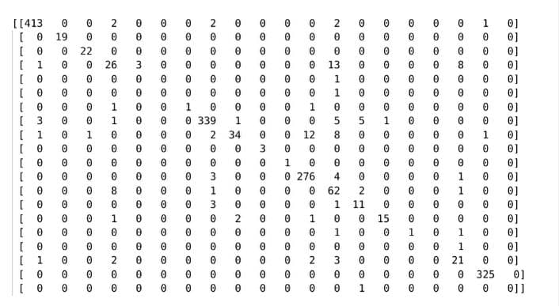
VGG19 – third experiment
We then try to unite the VGG19 method with the Batch Normalization, providing the same specifics as before.
We can see that it finds itself really confortable if paired with VGG19.
These results are actually the best we have gotten.

Slide 21
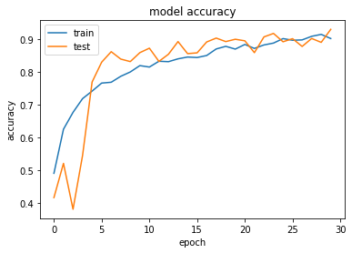
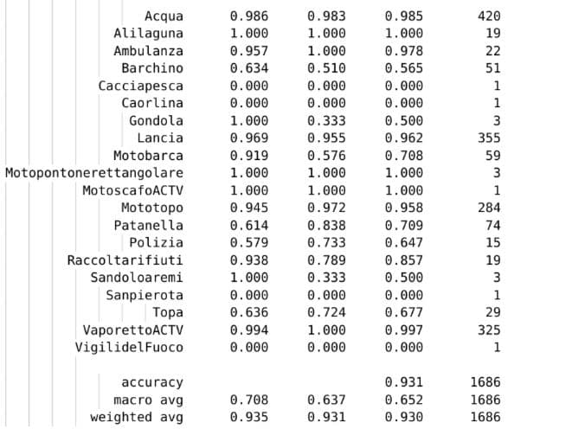
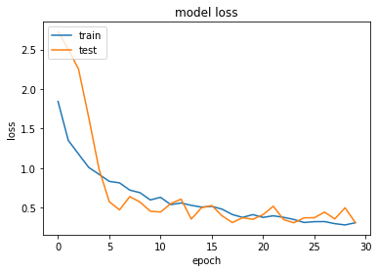
VGG19 – third experiment results

Slide 22
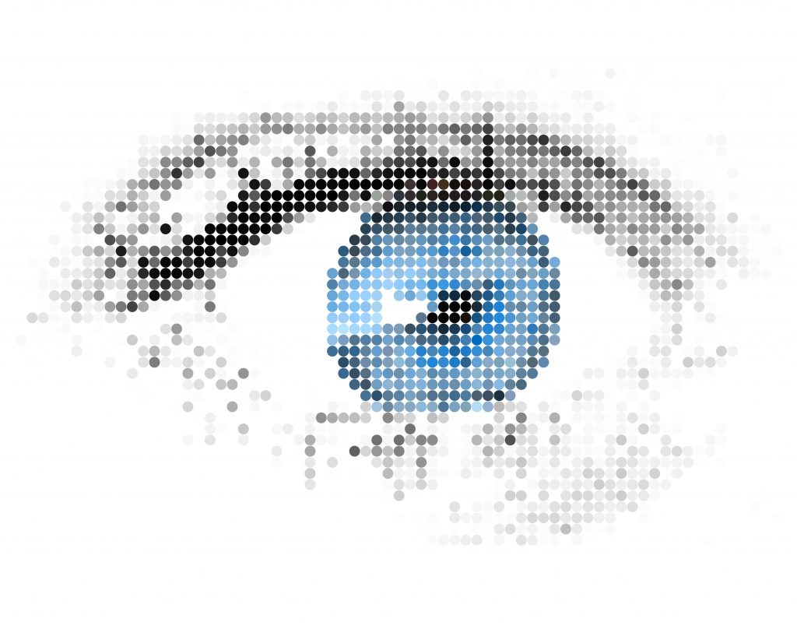
Conclusions
VGG16 with the right conditions can still perform really well even on the tougher conditions of ARGOS.
VGG19 presents the best overall outcomes considering the same initial conditions. It can also work better with Batch Normalization.
We managed also to highlight the importance of data augmentation and other optimizers and tricks like Adam, Dropout and Early Stopping in the computer vision environment.

